Slide 1
Biomedical Measurement using NIR-light HOMEWORK
seminar＠Hase
2012/07/05

Slide 2
HOMEWORK
The fitted curve obtained from Rayleigh scattering theory
A balanced detection
Sonication
Why doesn't THG generate from interface of PTD and ITD?
The position of deformable mirror

Slide 3
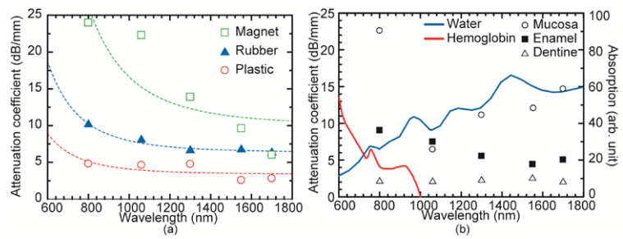
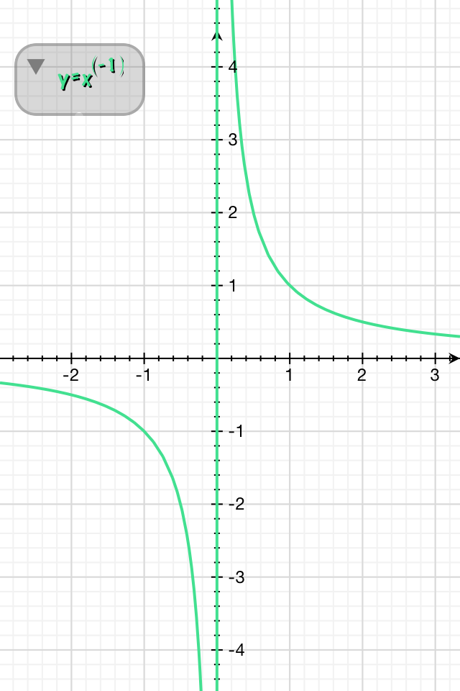
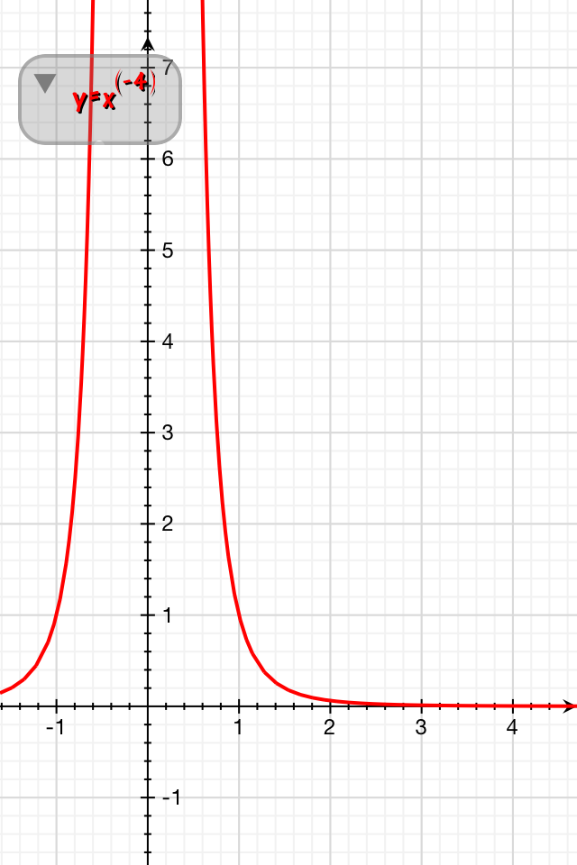
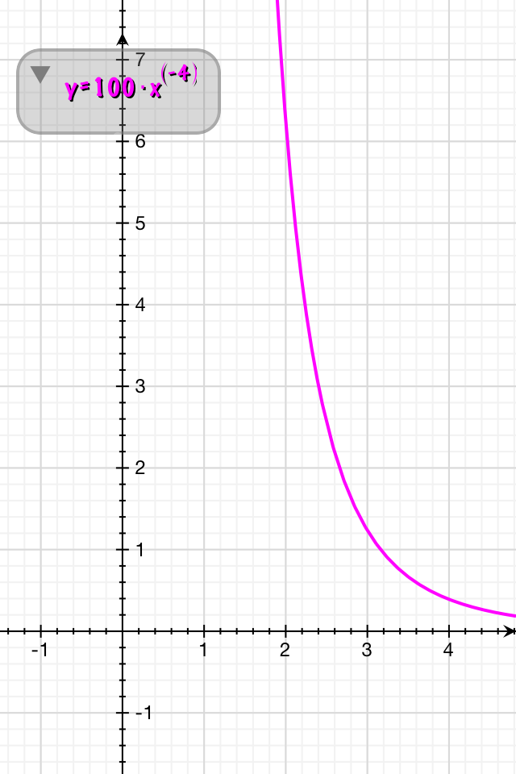
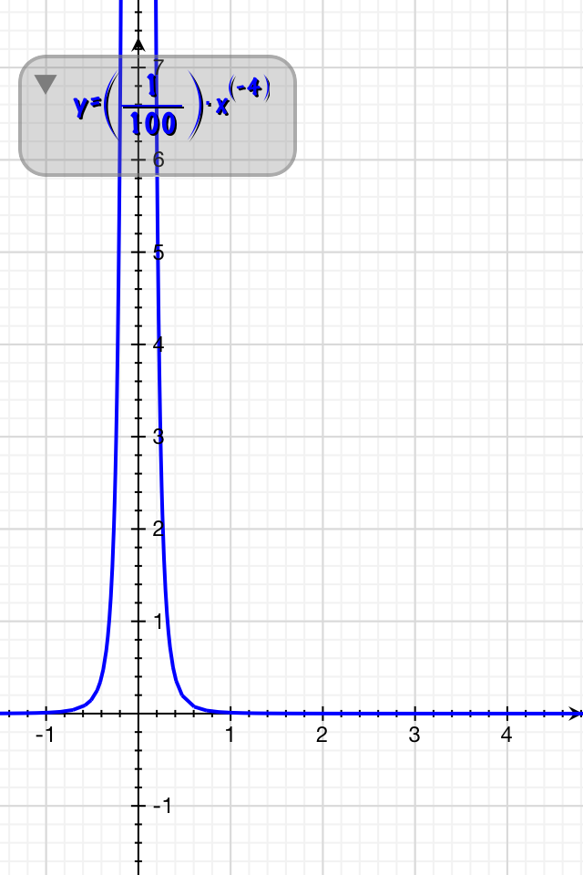
The fitted curve obtained from Rayleigh scattering theory
a = 1
a = 100
a = 1/100
: scattering coefficient
n: particle number
m: refractive coefficient
d: particle diameter
λ: wavelength

Slide 4
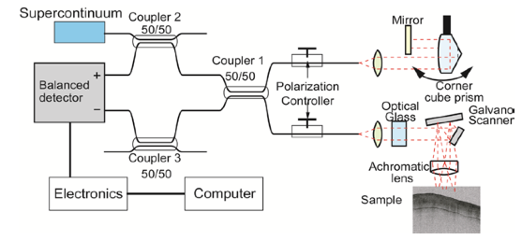
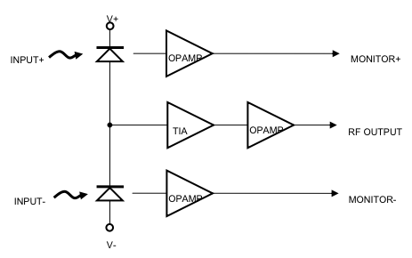
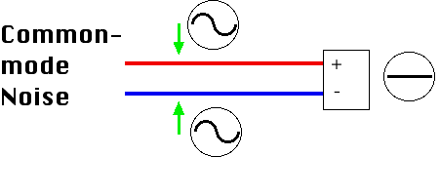
A balanced detection
PDB150, Thorlabs

Slide 5
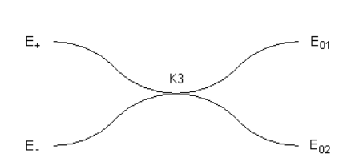

Slide 6
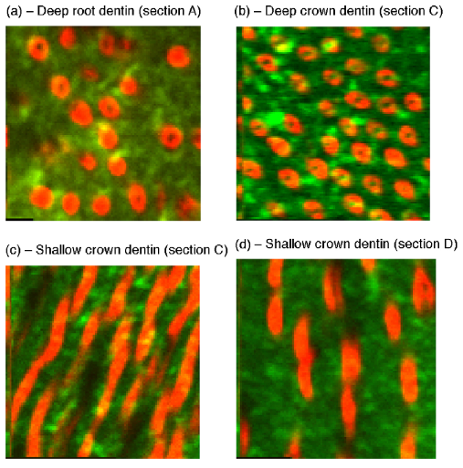
Sonication
・To clean the samples
・To penetrate the solution
Murray solution
refractive index close to that of dentin
it penetrates into the lumen of the tubules
↓
The dentin becomes nearly transparent
HBSS solution
only the dental part which is constructed
from tubules perpendicular to the section
surface is transparent.

Slide 7
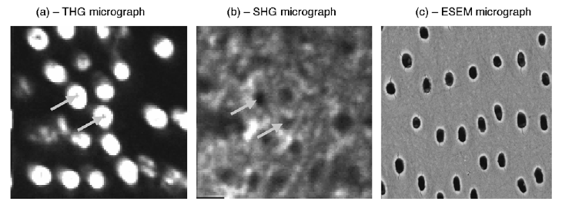
Why doesn't THG generate from interface of PTD and ITD?
THG
lumen
0.9 μm
1.0 μm
1.4 μm

Slide 8
The position of deformable mirror
Ref) Juan M. Bueno ,Emilio J. Gualda ,Pablo Artal “Adaptive optics multiphoton microscopy to study ex vivo ocular tissues” Journal of Biomedical Optics 15 No.6 066004 (2010)
Hartmann-Shack (HS) wavefront sensor
deformable mirror
wavefront
measuring
aberrations
lens array
CCD

