Slide 1
Journal seminar (the first semester)
M1 Hiroto Kimura

Slide 2
①History of optical comb development
John L.Hall, and Theodor W. Hansch, FEMTOSECOND OPTICAL FREQUENCY COMB TECHNOLOGY, pp. 1-11(2004).
I explain the history and the foundation theory of the laser.
②Optical comb dynamics and stabilization
Gunter Steinmeyer, and Ursula Keller, FEMTOSECOND OPTICAL FREQUENCY COMB TECHNOLOGY,
pp. 112-132(2004).
I explain a concept of frequency comb and stabilization
of $f_{rep}$ and $f_{CEO}$.
③Carrier-Envelope Phase Control of Femtosecond Mode-Locked Lasers and Direct Optical Frequency Synthesis
David J. Jones, et al, Science 288, 635-639 (2000).
Using a setup, I explain the absolute optical frequency metrology.

Slide 3
History of optical comb development
John L.Hall, and Theodor W. Hansch, FEMTOSECOND OPTICAL FREQUENCY COMB TECHNOLOGY,
pp. 1-11(2004).

Slide 4
Chronological table of laser and optical comb development
Ted Maiman invented the first laser
in the world.
1960
Mode-locked gas lasers was developed
to give nanosecond pulses at 100 MHz
rates.
1970
Mode-locked picosecond dye lasers
were introduced.
The comb approach to frequency
measurement was inevitable.
The mid
-1970s

Slide 5
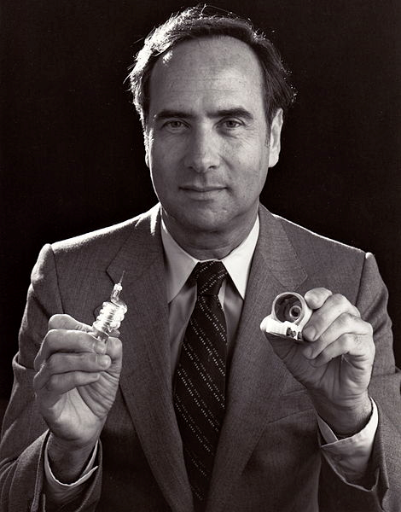
The first laser in the world
Ted Maiman was an American
physicist who made the first
laser.
His solid-state ruby laser
involved kilojule discharges
into flash lamps and repetition
rates from zero up to once per
minute.
694.3nm
Theodore Harold Maiman
flash lamp
silver
ruby
silver

Slide 6
Chronological table of laser and optical comb development
Ted Maiman invented the first laser
in the world.
1960
Mode-locked He-Ne and Argon lasers
was developed to give nanosecond
pulses at 100 MHz rates.
1970
Mode-locked picosecond dye lasers
were introduced.
The comb approach to frequency
measurement was inevitable.
The mid
-1970s

Slide 7
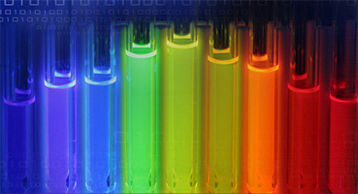
Dye lasers
It is the organic dye that dissolved dye molecules in an organic solvent (alcohol, ethylene glycol, ethyl, methyl) to be used in the medium of the liquid laser most.
Wavelength：320nm ～ 1200nm
Oscillation form：CW, pulsed
Pumping source：flash lamp
merits
●The oscillation wavelength area is large.
●The exchange of the medium is easy.
demerits
●The life of the medium is short.
●The solvent has venomousness.

Slide 8
Chronological table of laser and optical comb development
Hansch’s team demonstrated one of the
first mode-locked “femtosecond” dye
lasers (with a pulse length of less than
one picosecond).
1977
The titanium-doped sapphire laser
system with the important discovery of
Kerr-lens mode locking was introduced
and developed by Wilson Sibbett.
1990

Slide 9
Kerr-lens mode locking
Intensity
Nonlinear refractive index change：$n=n_{0}+n_{2}I$
Only short pulse is affected
A laser crystal becomes the oversaturated absorber.

Slide 10
Chronological table of laser and optical comb development
Kourogi demonstrated intracavity
modulator-based spectral comb
generators.
1993
Hansch’s proposed an octave-spannning
self-referenced universal
optical-frequency comb synthesizer.
1997
I illustrate by the next article in detail.
Theodor W. Hansch and John L. Hall
won the Nobel Prize.
2005

Slide 11
Summary
●Optical frequency combs have given us some comfortable
metrological headroom for pushing ideas for new optical
frequency standards and for measuring interesting physical
constants.

Slide 12
Optical comb dynamics and stabilization
Gunter Steinmeyer, and Ursula Keller, FEMTOSECOND OPTICAL FREQUENCY COMB TECHNOLOGY,
pp. 112-132(2004).

Slide 13
Time versus frequency
The electric field E(t) of two
subsequent pulses from a
mode-locked laser (solid line).
The envelope $±$A(t) is shown
as dashed lines. The electric-field
patterns of the pulses experience
a pulse-to-pulse phase shift $∆φ_{ce}$
according to Equation(1).
$${Δφ}_{ce}=\left[\frac{2π}{λ}\int_{0}^{L}{n_{g}\left(z\right)−n\left(z\right)dz}\right]mod2π=\left[\frac{ω^{2}}{c}\int_{0}^{L}{\frac{dn(z)}{dω}dz}\right]mod2π \left(1\right)$$
$${Δφ}_{ce}\left(t\right)=φ_{ce}\left(t\right)−φ_{ce}\left(t−T_{R}\right) \left(2\right)$$
$$f_{0}=\frac{∆φ_{ce}}{2π}f_{r} (3)$$

Slide 14
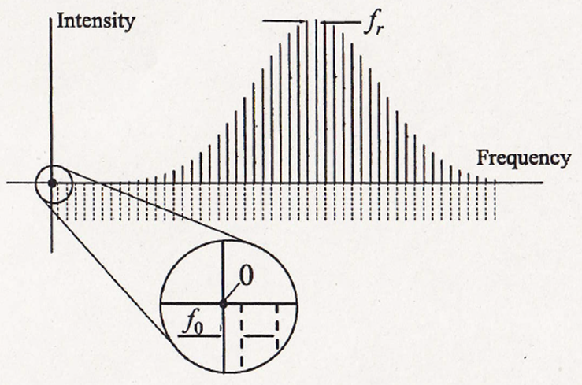
Time versus frequency
$$f_{CEO}$$
Equidistant frequency comb of a mode-locked laser. The comb lines are spaced by the repetition rate $f_{r}$ and exhibit a nonvanishing offset frequency $f_{0}$ at zero frequency unless the electric-field pattern exactly reproduces from pulse to pulse (compare to th time domain picture in upper figure).

Slide 15
Self-referencing technique
The second harmonics of
the low frequency edge
$$2f\left(n\right)=2×(nf_{rep})+2f_{CEO}$$
The high frequency edge
of basic wave
$$f\left(2n\right)=2nf_{rep}+f_{CEO}$$
beat frequency $=f_{CEO}$
We can measure the laser frequency
of a wide wavelength range continually.

Slide 16
CEO beat note signal
This signal was measured at a Ti:sapphire laser heterodyning the fundamental
and the second-harmonic-generation (SHG) signal from a continuum generated
in a microstructure fiber.
The laser has a 100 MHz
repetition rate.
The CEO beat is located at
35 MHz.
Its mirror frequency is also
visible at 65 MHz.
Some spurious contributions have been
generated by nonlinear electronic mixing
process in the detector circuitry.
RF spectrum of the CEO beat note signal

Slide 17
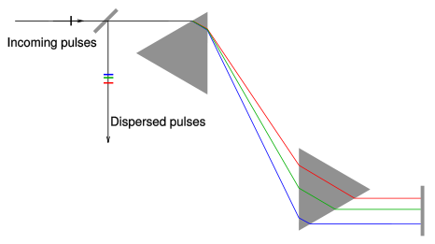
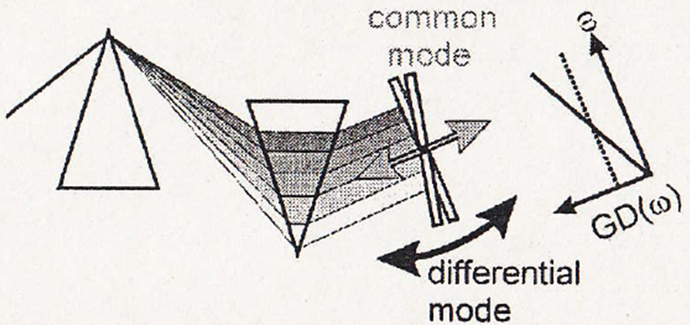
Controlling the CEO frequency
with normal dispersion
We can change
a dispersion level.
movement
Negative dispersion
slow
fast

Slide 18
Summary
●The CEO phase turns out to be a very sensitive parameter that is easily shielded by enclosing the laser.
●An improved control of frequency comb parameters offers even higher precision in metrology applications and opens up novel applications in extreme nonlinear optics.

Slide 19
Carrier-Envelope Phase Control of Femtosecond Mode-Locked Lasers and Direct Optical Frequency Synthesis
David J. Jones, et al,
Science 288, 635-639 (2000)

Slide 20
Experimental setup for locking
90 MHz repetition rate

Slide 21
Microstructure optical fiber
Refractive index
core>>>>>>>clad
●The effectiveness core cross section ($A_{eff}$) is small.
●The enclosure effect of the light is big.
$$γ =\frac{2π}{λ} \frac{n_{2}}{A_{eff}}$$
●It has a zero dispersion wavelength.
increase
$λ$ is nonlinear fixed number.
$n_{2}$ is nonlinear refractive index of the core.
We can get an octave-spanning spectrum without changing pulse width.

Slide 22
The spectra after optical fiber
25mW
Continuum generated by microstructure fiber.
Self-phase modulation
in the microstructured fiber
The spectra spans
more than one octave.

Slide 23
Experimental setup for locking

Slide 24
The phase and group velocity
Phase velocity
$$v_{p}=\frac{c}{n}$$
Group velocity
$$v_{g}=\frac{c}{n+λ\frac{dn}{dλ}}$$
If the pulse-to-pulse phase shift is 2π/8, then every eighth pulse
will have the same phase, and the frequency offset will be $f_{rep}$/8.

Slide 25
Experimental setup for locking

Slide 26
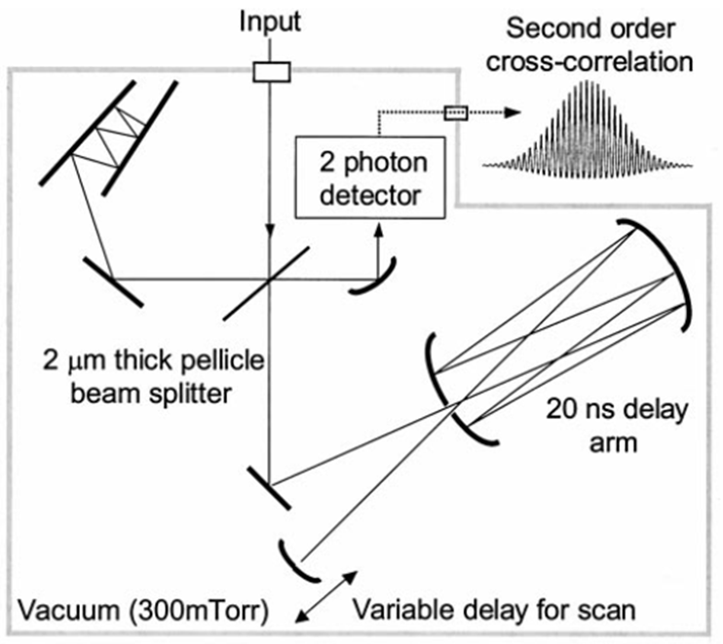
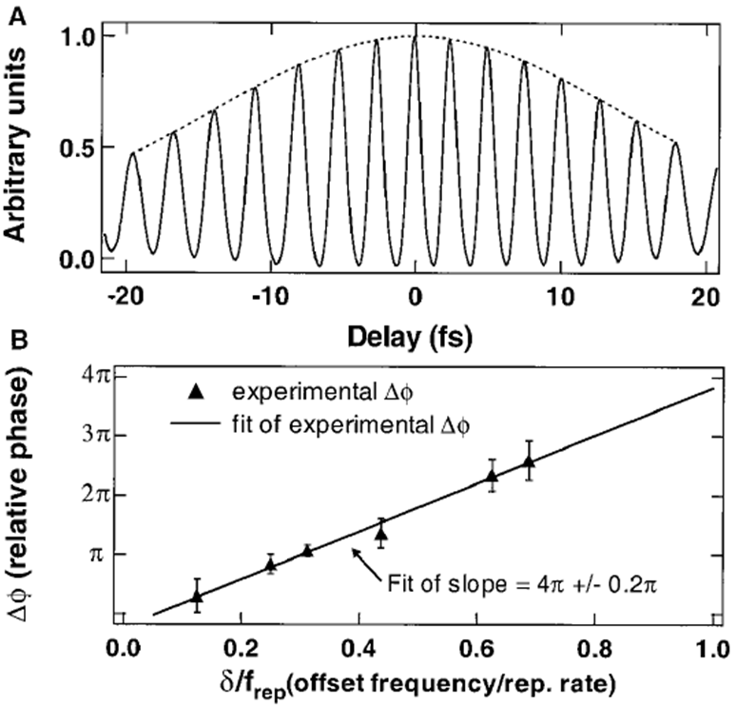
Temporal cross correlation
It keeps a peak and a peak.
With a 5% uncertainty
The second-order cross correlation between pulse i and pulse i+2 is measured to determine the pulse-to-pulse carrier-envelope phase shift.

Slide 27
Absolute optical frequency metrology
1200 lines/mm
By counting both the offset
frequency $δ$ and the heterodyne
beat signal between the CW
Ti:S and the comb($f_{beat}$).
$$f_{unknown}=±δ+nf_{rep}±f_{beat}$$
Histogram of one set of
measurements in relation to the
recommended CIPM(1997)
value of 385,285,142,378$±$5kHz
for the rubidium transition.
The standard deviation at the 5kHz, which is
an absolute uncertainty of 1 part in ${10}^{11}$.

Slide 28
Summary
●The self-referencing method represents a dramatic advance in optical frequency metrology, making measurement of absolute optical frequencies possible with a single laser.

Slide 30
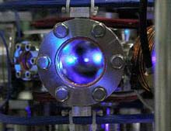
Summary
In the past 15 years, progress in laser stabilization,
optical frequency measurement, femtosecond laser
development and stabilization, nonlinear optics, and
related topics has been stunning and unexpected.
The self-referencing method
represents a dramatic advance
in optical frequency metrology,
making measurement of absolute
optical frequencies possible
with a single laser.

Slide 31
Temporal cross correlation
With a 5% uncertainty
The second-order cross correlation between pulse i and pulse i+2 is measured to determine the pulse-to-pulse carrier-envelope phase shift.

Slide 32
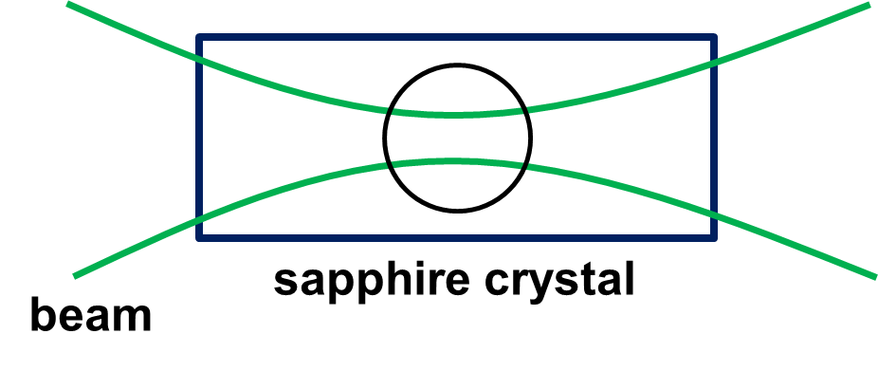
Controlling the CEO frequency
$f_{CEO}$ originates in the difference between the group and phase velocity.
The high-reflector mirror is mounted on PZT.
Change of the tilting and excursion.
Change of the pulse intensity.
Change of the nonlinear refractive index.

Slide 33
Experimental setup for locking

Slide 34
Acousto-Optic Modulator
The AOM lets frequency shift.
$$ω_{m}$$
$$\cos{(ω_{1}t+θ)}$$
target
laser
AOM
coupler
PD
$$\cos{ω_{1}t}$$
$$\cos\left(ω_{1}+ω_{m}\right)t$$
oscilloscope
$$\cos{(ω_{m}t−θ)}$$
The phase measurement by two wavelength heterodynes
Continuous phase measurement is enabled.

Slide 35
Microstructure optical fiber
Refractive index
core>>>>>>>clad
many air holes
●The effectiveness core cross section ($A_{eff}$) is small.
●The enclosure effect of the light is big.
$$γ =\frac{2π}{λ} \frac{n_{2}}{A_{eff}}$$
●It has a zero dispersion wavelength.
increase
$λ$ is nonlinear fixed number.
$n_{2}$ is nonlinear refractive index of the core.
URL：http://www.mitsubishi-cable.co.jp/jihou/pdf/102/gi07.pdf
We can get an octave-spanning spectrum without changing pulse width.

Slide 36
Kerr-lens mode locking
●Kerr-lens mode(KLM) locking
KLM is one form of the passive mode locking.
Sapphire crystal in itself acts as a mode locker and
raises self-phase modulation in that. We perform
passive mode locking by amplitude modulating it.
By the condensing strength
of the beam, this sectional
refractive index changes.
sapphire crystal
beam
The pulsed light of the femtosecond occurs.

Slide 37
