Slide 1
中間報告 「テラヘルツコム参照型 スペクトラム・アナライザーによる高精度周波数計測」
H25/8/8 M1 林 建太

Slide 2
背景
近年、テラヘルツ (THz) 波が大容量無線通信のための新しい手段として注目
THz無線通信など
テンポラリなネットワーク
多数局間の混信を避ける必要がある
ホットスポット, レンタルDVDショップ
THz領域において高精度な周波数計測技術が必要
(http://www.ile.osaka-u.ac.jp/research/THP/pdf/oyobuturi300.pdfより)
(テラヘルツ技術動向調査報告より)
Notes:
無線LANを用いる。
周波数の割り当てが厳密に決められていて、THz領域でも同じことが言える。
無線周波数(10GHz～275GHz)
天文分野やアマチュア無線

Slide 3
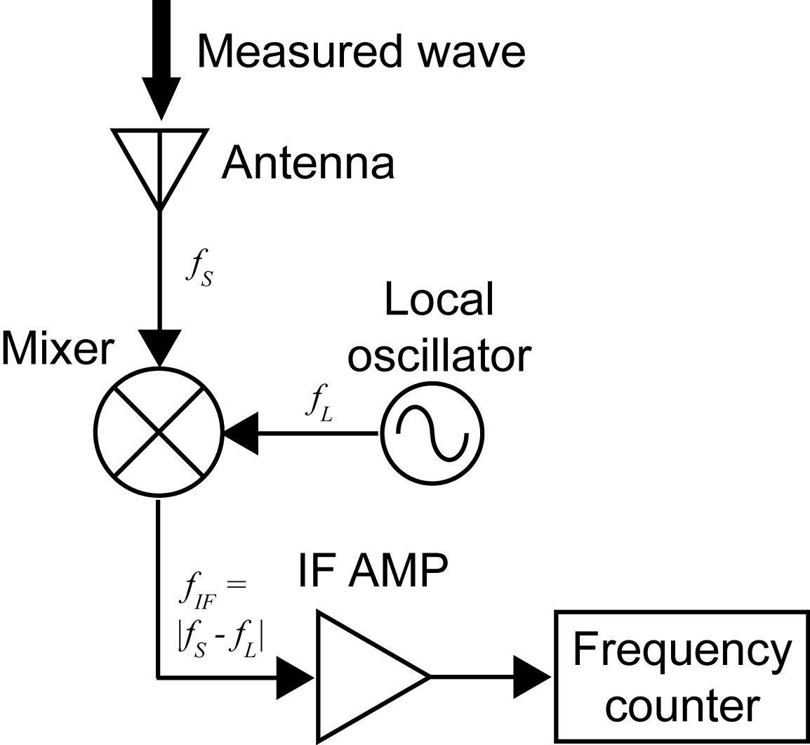
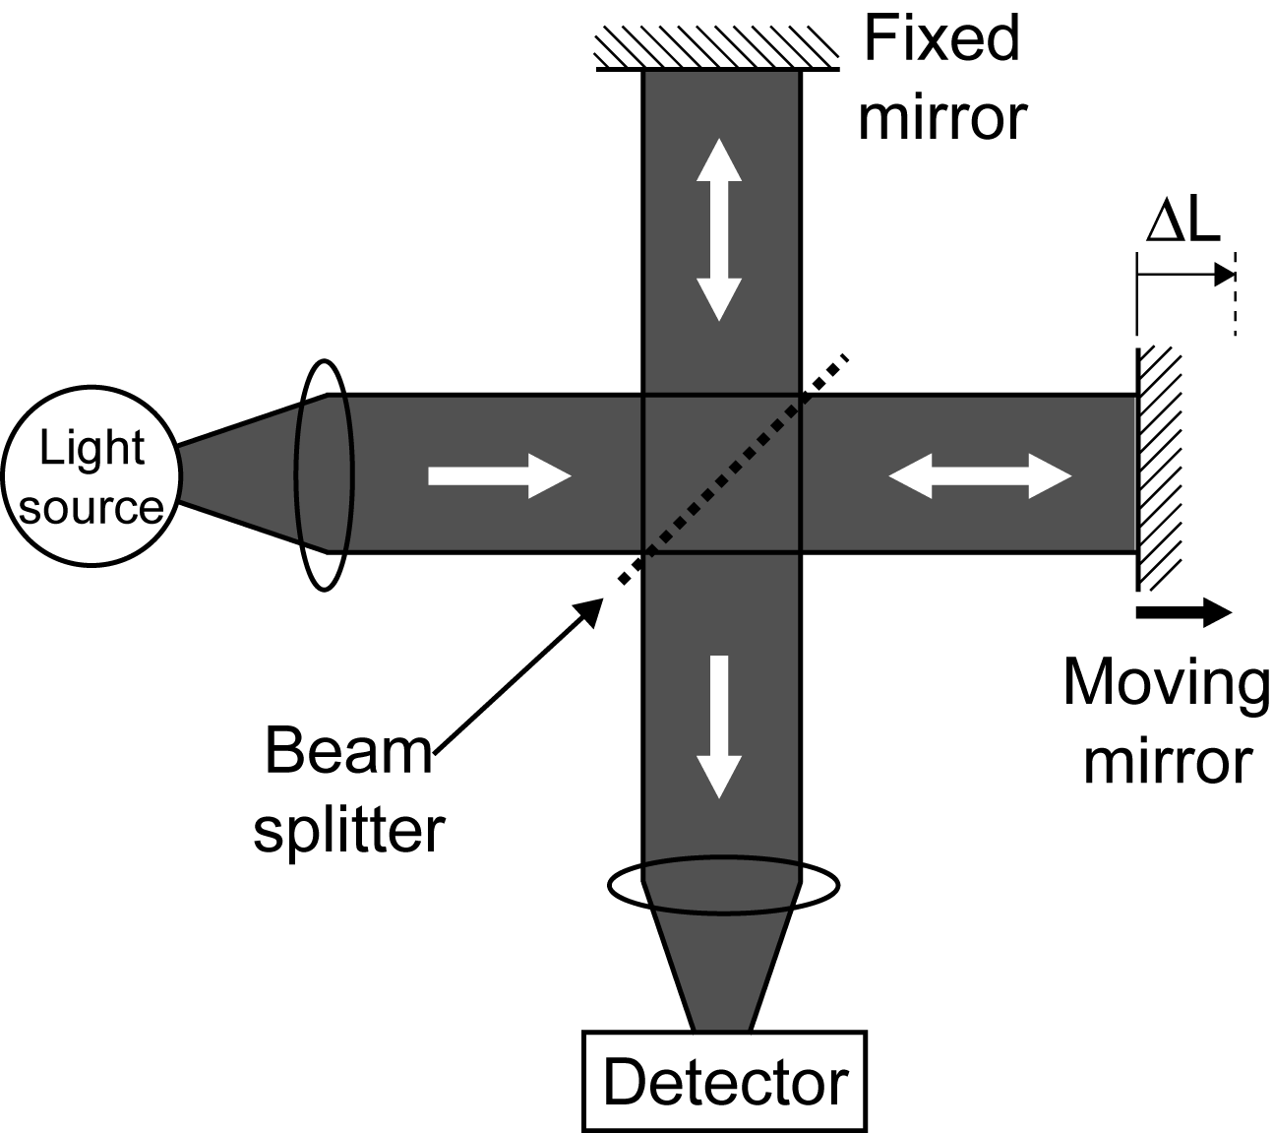
従来法
電気的ヘテロダイン法
光学的手法 (干渉計測)
Cryogenic cooling
ΔL=(λ/2)*N
Obstacle to
practical use!
テラヘルツ領域 (0.1~10THz) をカバーすることは難しい
→THz波をカバーできる新しい手法が必要!
Notes:
Conventionally, ele^ctrical he^terodyned method and o^ptical interfero^metric method have been widely used. However, these methods often requires cryoge^nic cooling of mixer or detector to suppress thermal noise. This results in obstacle to practical use. Furthermore, even though such cooling is applied for these methods, it is still difficult to cover all frequency region of THz wave. In this way, THz gap of frequency measurement is existing between electrical and optical regions. Therefore, new method optimized for THz wave is required. To bridge the THz gap of frequency measurement, we focus on the THz frequency comb.

Slide 4
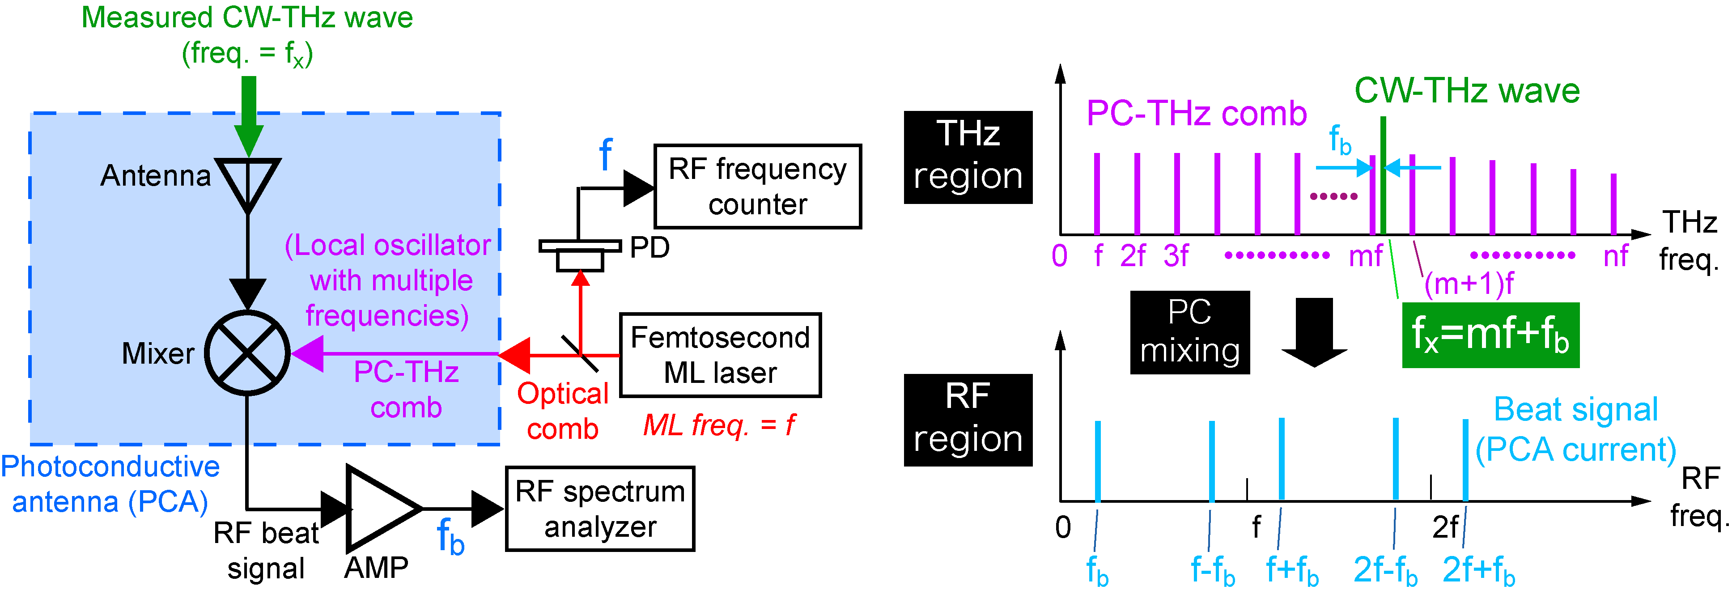
光伝導ミキシング法を用いた THzコム参照型スペクトラム・アナライザー(1)
Freq. domain
f_{THz}
f_{THz}=mf+f_{b}
f_{THz}=mf ± f_{b}
m: order of comb mode
f: ML frequency
f_{b}: beat frequency
Ref) S. Yokoyama et al, Opt. Express 16, 13052-13061 (2008).
T. Yasui et al. Opt. Express 17, 17034-17043 (2009).
Notes:
The next slide shows the method which is based on heterodyned technique. Compared with the electrical heterodyne technique, a key difference here is that the PCA is used as a heterodyne receiver. This results in high, broadband spectral sensitivity in the THz region without the need for cooling. Another difference is the use of a PC-THz comb whose frequency covers from the sub-THz to the THz region as a local oscillator. The diagram on the right shows spectral behavior of this method. When an optical comb with mode-locked frequency of f is on the antenna gap, the PC-THz comb with mode spacing of f is induced in the PCA like this. And then a measured CW-THz wave is induced on the PCA detector like this. As a result of PC mixing between the PC-THz comb and the CW-THz wave, a group of beat signals between them is generated as a PCA current in the RF region. Here, please focus on a beat signal at the lowest frequency. This fb beat signal is generated by mixing the CW-THz wave at f_{THz} and the m-order mode of the PC-THz comb nearest in frequency to the CW-THz wave at mf. Therefore, the f_{THz} is given by this equation. The f and fb can be easily measured with RF spectrum analyzer or frequency counter. To obtain the f_{THz}, we have to determine the m and sign of the fb.

Slide 5
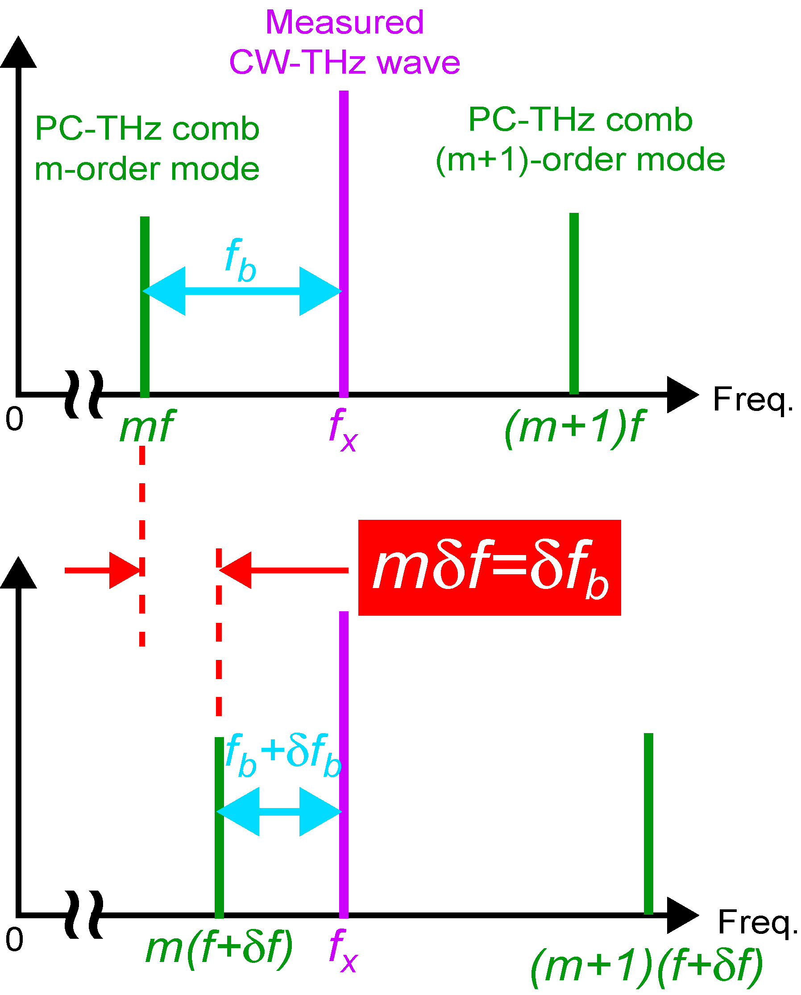
光伝導ミキシング法を用いた THzコム参照型スペクトラム・アナライザー(1)
Shift of ML freq. by δf (f → f+δf)
Change of beat freq. by δf_{b} (f_{b} → f_{b}+δf_{b})
Notes:
To determine the m and sign of the fb, mode-locked frequency of f is shifted by using the laser control system. This results in the change of the beat frequency δfb. Since δf and δfb must satisfy this relationship, we can determine the m by measuring the δf and δfb. Also, equation of f_{THz} can determine by sign of m. Finally, we can obtain the f_{THz} using this equation.

Slide 6
従来研究
Ref) T. Yasui et al. Opt. Express 17, 17034-17043 (2009).
CW-THz波の
リアルタイムモニタリング
絶対周波数計測
Active frequency multiplier
F-band UTC-PD
Notes:
Next, I will introduce previous study. The left graph shows the result of absolute measuring of 75~110GHz frequency. The right graph shows a real-time monitoring of the beat signal that uses UTC-PD of F band.

Slide 7
Problems of previous studies for practical use
絶対周波数を決定するためのビート周波数計測が2ステップである ☞ リアルタイムではない!
1.5μmのファイバーレーザー光をPCAに入射する際に光学系が必要である ☞ 持ち運び出来ない!
Present talk
2つのPC-THzコムを用いることで, 絶対周波数をリアルタイムで決定する
1.5µm光のファイバーをLT-GaAs-PCAに直付けする
Notes:
However, there were two problems in this study. One was that a two-step measurement of beat signal was necessary to determine the absolute frequency. As a result, it was not possible to measure it in real time. Secondarily, the equipment was not portable because the laser beam that entered into PCA used free-space to propagate. Then this time, we aimed at a real-time determination of an absolute frequency that used dual PC-THz combs and at the acquisition of the beat frequency by connecting the fiber laser of 1.5μm directly with PCA.

Slide 8
(1) Real-time determination of absolute frequency using dual PC-THz combs
Notes:
Real time determination of absolute frequency using dual PC-THz combs

Slide 9
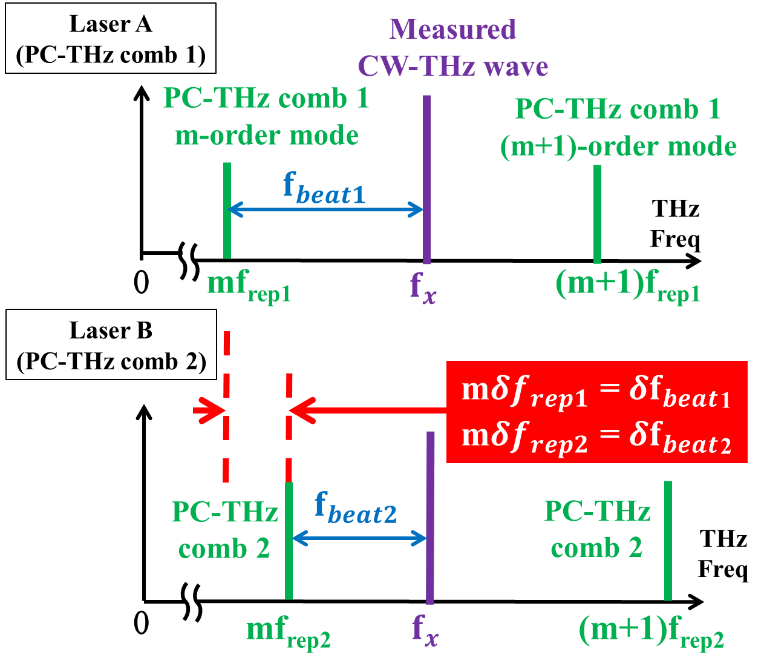
リアルタイムでの絶対周波数の決定法
Notes:
This slide explains the mechanism to determine the absolute frequency in real time. The point is to use dual PC-THz comb with different mode locked frequency. m can be determined in real time by measuring the beat frequency generated by CW-THz wave and each PC-THz comb at the same time like the equation on the right. Therefore, the frequency can be absolutely determined.

Slide 10
実験セットアップ①
Notes:
This slide shows the experimental setup of the real-time measurement of the absolute frequency. After the wavelength is converted by the SHG crystal, two laser beams with different mode locked frequency enter PCA. The CW-THz wave whose frequency synthesizer output is multiplied by six is divided into two and enters from the opposite side. Then, the generated beat signal is amplified by the amp and tracking oscillator to a level detectable by the RF frequency counter. We can absolutely measure the frequency in real time by calculating the two beat frequencies measured with the frequency counter with PC.

Slide 11
CW-THz波と2つのPC-THzコム間のビート信号
PC-THz comb (1)
(f_{rep1} = 100,000,000 Hz)
PC-THz comb (2)
(f_{rep2} = 100,000,050 Hz)
f_{beat1}=10,004,000.01Hz
f_{beat2}=9,953,700.002Hz
Real-time determination!
m= |f_{beat1}-f_{beat2}|/|f_{rep1}-f_{rep2}|
=|10,004,000.01-9,953,700.002|/|100,000,000-100,000,050| = 1006
f_{THz} = mf_{rep1}+f_{beat1}) = 1006*100,000,000+10,004,000.01 = 100,610,004,000Hz
Notes:
This slide shows beat signals between CW-THz wave and dual PC-THz comb. The calculation using this beat frequency is like this, and the frequency can be determined.

Slide 12
絶対周波数計測の実験精度①
測定誤差の見積もり
∆f_{rep1} = 400µHz
∆f_{beat1} = 21mHz
m = 800~1100
↓
∆f_{THz} = 341~461mHz
Mean precision=3.8*10⁻¹⁴
Notes:
To evaluate the precision of the frequency measurement, we set the output frequency of the test source between 80 and 110 GHz and measured the absolute frequency. The blue diagram line shows errors of absolute frequency. And accuracy is indicated by the red diagram line. When the measurement precision is defined as a ratio of errors to the output, the precision of 3.8×10⁻¹⁴ was achieved in this demonstration. Here, I calculated the error of absolute frequency to evaluate this result validity. The result is shown right. As the result, fluctuation of the absolute frequency became 341~461mHz and a value that was about two digits bigger than the outcome of an experiment. It is thought that in the calculation each fluctuation of the frequency is reflected as it is but in an actual measurement fluctuation of the frequency is canceled relatively.

Slide 13
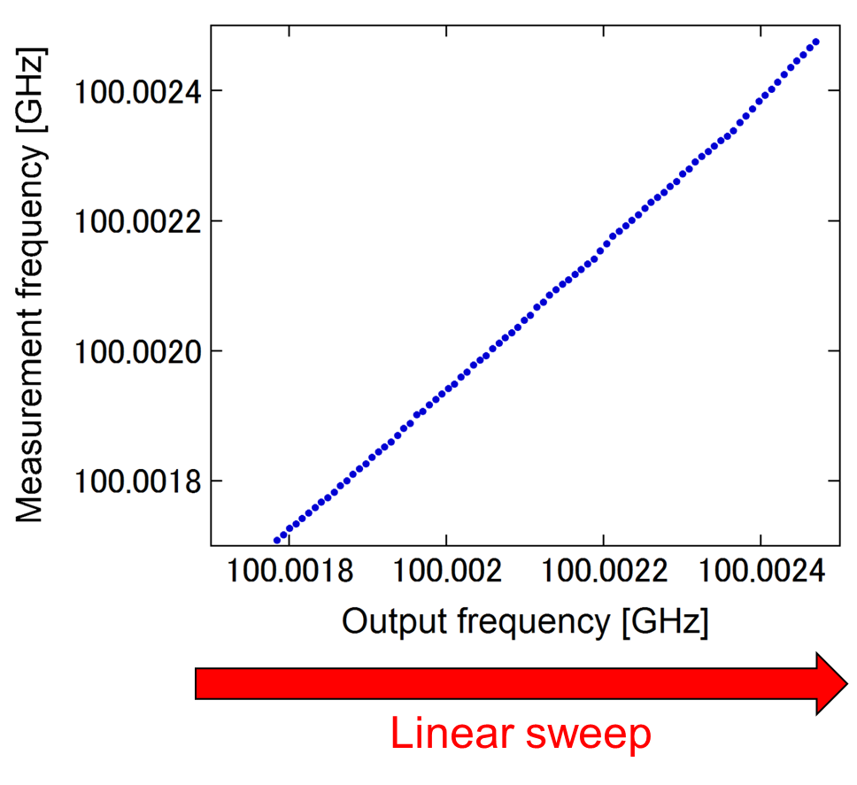
CW-THz波を直線的にスイープした時の リアルタイムモニタリング①
700kHzのスイープをリアルタイムモニタリング
ビート周波数が変化するため, CW-THz波を大きくスイープすることが出来ない
Notes:
Next, this slide shows the result of the absolute frequency measurement by real time when the absolute frequency of CW-THz wave changed linear. From this graph, it understands that can measure sweep of absolute frequency linearly.

Slide 14
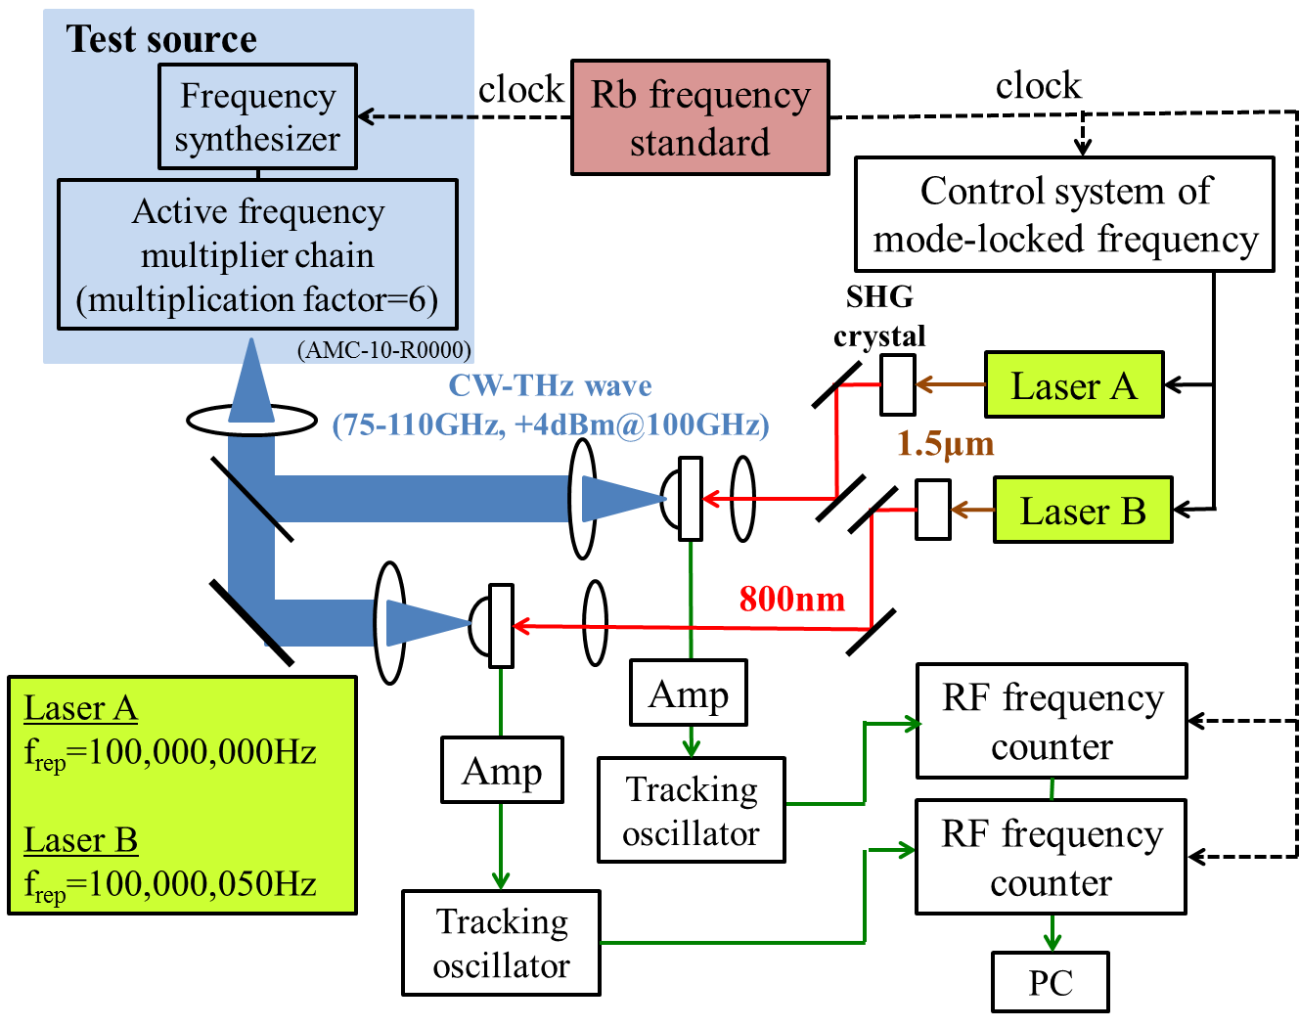
実験セットアップ②
Notes:
This slide shows the experimental setup of the real-time measurement of the absolute frequency. After the wavelength is converted by the SHG crystal, two laser beams with different mode locked frequency enter PCA. The CW-THz wave whose frequency synthesizer output is multiplied by six is divided into two and enters from the opposite side. Then, the generated beat signal is amplified by the amp and tracking oscillator to a level detectable by the RF frequency counter. We can absolutely measure the frequency in real time by calculating the two beat frequencies measured with the frequency counter with PC.

Slide 15
絶対周波数計測の実験精度②
測定誤差の見積もり
∆f_{rep1} = 400µHz
∆f_{beat1} = 21mHz
m = 800~1100
↓
∆f_{THz} = 341~461mHz
Mean precision=3.1*10⁻¹³
Notes:
To evaluate the precision of the frequency measurement, we set the output frequency of the test source between 80 and 110 GHz and measured the absolute frequency. The blue diagram line shows errors of absolute frequency. And accuracy is indicated by the red diagram line. When the measurement precision is defined as a ratio of errors to the output, the precision of 3.8×10⁻¹⁴ was achieved in this demonstration. Here, I calculated the error of absolute frequency to evaluate this result validity. The result is shown right. As the result, fluctuation of the absolute frequency became 341~461mHz and a value that was about two digits bigger than the outcome of an experiment. It is thought that in the calculation each fluctuation of the frequency is reflected as it is but in an actual measurement fluctuation of the frequency is canceled relatively.

Slide 16
CW-THz波を直線的にスイープした時の リアルタイムモニタリング②
2MHzのスイープをリアルタイムでモニタリング
この場合でもビート周波数が変化するため大きくスイープすることが出来ない
Linear sweep
Notes:
Next, this slide shows the result of the absolute frequency measurement by real time when the absolute frequency of CW-THz wave changed linear. From this graph, it understands that can measure sweep of absolute frequency linearly.

Slide 17
(2) Direct coupling of LT-GaAs-PCA with output fiber tip of 1.5µm fiber laser
Notes:
Direct coupling of LT-GaAs-PCA with output fiber tip of 1.5µm fiber laser.

Slide 18
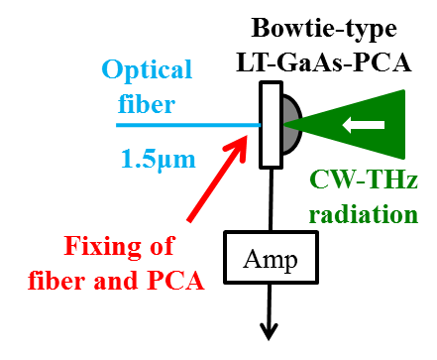
1.5µm光とPCAの接続方法
(1) SHG & lenses @ LT-GaAs PCA
(2) lenses @ LT-InGaAs PCA
自由空間での光学系が必要
感度が低い
(3) No optical components @ LT-GaAs PCA
Direct contact
without lens
自由空間での光学系を必要とせず, ある程度の感度が望める
Notes:
This slide show the comparison of coupling methods of PCA with1.5µm light. First of all, it is a method of converting wavelength by using the SHG crystal and entering the light into PCA of the gallium arsenic. However, several free space optics required. Moreover, it is a method of entering the light of 1.5μm into indium gallium arsenic PCA. However, there was a problem with low sensitivity. This time, fiber is directly connecting PCA of gallium arsenic. As a result, no free space, no optics, and moderate sensitivity.

Slide 19
0.8µm光と1.5μm光の比較
ビート周波数100kHz (amp 100kHz, 50MΩ), RBW=3kHz
入射パワーと
PCAの抵抗値の関係
PCAの抵抗値と
ビート信号SN比の関係
0.8-µm
light
1.5-µm
light
0.8-µm
light
1.5-µm
light
Notes:
This slide show comparison between 0.8µm and 1.5μm lights. A left graph shows PCA resistance to the laser power. Moreover, a right graph shows Signal-Noise ratio of the beat signal in PCA resistance. As a result, the light of 1.5μm is more inefficient by comparison the light of 0.8μm. However, it was thought that the beat signal was able to be measured also with 1.5μm if the light of strong laser power was used.

Slide 20
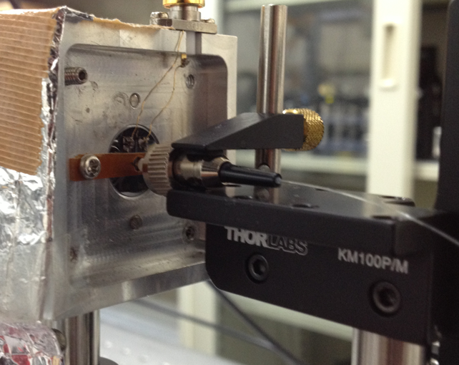
実験結果
Direct fiber coupling without lens
(P_{mean} = 189mW, f_{rep} = 56MHz)
RF spectrum of f_{b} beat signal
(f_{beat} = 100kHz)
Fiber
25dB
PCA
PCAに直接ファイバーを接続する方法は, メンテナンスフリーで小型なTHzスペアナを実現し, 実用的なアプリケーションになりうる!
Notes:
Then, the point of the fiber was fixed to PCA, and it aimed at the acquisition of the beat signal as shown in a left picture. A right graph shows the beat signal of that time. As a result, it is thought that direct fiber coupling enables us to construct compact, robust, maintenance-free THz spectrum analyzer for portable use in practical applications.

Slide 21
まとめ
リアルタイムでの絶対周波数計測を実現
PCAに直接ファイバーを接続し, ビート信号を確認
今後の予定
周波数の速い変動も測定できるようにする
ビート周波数を制御して, 繰り返し周波数の変化から絶対周波数を測定する

