Slide 1
研究報告 Real-Time Absolute Frequency Measurement of CW-THz Wave Based on THz Combs
H26/8/4 M2 Kenta Hayashi

Slide 2
THz Radio Communication
Recently, THz wave has attracted attention as a new tool for high capacity radio communication
3Dシネマや
ハイビジョン
Alternative lines and backup lines for emergency
Instantaneous wireless data transfer
Ref)テラヘルツ波帯の情報通信利用に関する調査報告書
Notes:
近年，テラヘルツ波が大容量無線通信のための新しい手段として注目されている．これにより，光ファイバの設置が困難な場所のリンクだけでなく，テレビ中継のためのテンポラリーな回線や災害・緊急時のバックアップ回線などに利用できる．さらに，3Dシネマやハイビジョンなどの大容量のデータを瞬時にダウンロードできるホットスポットにも利用できる．

Slide 3
Frequency allocation of radio communication
Ref)テラヘルツ技術動向調査報告
Precise frequency measurement of
CW-THz wave is required
However, techniques of absolute frequency measurement of CW-THz wave are still immature!
Notes:
しかし無線通信において，他数局間の混信を避ける必要があるため分野ごとに使う周波数が細かく割り振られている．電波領域においては、周波数計測技術が発達しているため細かく割り振りができる．しかしTHz領域では周波数計測技術は十分に確立していないため，高精度なTHz波の周波数計測技術が求められている．

Slide 4
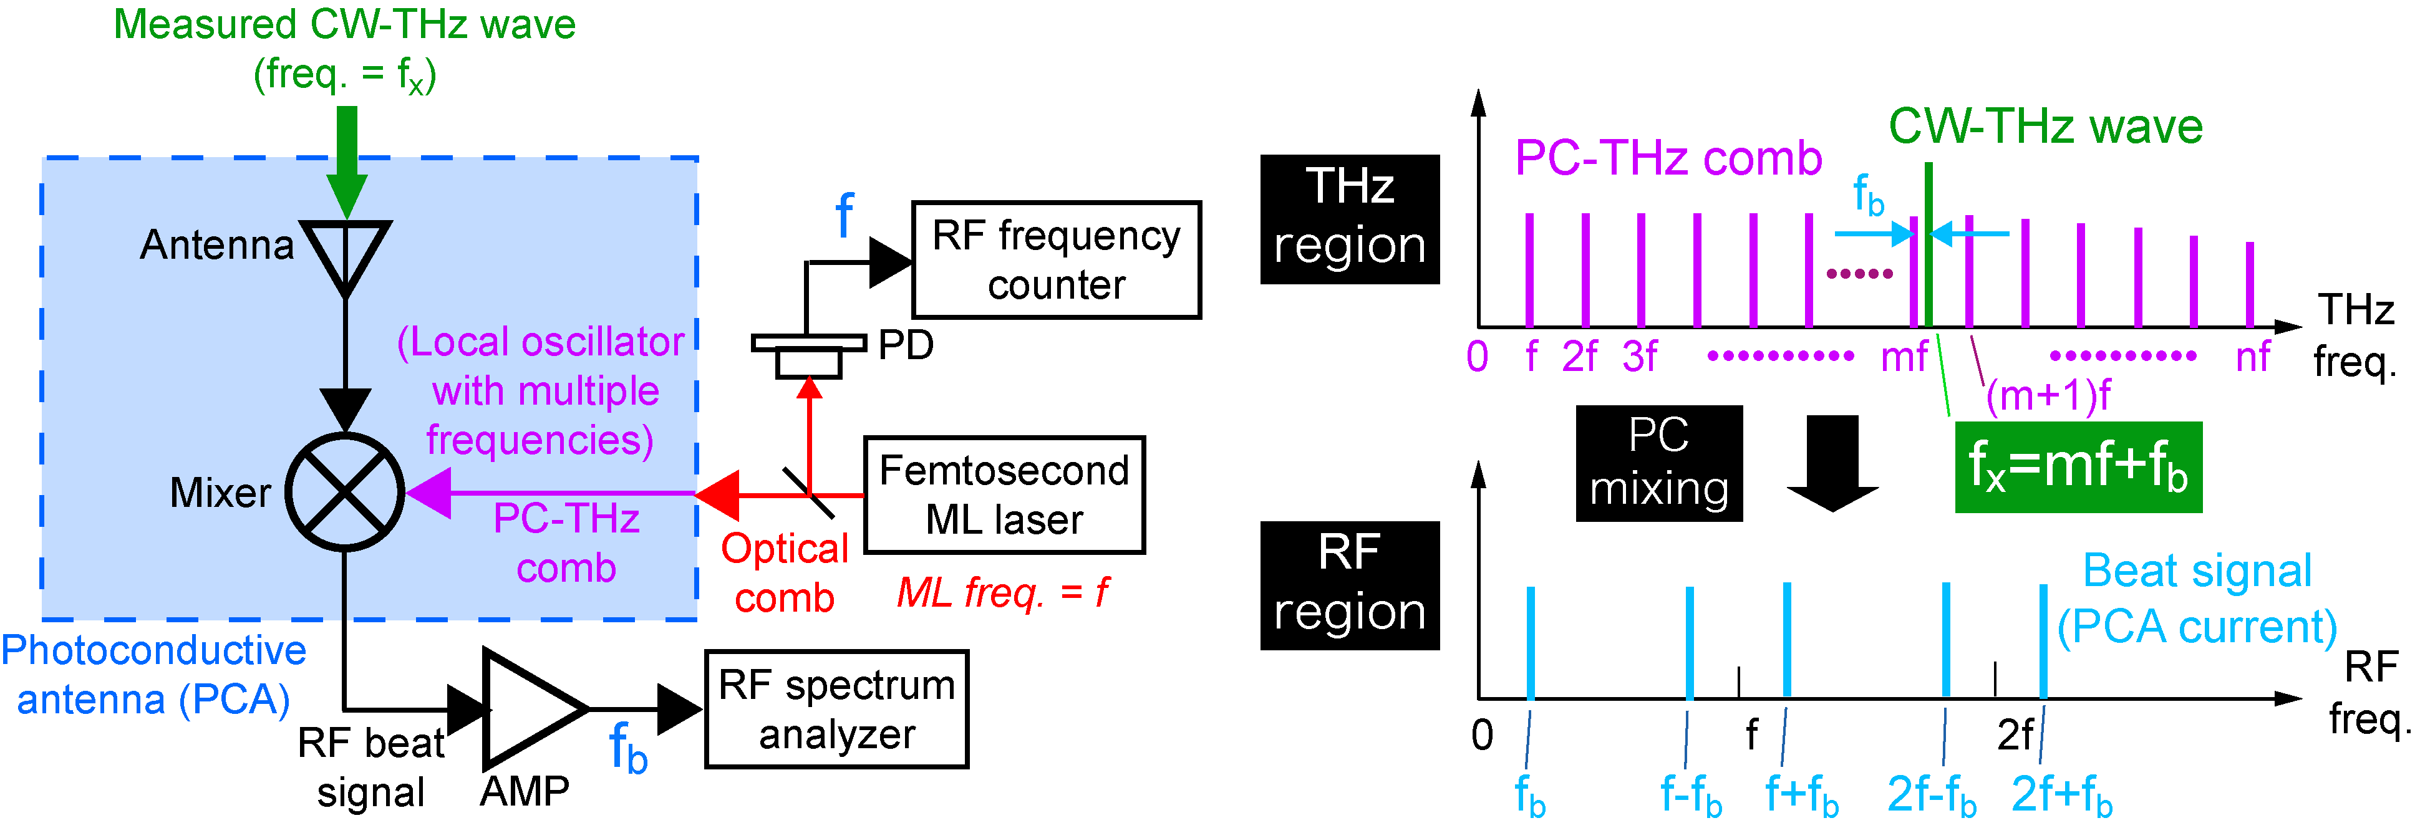
THz-comb-referenced frequency measurement
Freq. domain
f_{THz}
f_{rep}
f_{THz}=mf+f_{b}
f_{rep}
f_{beat}
f_{THz}=mf_{rep} ± f_{beat}
m: order of comb mode
f_{rep}: ML frequency
f_{beat}: beat frequency
Ref) S. Yokoyama et al, Opt. Express 16, 13052-13061 (2008).
T. Yasui et al. Opt. Express 17, 17034-17043 (2009).
Notes:
So, we developed THz-comb-referenced frequency measurement.
Here is the principle of the frequency measurement, which is based on heterodyne technique. Compared with the electrical heterodyne technique, a key difference is that the PCA is used as a heterodyne receiver. This results in high, broadband spectral sensitivity in the THz region without the need for cryogenic cooling. Another difference is the use of a PC-THz comb as a local oscillator.
The right part shows spectral behavior of this method. When an optical comb with mode-locked frequency of f is incident on the antenna gap, the PC-THz comb is induced in the PCA. Then a measured CW-THz wave is induced on the PCA. As a result, PC mixing generates a group of beat signals in the RF region. Please focus on a beat signal at the lowest frequency. This beat signal is generated by mixing this CW-THz wave and this mf. Therefore, the fTHz is given by this equation. The frep and fbeat can be easily measured with RF spectrum analyzer or frequency counter. To obtain the fTHz, we have to determine the m and sign of the fbeat.

Slide 5
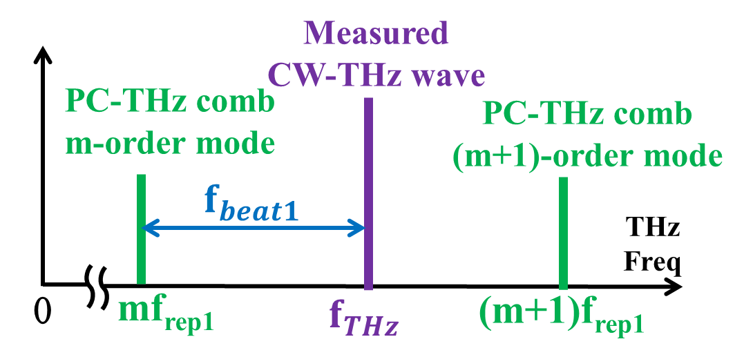
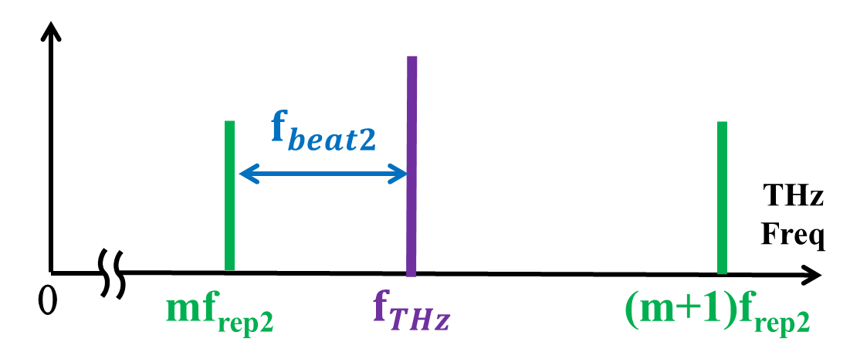
Determination of m and sign of f_{beat}
Measurement of f_{rep1} and f_{beat1}
Measurement of f_{rep2} and f_{beat2}
Assumption : f_{THz} is sufficiently stable during measurements of f_{beat1} and f_{beat2}
Notes:
In the previous study, we first measured frep1 and the corresponding fbeat1. Then, we shift frep1 to frep2 by laser control, and measure frep2 and the corresponding fbeat2. Since the frep and fbeat satisfy this relationship, we can obtain the m based on this equation. Finally, we can obtain the fTHz following these equations. However, fTHz must be sufficiently stable during measurements of fbeat1 and fbeat2.

Slide 6
For example
CW-THz source
(UTC-PD)
・fast frequency fluctuation
・large frequency fluctuation
(mode hopping)
Present talk
Real-time determination of the fast or largely fluctuating CW-THz frequency using dual PC-THz combs .
Notes:
Unfortunately, most of practical CW-THz sources are not so stable. Moreover, their output frequency fluctuate from moment to moment like here. The previous method is applicable on the assumption that fTHz is stable during the serial two-step measurement. However, fTHz fluctuates rapidly during the measurement. At the present talk, we demonstrate real-time determination of the fast or largely fluctuating CW-THz frequency using dual PC-THz combs.

Slide 7
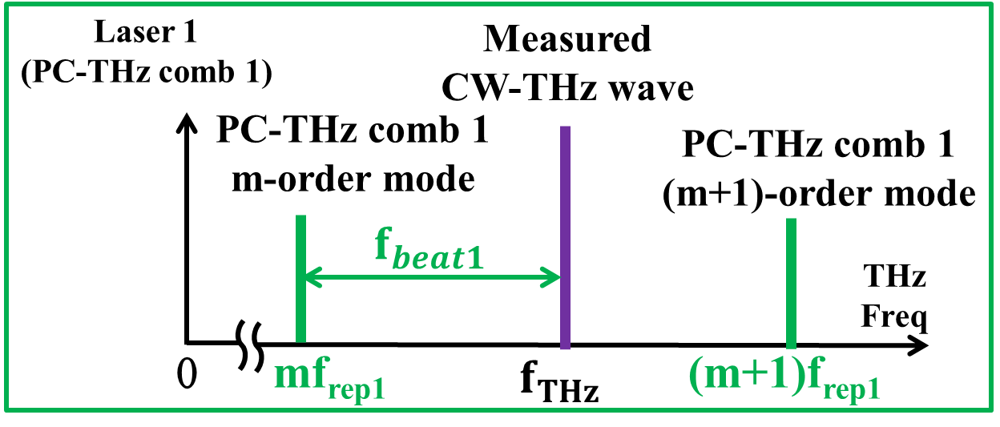
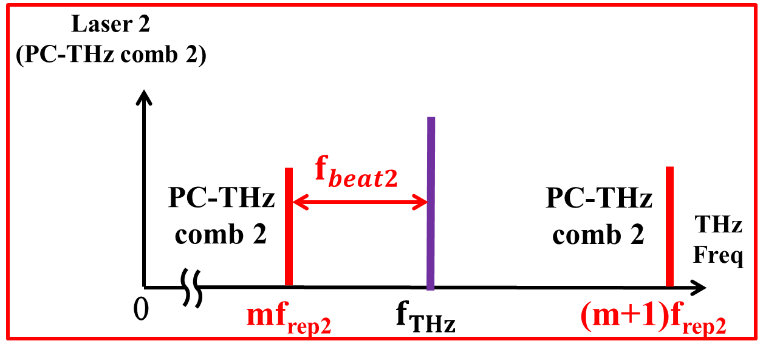
Real-time determination of CW-THz frequency
parallel measurement using dual PC-THz combs！
Notes:
Our new approach is very simple. We adopt the parallel measurement using dual PC-THz combs with slightly mismatched mode-locked frequencies. By measuring all of frep1, frep2, fbeat1, and fbeat2 at the same time, we can obtain m and fTHz in real time.

Slide 8
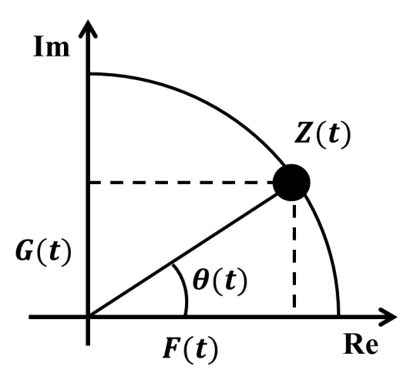
Instantaneous frequency measurement using Hilbert transformation
Ref) H. Füser et al, Appl. Phys. Lett. 99, 121111 (2011).
$$Z\left(t\right)=F\left(t\right)+iG\left(t\right)$$
measurement signal
$G\left(t\right)$:
signal after
Hilbert transform
Z(t): analytic signal
$F\left(t\right)$:
Notes:
Also, we employed Hilbert transformation to extract instantaneous values of fbeat from the temporal waveform measured by a fast digitizer. Hilbert transformation converts the signal F(t) measured in the real domain into the signal G(t) in the imaginary domain. The complex function of F(t) +iG(t) gives the analytic signal Z(t).
The instantaneous frequency f can be calculated by these two equations. Therefore, the instantaneous frequency can be obtained from the temporal waveform.

Slide 9
Experimental setup
PC-THz comb1, 2
f_{beat1}
f_{beat2}
Notes:
This is our experimental setup. In the following experiments, frep1 was fixed at 100 MHz, and frep2 was fixed at 100MHz+50Hz by laser control. After wavelength conversion by SHG crystal, the two laser lights were incident onto the PCA, generating PC-THz combs in PCAs. Then, CW-THz wave is directed onto each PCA. The PC mixing between PC-THz comb and CW-THz wave generates beat signals. After amplification with current preamplifier, the temporal waveforms of both beat signals were acquired by a fast digitizer. Then, we obtain the instantaneous value of fTHz in real time.

Slide 10
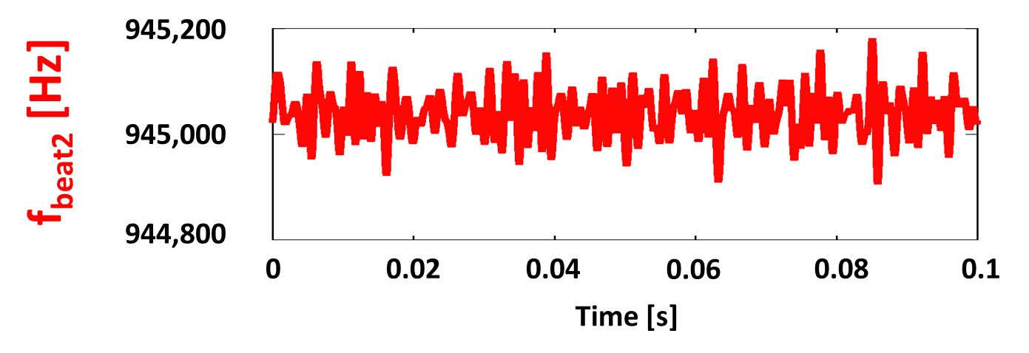
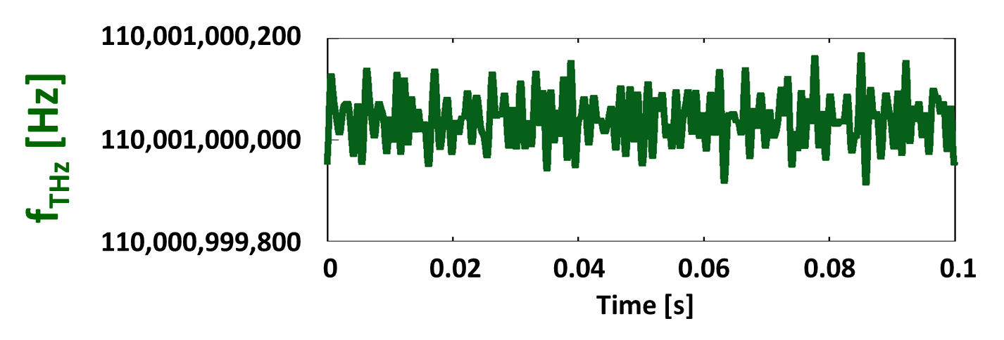
Real-time determination of f_{THz}
Sampling rate 10MHz
f_{rep1} = 100,000,000 Hz
f_{rep2} = 100,000,050 Hz
fixed
Notes:
The result of real-time determination of fTHz is shown here. The fTHz can be obtained at a sampling rate of 10 MHz. Since the frep1 and frep2 are fixed, we can determine fTHz by measuring fbeat1 and fbeat2. The resulting fTHz is here. Although these values were roughly consistent with the setting frequency in the CW-THz source, it includes a frequency error within 100 Hz due to no averaging.

Slide 11
Frequency error with respect to a various integration number
The comb mode cannot be determined
The comb mode can be determined
Notes:
The graph here show the frequency error with respect to a various integration number. The frequency error is large due to fast measurement, and the comb mode cannot be determined. But it can be improved by increasing the number of integration.

Slide 12
Comparison of accuracy between Hilbert transformation and frequency counter
impossible
sampling rate
10 Hz
counting errors of f_{beat}
Notes:
Furthermore, the comparison of accuracy between Hilbert transformation and frequency counter is shown here. The red line indicates measurement using Hildert transformation and the blue line indicates measurement using frequency counter. From the graph, the signal of 20dB or less cannot be measured in frequency counter. And the difference of accuracy between two methods is the counting errors of fbeat due to insufficient SNR. Therefore, we found the measurement using Hilbert transformation was better.

Slide 13
Real-time monitoring of CW-THz wave ① (Frequency fluctuation = 0.1 THz ±100 Hz)
m
Absolute frequency [Hz]
Time [ms]
Notes:
Here we demonstrate a movie of real-time monitoring of CW-THz wave. In this demonstration, the output frequency was manually changed within a frequency range of 100 Hz. In this way, the proposed system could track the fluctuation of fTHz in real time.

Slide 14
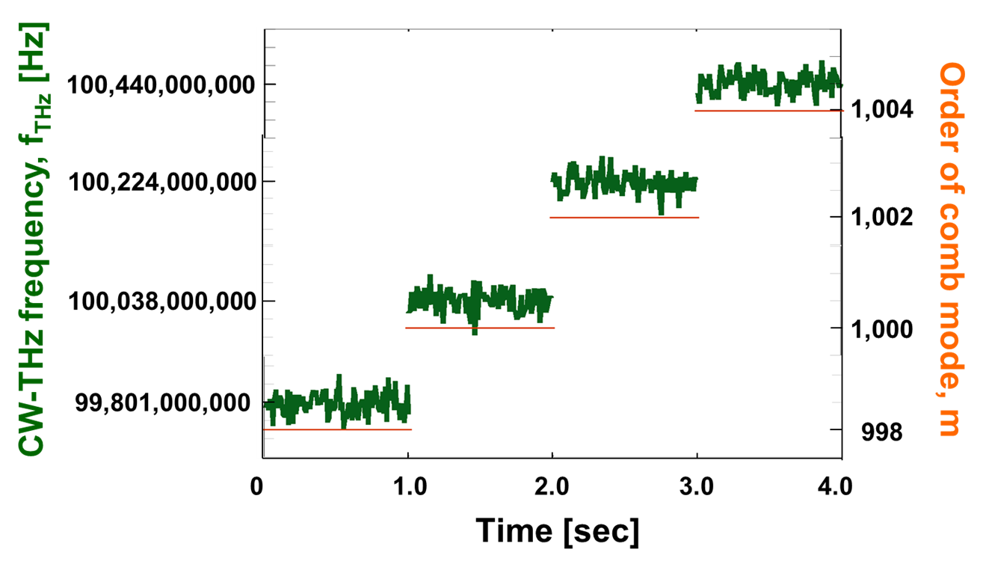
Real-time monitoring of CW-THz wave ② (Frequency fluctuation = 0.1THz + 200MHz)
A high potential for real time monitoring of large fluctuation such as mode hopping in CW-THz sources!
$$f_{THz}$$
$$f_{THz}$$
$$f_{THz}$$
$$f_{THz}$$
Order of comb mode
998
1000
1002
1004
Notes:
We next monitor the four-step large fluctuation in fTHz. Even though the CW-THz wave move 200 MHz across comb mode, the m and fTHz were correctly determined. This result indicates a high potential for real-time monitoring of large fluctuation such as mode hopping in CW-THz sources.

Slide 15
Experimental setup
Notes:
This is our experimental setup. In the following experiments, frep1 was fixed at 100 MHz, and frep2 was fixed at 100MHz+50Hz by laser control. After wavelength conversion by SHG crystal, the two laser lights were incident onto the PCA, generating PC-THz combs in PCAs. Then, CW-THz wave is directed onto each PCA. The PC mixing between PC-THz comb and CW-THz wave generates beat signals. After amplification with current preamplifier, the temporal waveforms of both beat signals were acquired by a fast digitizer. Then, we obtain the instantaneous value of fTHz in real time.

Slide 16
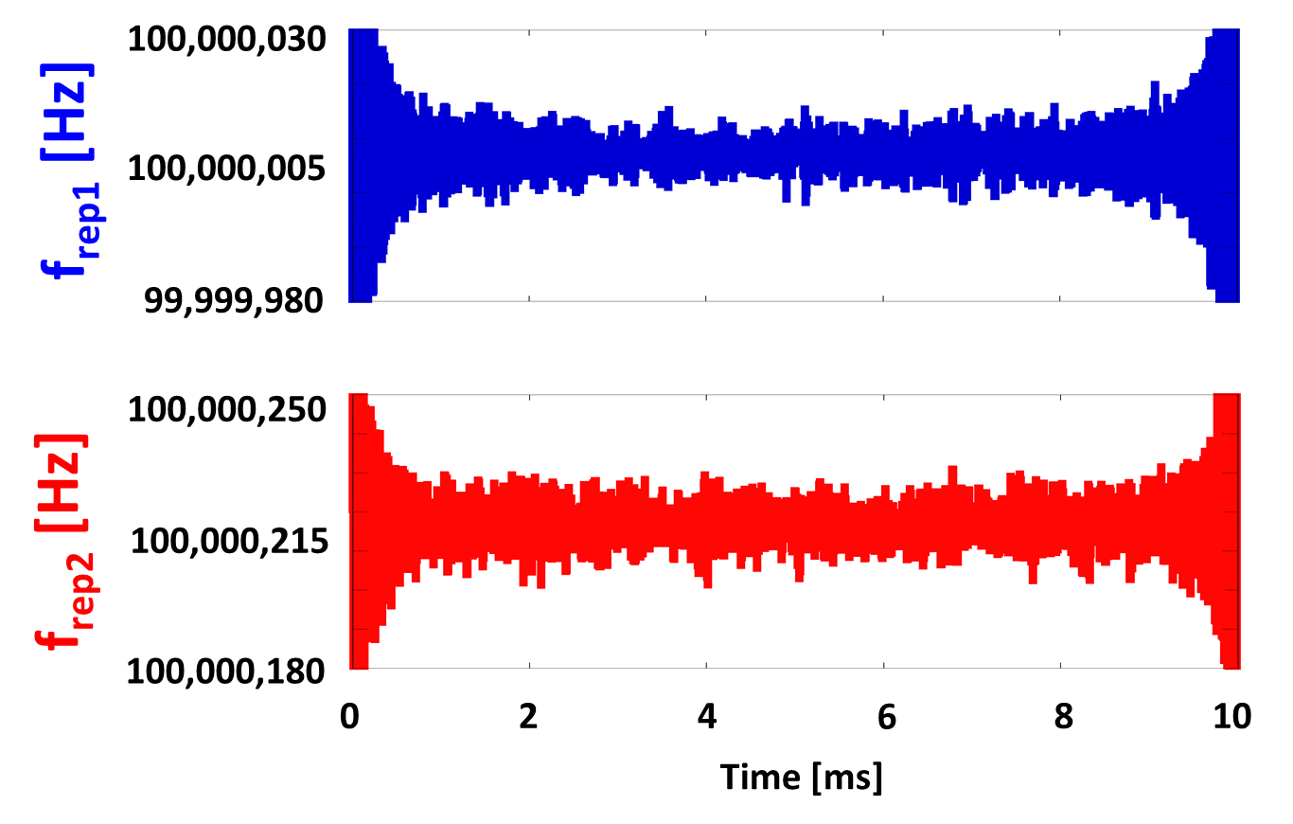
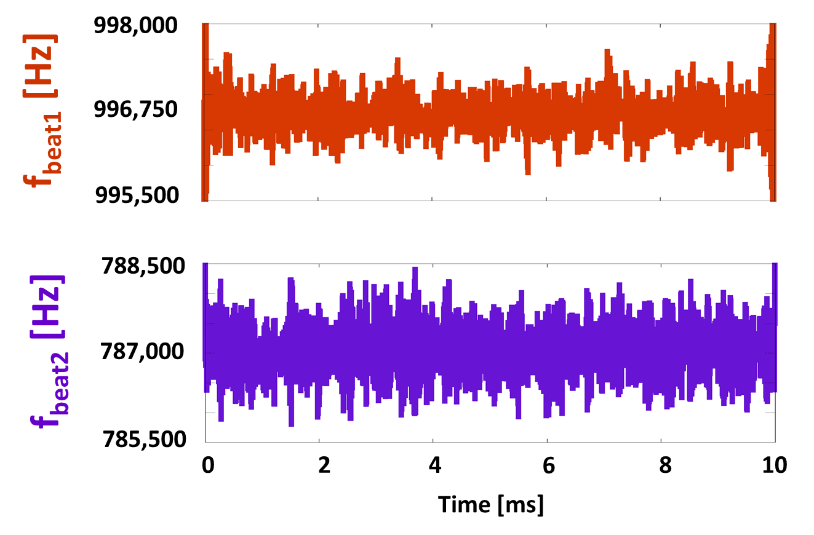
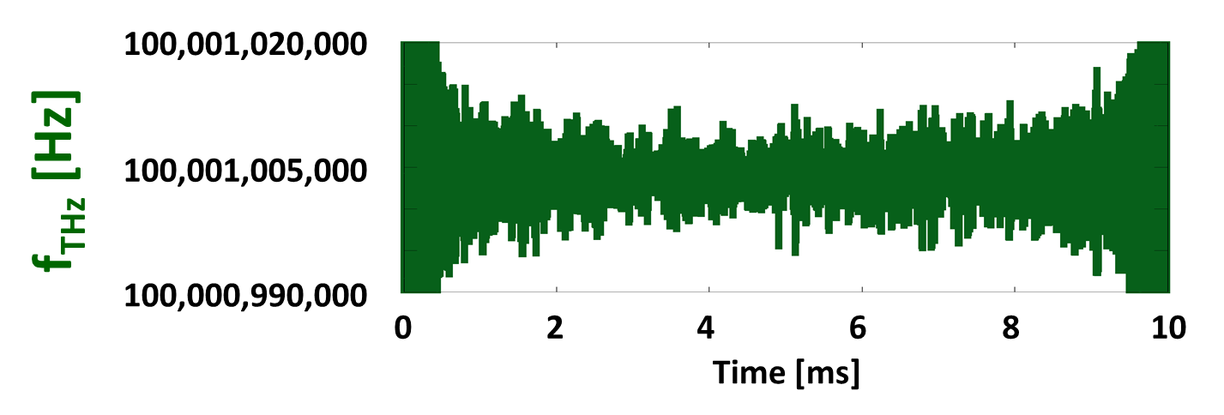
Real-time determination of f_{THz}
Sampling rate 10MHz
Notes:
The result of real-time determination of fTHz is shown here. The fTHz can be obtained at a sampling rate of 10 MHz. Since the frep1 and frep2 are fixed, we can determine fTHz by measuring fbeat1 and fbeat2. The resulting fTHz is here. Although these values were roughly consistent with the setting frequency in the CW-THz source, it includes a frequency error within 100 Hz due to no averaging.

Slide 17
Real-time monitoring of CW-THz wave (Frequency fluctuation = 0.1THz + 200MHz)

Slide 18
Experimental setup
Notes:
This is our experimental setup. In the following experiments, frep1 was fixed at 100 MHz, and frep2 was fixed at 100MHz+50Hz by laser control. After wavelength conversion by SHG crystal, the two laser lights were incident onto the PCA, generating PC-THz combs in PCAs. Then, CW-THz wave is directed onto each PCA. The PC mixing between PC-THz comb and CW-THz wave generates beat signals. After amplification with current preamplifier, the temporal waveforms of both beat signals were acquired by a fast digitizer. Then, we obtain the instantaneous value of fTHz in real time.

Slide 19
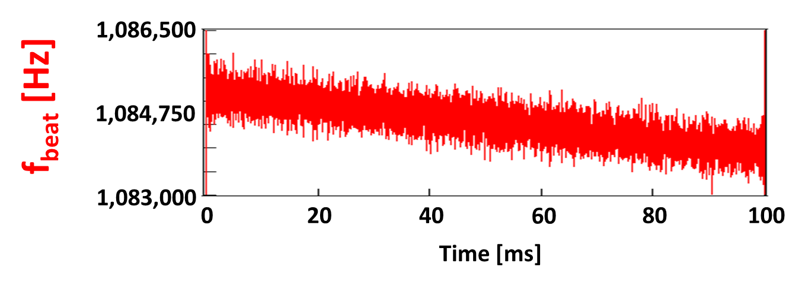
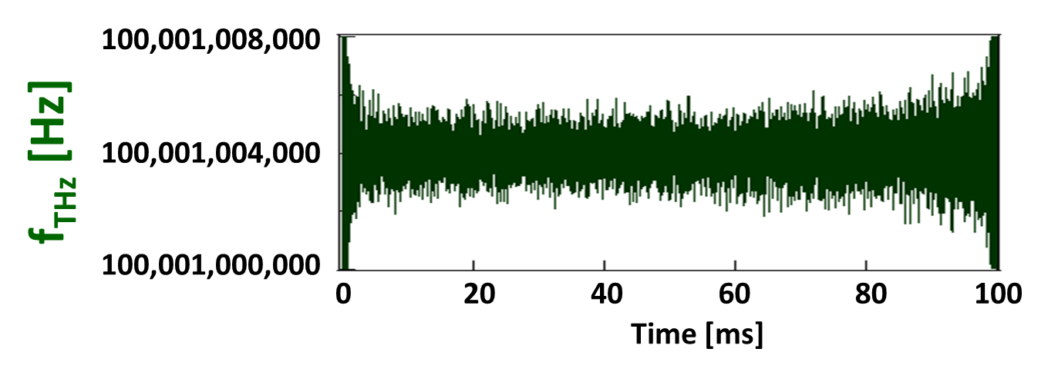
Real-time determination of f_{THz}
Sampling rate 10MHz
f_{rep} : freerun
Notes:
The result of real-time determination of fTHz is shown here. The fTHz can be obtained at a sampling rate of 10 MHz. Since the frep1 and frep2 are fixed, we can determine fTHz by measuring fbeat1 and fbeat2. The resulting fTHz is here. Although these values were roughly consistent with the setting frequency in the CW-THz source, it includes a frequency error within 100 Hz due to no averaging.

Slide 20
Real-time monitoring of CW-THz wave (Frequency fluctuation = 0.1THz + 500MHz)

Slide 21
Summary
Real-time absolute frequency measurement of the fast or largely fluctuating CW-THz wave using dual PC-THz combs
(1) Frequency accuracy
2.2×10⁻¹⁰ at a sampling rate of 10 kHz
1.5×10⁻¹² at a sampling rate of 10 Hz
(2) Possible to determine f_{THz} at lower SNR (~10)
(3) Available for large change of f_{THz} across the comb mode
Notes:
In summary, we demonstrated real-time absolute frequency measurement of the fast or largely fluctuating CW-THz wave using dual PC-THz combs. This experimental result is shown here. Thank you for your attention.

Slide 23
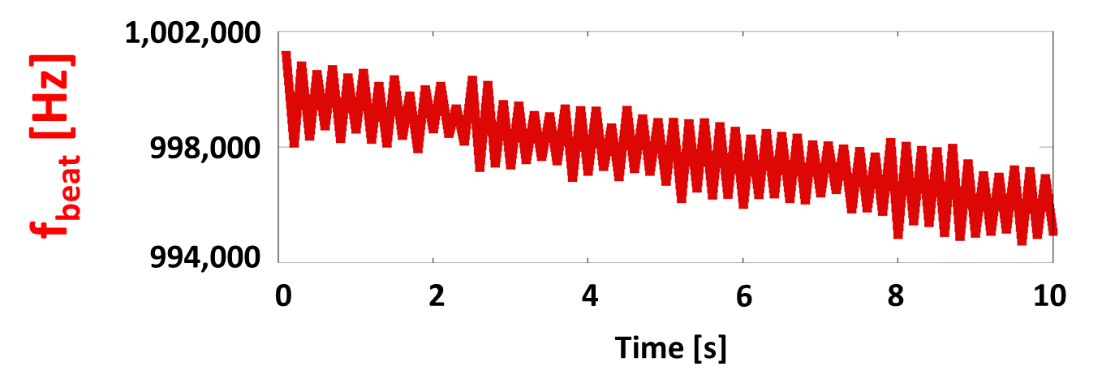
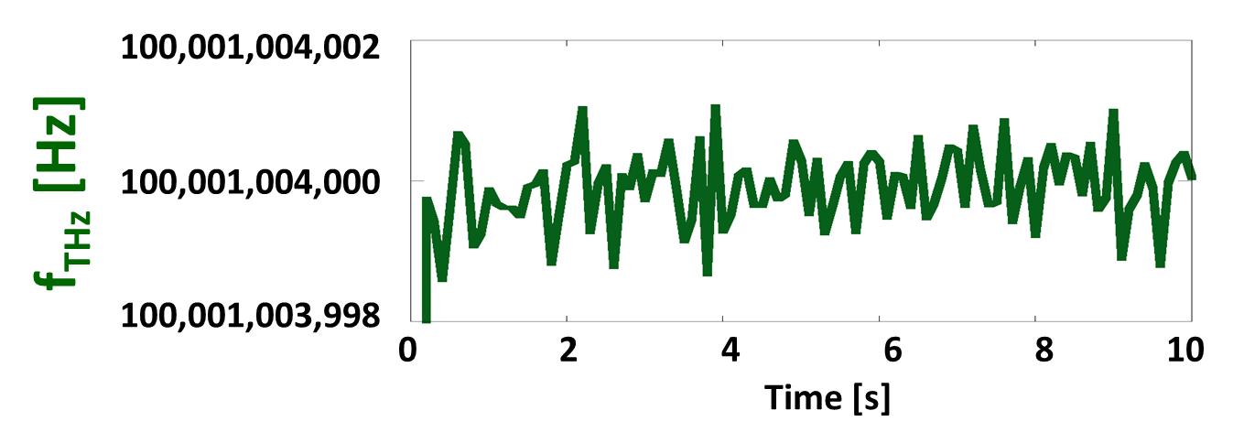
Real-time determination of f_{THz}
Sampling rate 10Hz
f_{rep} : freerun
Notes:
The result of real-time determination of fTHz is shown here. The fTHz can be obtained at a sampling rate of 10 MHz. Since the frep1 and frep2 are fixed, we can determine fTHz by measuring fbeat1 and fbeat2. The resulting fTHz is here. Although these values were roughly consistent with the setting frequency in the CW-THz source, it includes a frequency error within 100 Hz due to no averaging.

Slide 24
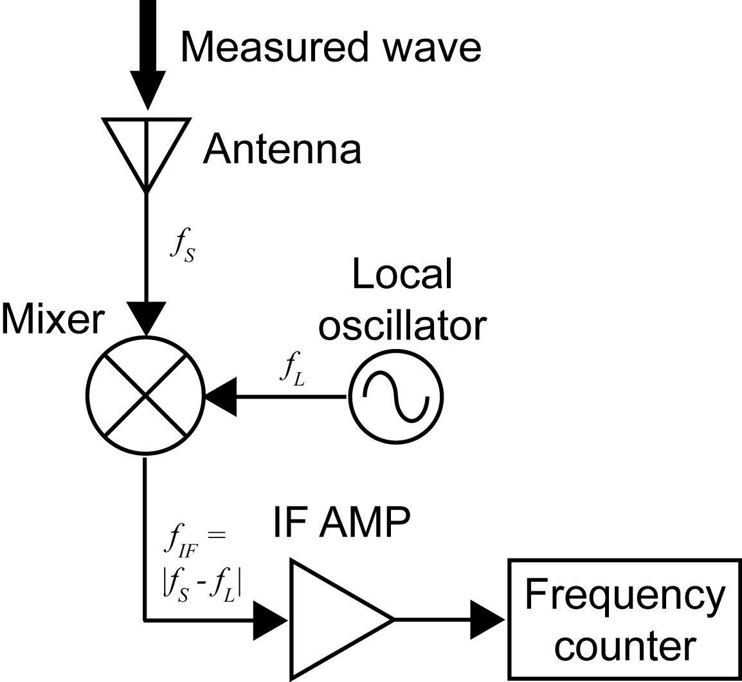
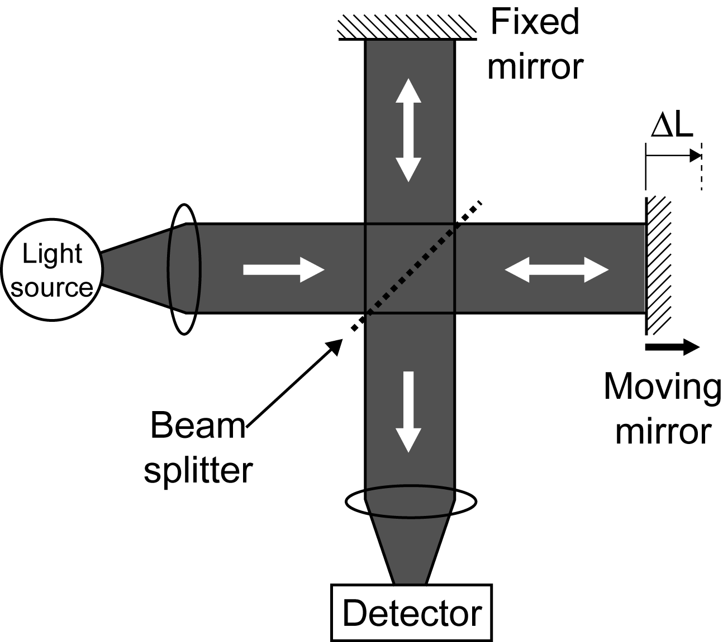
周波数計測の従来法
電気的手法 (ヘテロダイン)
光学的手法 (干渉計測)
極低温冷却
ΔL=(λ/2)*N
実用化の障害!
テラヘルツ領域 (0.1~10THz) をカバーすることは難しい
→THz領域をフルカバーできる新しい手法が必要!
Notes:
周波数計測における従来法を示す．こちらに電気的手法としてヘテロダイン，こちらには光学的手法として干渉計測を示す．しかし，これらの手法をTHz領域まで拡張した場合，ミキサーや検出器の熱ノイズを抑制するために極低温冷却が必要となり，実用化の障害となっていた．さらに，この手法ではTHz領域をフルカバーすることは難しく，THz領域をフルカバーできる新しい手法が必要でした．

