Slide 1
Real-Time Absolute Frequency Measurement of CW-THz Wave Based on Dual THz Combs
STu1F.4
○Kenta Hayashi¹⁾, Hajime Inaba^{2,3)},
Kaoru Minoshima^{3,4)}, and Takeshi Yasui^{1,3)}
1) Univ. Tokushima, Japan 2) AIST, Japan
3) JST-ERATO, Japan 4) UEC, Japan
CLEO 2014@San Jose
Notes:
Thank you, Mr. Chairman. My name is Kenta Hayashi from the University of Tokushima, Japan. Today, I will present Real-Time Absolute Frequency Measurement of CW-THz Wave Based on Dual THz Combs.

Slide 2
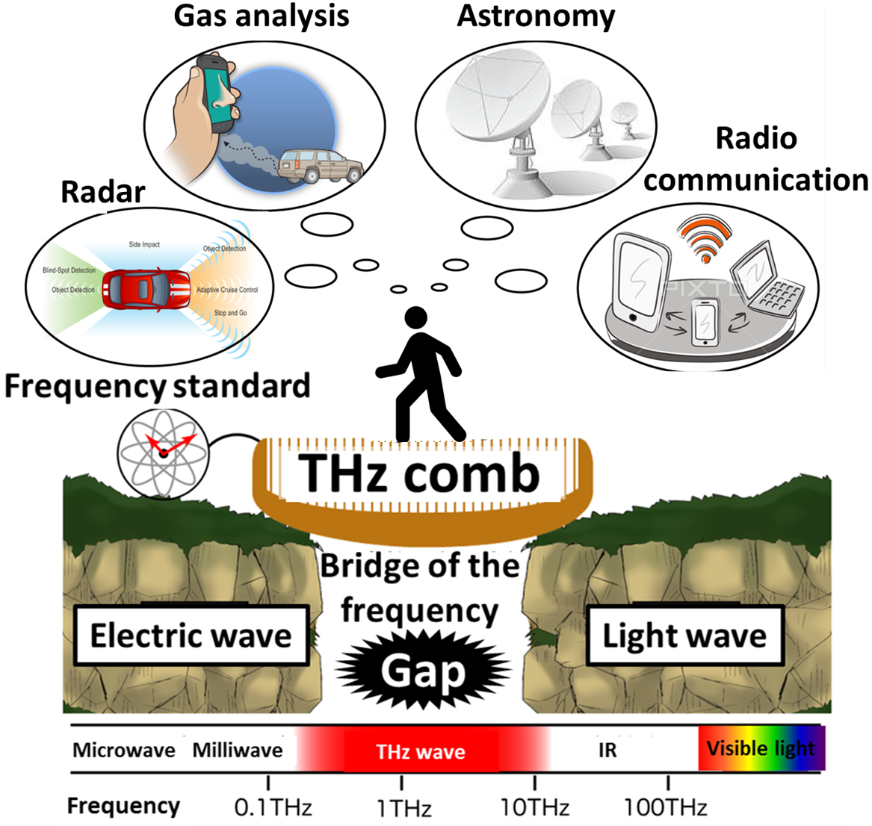
THz comb bridges THz gap as
frequency scale
Notes:
THz region lies between light wave and electric wave. Although THz technology has attracted attentions due to high potential, a large gap of technology, namely THz gap is still existing at this boundary because of its short history. The first step to expand the THz technology widely is to make various bridges over this THz gap. Our group is constructing a bridge of frequency because the frequency metrology is most important among various metrology for electromagnetic waves. In particular, THz comb enables a bridge of frequency to link coherently to a microwave frequency standard. The frequency bridge of THz comb will expand these THz applications.

Slide 3
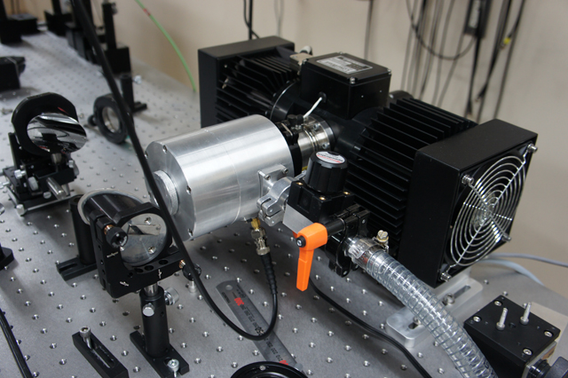
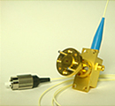
Frequency measurement of CW-THz wave
Practical
CW-THz sources
THz-QCL
UTC-PD
Conventional methods of the frequency measurement
・Electrical heterodyne method
・Optical interferometric method
Cryogenic cooling of mixers or detectors is required
Frequency measurement of CW-THz wave without the need for cryogenic cooling is strongly required !
Notes:
Along with recent progress in CW-THz sources such as THz-QCL and UTC-PD, the requirements of frequency measurement of CW-THz wave have increased in various applications. Conventionally, electrical heterodyne method and optical interferometric method have been often used for this purpose.
However, these methods require cryogenic cooling of mixers or detectors to suppress thermal noise. Therefore, frequency measurement of CW-THz wave without the need for cryogenic cooling is strongly required.

Slide 4
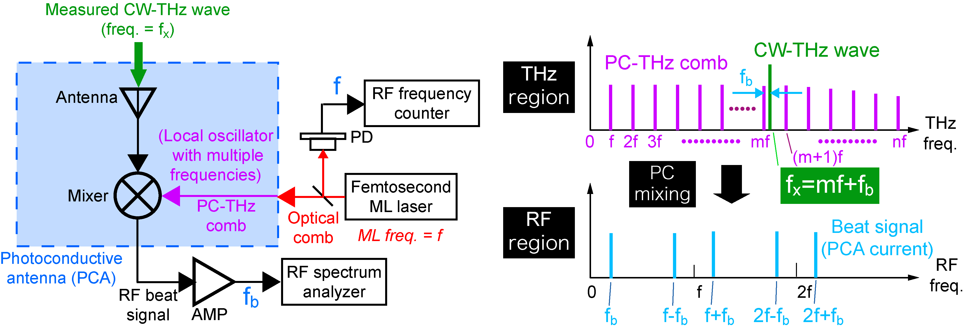
THz-comb-referenced frequency measurement
Freq. domain
f_{THz}
f_{rep}
f_{THz}=mf+f_{b}
f_{rep}
f_{beat}
f_{THz}=mf_{rep} ± f_{beat}
m: order of comb mode
f_{rep}: ML frequency
f_{beat}: beat frequency
Ref) S. Yokoyama et al, Opt. Express 16, 13052-13061 (2008).
T. Yasui et al. Opt. Express 17, 17034-17043 (2009).
Notes:
So, we developed THz-comb-referenced frequency measurement.
Here is the principle of the frequency measurement, which is based on heterodyne technique. Compared with the electrical heterodyne technique, a key difference is that the PCA is used as a heterodyne receiver. This results in high, broadband spectral sensitivity in the THz region without the need for cryogenic cooling. Another difference is the use of a PC-THz comb as a local oscillator.
The right part shows spectral behavior of this method. When an optical comb with mode-locked frequency of f is incident on the antenna gap, the PC-THz comb is induced in the PCA. Then a measured CW-THz wave is induced on the PCA. As a result, PC mixing generates a group of beat signals in the RF region. Please focus on a beat signal at the lowest frequency. This beat signal is generated by mixing this CW-THz wave and this mf. Therefore, the fTHz is given by this equation. The frep and fbeat can be easily measured with RF spectrum analyzer or frequency counter. To obtain the fTHz, we have to determine the m and sign of the fbeat.

Slide 5
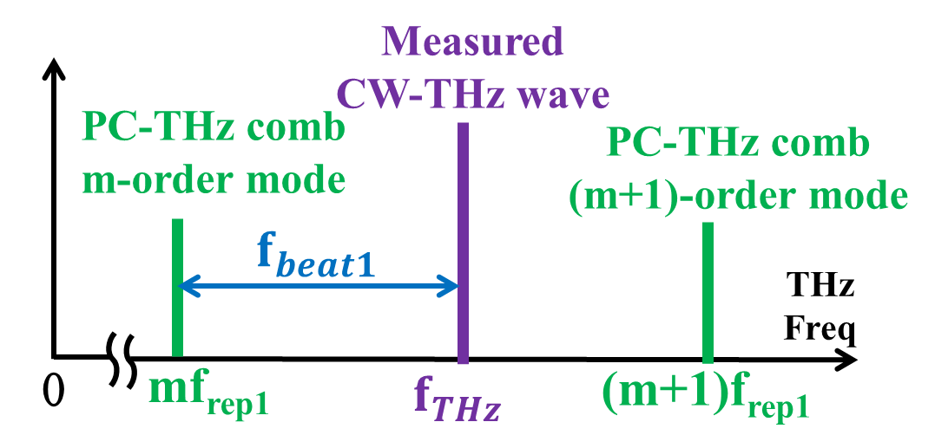
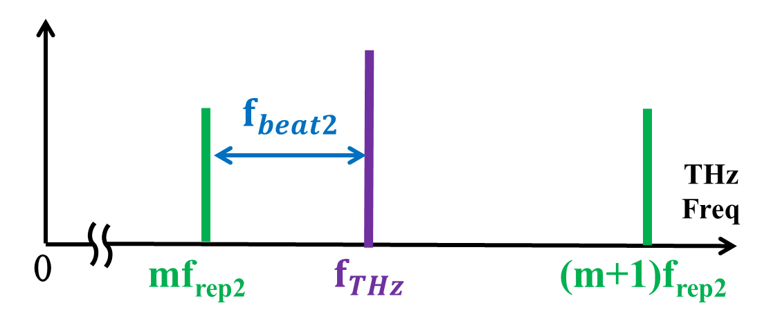
Determination of m and sign of f_{beat}
Measurement of f_{rep1} and f_{beat1}
Measurement of f_{rep2} and f_{beat2}
Assumption : f_{THz} is sufficiently stable during measurements of f_{beat1} and f_{beat2}
Notes:
In the previous study, we first measured frep1 and the corresponding fbeat1. Then, we shift frep1 to frep2 by laser control, and measure frep2 and the corresponding fbeat2. Since the frep and fbeat satisfy this relationship, we can obtain the m based on this equation. Finally, we can obtain the fTHz following these equations. However, fTHz must be sufficiently stable during measurements of fbeat1 and fbeat2.

Slide 6
For example
CW-THz source
(UTC-PD)
・fast frequency fluctuation
・large frequency fluctuation
(mode hopping)
Present talk
Real-time determination of the fast or largely fluctuating CW-THz frequency using dual PC-THz combs .
Notes:
Unfortunately, most of practical CW-THz sources are not so stable. Moreover, their output frequency fluctuate from moment to moment like here. The previous method is applicable on the assumption that fTHz is stable during the serial two-step measurement. However, fTHz fluctuates rapidly during the measurement. At the present talk, we demonstrate real-time determination of the fast or largely fluctuating CW-THz frequency using dual PC-THz combs.

Slide 7
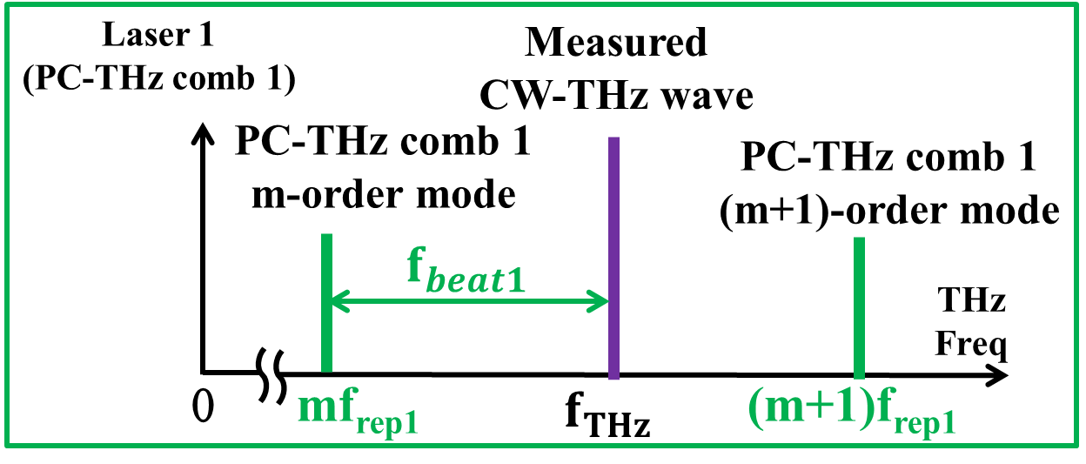
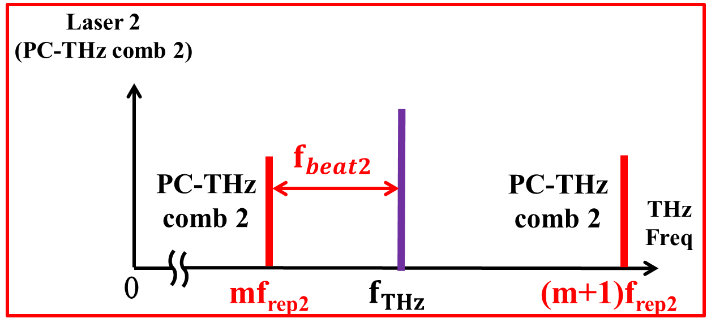
Real-time determination of CW-THz frequency
parallel measurement using dual PC-THz combs！
Notes:
Our new approach is very simple. We adopt the parallel measurement using dual PC-THz combs with slightly mismatched mode-locked frequencies. By measuring all of frep1, frep2, fbeat1, and fbeat2 at the same time, we can obtain m and fTHz in real time.

Slide 8
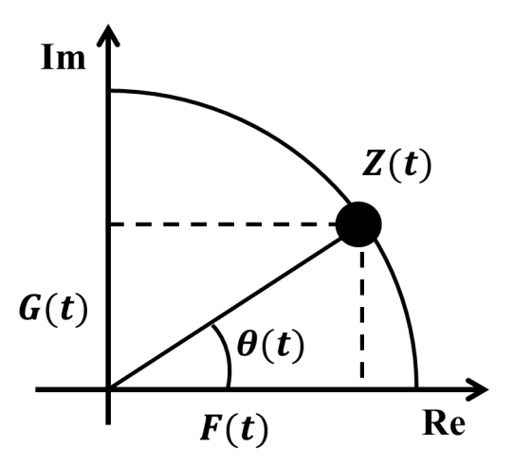
Instantaneous frequency measurement using Hilbert transformation
Ref) H. Füser et al, Appl. Phys. Lett. 99, 121111 (2011).
$$Z\left(t\right)=F\left(t\right)+iG\left(t\right)$$
measurement signal
$G\left(t\right)$:
signal after
Hilbert transform
Z(t): analytic signal
$F\left(t\right)$:
Notes:
Also, we employed Hilbert transformation to extract instantaneous values of fbeat from the temporal waveform measured by a fast digitizer. Hilbert transformation converts the signal F(t) measured in the real domain into the signal G(t) in the imaginary domain. The complex function of F(t) +iG(t) gives the analytic signal Z(t).
The instantaneous frequency f can be calculated by these two equations. Therefore, the instantaneous frequency can be obtained from the temporal waveform.

Slide 9
Experimental setup
PC-THz comb1, 2
f_{beat1}
f_{beat2}
Notes:
This is our experimental setup. In the following experiments, frep1 was fixed at 100 MHz, and frep2 was fixed at 100MHz+50Hz by laser control. After wavelength conversion by SHG crystal, the two laser lights were incident onto the PCA, generating PC-THz combs in PCAs. Then, CW-THz wave is directed onto each PCA. The PC mixing between PC-THz comb and CW-THz wave generates beat signals. After amplification with current preamplifier, the temporal waveforms of both beat signals were acquired by a fast digitizer. Then, we obtain the instantaneous value of fTHz in real time.

Slide 10
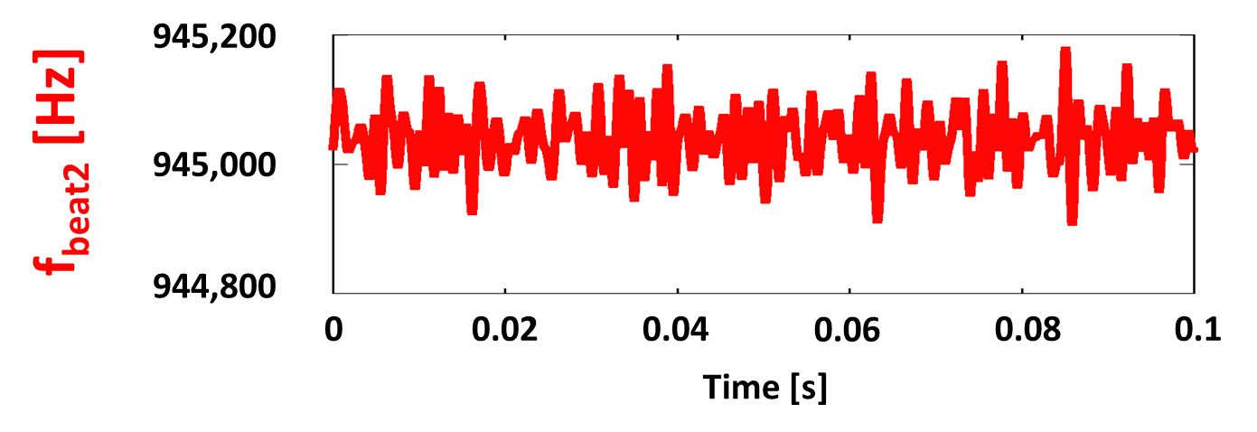
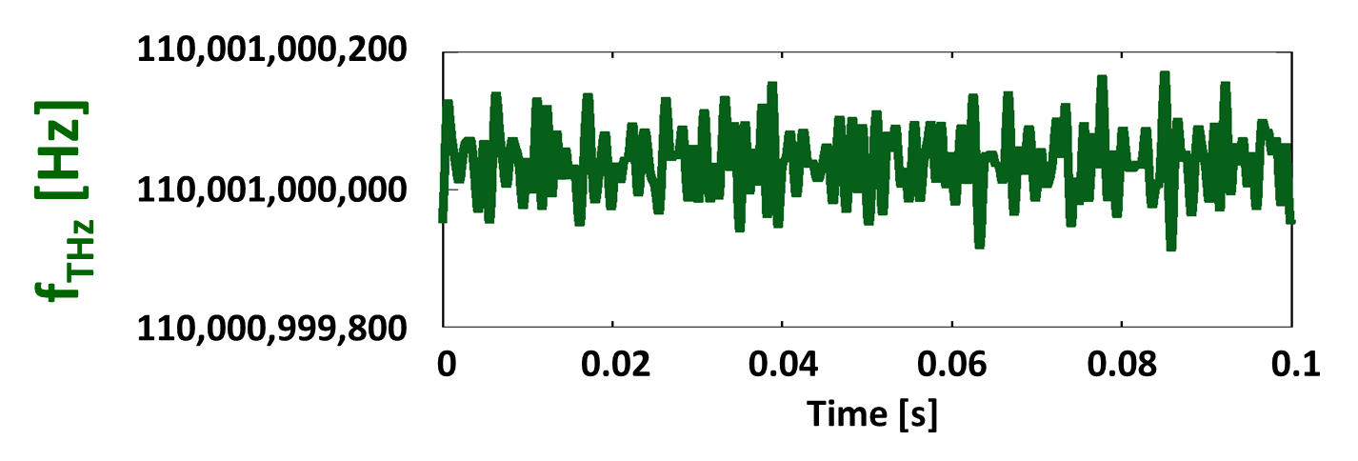
Real-time determination of f_{THz}
Sampling rate 10MHz
f_{rep1} = 100,000,000 Hz
f_{rep2} = 100,000,050 Hz
fixed
Notes:
The result of real-time determination of fTHz is shown here. The fTHz can be obtained at a sampling rate of 10 MHz. Since the frep1 and frep2 are fixed, we can determine fTHz by measuring fbeat1 and fbeat2. The resulting fTHz is here. Although these values were roughly consistent with the setting frequency in the CW-THz source, it includes a frequency error within 100 Hz due to no averaging.

Slide 11
Frequency error with respect to a various integration number
The comb mode can be determined
The comb mode cannot be determined
Notes:
The graph here show the frequency error with respect to a various integration number. The frequency error is large due to fast measurement, and the comb mode cannot be determined. But it can be improved by increasing the number of integration.

Slide 12
Comparison of accuracy between Hilbert transformation and frequency counter
impossible
sampling rate
10 Hz
counting errors of f_{beat}
Notes:
Furthermore, the comparison of accuracy between Hilbert transformation and frequency counter is shown here. The red line indicates measurement using Hildert transformation and the blue line indicates measurement using frequency counter. From the graph, the signal of 20dB or less cannot be measured in frequency counter. And the difference of accuracy between two methods is the counting errors of fbeat due to insufficient SNR. Therefore, we found the measurement using Hilbert transformation was better.

Slide 13
Real-time monitoring of CW-THz wave ① (Frequency fluctuation = 0.1 THz ±100 Hz)
m
Absolute frequency [Hz]
Time [ms]
Notes:
Here we demonstrate a movie of real-time monitoring of CW-THz wave. In this demonstration, the output frequency was manually changed within a frequency range of 100 Hz. In this way, the proposed system could track the fluctuation of fTHz in real time.

Slide 14
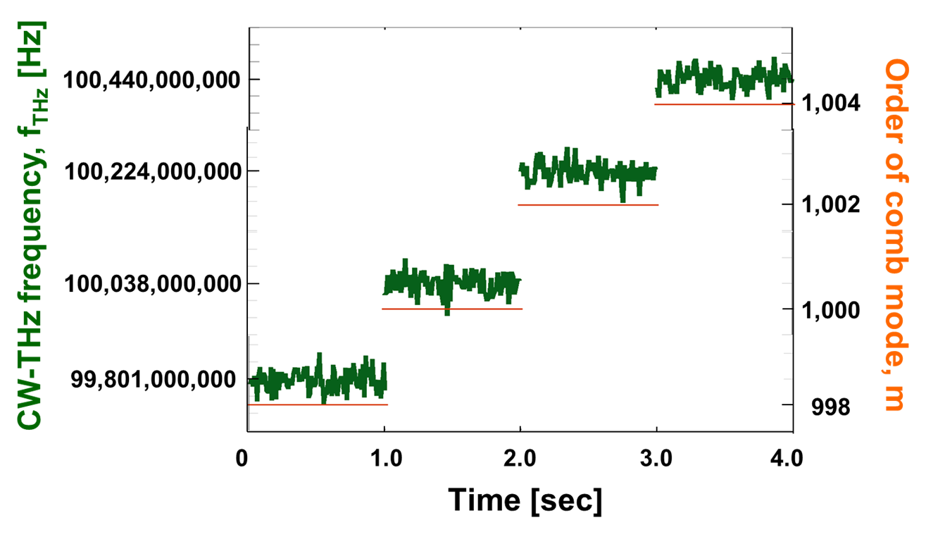
Real-time monitoring of CW-THz wave ② (Frequency fluctuation = 0.1THz + 200MHz)
A high potential for real time monitoring of large fluctuation such as mode hopping in CW-THz sources!
$$f_{THz}$$
$$f_{THz}$$
$$f_{THz}$$
$$f_{THz}$$
Order of comb mode
998
1000
1002
1004
Notes:
We next monitor the four-step large fluctuation in fTHz. Even though the CW-THz wave move 200 MHz across comb mode, the m and fTHz were correctly determined. This result indicates a high potential for real-time monitoring of large fluctuation such as mode hopping in CW-THz sources.

Slide 15
Summary
Real-time absolute frequency measurement of the fast or largely fluctuating CW-THz wave using dual PC-THz combs
(1) Frequency accuracy
2.2×10⁻¹⁰ at a sampling rate of 10 kHz
1.5×10⁻¹² at a sampling rate of 10 Hz
(2) Possible to determine f_{THz} at lower SNR (~10)
(3) Available for large change of f_{THz} across the comb mode
Notes:
In summary, we demonstrated real-time absolute frequency measurement of the fast or largely fluctuating CW-THz wave using dual PC-THz combs. This experimental result is shown here. Thank you for your attention.

Slide 17
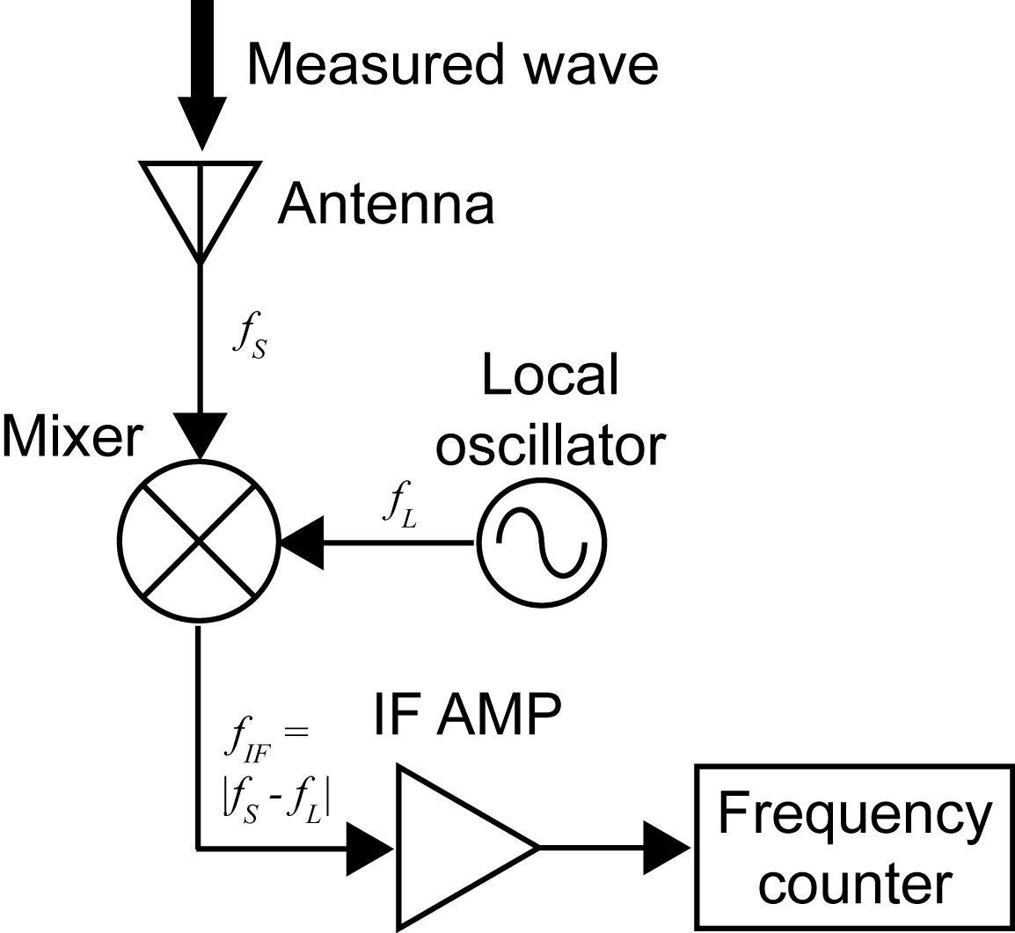
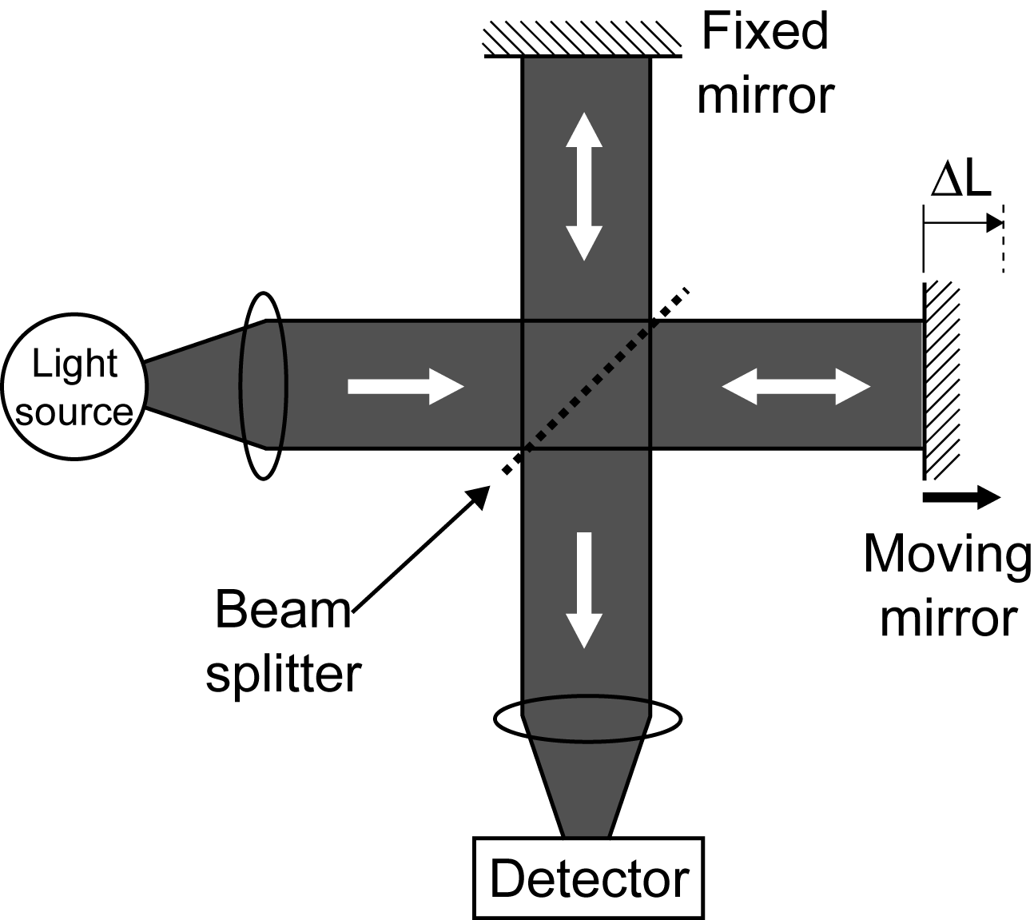
Conventional method
Electrical heterodyned method
Optical interferometric method
Cryogenic cooling
ΔL=(λ/2)*N
Obstacle to
practical use!
Difficult to cover all frequency region of THz wave (0.1~10THz)
→Requirement of new method optimized for THz wave!
Notes:
Conventionally, ele^ctrical he^terodyned method and o^ptical interfero^metric method have been widely used. However, these methods often requires cryoge^nic cooling of mixer or detector to suppress thermal noise. This results in obstacle to practical use. Furthermore, even though such cooling is applied for these methods, it is still difficult to cover all frequency region of THz wave. In this way, THz gap of frequency measurement is existing between electrical and optical regions. Therefore, new method optimized for THz wave is required. To bridge the THz gap of frequency measurement, we focus on the THz frequency comb.

Slide 18
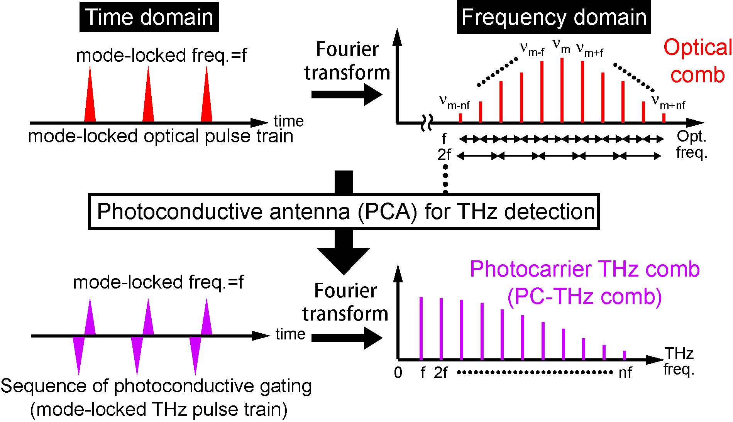
Optical comb and THz comb
Simple, broadband selectivity, high spectral purity,
offset free, and absolute frequency calibration
Notes:
This slide shows behavior of optical comb and THz comb in time and frequency domains. Recently, in the optical region, optical frequency combs radiated from a femtosecond mode-locked laser have attracted attention as a powerful tool for optical frequency metrology because it can be used as a precise frequency ruler in optical region. When the mode-locked optical pulse is incident to the PCA for THz detection, a sequence of photoconductive gating is induced in the PCA. Such photoconductive ML THz pulse train constructs frequency comb structure of photocarrier in the PCA, namely PC-THZ comb. In this way, the optical comb is down-converted to the THz region without any change in its frequency spacing. The resulting PC-THz comb is a harmonic frequency comb without any offset, composed of a fundamental component and a series of harmonic components of a mode-locked frequency of f. Such the PC-THz comb provides attractive features for frequency metrology, namely simple, broadband selectivity, high spectral purity, offset free, and absolute frequency calibration. Therefore, if the laser ML freq. of f is well stabilized, the PC-THz comb can be used as a precise frequency ruler in the THz region. At the present talk, we proposed a THz spectrum analyzer based on the PC-THz comb.

Slide 19
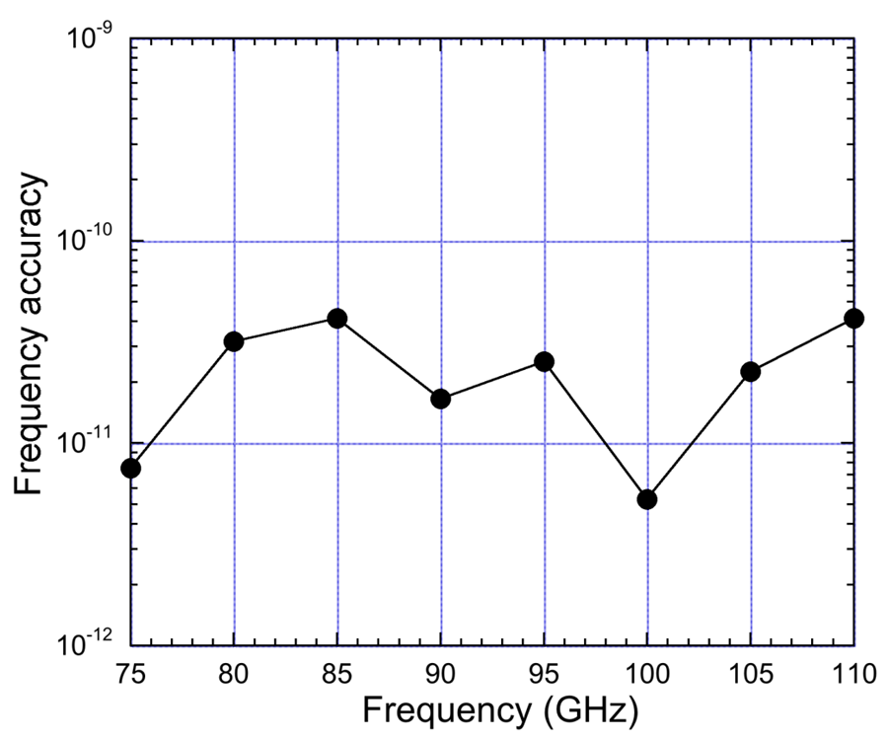
Previous study
Ref) T. Yasui et al. Opt. Express 17, 17034-17043 (2009).
Absolute frequency
measurement
Real-time monitoring
of CW-THz wave
Notes:
Next, I will introduce previous study. The left graph shows the result of absolute measuring of 75~110GHz frequency. The right graph shows a real-time monitoring of the beat signal that uses UTC-PD of F band.

Slide 20
The advantage of Hilbert transformation
Compared with frequency counter
The beat signal of lower SNR (~10) can be measured
Fast phenomenon can be measured
→frequency counter is limited by gate time

Slide 21
The disadvantage of Hilbert transformation
Trade-off between accuracy and integration number !

Slide 22
Accuracy of absolute frequency measurement
Estimation of measurement error
∆f_{rep1} = 120µHz
∆f_{beat1} = 21mHz
m = 800~1100
↓
∆f_{THz} = 117~153mHz
Mean precision = 1.5*10⁻¹²
Notes:
Finally, we show the accuracy of this absolute frequency measurement. The output frequencies of the test source are set between 80 and 110 GHz, the blue line shows measurement error and the red line shows accuracy. This result shows measurement error is about several tens mHz. Here, we estimate the measurement error to investigate whether this value is proper. Then it becomes such a result, it is coincident within the range of permissible. Finally, the mean precision of 3.9*10-13 was achieved in this demonstration.
このスライドは、絶対周波数計測の実験精度を示している。テストソースの出力周波数は80-110GHzに設定され、青線は測定誤差、赤線は実験精度を示している。この結果から測定誤差は数十ミリヘルツ程度であることが分かった。ここで、この値が妥当かどうかを調べるため測定誤差の見積を行った。すると結果がこのようになり、許容の範囲内で一致している。最後に、本実験の平均精度3.9*10-13であった。
解析の方法が変わったから２ケタ向上 前回はスペアナで計測

Slide 23
Accuracy
$$Accuracy=\frac{frequency error}{setting frequency}$$

Slide 24
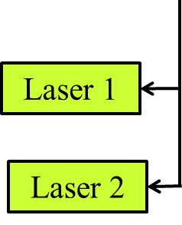
The limitation of accuracy
The accuracy is limited by stability of f_{rep}

Slide 25
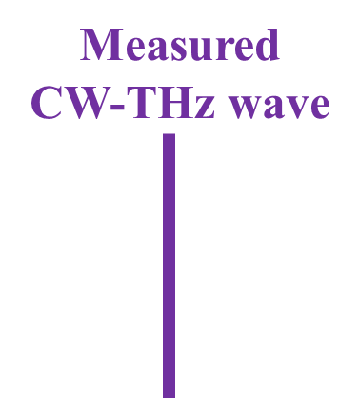
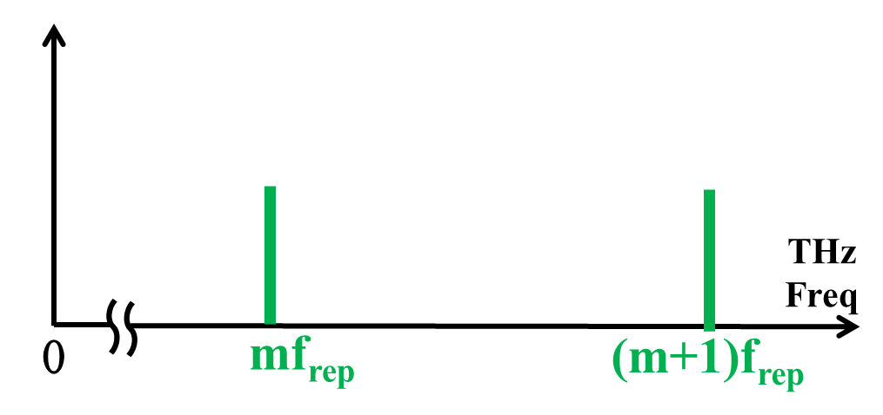
The fast or largely fluctuation of CW-THz wave
limited by response speed or sensitivity of PCA detector
However
mf_{rep} and f_{THz} are same value → f_{beat} = 0
The m and f_{THz} cannot be determine due to no beat signal !!

Slide 26
Real-time absolute frequency measurement using a single PC-THz comb
modulating f_{rep}
→Δf_{rep} and Δf_{beat} can be measured
2. using free-running laser
→Δf_{rep} and Δf_{beat} can be measured
The m and f_{THz} can be determined by measuring Δf_{rep} and Δf_{beat} at the same time !!

