Slide 1
Spectrally Interleaved, Comb-Mode-Resolved, Dual-Terahertz-Comb Spectroscopy
CLEO2014: STh1N.2
Y.-D. Hsieh^{4,7)}, Y. Iyonaga¹⁾, Y. Sakaguchi¹⁾,
S. Yokoyama²⁾, H. Inaba^{3,4)}, K. Minoshima^{4,5)}, F. Hindle⁶⁾,
T. Araki¹⁾, and T. Yasui^{4,7)}
¹⁾Osaka University, Toyonaka, Japan.
²⁾Micro Optics Co., Ltd, Kyoto, Japan.
³⁾National Institute of Advanced Industrial Science and Technology, Tsukuba, Japan.
⁴⁾ERATO MINOSHIMA Intelligent Optical Synthesizer Project, JST, Chofu, Japan.
⁵⁾The University of Electro-Communications, Chofu, Japan.
⁶⁾Université du Littoral Côte d'Opale, Dunkerque, France.
⁷⁾The University of Tokushima, Tokushima, Japan.

Slide 2
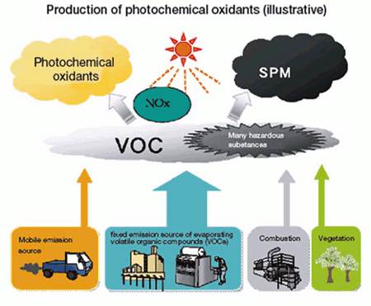
Air pollution by VOCs
Volatile organic compounds (VOCs)
VOC is the general term of organic compounds that become gaseous in the atmosphere
(O₃)
Photochemical reaction
Primary air pollutants
Ozone (O₃)
Small particulate matter (SPM)
Human-made
Natural origin
From: Environment of Tokyo
The instrumental analysis of VOC gases is important to pollution control !!

Slide 3
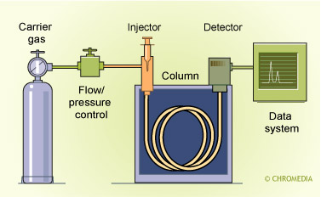
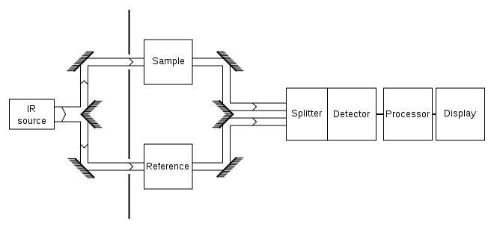
Conventional techniques
Gas chromatography
Infrared spectroscopy
Need to remove small particles
Form: http://www.chromedia.org/
From: en.wikipedia.org
Advantages: Excellent resolution, Sensitivity
Disadvantages: Need skilled instrumental analyst,
Long measurement time
Advantages: High speed, Broadband spectrum
Disadvantages: Scattering by aerosol, Low sensitivity
With conventional techniques, it was difficult to analyze VOC gases directly without preparing samples in advance

Slide 4
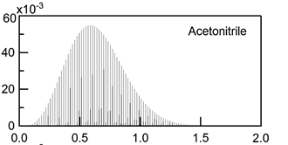
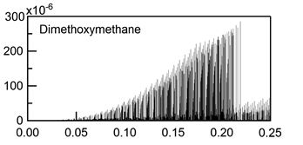
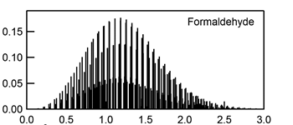
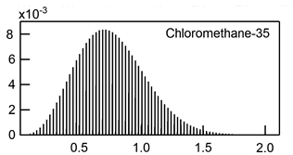
THz gas spectroscopy
(1) Rotational transition of polar molecules
Rich spectral fingerprints, high discrimination, high sensitivity
Intergraded absorption
intensity (mm²MHz)
Frequency (THz)
From: NASA database
THz spectral fingerprints of VOC gases
(2) Reduced scattering in small particles
λ_{THz} >> particle diameter
Possible to analyze gas molecules mixed with aerosols, fog, cloud, smoke, soot, etc.
THz spectroscopy has high potential for analysis of VOC gas.
However, high accuracy, high resolution, and broadband spectrum are required for correct discrimination!!

Slide 5
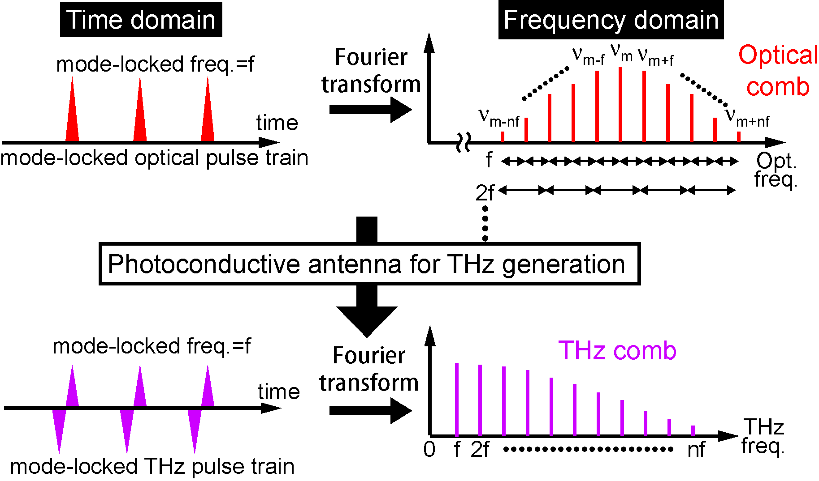
Optical comb & THz comb
Optical
rectification
Precise frequency ruler in THz region!
Simple, broadband selectivity, high spectral purity,
and absolute frequency calibration
Ref) T. Yasui, et al, IEEE J. Quantum. Electron., 17, 191 (2011).

Slide 6
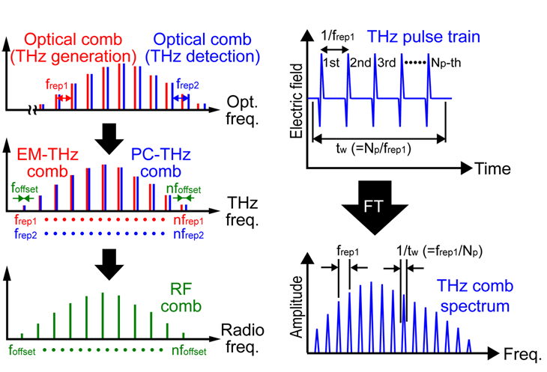
Dual THz comb spectroscopy
Frequency domain
Time domain
Ref) T. Yasui, et al, Appl. Phys. Lett., 88, 241104 (2006).
Ref) Y. -D. Hsieh, et al, Sci. Rep., 4, 3816 (2014)

Slide 7
Previous study
Time window (= Tw)
Temporal
waveform
1/f_{rep}
F. T.
Spectral sampling interval is limited by comb spacing rather than comb linewidth
Amplitude spectrum
Ref) Y. -D. Hsieh, et al, IEEE Trans. Terahertz Sci. Tech. 3 , 322 (2013).
Water vapor abs.
1/Tw
f_{rep.}
Expanded
around 0.5THz

Slide 8
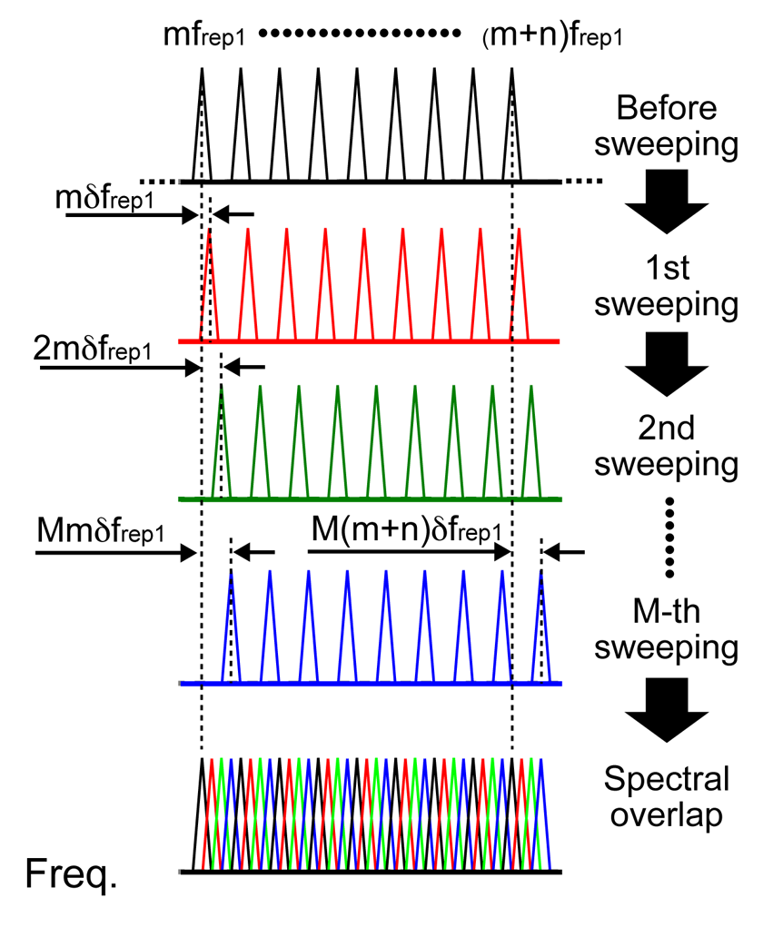
Spectrally interleaved THz comb
f₁, f₂ : tune
Δ : constant
• Sweeping at intervals of
linewidth of comb mode
• Overlapping of all spectra
Gap between comb mode
can be interpolated!
Equivalent to tunable
CW-THz radiation
Ref) Y. -D. Hsieh, et al, Sci. Rep., 4, 3816 (2014)
Notes:
8

Slide 9
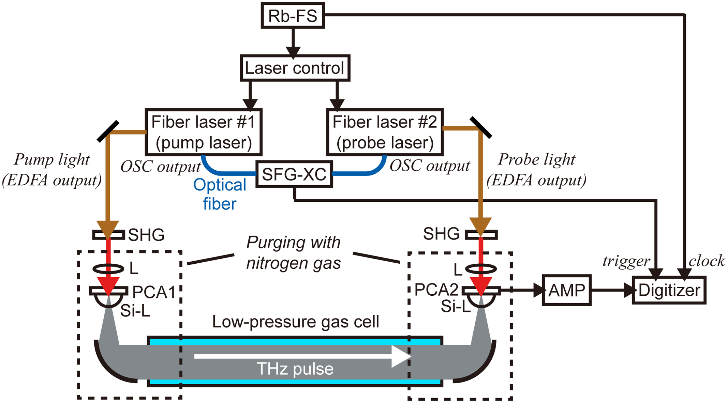
Experimental setup
λc= 1550 nm, Δt =50 fs, P_{mean}= 500mW
f₁=250,000,049Hz , f₂= 250,000,099Hz , Δf= f₂-f₁= 50Hz,
Rb-FS:
Accuracy=5×10⁻¹¹
Instability=2×10⁻¹¹ at 1s
Bandwidth: 1MHz
Gain: 4×10⁶ V/A

Slide 10
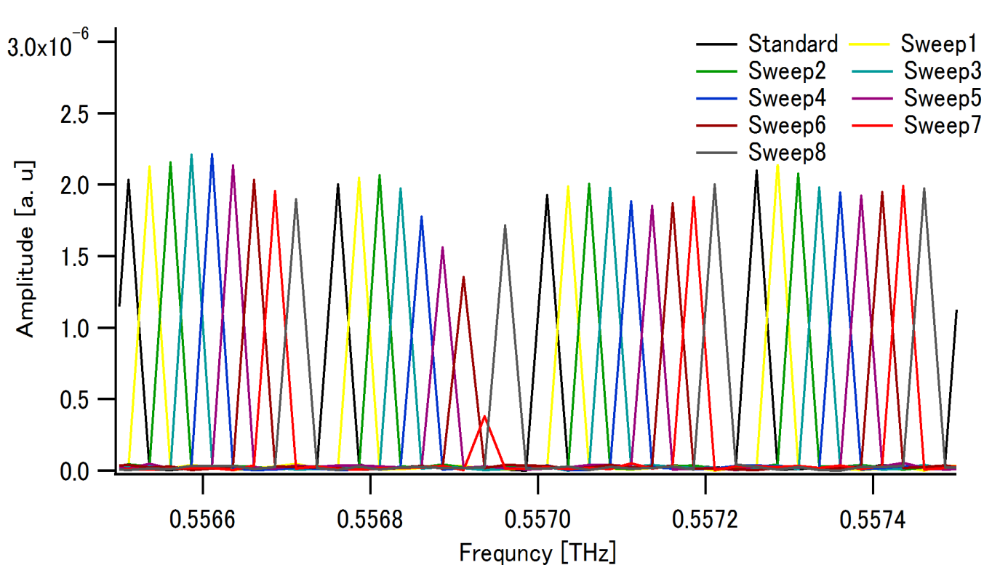
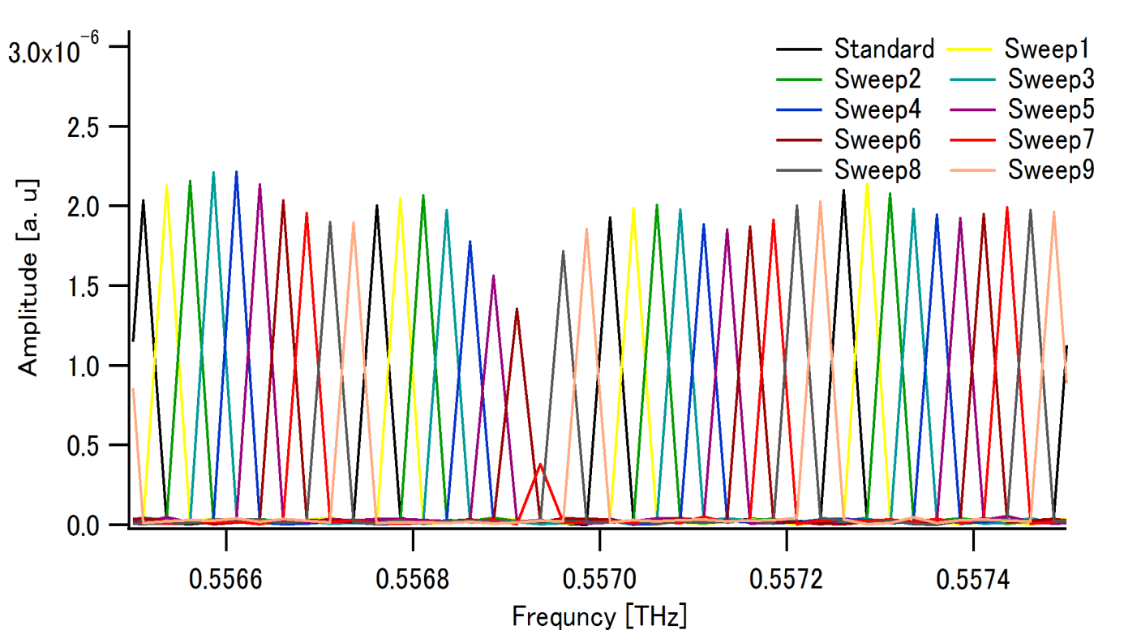
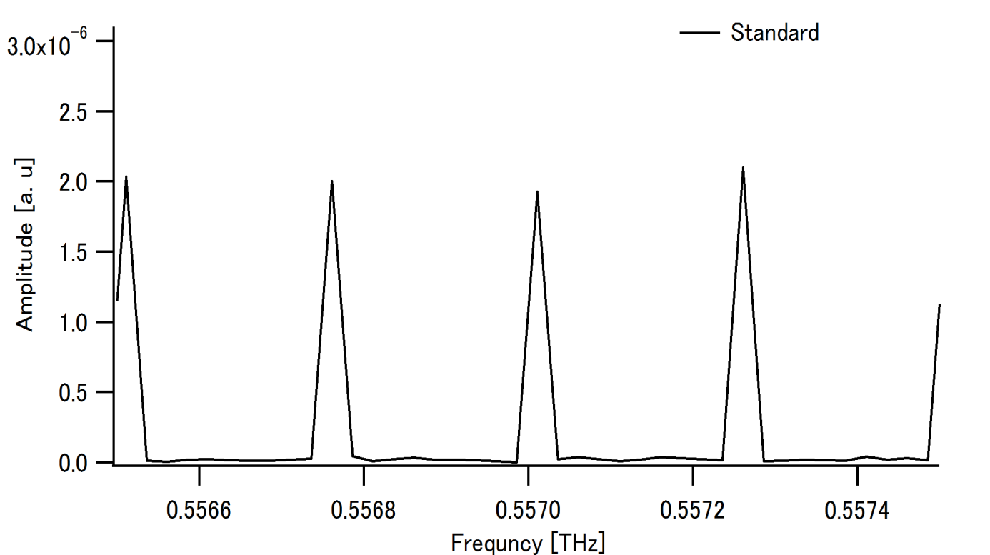
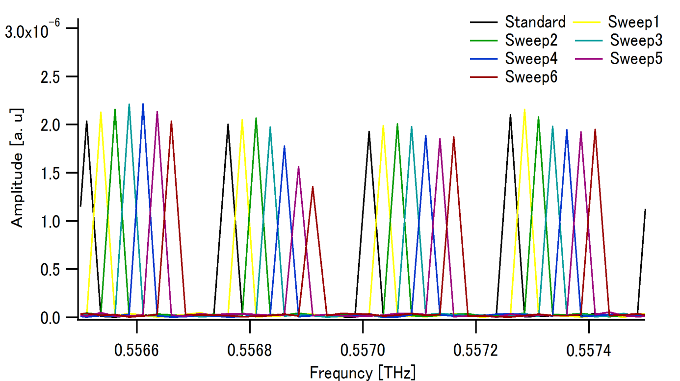
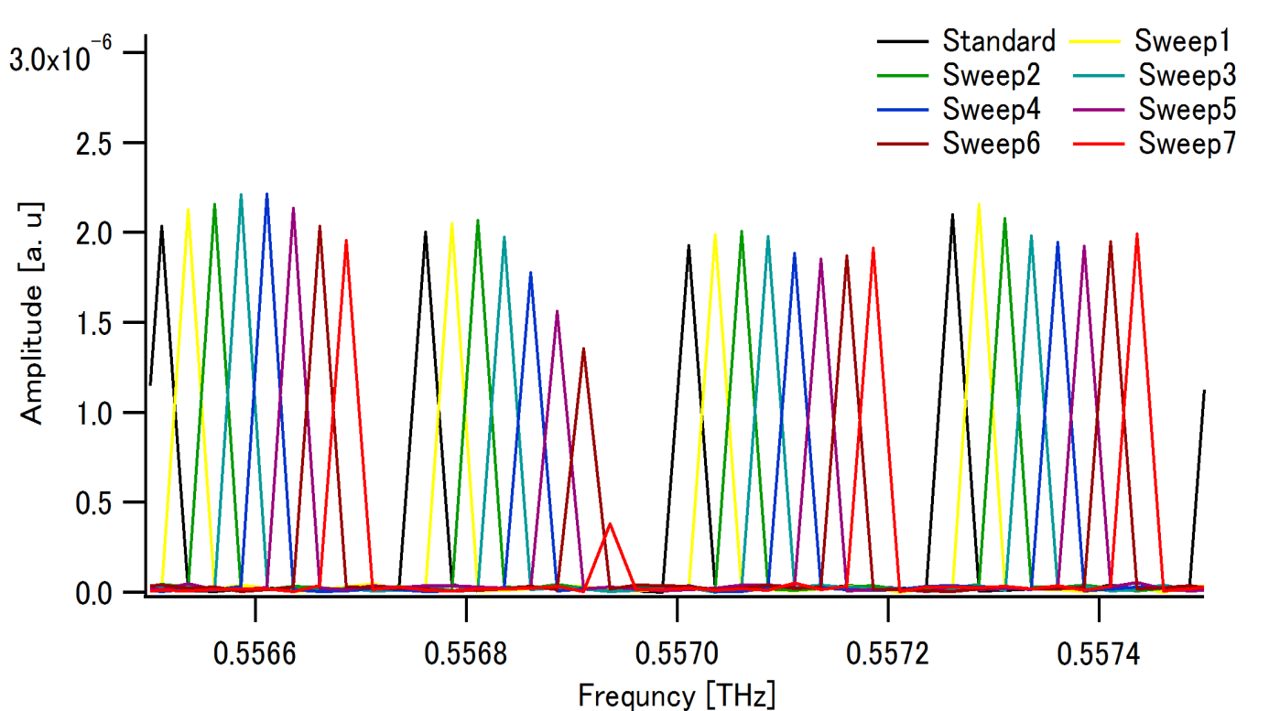
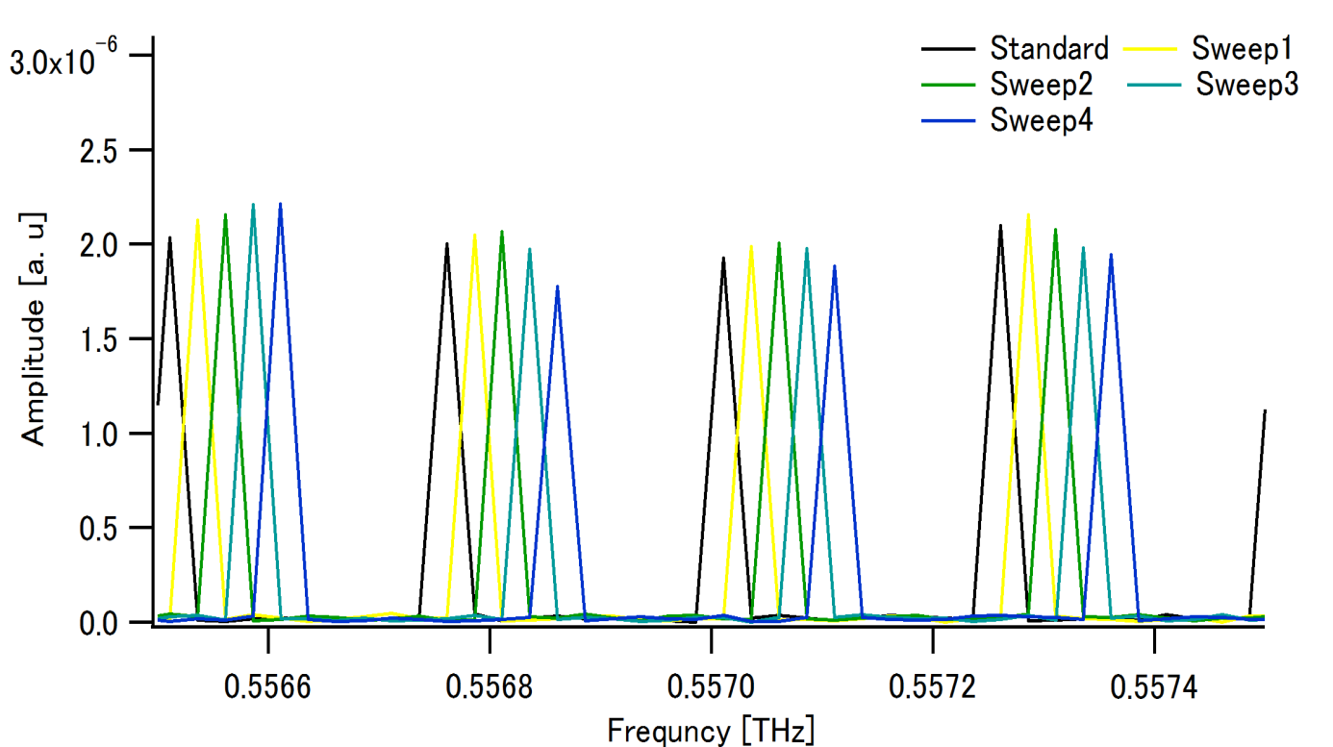
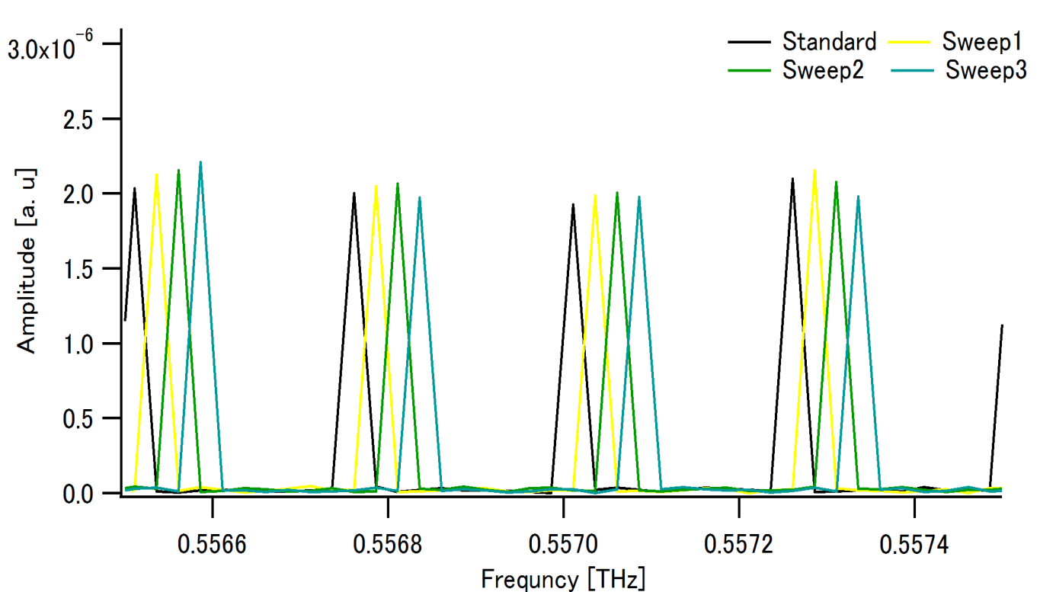
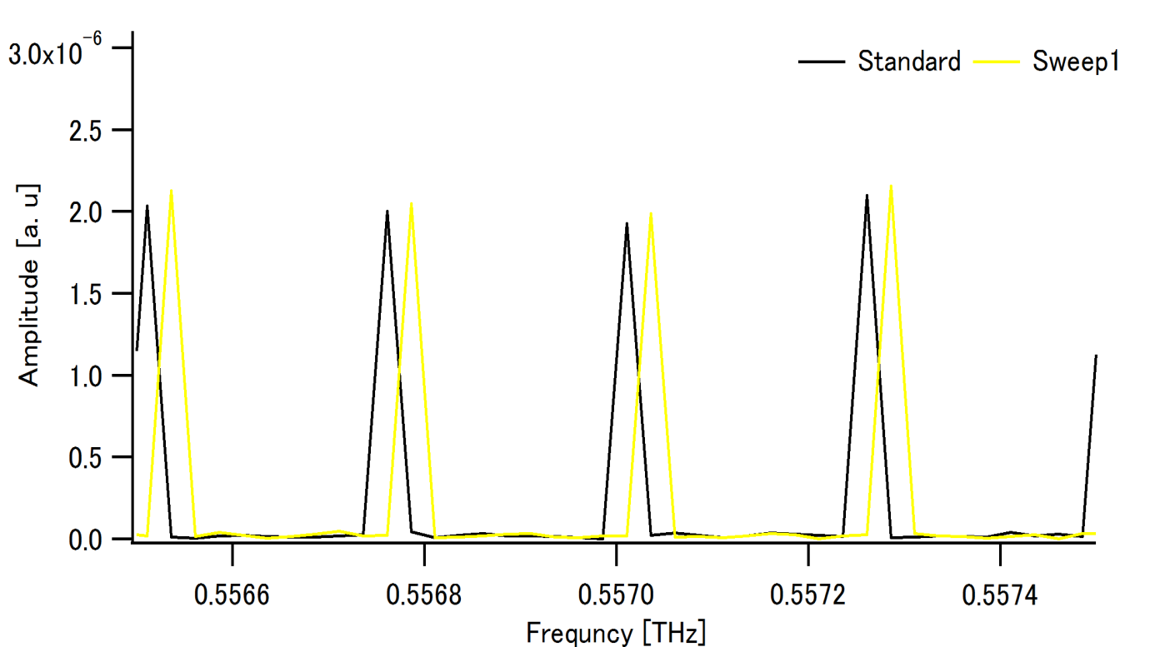
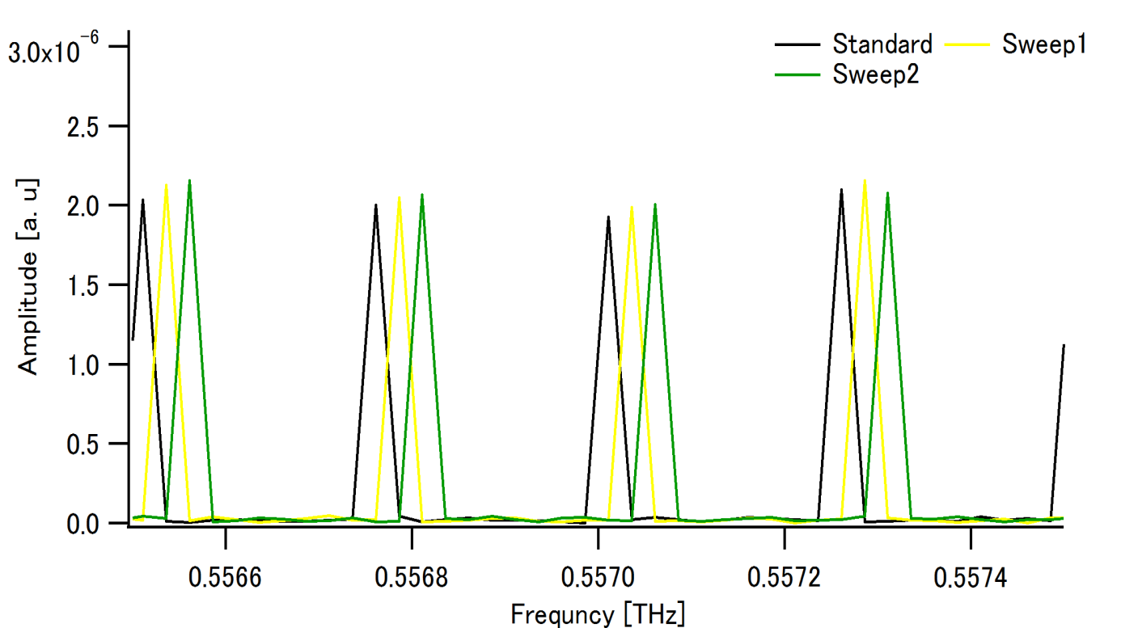
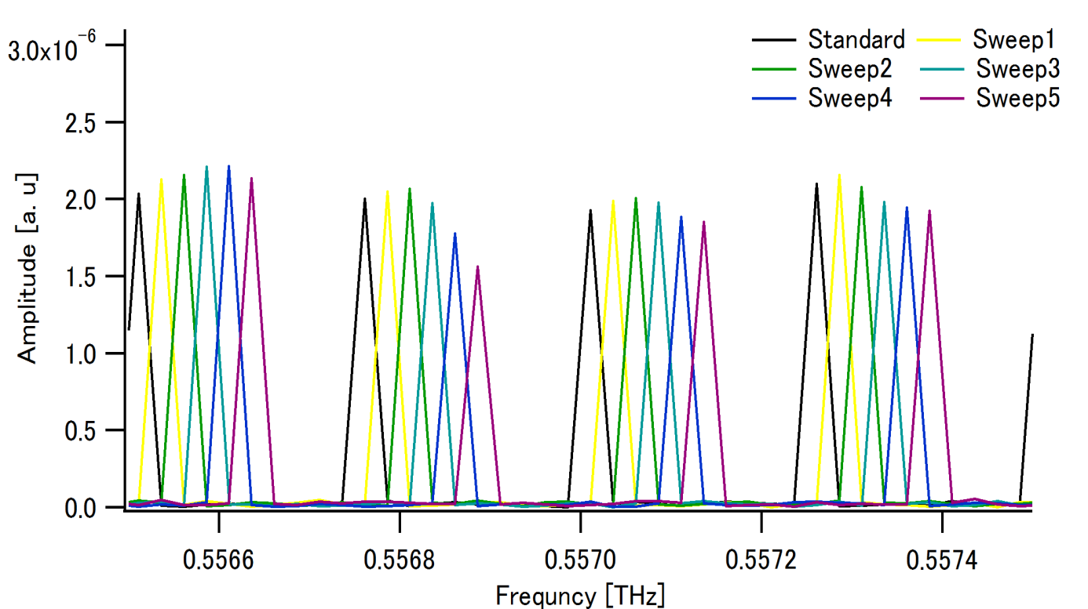
Spectroscopy of low-pressure water vapor
Rotational transition 1₁₀ ← 1₀₁ : 0.5569360THz@NASA database
(Pressure broadening linewidth = 23 MHz @H₂O:10Pa&N₂:320Pa)
Absorption line of water vapor
25MHz
250MHz

Slide 11
Absorbance spectrum of acetonitrile gas
Acetonitrile (CH₃CN) :
Symmetric top molecule, rotational constant B = 9.2 GHz
Manifold of rotational transitions regularly spaced by 2B
Total pressure: 40Pa
Linewidth of comb mode: 25MHz
10 times sweep
18.4GHz

Slide 12
Absorbance spectrum of acetonitrile gas
Expanded around 640GHz
Multi-peak fitting by Lorentzian function (red line)
12MHz
1
0
10
9
8
7
6
5
4
3
2
J=35-34
The linewidth and incremental step of the comb modes should be further reduced

Slide 13
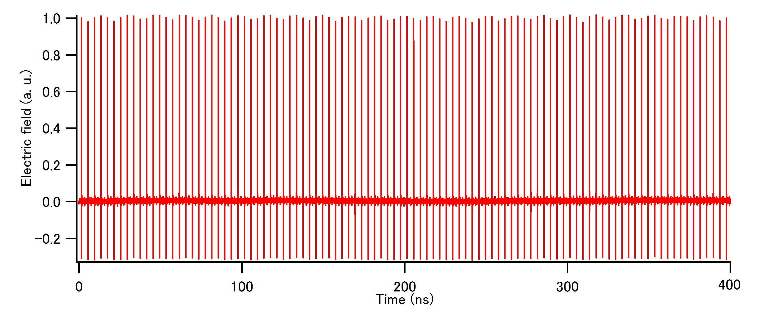
Mechanical time-delay scanning by 60 meter
Linewidth of comb mode: 2.5MHz
15 times sweep

Slide 14
Absorbance spectrum of acetonitrile gas
Expended absorbance spectrum around 643GHz
Multi-peak fitting by Lorentzian function (red line)
K
1
0
J=35-34
Discrepancy = 0.578MHz
Discrepancy = 0.502MHz
Corresponding to a mean spectral accuracy of 10⁻⁷

Slide 15
Conclusions
• Resolution = linewidth of comb mode (2.5MHz)
Spectral accuracy: 10 ⁻⁷
Precise analysis of VOC gases
Future work
Analysis of VOC gases mixed with aerosols, smoke.

Slide 16
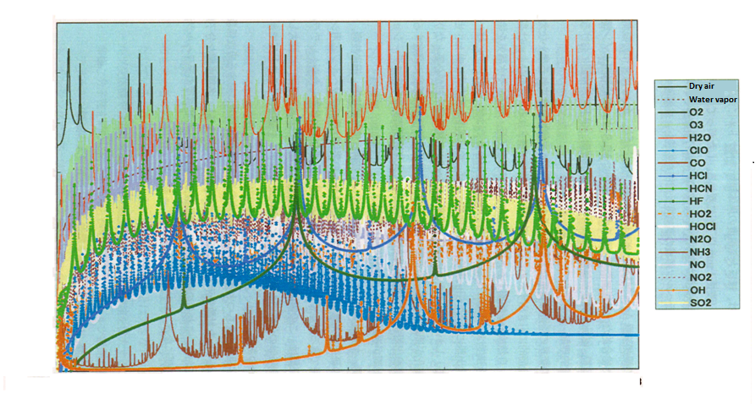
The THz spectrum of atmospheric gases
Many absorption line of atmospheric gases are concentrated in THz region

Slide 17
Pressure broadening characteristics of the rotational transition 1₁₀ ←1₀₁ in water vapor
THz Comb (interval=250MHz)
Spectrally interleaved THz comb
Expected curve
Comb mode linewidth

Slide 18
Comparison of CH₃CN absorbance peak positions with NASA database
Line number (K) | NASA database (THz) | Experimental value (THz) | Discrepancy (MHz)
10 | 0.642049 | 0.642046 | 3
9 | 0.642280 | 0.642276 | 4
8 | 0.642487 | 0.642488 | 1
7 | 0.642670 | 0.642664 | 6
6 | 0.642829 | 0.642821 | 8
5 | 0.642963 | 0.642961 | 2
4 | 0.643074 | 0.643068 | 6
3 | 0.643159 | 0.643150 | 9
2 | 0.643220 | 0.643216 | 4
1 | 0.643257 | 0.643257 | <1
0 | 0.643269 | 0.643269 | <1
Linwidth=
25MHz
Linwidth=
2.5MHz
Corresponding to a mean spectral accuracy of 8.39×10⁻⁷

Slide 20
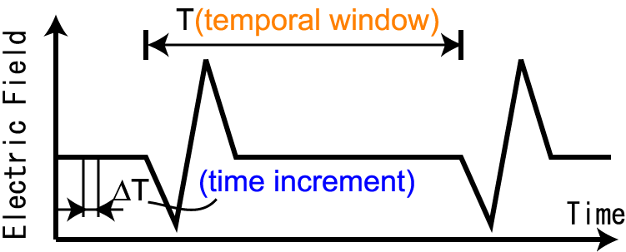
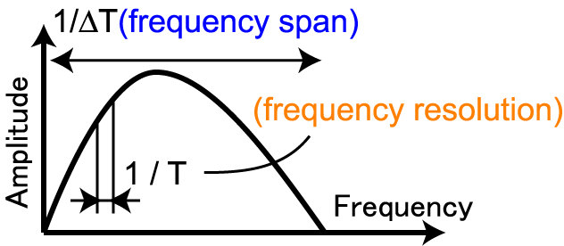
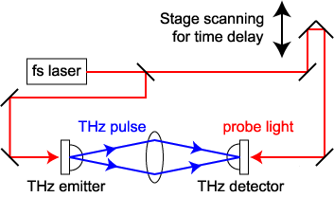
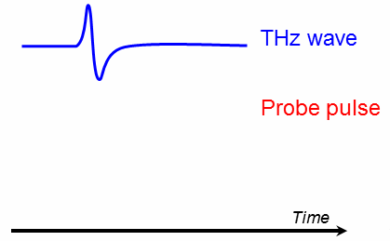
Terahertz time-domain spectroscopy
F.T.
Temporal waveform
THz spectrum
Spectral resolution
= 1/Time window
Spectral accuracy
$∝$ Time-delay scanning
Pump–probe
measurement
Determined by mechanical time delay stage
Time delay

Slide 21
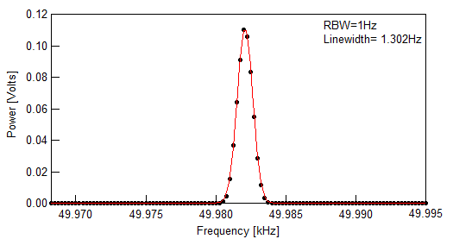
Relative linewidth of THz comb
1.302Hz

Slide 22
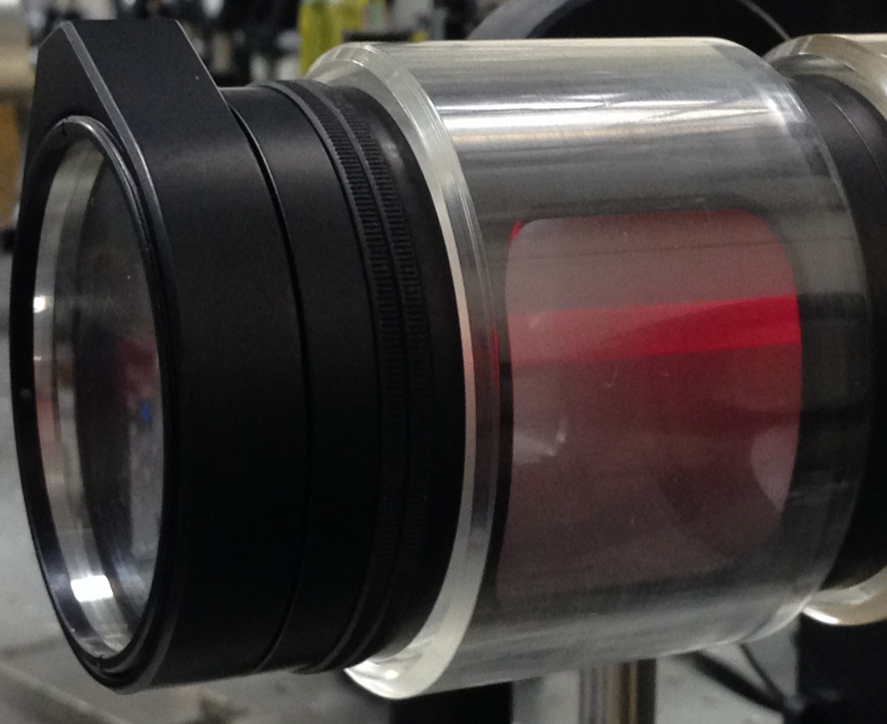
Comparison of visible laser & THz pulse
Visible laser :632nm

Slide 23
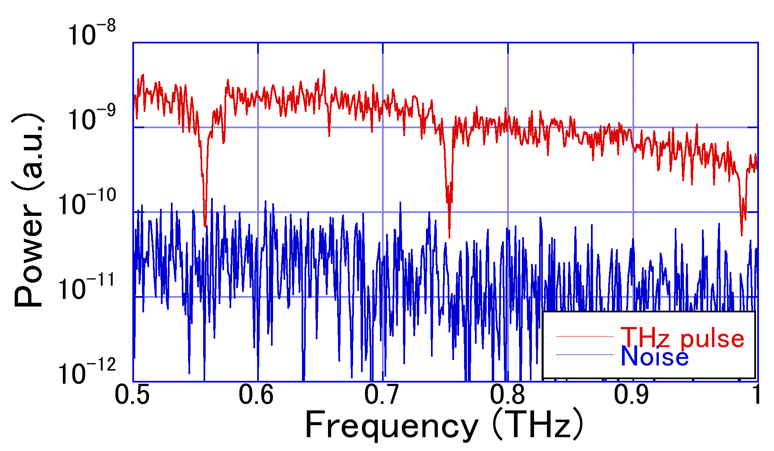
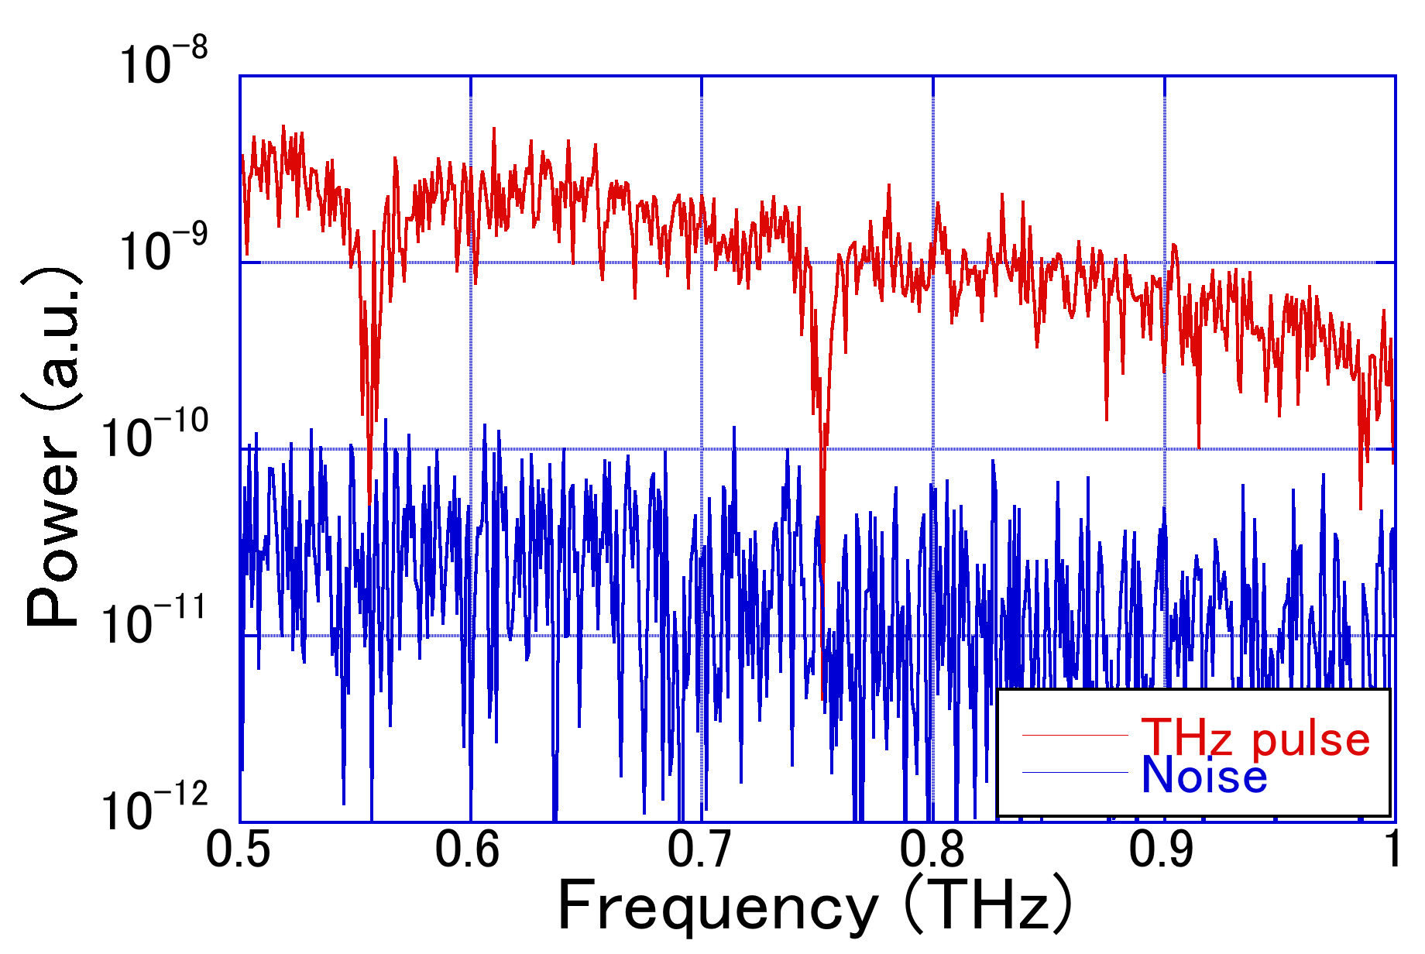
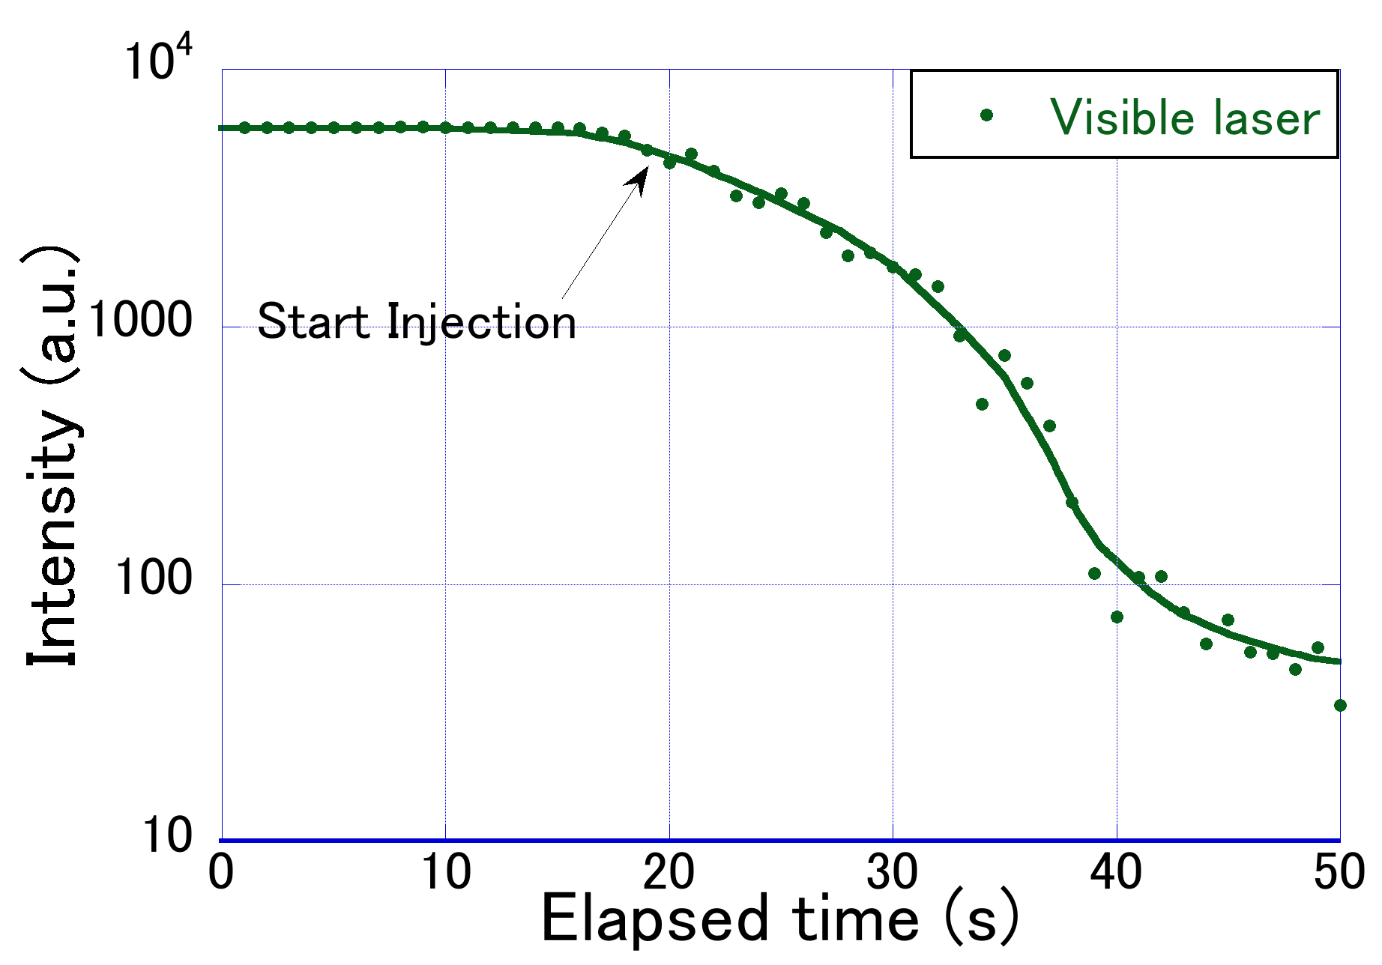
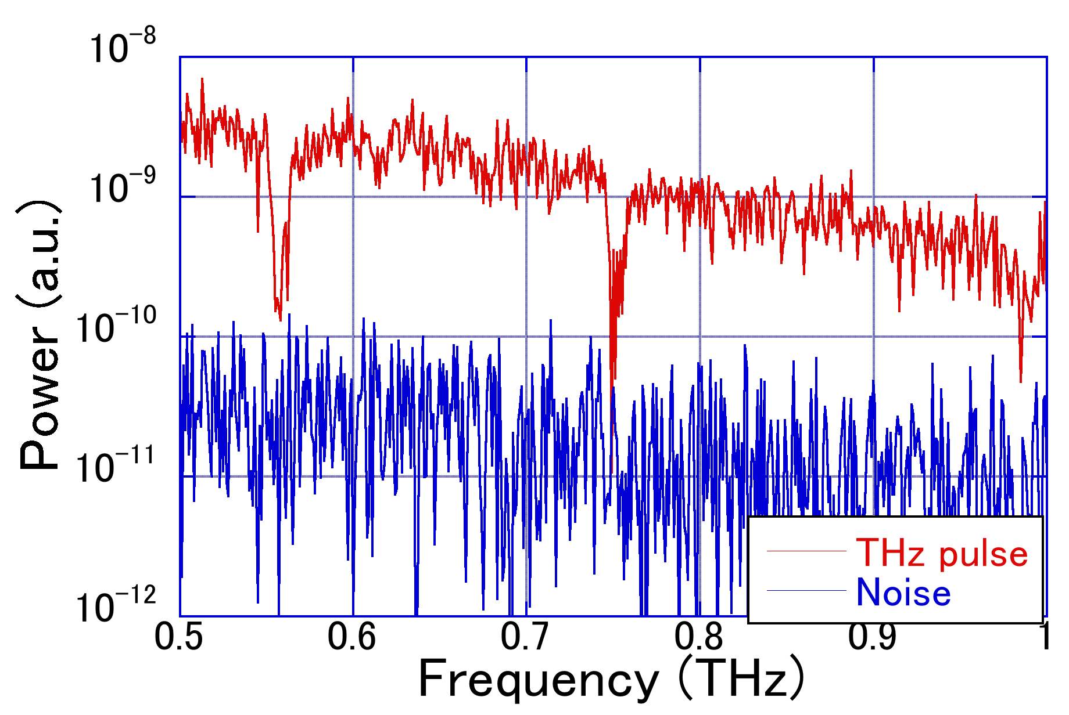
Comparison of visible laser & THz pulse
Amplitude (a. u.)
Amplitude (a. u.)
Amplitude (a. u.)

Slide 24
Low-pressure
Absorbance
Aera $∝$ Concentration
Absorbance
Frequency
Linewidth $∝$ Pressure
Absorbance
High-pressure
Frequency
Frequency

Slide 25
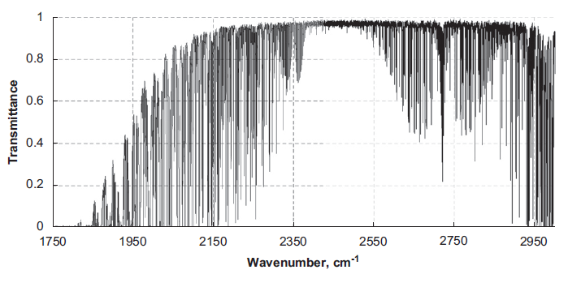
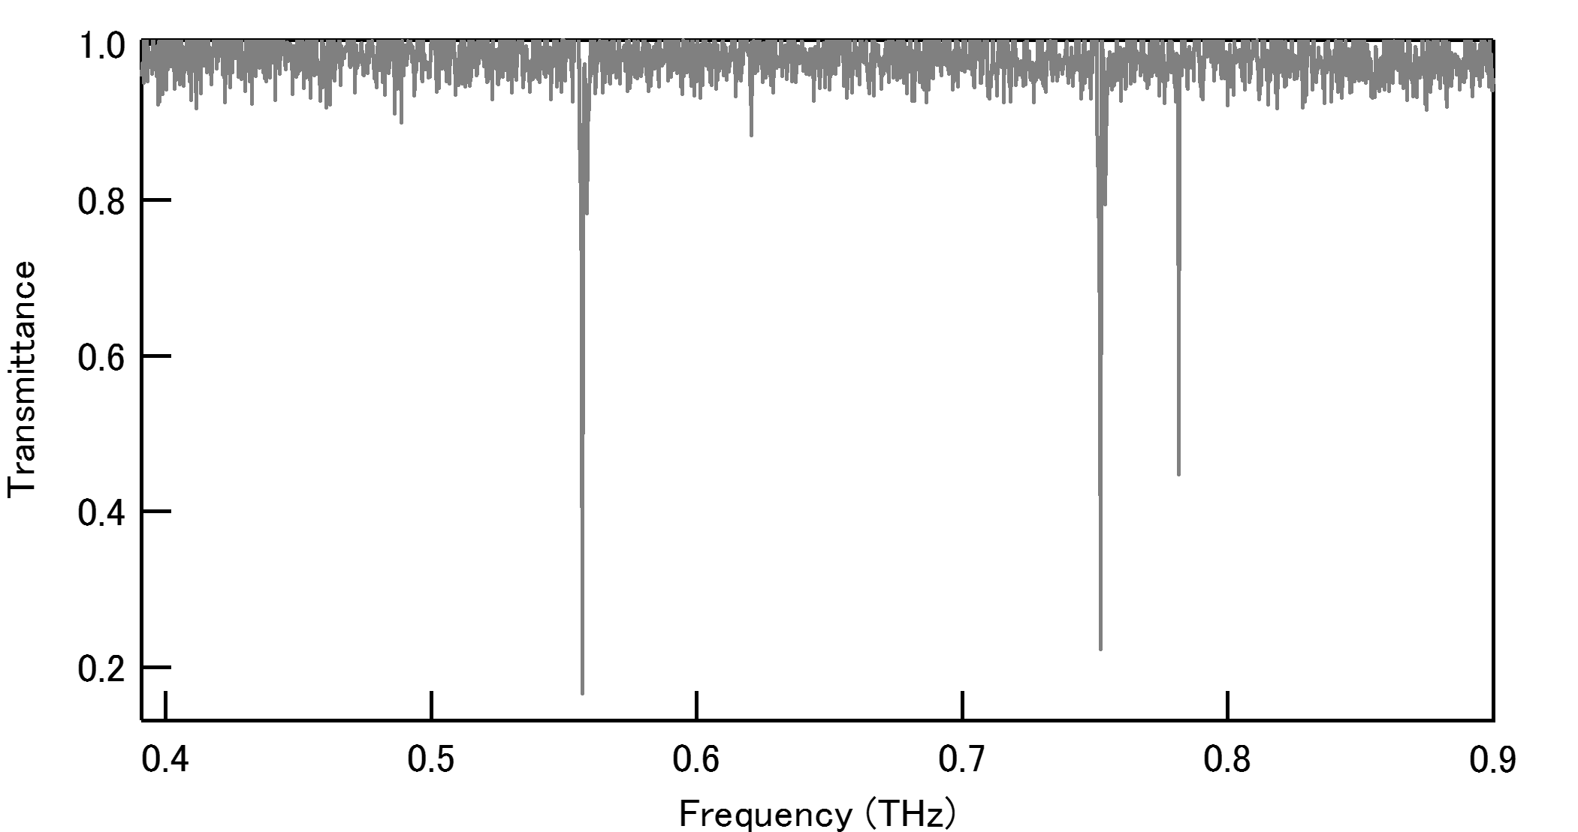
Transmittance spectrum of Water vapor
Infrared spectroscopy
THz spectroscopy
Ref) Yu. I. Baranov, et al., J. Quant. Spectrosc. Radiat. Transfer. 109, 2291 (2008)
$$∆ν=\frac{v}{c}\sqrt{\frac{2kTln2}{m}}$$
Doppler linewidth:

