Slide 1
1st Journal seminar
Technique of fiber-based microscope
2014 6/4 Atsuta

Slide 2
Traditional diagnosis
Definitive diagnosis in the early stage is thus vital for improving the quality of life
→ Physical biopsy diagnosis was regarded
as the standard for early diagnosis
http://www.momohime-medical.com/
However, the invasive sampling of physical biopsy takes risks of trauma, infection, hematoma, and hemorrhage

Slide 3
Nonlinear optical microscopy
For clinical or animal studies…
A standard laboratory microscopy with inflexible free-space light delivery limits its applications especially
A flexible fiber-optical probe is versatile to deliver
light into tight space where free-space delivery is difficult

Slide 4
①Shih-Hsuan Chia, Che-Hang Yu, Chih-Han Lin, Nai-Chia Cheng, Tzu-Ming Liu, Ming-Che Chan, I-Hsiu Chen, and Chi-Kuang Sun, “Miniaturized video-rate epi-third-harmonic-generation fiber-microscope” Vol. 18, No. 16/OPTICS EXPRESS 17382(2010)
②Hongchun Bao and Min Gu, “A 0.4-mm-diameter probe for nonlinear optical imaging” Vol. 17, No. 12/OPTICS EXPRESS 10098(2009)
③Yuying Zhanga, Meredith L.Akinsb,c, Kartikeya Muraria, Jiefeng Xia, Ming-Jun Lid, Katherine Luby-Phelpse, Mala Mahendroob,c,2, and Xingde L, “A compact fiber-optic SHG scanning endomicroscope and its application to visualize cervical remodeling during pregnancy” pnas1121495109(2012)

Slide 5
① “Miniaturized video-rate epi-third-harmonic-generation fiber-microscope”
Introduction
The mortality from malignancies is still high despite many efforts in the past. → We need definitive diagnosis in the early stage
Harmonic generation microscopy can…
・provide better optical sectioning capability
・be considered as a truly noninvasive modality
・provide in vivo morphological images
→with information including sizes, shapes, distributions of basal
cells, high penetrability of ~300μm, a sub-μm spatial resolution
◎ Besides, the movement of red blood cells in capillaries can also
be clearly resolved in vivo by epi-THG microscopy.

Slide 6
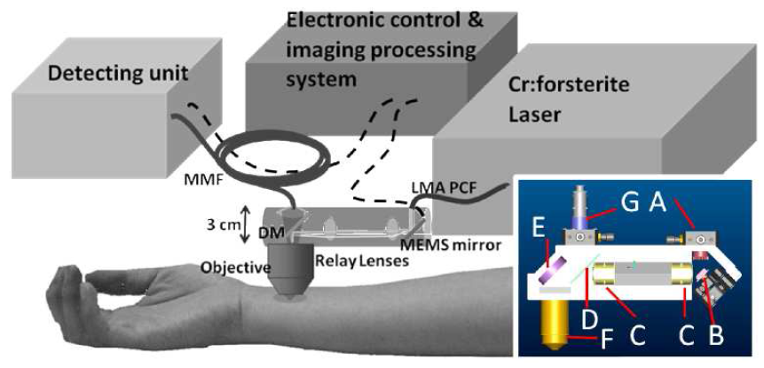
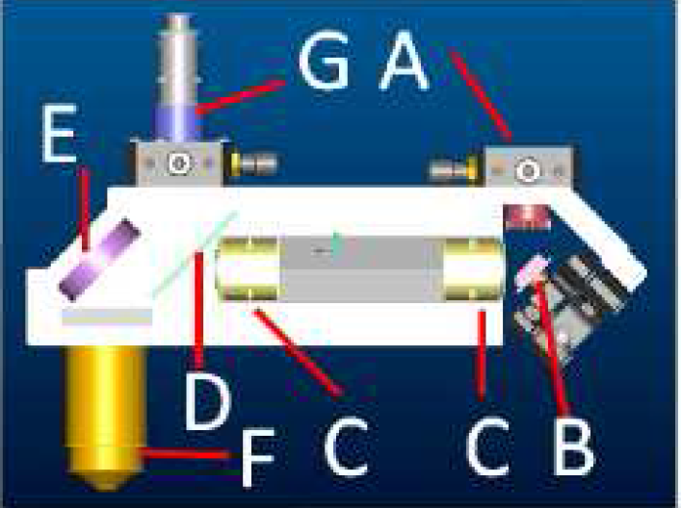
Setup:
is combined the fiber-based light source, the MEMS mirror, and the miniaturized probe
the MEMS mirror and
the designed relay-lens set
(anti-reflection coated around the wavelength of 1250 nm)
scanning beam was focused on the sample by a 1.2NA 60X water immersion objective
the generated SHG and THG signals coupled into a multimode fiber
the whole module (including the mounting) was designed to be within 3cm
compact enough for in vivo hand-held human skin observation !

Slide 7
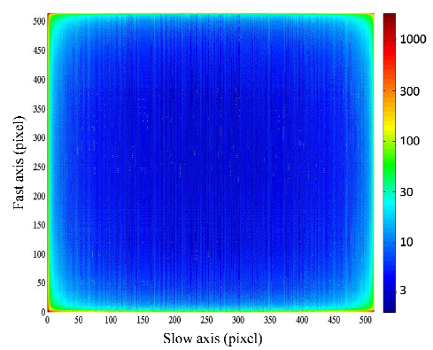
MEMS scanning scheme
scanning frequencies is
Fx=16.41 kHz and fy=1.71 kHz
laser beam was deflected by
19 degrees in the x axis, the fast axis, and by 15 degrees in the y axis, the slow axis
512×512-pixel image
Fig. 1. The counts of sampling points per pixel in a frame trigger period.

Slide 8
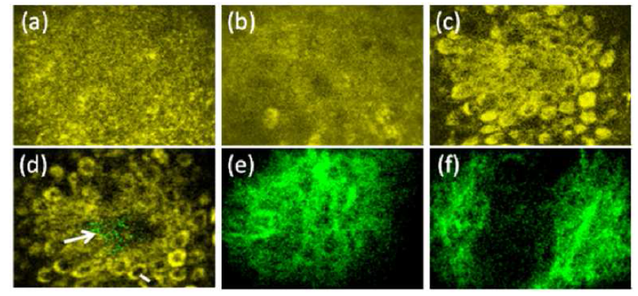
In vivo optical harmonics biopsy of human skin
In vivo horizontal-sectioned epi-THG and epi-SHG images of Asian forearn skin in different layers
In the epidermis, the morphology of (a) the stratum corneum, (b) the stratum spinosum, (c) the upper section and (d) the deeper section of the stratum basale (epi-THG), (e) and (f) the collagenous distribution in the dermis (epi-SHG) Yellow: THG; Green
SHG Image size 100μm×70μm. The integration time of each image
except (b) is 0.33 second and 2 second in (b).
movie showing the in vivo blood flow with a speed of ~300 μm/s
Image size: 100μm×70μm. Scale bar: 20 μm. Actual size of the recorded movie: 512×512 pixels

Slide 9
summary
・ The first-ever miniaturized epi-THG fiber-microscope with
a submicron spatial resolution and a video frame rate was
demonstrated for in vivo optical harmonics biopsy.
・ This miniaturized system was compact enough for the least
invasive hand-held clinical use.

Slide 10
② “A 0.4-mm-diameter probe for nonlinear optical imaging”
Introduction
Single-mode fiber system exhibits a low signal level because the near infrared laser beam and the visible fluorescence signal cannot efficiently propagate through the core of the fiber.
→ This issue has been overcome by using a double-clad photonic crystal fiber (DCPCF) that has a large core is applied.
Reducing the size of probes is essential for minimizing invasion during medical procedures and reducing the risk of complications as well as costs and recovery times.

Slide 11
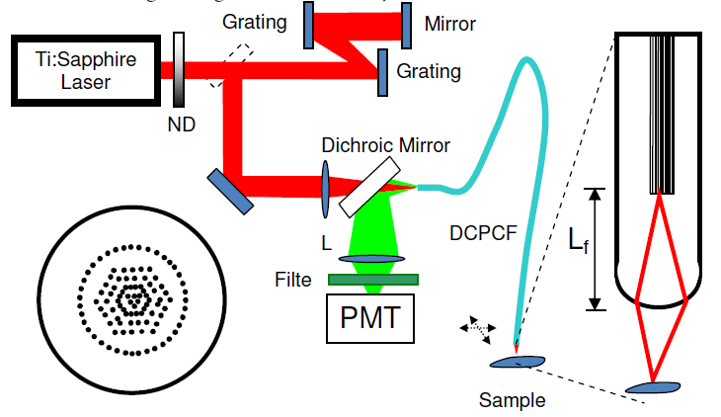
Two-photon-excited fluorescence imaging system
Light source →Ti:Sapphire laser
A DCPCF deliver 80 MHz
repetition rate pulses of 100
The excitation laser beam has a center wavelength of 800 nm with a FWHM bandwidth of 12 nm.
power on the sample is 10 mW input power to the fiber is 34 mW
→ The coupling ratio is 29%
(The coupling efficiency of
a DCPCF is 82%)
The laser beam is focused on
a sample by the lens on the tip the DCPCF
(The images were obtained by scanning the sample)

Slide 12
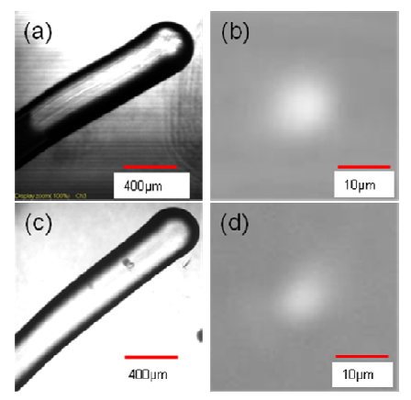
the lens on the tip the DCPCF
The electric arc discharges melt the tip of the DCPCF and then the tip is gradually developed into a semi-sphere shape.
The length $L_{f}$ and NA can be varied by changing the length of the region where the electric arc discharges are applied.
Fig. (a) Optical microscopy transmission image of the fabricated DCPCF tip with R = 200 μm and Lf = 1.4 mm. (c) Optical microscope transmission image of the fabricated DCPCF tip with R = 200 μm and Lf = 2.4 mm. (b) and (d) Light intensity image of the excitation laser focal spot using the DCPCF tip in (a) and (c).

Slide 13
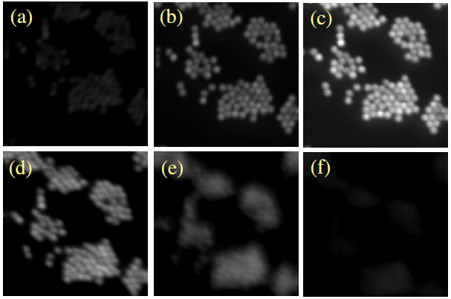
The two-photon fluorescence images
The two-photon fluorescence images of 10-μm-diameter fluorescent microspheres at different D.
[(a) D = 530 μm (b) D = 490 μm (c) D = 450 μm
(d) D = 410 μm (e) D = 370 μm (f) D = 330 μm]
(c) displays clear and bright two-photon-excited fluorescence image of the 10 μm fluorescent microspheres.
A set of two-photon-excited fluorescence images of 10-μm-diameter fluorescent microspheres.
Size of the images: 200 μm × 200 μm.

Slide 14
summary
・ a miniaturized optical fiber probe of 0.4 mm in diameter
has been demonstrated.
・ Such a light and rigid probe may be advantageous for future
in vivo nonlinear optical endoscopy

Slide 15
③ “A compact fiber-optic SHG scanning endomicroscope and its
application to visualize cervical remodeling during pregnancy”
Introduction
Appropriate remodeling of the cervix during gestation is an essential component of the birth process.
Collagen is the main structural protein in the cervix
→ Observe how to change Collagen in the cervix
Preterm birth (PTB) 12.7% (PTB in 50% of cases remains elusive) of all births in the United States
→ Observe using Compact SHG Endomicroscope.

Slide 16
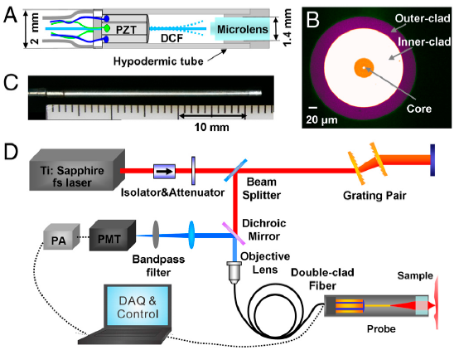
Compact SHG Endomicroscope
probe consists of three main parts:
a four-quadrant PZT tube to
actuate a fiber cantilever
(ii) a single piece of DCF running through and glued to the end of the PZT tube to serve as a cantilever and perform fast two-dimensional beam scanning
(iii) a miniature objective lens at the distal end of the probe to focus the excitation beam and collect the SHG signal.

Slide 17
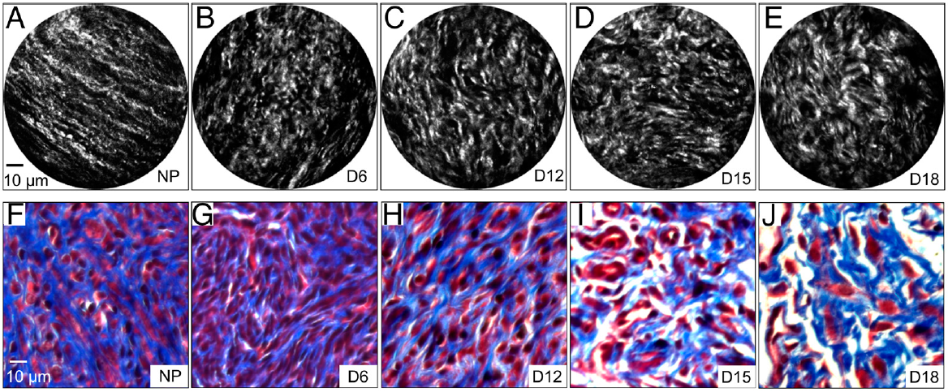
Analysis of Collagen Changes During Pregnancy @ ex vivo
SHG microscopy has previously shown that there is a rogressive increase in SHG intensity from early to late pregnancy.
Sample : nonpregnant(NP) mice and mice at days 6, 12, 15, 18 of pregnancy
Collagen fibers were highly aligned, thin, and relatively straight in the NP cervix and in early pregnancy (e.g., at day 6 of gestation).
SHG endomicroscopy images of cervical tissues sections from nonpregnant (NP) (A) and pregnant mice at gestation days 6 (B), 12
(F,G,H) are microscopic images of trichrome stained sample
Blue : collagen, pink : keratin and cytoplasm

Slide 18
Analysis of Collagen Changes During Pregnancy
The collagen fibers gradually became more curved and thicker in appearance in the later stages of pregnancy.
Fig. shows that the progressive changes in morphology of collagen in the SHG images
(Fig. A–E) correlate generally with images of trichrome stained cervical tissue sections (Fig. F–J) at each stage of pregnancy and highlights the power of SHG endomicroscopy to reveal fine details of collagen matrix architecture.
(C), 15 (D), and 18 (E)
(I,J) Blue : collagen, pink : keratin and cytoplasm

Slide 19
summary
・We have demonstrated the development of a compact
fiber-optic SHG endomicroscope
・Compared to MEMS-based probes the current probe configuration does not involve beam folding optics and thus allows for an overall compact probe size.
・Application of our SHG endomicroscopy technology will help
women at risk for PTB

Slide 20
That’s all.
Thank you for your attention.

