Slide 1
H26 journal seminar Current topic of Nonlinear optical microscopy
5/20 Hase

Slide 2
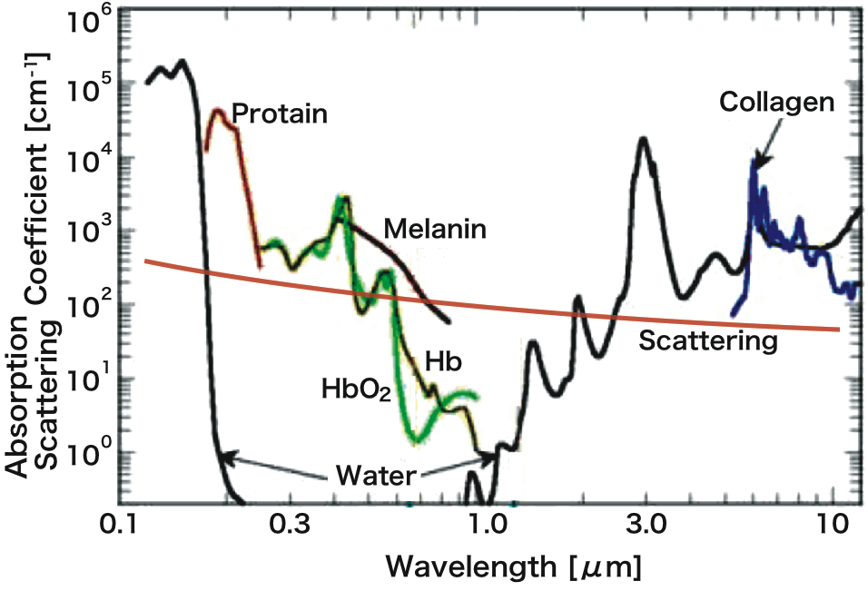
Nonlinear optical microscopy
interaction region
attenuation coefficient in biological tissue
one photon
two photon
NIR
visible
CW Laser
NIR
Pulse Laser
Ref) W.R.Zipfel, et al. Nature Bio. 21,1369 (2003)
minimally invasive，high spatial resolution,
3D imaging, high penetration depth
Notes:
近年，生体組織のイメージングツールとして，非線形光学顕微鏡が注目されております．本手法では非線形光学効果を利用しますので，光子密度の高い焦点近傍でのみ試料と作用します．また，生体組織内での吸収，散乱が小さい波長域に位置する近赤外光を光源に利用しております．そのため〜を持っております．

Slide 3
①Demirhan Kobat, Nicholas G. Horton, and Chris Xu, “In vivo two-photon microscopy to 1.6-mm depth in mouse cortex”, Journal of Biomedical Optics 16, 106014 (2011).
②Nicholas G. Horton, Ke Wang, Demirhan Kobat, Catharine G. Clark, Frank W. Wise, Chris B. Schaffer and Chris Xu, “In vivo three-photon microscopy of subcortical structures within an intact mouse brain”. Nature Photonics 20, 1 (2013).
③Adrian F. Pegoraro, Aaron D. Slepkov, Andrew Ridsdale, Douglas J. Moffatt and Albert Stolow, “Hyperspectral multimodal CARS microscopy in the fingerprint region”. Journal of Biophotonics 7, 49 (2014).

Slide 4
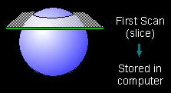
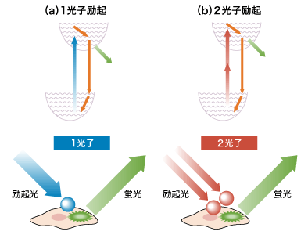
①In vivo two-photon microscopy to 1.6-mm depth in mouse cortex
Deep tissue imaging
mechanical slice▶︎ ○ high resolution × 3D
optical slice (laser scanning)
slice ▶
optical slice ▶︎ ○ 3D × penetration depth
Problem
attenuation
Rayleigh scattering (∝ )
Absorption (water)
attenuation coefficient in biological tissue
This paper
NIR
・Two-photon microscopy ▶︎ longer wavelength

Slide 5
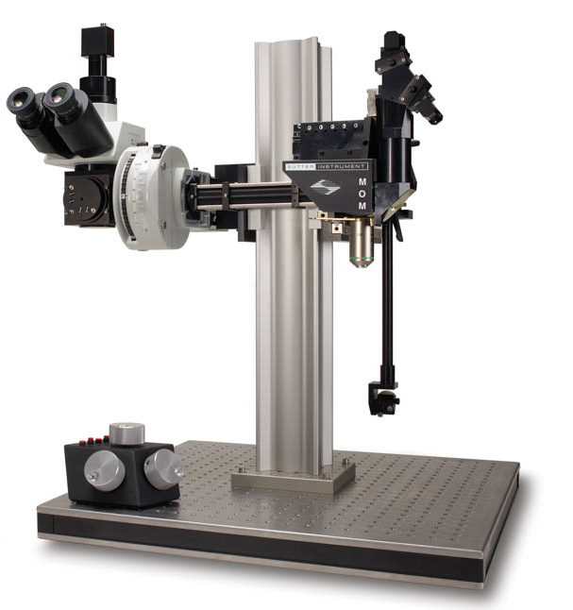
Setup &Sample
for 3D sectioning
1280 nm
80MHz
140 fs
Sample
Ti:S laser
OPO
・adult (10 to 12 weeks old) male FVB/N mice.
・Animals were anesthetized using isoflurane
for surgery and imaging. (4% in O2 for
induction, 1.5% to 2% in O2).
・Body temperature was maintained with a
feedback-controlled heat blanket.
・After the skull was exposed and cleaned
with ethanol and ferric chloride.
・A 4-mm diameter craniotomy was centered
at the Bregma．
・A 5-mm diameter glass coverslip was used
to seal the craniotomy.
・100 μl of 10 kDa Alexa680-Dextran
(Invitrogen, dissolved at 5% w/v in saline)
was retro-orbitally injected to label the
vasculature.
movable objective microscope head
PMT
raster scan unit
dichroic
mirror
water immersion
NA= 0.95
WD= 2 mm

Slide 6
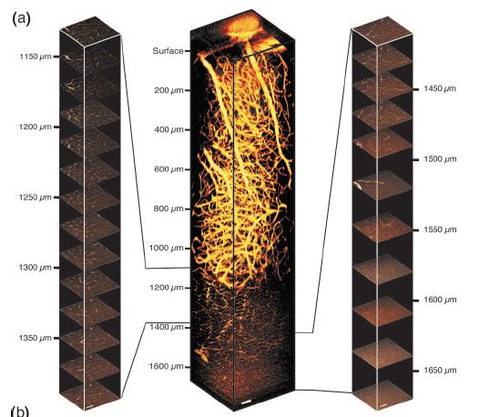
Two photon fluorescence images of cortical vasculature in a mouse brain
Scale bars are 50 μm

Slide 7
Two photon fluorescence images of cortical vasculature in a mouse brain
・235 x-y frames from 60 μm above the
cortical surface to 1110 μm below are
taken at a depth increment of 5 μm.
・The image size of 512×512 pixels, with 1 fps.
・The depth increments in the stack are
20 μm from 1110 to 1490 μm and 30 μm
from 1490 to 1670 μm. ▶︎To keep the total
imaging time at a practical limit while
covering all the available depths.
・For the top 0.7-mm imaging depth, the
excitation powers were adjusted so that
approximately the same signal level (SNR) ,
starting with 20 mW for the surface.
・At the imaging depths beyond 0.7 mm,
120 mW average power at the surface
of the brain．
8 frame
16
32
224

Slide 8
Intensity line profiles across lateral blood vessels are used to characterize the SBR and resolution
・resolution
theoretical value▶︎0.51 μm in the lateral dimension for a 0.95-NA water immersion
lens and 1280-nm excitation
smallest blood vessels ▶︎2 to 3 μm in diameter
no loss of resolution in the lateral dimension is observed in this experiment.
・penetration depth
The SBR decreases with depth and reaches the practical limit of 1 at approximately 1.5-mm depth.

Slide 9
summry
This paper demonstrates in vivo deep tissue TPM of a mouse brain using 1280-nm excitation.
A record imaging depth of 1.6mmin a mouse cortex is achieved.

Slide 10
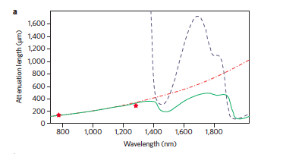
②In vivo three-photon microscopy of subcortical structures within an intact mouse brain
・Wavelength-dependent attenuation length
1700 nm
blue dashed line：the absorption
length of water
red dashed-dotted line：scattering
length of mouse brain cortex
green solid line:combined effective
attenuation length
This paper
Three-photon microscopy at the 1,700 nm
・longer wavelengh▶︎reducing the attenuation of the excitation light.
567 nm
1134 nm
1700 nm
・3PE dramatically reduces the out-of-focus background in regions
far from the focal plane▶︎improving the SBR
・3PE allows a wide variety of existing fluorescent dyes, fluorescent
proteins to be excited at the 1,700 nm spectral window.

Slide 11
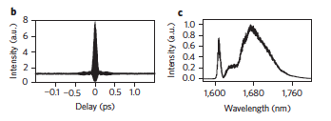
setup
1 MHz
1550 nm
360 fs
1675 nm
65 fs
67 nJ
fiber laser
photonic crystal rod
movable objective microscope head
PMT
raster scan unit
dichroic
mirror
water immersion
NA= 0.95
WD= 2 mm
〜100 fs

Slide 12
In vivo 3PM images of Texas-Red–dextran labelled mouse brainvasculature.
・1,400 μm-deep stackt，aken with
4 μm depth increments
・at the surface of the brain in our experiments is
3 mW▶︎full power (22 mW) at 0.7 mm．
・the first 0.8 mm of imaging depth▶︎
constant frame time of 8 s (512 × 512 pixels).
・from 0.74 mm, the integration time is 16 s/frame.
0.9 mm〜 20 s/frame
・The myelinated axons in the external capsule
produce a bright third harmonic generation signal
▶︎delineating the boundaries of the external
capsule.
All scale bars, 50 μm.

Slide 13
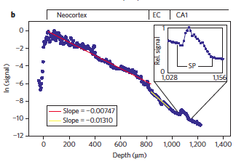
In vivo 3PM images of RFP-labelled neurons in mouse brain
・Labelled neurons in the stratum pyramidale
can be seen 1,060–1,120 μm below the
surface of the brain▶︎Visualization of this layer is
clear evidence of direct imaging of the mouse
hippocampus through an intact brain.

Slide 14
summry
3PM at the new spectral window of 1,700 nm has potential as a powerful new tool for in vivo, high-resolution, deep-tissue imaging.
By further improving the excitation source and microscope optics at 1,700 nm, authors estimate that at least one order of magnitude improvement in frame rate can be achieved.

Slide 15
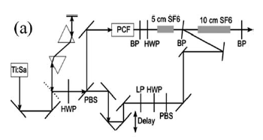
③Hyperspectral multimodal CARS microscopy in the fingerprint region
This paper
60 fs
80 MHz
Delay
t
chairp pulse

Slide 16
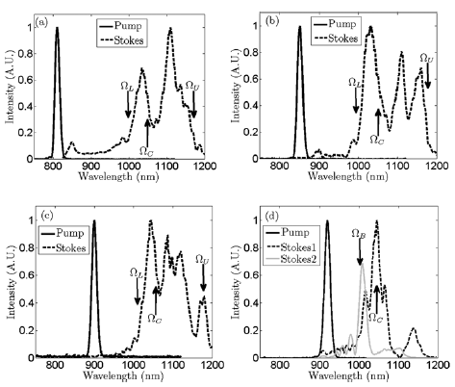
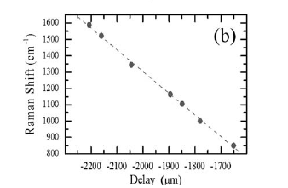
Stokes generation and CARS spectral regions accessible
Stokes2:Lowering the pump power to 40 mW
linear slope
(a) Ω_{L，}Ω_{C} ，Ω_{U}▶︎CARS frequencies 2400 cm⁻¹, 2900 cm⁻¹, and 3800 cm⁻¹ CH– and OH– vibrational regions.
(b) Ω_{L} 1650 cm⁻¹ ，Ω_{U} 3300 cm⁻1，Ωc 2240 cm⁻¹ (CN stretch) frequency
(d) Phosphate resonance around Ω_{B} 960 cm⁻¹

Slide 17
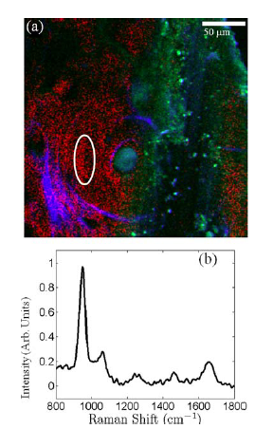
Label-free multimodal imaging of osteon in cortical bone.
to microscope
FV300 Fluoview Olympus microscope
TPEF
raster scan unit
water immersion
NA= 1.15
SHG, CARS
・533 frames, 0.89 s per frame, 800–1800 cm⁻¹
・Blue:SHG, collagen matrix swirling around an osteon
・Green:TPEF from blood
・Red：CARS, phosphate peak at 960 cm⁻¹
organic peaks between 1200 cm⁻¹ –1800 cm⁻¹
(amide III (~1275 cm⁻¹), C–H bending(~1425 cm⁻¹),
and amide I (~1650 cm⁻¹) modes)
Sample thickness is 100 μm

Slide 18
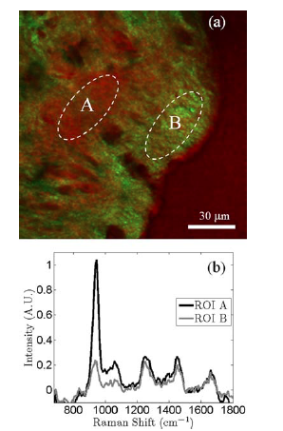
CARS and SHGin bovine rib bone.
Green:SHG, collagen
Red:CARS, Phosphate
474 frames, 1.34 s per frame, 800–1800 cm⁻¹
Regions of high collagen content (bright green, ROI B)
and lower collagen content (ROI A) are identified.
The change in mineral content is strongly anticorrelated
with the SHG measured from the same ROI.
Sample thickness is 100 μm

Slide 19
summry
This technique is sensitive to differences in phosphate concentration.
Backwards-detection should be feasible. Nonetheless, the use of this technique for monitoring osteogenesis.

Slide 20
conclusion
3PM at the new spectral window of 1,700 nm has potential as a powerful new tool for in vivo, high-resolution, deep-tissue imaging.
Multimodal NLOM imaging has potential as a powerful new tool.

