Slide 1
Spectroscopy using terahertz quantum cascade laser
journal seminar
2014/6/4 M2 Hayashi

Slide 2
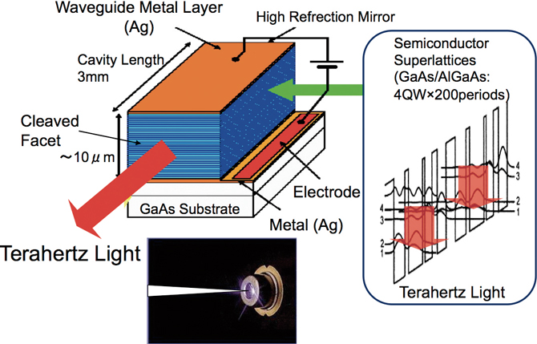
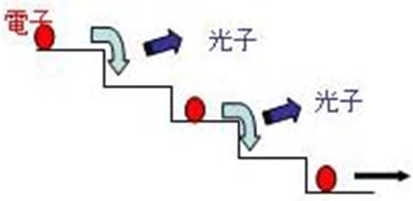
THz-QCL
Advantage
compact
high power
(several mW)
narrow linewidth
(~10kHz)
Electron-injection layer
Emitting layer
It is expected as an imaging light source and gas spectroscopy!!
Notes:
半導体中のバンド構造の制御によって, 中赤外からテラヘルツ領域の広い範囲で任意の周波数を発振可能

Slide 3
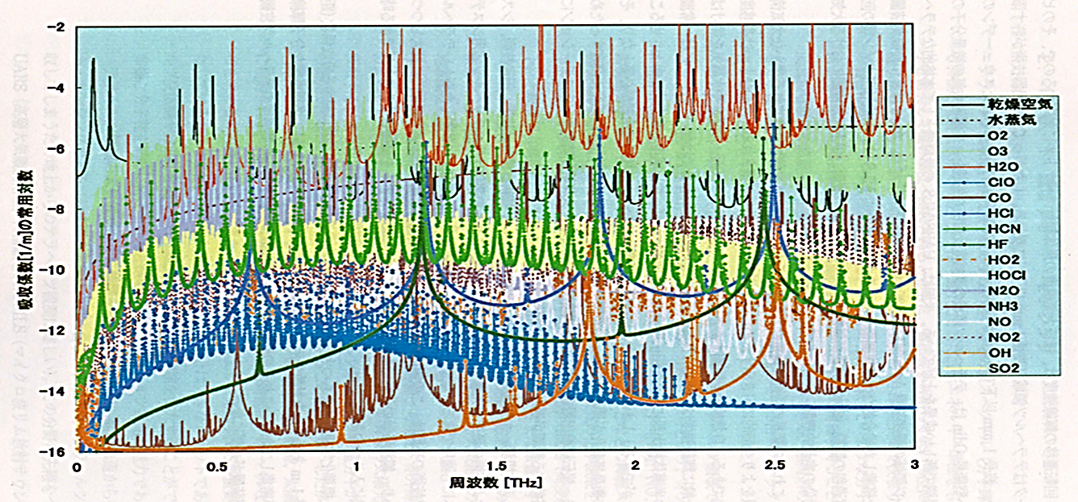
THz spectroscopy
Problem of using THz-QCL
no tuning range
free-running linewidth is several MHz

Slide 4
Y. Ren, J. N. Hovenier, R. Higgins, J. R. Gao, T. M. Klapwijk, S. C. Shi, B. Klein, T.-Y. Kao, Q. Hu, and J. L. Reno, “High-resolution heterodyne spectroscopy using a tunable quantum cascade laser around 3.5 THz”. APPLIED PHYSICS LETTERS 98, 231109 (2011)
R. Eichholz, H. Richter, S. G. Pavlov, M. Wienold, L. Schrottke, R. Hey, H. T. Grahn, and H.-W. Hubers, ” Multi-channel terahertz grating spectrometer with quantum-cascade laser and microbolometer array”. APPLIED PHYSICS LETTERS 99, 141112 (2011)
S. Bartalini, L. Consolino, P. Cancio, and P. De Natale, “Frequency-Comb-Assisted Terahertz Quantum Cascade Laser Spectroscopy”, PHYSICAL REVIEW X 4, 021006 (2014)

Slide 5
Y. Ren, J. N. Hovenier, R. Higgins, J. R. Gao, T. M. Klapwijk, S. C. Shi, B. Klein, T.-Y. Kao, Q. Hu, and J. L. Reno, ”High-resolution heterodyne spectroscopy using a tunable quantum cascade laser around 3.5 THz” APPLIED PHYSICS LETTERS 98, 231109 (2011)

Slide 6
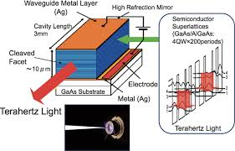
Introduction
High resolution heterodyne spectrometer
→QCL
problem
QCL no tuning range
In this letter
Using a tunable THz-QCL
Observation methanol molecular lines at 3.5THz

Slide 7
Setup
a single mode emission from 3452.0 to 3450.8 GHz by increasing the bias voltage from 13.9 to 14.9 V
a maximum output power of 0.8 mW
Notes:
上記の値は0.6GHzの分解能を持つFTSで測定した

Slide 8
Experimental and simulated methanol spectral lines
f_{THz} = 3450.232GHz
: low pressure spectrum
: high pressure spectrum
Notes:
(b)のずれは、ガスセルからの放射が原因でHEBミキサーの動作点がシフトしたことによって。
圧力の違いは、ガス圧力較正の誤差によって。
圧力拡がり特性は14.8MHz/mbar (HITRANより) で、周波数によって大きく異なる。

Slide 9
Several methanol spectra recorded at different QCL frequencies
tuned with the bias voltage of the QCL from 14.05 to 14.99V
→ excellent agreements were achieved for the entire frequency region

Slide 10
QCL emission frequency
150 MHz tuning range is shown for a temperature range from 13.2 to 17.6 K
1GHz tuning range is shown for a bias voltage range from 13.90 to 14.99V
① thermal tuning coefficient
→33 MHz/K
② electrical tuning coefficient
→ 859 MHz/V

Slide 11
Summary
A tunable high-resolution heterodyne spectrometer using 3.5THz-QCL is demonstrated.
Within the entire frequency tuning range, the measured spectra show excellent agreement with the theoretical simulations.

Slide 12
R. Eichholz, H. Richter, S. G. Pavlov, M. Wienold, L. Schrottke, R. Hey, H. T. Grahn, and H.-W. Hubers, “Multi-channel terahertz grating spectrometer with quantum-cascade laser and microbolometer array” APPLIED PHYSICS LETTERS 99, 141112 (2011)

Slide 13
Introduction
THz-QCL is very attractive radiation sources for laser-based absorption spectroscopy
emission is narrow
(less than 20 kHz)
high output powers up to several tens of mW
Multi-channel THz grating spectrometer
advantage
In this letter
Notes:
マルチモード発振するQCLを用いて

Slide 14
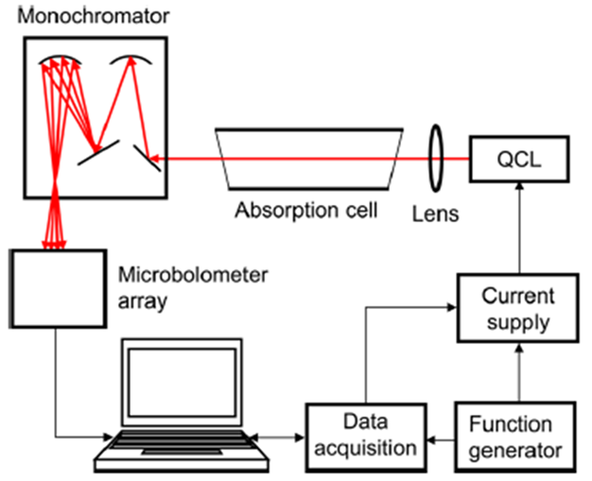
Setup
27cm
air cooled
640×480 pixels
Notes:
モノクロメーター：入口のスリット幅は3mm、出口は開けている (17mm)。
これにより、異なるモードのイメージを同時に測定できる。
the spectral resolution is approximately 10 GHz

Slide 15
The emission spectrum of the QCL
Each image contains 100×500 pixels of the full image of the microbolometer array width
emission power is about 0.1 mW
emission power is about 0.3 mW
Notes:
31GHzごとのモードで分けられている。
周波数較正はゴーレイセル検出器とモノクロメーターの標準モードで行った。
パワー較正はゴーレイセル検出器。

Slide 16
Spectrum of CH₃OH at 1 hPa
The numbers given next to each absorption line are the SNR
The poor SNR in the spectrum of mode 3 is caused by the rather small available laser power
Notes:
モードⅠ～Ⅳのパワーは0.1、0.3、<0.1、0.3mW

Slide 17
Frequency tuning of the emission modes
The straight lines are linear fits to the data points
It varies between 12 and 31 MHz/mA
The measured FWHM of the absorption lines
about 30 MHz at 3.363 THz
about 100 MHz at 3.459 THz
Notes:
周波数較正はFTSで行った。
周波数が高くなると、チューニングレートも大きくなった。

Slide 18
Summary
A broadband THz spectrometer based on a THz QCL is demonstrated
By using more sensitive detector array, SNR is improved
By using more precise reference data, it is possible to significantly improve the accuracy
Several improvements
Notes:
周波数適応範囲はモードにつき約5GHzで、全部で20GHz。

Slide 19
S. Bartalini, L. Consolino, P. Cancio, and P. De Natale, ” Frequency-Comb-Assisted Terahertz Quantum Cascade Laser Spectroscopy” PHYSICAL REVIEW X 4, 021006 (2014)

Slide 20
Introduction
THz molecular spectroscopy
THz QCL source
problem
free-running linewidth is about 1MHz
In this letter
→ using THz FCS
a reduction of QCLs frequency fluctuations down to the quantum limit
control on their absolute emission frequency

Slide 21
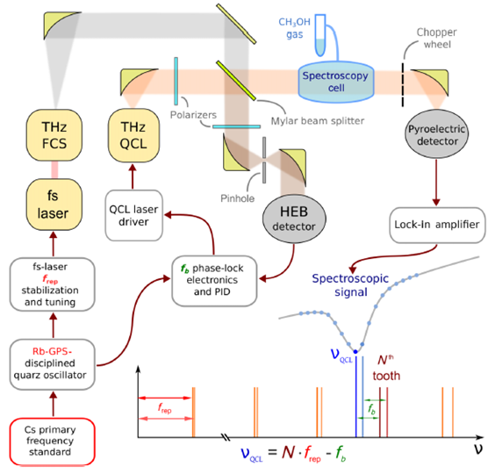
Set up
QCL2.5THz
T=~47.5K
I=430mA→P=~1mW
Ti:S laser
frep=77.5MHz

Slide 22
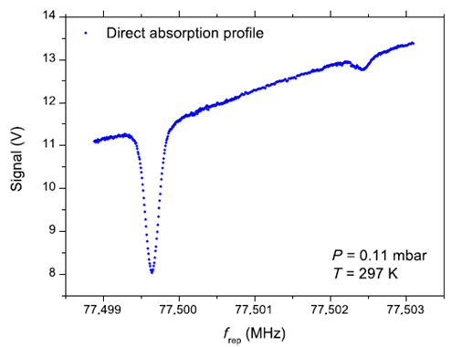
Spectroscopic signal
Tuning f_{rep} of about 5 kHz, with a 1Hz step
The 170MHz-wide frequency scan with 33kHz steps in QCL

Slide 23
(a) Experimental absorption profile (blue dots) and Voigt function fit (red line)
SNR is higher than 200
(b) Dependence of the center frequency on gas pressure
pressure shift is about 240 kHz/mbar
ν_{c0}=2553830.766(10) MHz
Notes:
フォークト関数：ローレンツ分布とガウス分布が畳み込まれた関数

Slide 24
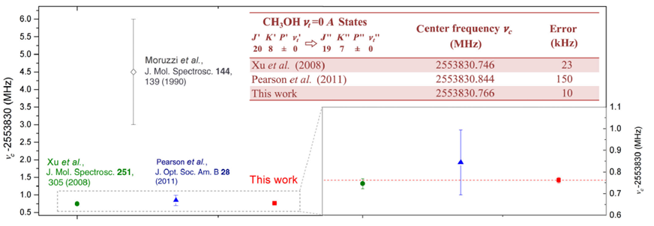
Comparison of absolute frequency with the previous measurements
relative uncertainty : 4×10⁻⁹
limited by SN ratio and Doppler-limited

Slide 25
Summary
The combination of THz comb with the frequency stability and mW-level power of the THz-QCL allows us to achieve an unprecedented precision
This first demonstration paves the way to new scenarios for a number of different fields, including novel THz-based astronomy, high-precision trace-gas sensing, and cold-molecule physics

Slide 26
Conclusion
THz-QCL is very attractive radiation sources for spectroscopy
Various applications using THz-QCL is expected

Slide 28
Determine the THz-QCL frequency

