Slide 1
Rapid and high signal to noise ratio dual frequency comb spectroscopy
2014 / 5 / 21 M2 Ichikawa

Slide 2
A. Schliesser, M. Brehm, and F. Keilmann, “Frequency-comb infrared spectrometer for rapid, remote chemical sensing”, Opt. Express 13, 9029 (2005).
F. Zhu, T. Mohamed, J. Strohaber, A. A. Kolomenskii, Th. Udem, and H. A. Schuessler, “Real-time dual frequency comb spectroscopy in the near infrared”, Appl. Phys. Lett., 102, 121116 (2013).
A. M. Zolot, F. R. Giorgetta, E. Baumann, J. W. Nicholson, I. Coddington, and N. R. Newbury, “Direct-comb molecular spectroscopy with accurate,resolved comb teeth over 43 THz”, OPTICS LETTER, 37, 638(2012).

Slide 3
Fourier transform spectroscopy
Temporal wave
Frequency spectrum
Temporal window
Spectrum resolution
Intensity
Fourier
Transform
amplitude
time
frequency
spectrum resolution＝
1 / temporal window
Accuracy ＝
Precision of time delay

Slide 4
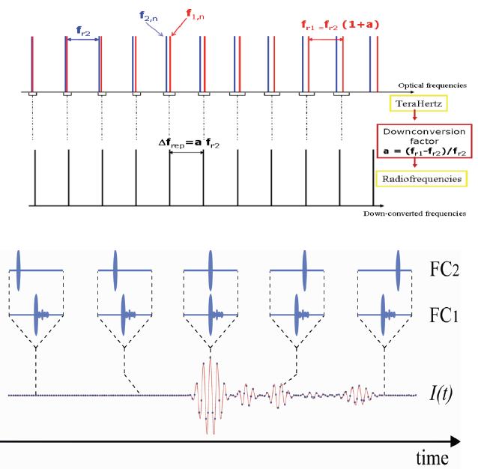
Dual frequency comb spectroscopy
fs LASER1
detector
fs LASER2
Time domain

Slide 5
Dual frequency comb spectroscopy
fs LASER1
detector
fs LASER2
Time domain
Interferogram
few ns
×$\frac{f_{rep1}}{Δf}$
few ms
few ten fs
few ten μs

Slide 6
Dual frequency comb spectroscopy
Frequency domain
・high resolution
・fast spectroscopy
・simple optical system
Δf
2Δf
3Δf
……
f_{rep1}
f_{rep2}
Down conversion factor
$$\frac{Δf}{f_{rep1}}$$
Optical frequency
Δf
Δf
2Δf
3Δf
……
Radio frequency

Slide 7
“Frequency-comb infrared spectrometer for rapid, remote chemical sensing”
Not need!!
(long waiting time)
This part is need.
In this letter, they changed repetition frequency to accelerate spectrum repetition.

Slide 8
Setup
Ti : S Laser
・Center wavelength : 800nm
・Pulse width : 10fs
・Average power : 500mW
・Repetition rate : 125.130MHz
Detector : HgCdTe detector
Emitter : GaSe crystals

Slide 9
Interferogram and spectrum
temporal window is 70μs (16μs displayed).
Δ = 29.93Hz.
Dotted : background.
Black : transmittance.
Red : conventional FTIR
(60s acquisition time and 32spectra averaged).
Resolusion : 2cm⁻¹.

Slide 10
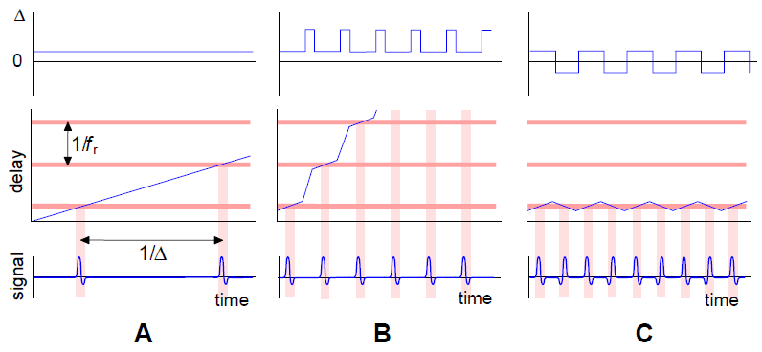
Accelerate spectrum repetition
Method C is changing the value of Δ(=f_{rep1} – f_{rep2} ) after an interferogram recording, by manipulation of one of the laser’s repetition frequency. = no waiting time

Slide 11
Accelerate spectrum repetition
Δ < 0
0 < Δ
Time delay direction
Time delay direction
Only this part is obtained without wait time.

Slide 12
Setup for remote sensing
outside
labratory
30m
NH₃
Concave mirror

Slide 13
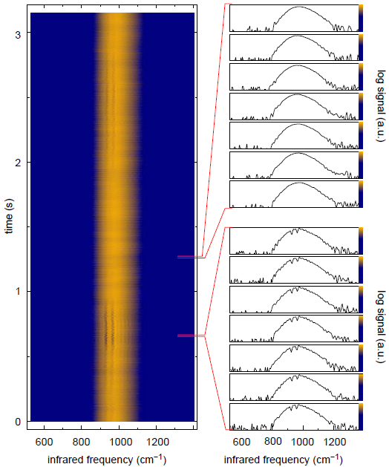
Result
3000 spectra
Record time = 3.15 s
Δ = 14 Hz to - 13.6 Hz
950 spectra / s

Slide 14
Summary
950 spectra repetition rate attained by manipulating the repetition rate of one laser.
Signal dose not depend on propagation phase or mild beam deviation by turbulence.

Slide 15
F. Zhu, T. Mohamed, J. Strohaber, A. A. Kolomenskii, Th. Udem, and H. A. Schuessler, “Real-time dual frequency comb spectroscopy in the near infrared”, Appl. Phys. Lett., 102, 121116 (2013).

Slide 16
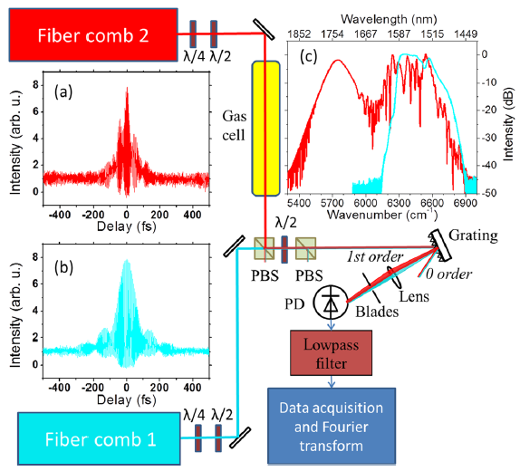
Setup
Comb1
Er-doped fiber laser
Power : 25 mW
Pulse width : 70 fs
Comb2
Er-doped fiber amplifier
Power : 500 mW
Pulse width : 90 fs
・Repetition rate : 250 MHz is locked
・CEO frequencies are not stabilized

Slide 17
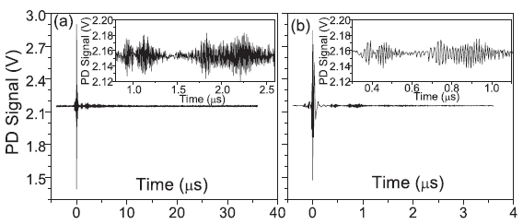
Interferogram
Δ = 1807 Hz, 40μs
Δ =4403 Hz, 4μs

Slide 18
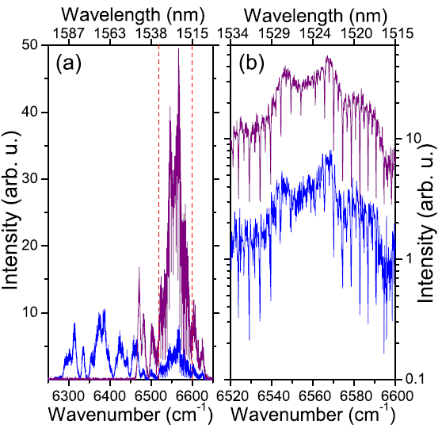
Fourier spectra
Blue : filtering between 6280 ～6625cm⁻¹
maroon : filtering between 6460 ～6625cm⁻¹
When selecting only the fingerprint spectral region, ～6 times stronger signal is obtain.

Slide 19
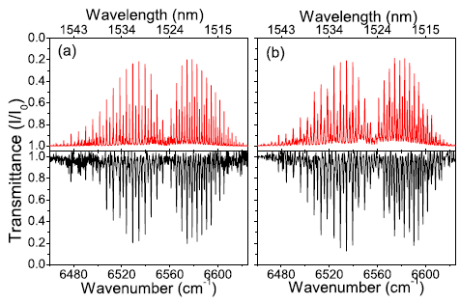
Rapid spectroscopy
40 μs interferogram,
Δ = 1807 Hz
4 μs interferogram,
Δ = 4403 Hz
$$resolution=$$
$$\frac{1}{temporal window}×\frac{f_{1}}{Δ}$$
HITRAN
HITRAN
(a) :
Resolution : 0.11 cm⁻¹
Spectral elements : 1500
Most intensity line’s SNR : 30
(b) :
Resolution : 0.47 cm⁻¹
Spectral elements : 351
Most intensity line’s SNR : 80
measurement
measurement

Slide 20
Summary
By used grating based spectral filter in a 2f-2f setup, increased the signal to noise ratio.
The difference between the repetition rates is 4403 Hz and measurement time is 4 μs.

Slide 21
A. M. Zolot, F. R. Giorgetta, E. Baumann, J. W. Nicholson, I. Coddington, and N. R. Newbury, “Direct-comb molecular spectroscopy with accurate, resolved comb teeth over 43 THz”, OPTICS LETTER, 37, 638(2012).

Slide 22
Setup

Slide 23
Setup
Signal comb, local comb
SC generated by HNLF
Power : ~300 mW
Bandwidth : ~43THz
Repetition rate : 100 MHz are locked.
CEO frequencies are stabilized.
Δ = 100 Hz

Slide 24
Multiple species spectroscopy
Black : full region of SC
SNR > 100
Phase noise : 0.01 rad
Absorbance noise : 0.02
Red : prism-filtered spectra
SNR > 3000
Phase noise : 330 μrad
Absorbance noise : 6.6*10⁻⁴

Slide 25
Evaluate the accuracy
Line centers agree to within the ~10 MHz .
Measurements data(symbols) is coincides Doppler-limiter line(solid line) .

Slide 26
Summary
Dual comb spectroscopy can probe multiple species of interest simultaneously over 43 THz.
Or select a subset of the bandwidth for increased SNR.

Slide 27
Conclusion
High signal to noise ratio dual comb spectroscopy is attained by prism-filtering or by grating filtering.
By changing the repetition rate, 950 spectra/s attained.

Slide 29
SNR of interferogram and spectra
Phase correction
Spike noise
Time-domain SNR with linear phase correction is increases as t^{1/2}.

