Slide 1
We10-4
Real-time frequency measurement of CW-THz wave based on dual THz combs
Kenta Hayashi¹, Shuko Yokoyama², Hajime Inaba³, Kaoru Minoshima⁴, and Takeshi Yasui¹
¹Univ. Tokushima, Japan ²Micro-Optics Co. Ltd, Japan
³AIST, Japan ⁴Univ. Electro-Comm., Japan
IRMMW-THz2013@Mainz (2013.9.2)

Slide 2
Background
Frequency is a fundamental physical quantity of electromagnetic wave
THz frequency metrology is required for various THz applications
Advent of practical CW-THz sources (THz-QCL, RTD, photomixing sources)
Precise frequency measurement of
CW-THz wave is required!
However, techniques of absolute frequency measurement for CW-THz wave are still immature!
Notes:
Frequency is a fundamental physical quantity of electromagnetic wave. Along with the recent progress of THz technology and science, maintenance of THz frequency metrology is required for various applications in THz region. Furthermore, the advent of practical continuous-wave THz (CW-THz) sources has increased demand for precise frequency measurement of CW-THz waves. However, techniques of absolute frequency measurement of CW-THz wave are still immature.

Slide 3
THz spectrum analyzer
OpEx 16, 13052 (2008).
OpEx 17, 17034 (2009).
Principle
Freq. domain
f_{THz}=mf_{rep} ± f_{b}
m: order of comb mode
f_{rep}: repetition frequency
f_{b}: beat frequency
Notes:
Recently, we have developed THz spectrum analyzer based on heterodyned technique with THz frequency comb. Compared with the electrical heterodyne technique, a key difference here is that the PCA is used as a heterodyne receiver. This results in high, broadband spectral sensitivity without the need for cryogenic cooling. Another difference is the use of a PC-THz comb as a local oscillator with multiple frequency covering from the sub-THz to the THz region. Right shows spectral behavior of this method. When the output light from ML fiber laser with frep is focused on the antenna gap, the PC-THz comb with frequency spacing of frep is induced in the PCA like this. And then a measured CW-THz wave at frequency of fTHz is incident onto the PCA detecto. As a result of PC mixing between the PC-THz comb and the CW-THz wave, a group of beat signals between them is generated as a PCA current in the RF region. Here, we focus on a beat signal at the lowest frequency. This fb beat signal is generated by mixing the CW-THz wave at f_{THz} and the m-order mode of the PC-THz comb at mfrep, which is the nearest in frequency to the CW-THz wave. Therefore, the f_{THz} is given by this equation. The f and fb can be easily measured with RF spectrum analyzer or frequency counter. To obtain the f_{THz}, we have to determine the m and sign of the fb.

Slide 4
Limit for practical use (1)
Shift of ML freq. f_{rep} by δf_{rep} (f_{rep} → f_{rep}+δf_{rep})
Change of beat freq. f_{b} by δf_{b} (f_{b} → f_{b}+δf_{b})
Two-step measurement of f_{rep} and f_{b}
Notes:
To determine the m, mode-locked frequency of frep is shifted by dfrep using the laser control system. This results in the change of the beat frequency fb by dfb. Since dfrep and dfb must satisfy this relationship, we can determine the m by measuring the df and dfb.
To this end, we have to make two step measurement of frep and fb before and after shifting frep.
Such two step measurement hinder the real-time measurement of m and fTHz.
This is the first limit of this method for practical use.

Slide 5
Limit for practical use (2)
f_{THz} = mf_{rep}
☞ f_{b} = 0
f_{THz} = (m+1/2)f_{rep}
☞ f_{b} = f_{rep}-f_{b}
f_{b} can not be determined correctly
Tuning range of CW-THz wave is limited by a half of frequency interval in PC-THz comb
Notes:
Next we consider that output frequency of CW-THz wave is largely changed like here. In this case, beat frequencies fb and frep-fb are also changed depending on fTHz.
If fTHz =mfrep, fb beat signal disappeared.
Also, CW-THz wave is located at the middle of two comb modes, two beat signal are overlapped. In this case, fb can not be measured correctly. Therefore, frequency change of fTHz must be limited within the range of a half frep of PC-THz comb.

Slide 6
Problems of previous studies for practical use
(1) Not real-time determination
(2) Limitation for tuning range
Present talk
Real-time determination of CW-THz wave using dual PC-THz combs
Real-time monitoring of CW-THz wave sweeping over frequency interval of PC-THz comb
Notes:
At the present talk, to overcome these two problems, we present two demonstrations.
The first demonstration is real-time determination of CW-THz wave using dual PC-THz combs.
The second demonstration is real-time monitoring of CW-THz wave sweeping over frequency interval of PC-THz comb.

Slide 7
(1) Real-time determination of fixed CW-THz wave using dual PC-THz combs
Notes:
Real time determination of absolute frequency using dual PC-THz combs

Slide 8
Use of dual PC-THz combs
fixed
fixed
Real-time
determination
Measure
fixed
fixed
f_{rep1}, f_{rep2}: fixed at
known values
f_{b1}, f_{b2}: measured
Notes:
To avoid two step measurements, we use dual PC-THz comb with different frequency spacing frep1 and frep2. frep1 and frep2 are fixed at known values by the laser control system.
Under this condition, beat frequency fb1 and fb2 are measured simultaneously using frequency counters.
Since m can be obtained from this equation, fTHz can be determined in real-time using this equation.

Slide 9
Experimental setup
Notes:
This slide shows the experimental setup of conventional THz spectrum analyzer using a single PC-THz comb. frep1 of fiber laser 1 is stabilized at a constant value using a PID control. A laser output of this stabilized fiber laser is converted into SHG light and then focused onto PCA gap. On the other hand, CW-THz wave, generated by a combination of frequency multiplier with frequency synthesizer, is incident onto PCA. This CW-THz wave has a linewidth of 1Hz and output power of 2.5mW, and its output frequency is tunable within the frequency range from 75 to 110 GHz. Finally, beat frequency fb1 between PC-THz comb and CW-THz wave is measured.
To avoid two-step measurement, we duplicated this setup using another fiber laser. In this case, frep1 and frep2 are stabilized at 100MHz and 100MHz+50Hz, respectively. Then, fb1 and fb2 are measured simultaneously. In this experiment, Rb frequency standard is used for external reference of CW-THz source, laser control, and frequency measurement.

Slide 10
Real-time measurement of f_{rep} and f_{b}
Notes:
Next shows the temporal change of frep1, frep2, fb1, and fb2 when output frequency of CW-THz wave is fluctuated. Frep1 and frep2 are constant at constant due to the laser stabilization.
On the other hand, fb1 and fb2 changed temporally due to the fluctuated output frequency of CW-THz wave.

Slide 11
Real-time determination of m and f_{THz}
Notes:
Using these values, we determined m and then obtain fTHz like here.
This graph clearly indicated that the proposed method could correctly measure the fTHz in real time.

Slide 12
Accuracy of frequency measurement
Mean precision=3.8*10⁻¹⁴
Notes:
Next, we evaluate accuracy of frequency measurement at four different frequencies.
Blue plots shows the frequency error of the measured frequency from the setting frequency and the red plot shows the corresponding accuracy.
In this demonstration, mean accuracy of 10~-14 was achieved.

Slide 13
(2) Real-time monitoring of frequency-swept CW-THz wave over frequency interval of PC-THz comb
Notes:
Real time determination of absolute frequency using dual PC-THz combs

Slide 14
Adjustment of f_{rep1} and f_{rep2} to keep f_{b1} and f_{b2} constant
f_{rep1}, f_{rep2}: measured
f_{b1}, f_{b2}: fixed at
known values
Keep
constant
f_{b1} and f_{b2} are always constant even though f_{THz} is tuned over f_{rep1} and f_{rep2}
Notes:
In the previous demonstration, fb1 and b2 are measured whereas frep1 and frep2 are kept at constant. However, in this demonstration, frep1 and frep2 are measured whereas fb1 and fb2 are fixed at constant, which is opposite to that in the previous demonstration.
In other words, frep1 and frep2 are adjusted to keep fb1 and fb2 constant.
As a result, fb1 and fb2 are always constant even though fTHz is tuned over frep1 and frep2.
This leads to no limitation for tuning range of fTHz because mfrep1 and mfrep2 can be changed over 1 THz.

Slide 15
Experimental setup
f_{b1}=1.0MHz
f_{b2}=1.1MHz
Notes:
To this end, experimental setup was somewhat modified.
Fb1 and fb2 are used to control frep1 and frep2 so that fb1 and fb2 are fixed at 1.0 MHz and 1.1 MHz.
Then, we measured adjusted frep1 and frep1 simultaneously.

Slide 16
Real-time monitoring of linearly frequency-swept CW-THz wave
100 MHz = f_{rep1}
Linear sweep
Notes:
Next shows the result of the real-time monitoring of CW-THz wave when the output frequency of CW-THz wave is swept over frep or 100 MHz.
Even such the large frequency change of CW-THz wave, the fTHz was correctly determined.

Slide 17
Summary
Real-time determination of absolute frequency of CW-THz wave using dual PC-THz combs
Real-time monitoring of CW-THz wave sweeping over frequency interval of PC-THz comb
Future works
Real-time determination of absolute frequency using a single PC-THz comb
Direct coupling of PCA with 1.5µm fiber lasers, enabling us to construct a portable system

Slide 19
Accuracy of absolute frequency measurement
Estimation of
measurement error
∆f_{rep1} = 400µHz
∆f_{beat1} = 21mHz
m = 800~1100
↓
∆f_{THz} = 341~461mHz
Mean precision=3.8*10⁻¹⁴
Notes:
To evaluate the precision of the frequency measurement, we set the output frequency of the test source between 80 and 110 GHz and measured the absolute frequency. The blue diagram line shows errors of absolute frequency. And accuracy is indicated by the red diagram line. When the measurement precision is defined as a ratio of errors to the output, the precision of 3.8×10⁻¹⁴ was achieved in this demonstration. Here, I calculated the error of absolute frequency to evaluate this result validity. The result is shown right. As the result, fluctuation of the absolute frequency became 341~461mHz and a value that was about two digits bigger than the outcome of an experiment. It is thought that in the calculation each fluctuation of the frequency is reflected as it is but in an actual measurement fluctuation of the frequency is canceled relatively.

Slide 20
Beat signals between CW-THz wave and dual PC-THz comb
PC-THz comb 1
(f_{rep1} = 100,000,000 Hz)
PC-THz comb 2
(f_{rep2} = 100,000,050 Hz)
f_{b1}=10,004,000.01Hz
f_{b2}=9,953,700.002Hz
Real-time determination!
m= |f_{beat1}-f_{beat2}|/|f_{rep1}-f_{rep2}|
=|10,004,000.01-9,953,700.002|/|100,000,000-100,000,050| = 1006
f_{THz} = mf_{rep1}+f_{beat1}) = 1006*100,000,000+10,004,000.01 = 100,610,004,000Hz
Notes:
This slide shows beat signals between CW-THz wave and dual PC-THz comb. The calculation using this beat frequency is like this, and the frequency can be determined.

Slide 21
Previous study
Absolute frequency
measurement
Real-time monitoring
of CW-THz wave
Active frequency multiplier
F-band UTC-PD
Ref) S. Yokoyama et al, Opt. Express 16, 13052-13061 (2008).
T. Yasui et al. Opt. Express 17, 17034-17043 (2009).
Notes:
Next, I will introduce previous study. The left graph shows the result of absolute measuring of 75~110GHz frequency. The right graph shows a real-time monitoring of the beat signal that uses UTC-PD of F band.

Slide 22
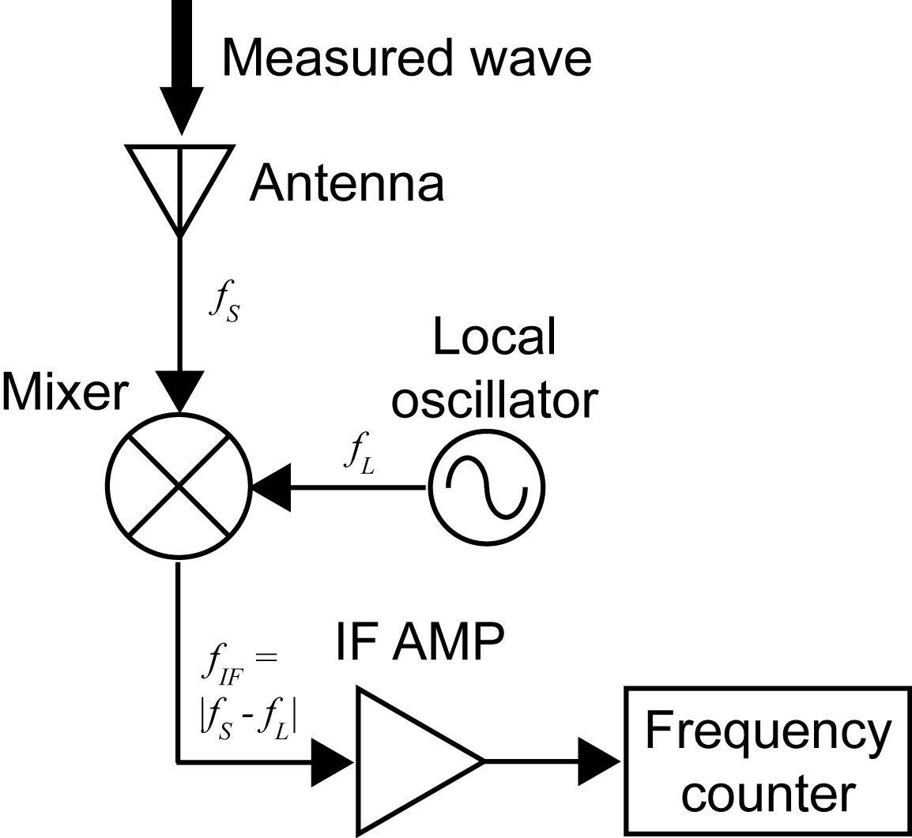
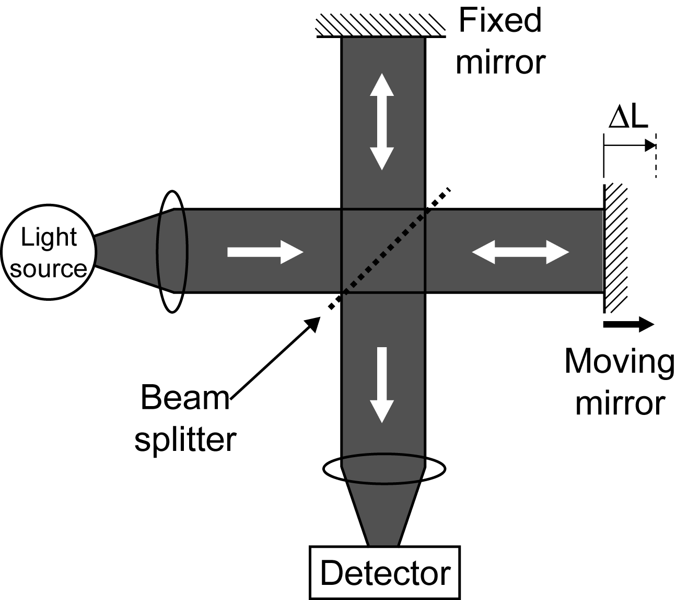
Conventional method
Electrical heterodyned method
Optical interferometric method
Cryogenic cooling
ΔL=(λ/2)*N
Obstacle to
practical use!
Difficult to cover all frequency region of THz wave (0.1~10THz)
→Requirement of new method optimized for THz wave!
Notes:
Conventionally, ele^ctrical he^terodyned method and o^ptical interfero^metric method have been widely used. However, these methods often requires cryoge^nic cooling of mixer or detector to suppress thermal noise. This results in obstacle to practical use. Furthermore, even though such cooling is applied for these methods, it is still difficult to cover all frequency region of THz wave. In this way, THz gap of frequency measurement is existing between electrical and optical regions. Therefore, new method optimized for THz wave is required. To bridge the THz gap of frequency measurement, we focus on the THz frequency comb.

Slide 23
Tracking Oscillator
入力周波数の変動はVCOがトラッキングし, 位相同期を維持
位相同期により入力信号を増幅
SN比の向上
トラッキングオシレーターを用いて絶対周波数の
リアルタイム測定を目指す
Notes:
トラッキングオシレーター (T/O) は, 微弱入力信号の周波数と電圧制御発振器 (VCO) の周波数を比較し, 位相同期を行うという, アナログ的なPLL制御システムである. その結果, 入力周波数が変換しても, VCOが追跡 (トラッキング) し, 常に位相同期を維持する. 通常, VCO出力の信号レベルやSN比は入力信号よりも十分に高いので, 位相同期されたVCO出力信号は, 間接的に, 入力信号を増幅するだけでなく, SN比も向上された信号と見なすことが出来る.
トラッキングオシレーターに入力された信号は位相・周波数検出される. オフセットとゲインによりに, LPF (ループパスフィルター) の条件を変化させ, 入力信号と同じ周波数にされた信号がVCOから出力される. VCOの信号はOutに出力される. また分周器を通った信号の周波数は分周比Nによって1/N倍され, 1/N Outから出力される. この信号は再び位相/周波数検出器にも戻り位相と周波数が一致するように制御されている. ここで分周器とは, ある信号の周波数を整数分の一に分けるものである..

Slide 24
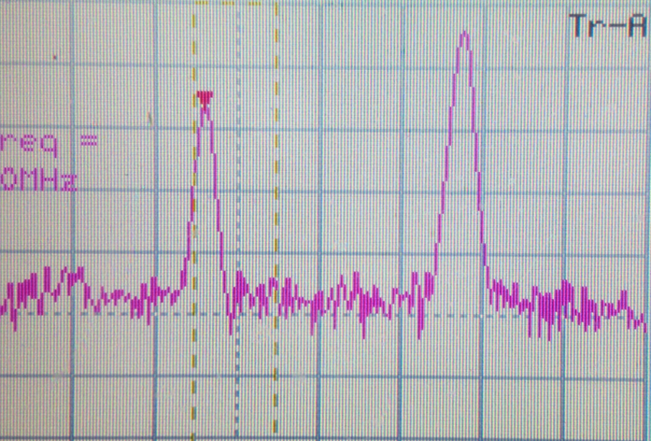
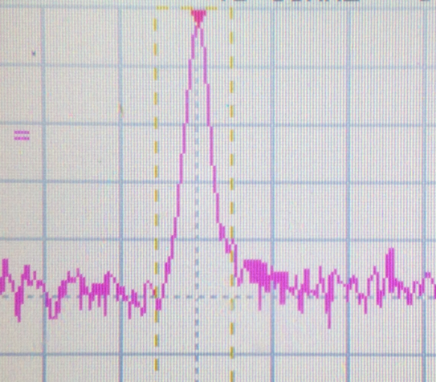
Tracking Oscillator の特性評価
Beat signal
TO signal
Lock signal
SN 45dB
SN 47dB
SN 30dB
最低30dB (RBW10kHz) のビート信号においてトラッキングオシレーターでロック可能

Slide 25
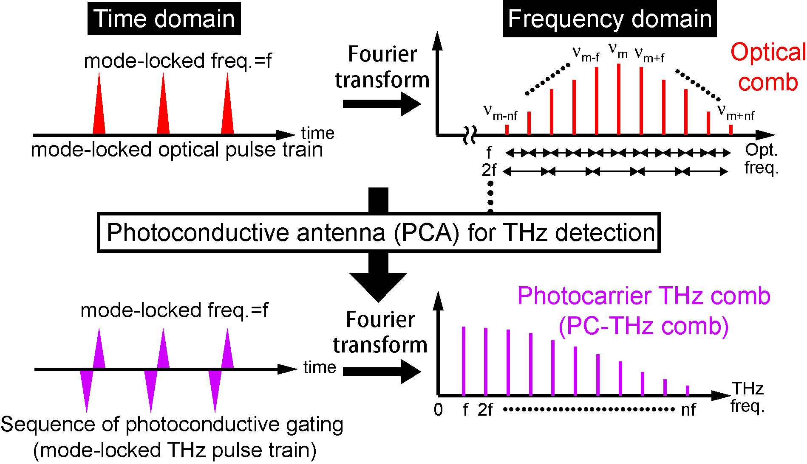
Optical comb and THz comb
Simple, broadband selectivity, high spectral purity,
offset free, and absolute frequency calibration
Notes:
This slide shows behavior of optical comb and THz comb in time and frequency domains. Recently, in the optical region, optical frequency combs radiated from a femtosecond mode-locked laser have attracted attention as a powerful tool for optical frequency metrology because it can be used as a precise frequency ruler in optical region. When the mode-locked optical pulse is incident to the PCA for THz detection, a sequence of photoconductive gating is induced in the PCA. Such photoconductive ML THz pulse train constructs frequency comb structure of photocarrier in the PCA, namely PC-THZ comb. In this way, the optical comb is down-converted to the THz region without any change in its frequency spacing. The resulting PC-THz comb is a harmonic frequency comb without any offset, composed of a fundamental component and a series of harmonic components of a mode-locked frequency of f. Such the PC-THz comb provides attractive features for frequency metrology, namely simple, broadband selectivity, high spectral purity, offset free, and absolute frequency calibration. Therefore, if the laser ML freq. of f is well stabilized, the PC-THz comb can be used as a precise frequency ruler in the THz region. At the present talk, we proposed a THz spectrum analyzer based on the PC-THz comb.

Slide 26
② Experimental setup
Center wavelength 1550nm
Repetition rate 56MHz
Pulse width 47fs
Average power 189mW
Er:fiber laser

