Slide 1
2015 1st semester journal seminar
Super resolution microscopy
5/7 Hase

Slide 2
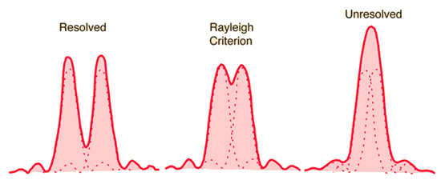
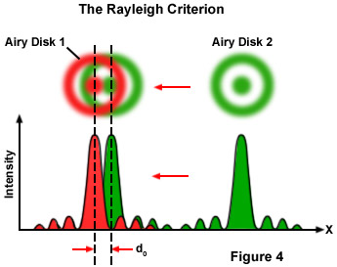
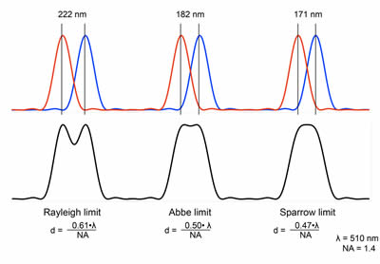
Optical Microscopy
Spatial resolution of microscopy is subject to a hard limit caused by diffraction.
“How do you resolve structures closer to one
another than 200 nm, obtain oodles of spa-
tial and temporal data and perform speedy
imaging—all with low phototoxicity?”

Slide 3
Super resolution microscopy
Vivien Marx, “Is super-resolution microscopy right for you?”,
Nature Methods 10, 1157 (2013).
‘Super’ resolution microscopy = diffraction-unlimited microscopy
by Stefan Hell
Main super resolution techniques
Photoactivated localization microscopy (PALM)
Stochastic optical reconstruction microscopy (STORM)
Stimulated emission depletion (STED) microscopy
Reversible saturable optical fluorescence transitions (RESOLFT)
Structured illumination microscopy (SIM)

Slide 4
Contents
Structured-illumination microscopy (SIM)
  Principle & Setup
  Results
  Conclusion
  How to adopt SIM to optical comb?
Photoactivation localization microscopy (PALM) &
Stochastic optical reconstruction microscopy (STORM)
  Principle & Setup
  Results
  Conclusion
  How to apply PALM & STORM to optical comb?

Slide 5
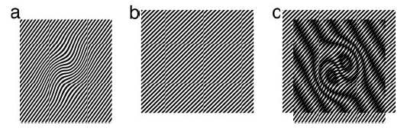
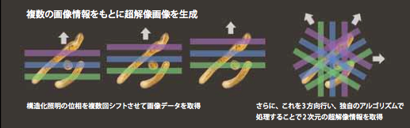
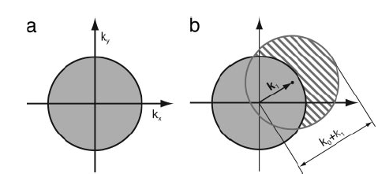
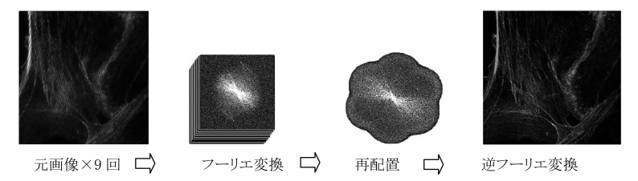
1. Structured-illumination microscopy (SIM)
Ref) Gustafsson, M. G. L., “Surpassing the lateral resolution limit by a factor of two using structured illumination microscopy”, Journal of Microscopy 198, 82 (2000).
Sample
illumination
moire fringes
maximum resolvable spatial frequency k₀
k₀ = 2NA/λ_{em}
Those fringes will be observable in the
microscope if
k₁
Spatial
frequency k
k – k₁
Image Reconstruction
conventional
microscope
proposed
method
moire fringes can be extracted by
using a phase-shift method
moire
F.T.
Replace
F.T.⁻¹

Slide 6
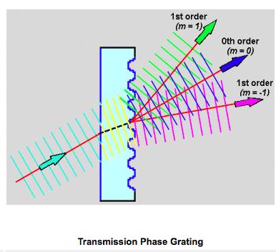
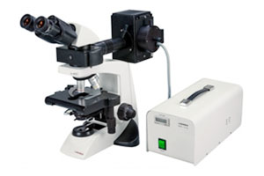
Setup
①Light source: wavelength of 532 nm
②Transmission phase grating
0.23 μm line spacing
diffraction orders 1 and -1 beams intersected at an angle in
the sample to produce a sinusoidal interference pattern
③Conventional microscope
+ 1.4 numerical aperture
oil-immersion objective lens.

Slide 7
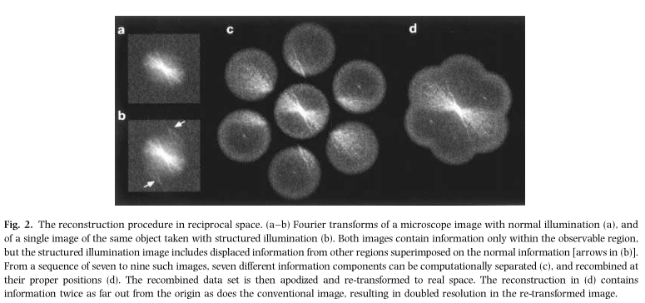
Results

Slide 8
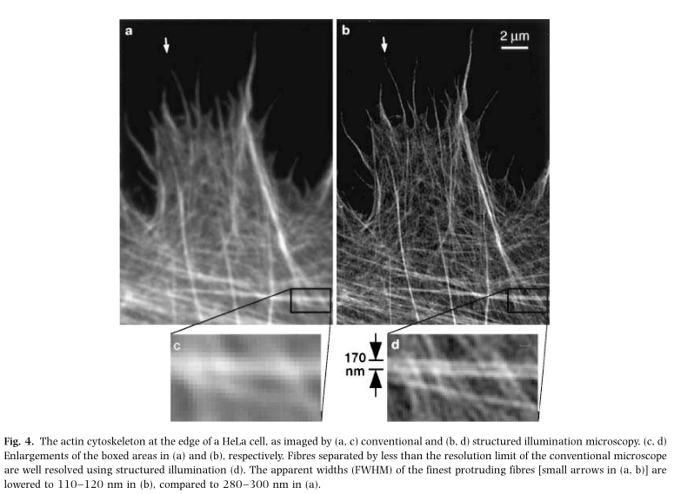
Results
Emission: 605 nm
The total exposure time for the data in this report was 1±10 s, and processing required about
30 s for a 512* 512 pixel final image

Slide 9
Conclusion
limited to a factor of 2 beyond the theoretical diffraction barrier

Slide 10
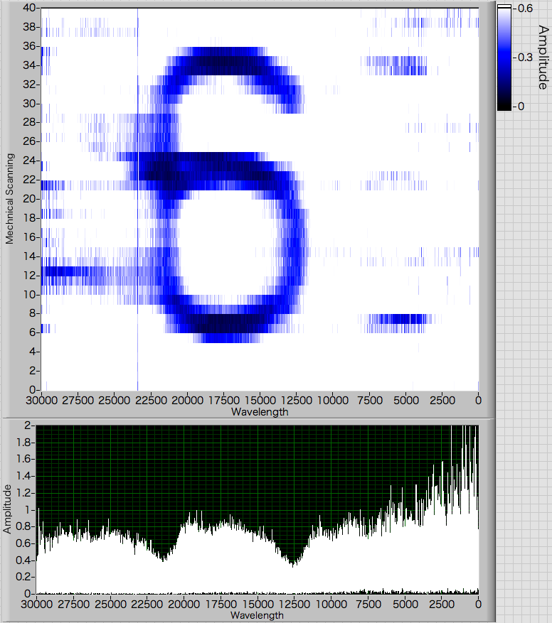
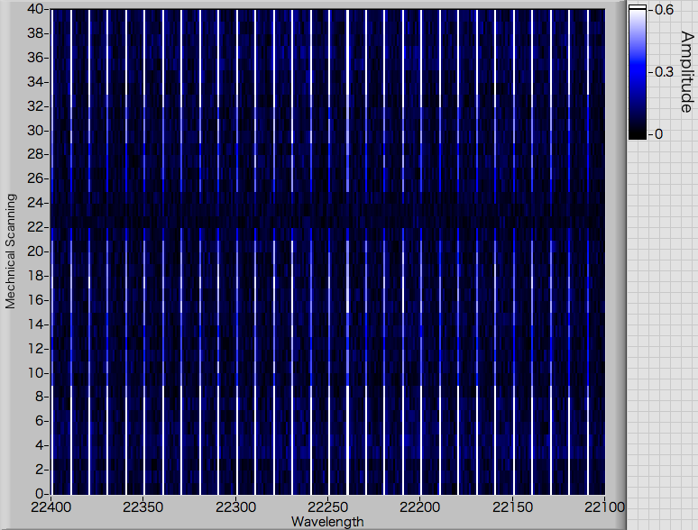
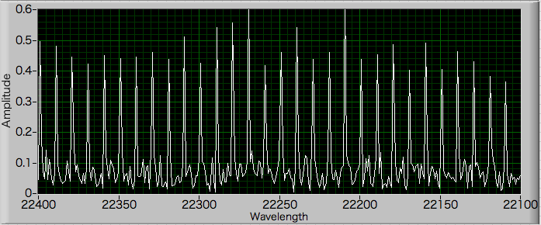
  How to apply SIM to optical comb?
Structured illumination is as same as 1D space wavelength conversion?
illumination pattern is not sine wave
1D Space-wavelength conversion by using Grating

Slide 11
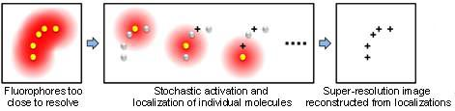
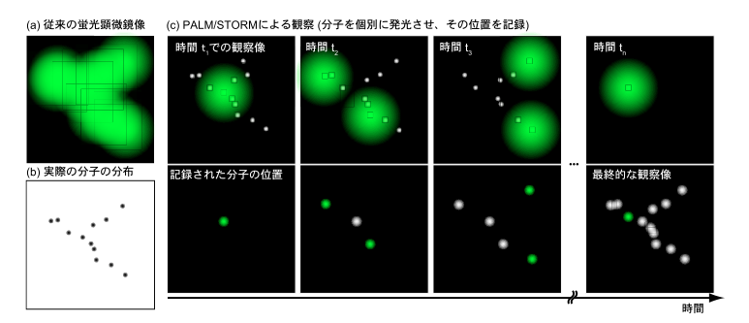
2. Photoactivation localization microscopy (PALM) &
Stochastic optical reconstruction microscopy (STORM)
Ref) Michael J. Rust, Mark Bates, and Xiaowei Zhuang, “Stochastic optical reconstruction microscopy (STORM) provides
sub-diffraction-limit image resolution”, Nature Methods 3, 793 (2006).
Ref) Samuel T. Hess, Thanu P. K. Girirajan, and Michael D. Masony Samuel, “Ultra-High Resolution Imaging by Fluorescence Photoactivation
Localization Microscopy”, Biophysical Journal 91, 4258 (2006).
Ref) Eric Betzig, George H. Patterson, Rachid Sougrat, O. Wolf Lindwasser, Scott Olenych, Juan S. Bonifacino, Michael W. Davidson, Jennifer Lippincott-Schwartz, Harald F. Hess, ”Imaging Intracellular Fluorescent Proteins at Nanometer Resolution”, Science 313, 1642 (2006).
Switch ON/OFF of fluorophores + Localization
time

Slide 12
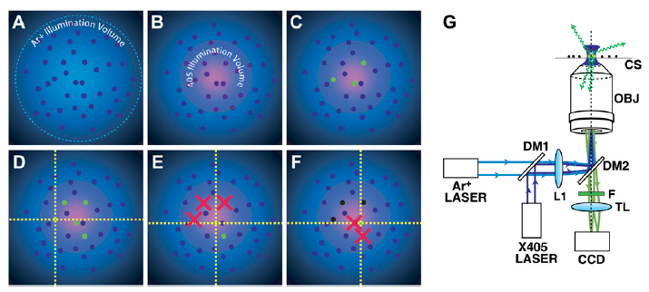
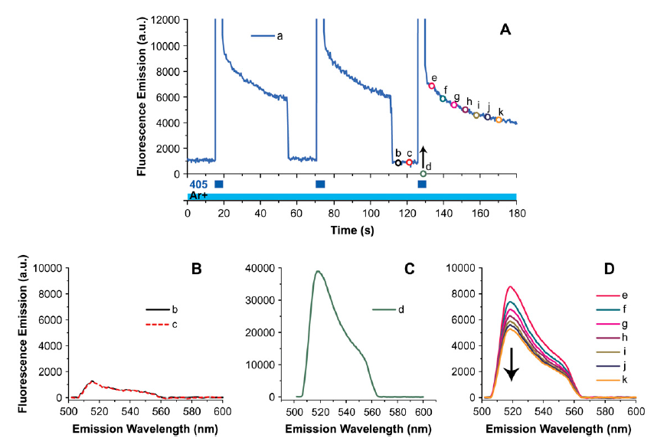
PALM: Switch ON/OFF of fluorophores & Setup

Slide 13
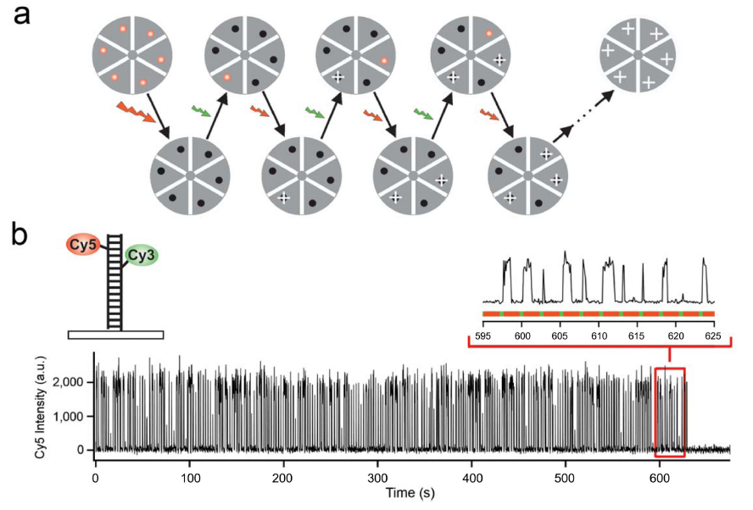
STORM: Switch ON/OFF of fluorophores

Slide 14
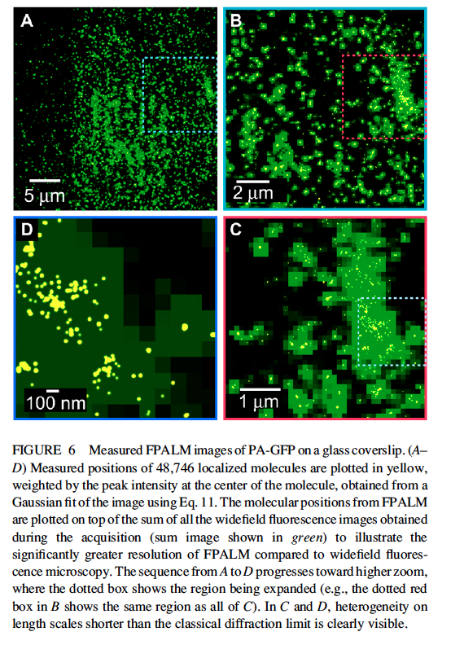

Results
Spatial resolution of PALM/STORM
measured accuracy of fluorophores
number of detected photon
precision of measurement (SD: σ ) is determined by PSF
SD of precision
N: num. of photon

Slide 15
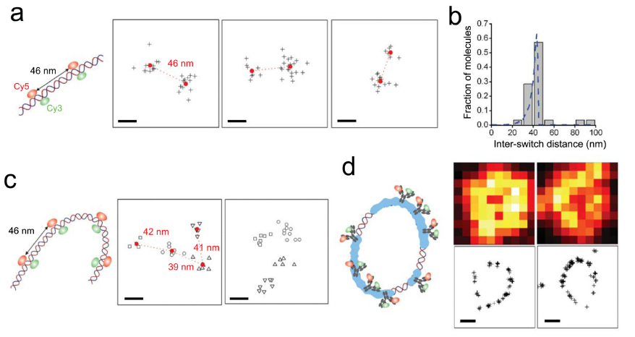
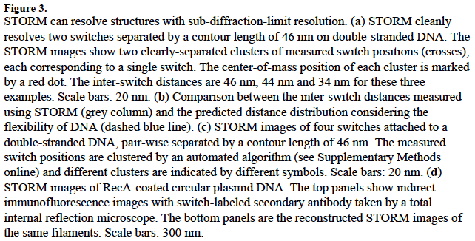
Results

Slide 16
Conclusion
Resolution of PALM/STORM is around 20 nm
Measurement time ∝
number of photon on the field of view

Slide 17
  How to apply PALM & STORM to optical comb?
Localization technique can be applied to comb?
BS
CL1
VIPA
CL2
CL3
G
Comb 1
λ
L1
Comb 2
DCS
L2
y
2D Space-wavelength conversion by using VIPA + Grating
λ
L3
x
Sample
y
X
λ

Slide 18
  How to apply PALM & STORM to optical comb?
Localization technique can be applied to comb?
y
y
y
changing
f_{rep} or f_{ceo}
changing
f_{rep} or f_{ceo}
x
x
x
changing f_{rep} or f_{ceo} ▶︎ equivalent to switch ON/OFF
of fluorophores in PALM and STORM
Spatial resolution depends on stability of frequency
Measurement time is not stochastic

Slide 19
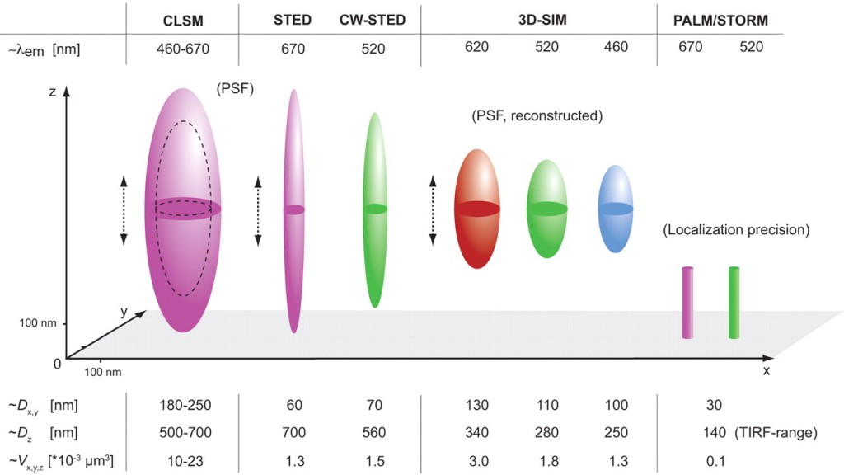
Conclusion

