Slide 1
1st Journal review
Construction of nonlinear optical microscopy for clinical application
2015/06/17 M2 Atsuta

Slide 2
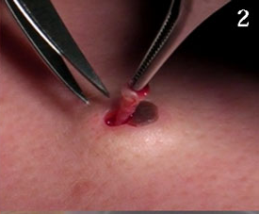
Nonlinear optical microscopy
In diagnosis, the invasive sampling of physical biopsy takes risks of trauma, infection, hematoma, and hemorrhage
⇒ Nonlinear optical microscopy
It is non-invasive and non-contact ,
so physical biopsy diagnosis is NOT needed on measurement using nonlinear optical microscopy. (SHG microscopy etc..)
http://www.momohime-medical.com/

Slide 3
Nonlinear optical microscopy
For clinical application…
Traditional laboratory microscopes are
large scale, inflexible, and free-space beam delivery.
So they are limited its applications.
Optical microscopes need flexible fiber-optical probe

Slide 4
① C. Bechtela, et al. “Large field of view MEMS-based confocal laser scanning microscope for fluorescence imaging” Optik.125,876 (2013)
②S. Tang, et al. ”Design and implementation of fiber-based multiphoton endoscopy with microelectromechanical systems scanning” Journal of Biomedical Optics.14, 034005 (2009)
(Fibroblast)
③B. A. Danowski “Fibroblast contractility and actin organization are stimulated by microtubule inhibitorsl” Journal of Cell Science .93, 255 (1990)

Slide 5
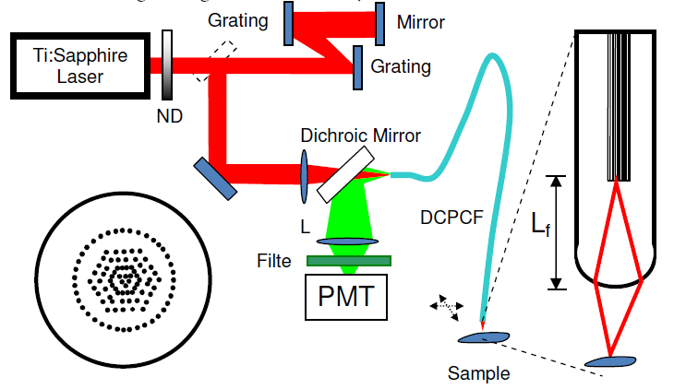
① “Large field of view MEMS-based confocal laser scanning microscope for fluorescence imaging”
Introduction Fluorescence confocal laser scanning microscopy
F-LSM is now a widely used and powerful imaging technique in fundamental biological and medical research.
Recently…
Fibre scan microscopy :
○ thin probe system ⇒ locally imaging for cell etc…
× restricted field of view ⇒ unsuitable for skin imaging
space saving, moderately prized sys-tem with a large field of view
Using MEMS mirror

Slide 6
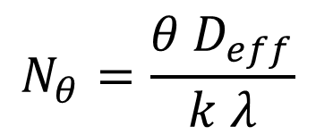
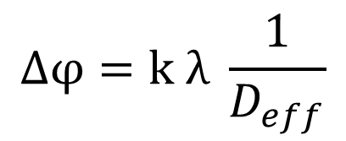
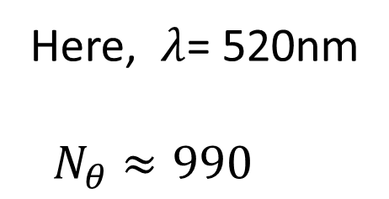
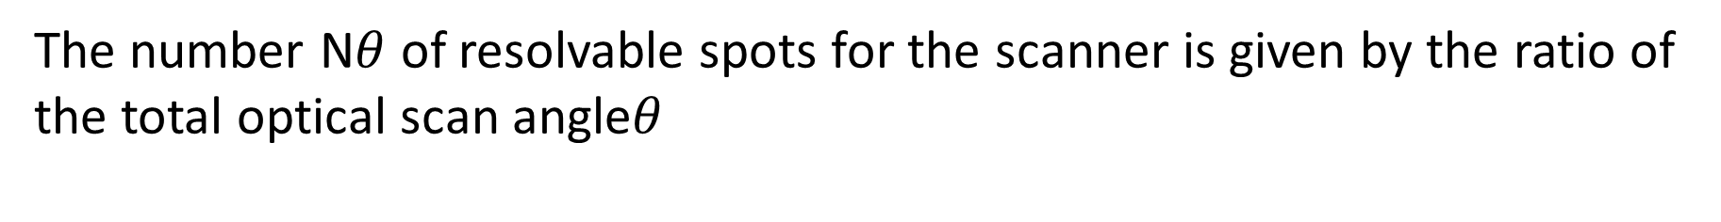
the MEMS mirror
fslow= 200 Hz ，ffast= 1.336kHz
The mirror deflect ±5[deg] D = 2mm
twice the total mirror scan angle of 2ϕ, and the smallest resolvable spot size given by
$$∆φ=k λ \frac{1}{D_{eff}}$$
Here, k : denoting the aperture shape factor
Deff : effective mirror diameter
The number N$θ$ of resolvable spots for the scanner is given by the ratio of the total optical scan angle$θ$
Here, $λ$= 520nm
$N_{θ}$ $≈990$
$$N_{θ}=\frac{θ D_{eff}}{k λ}$$

Slide 7
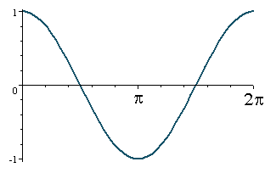
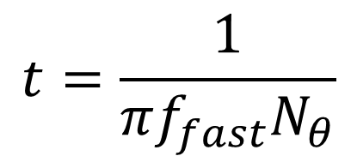
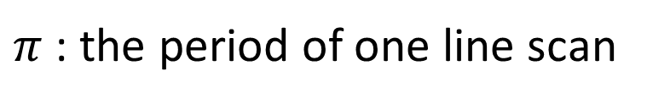
the MEMS mirror
fslow= 200 Hz ，ffast= 1.336kHz
The mirror deflect ±5[deg] D = 2mm
MEMS mirror scan the spot very fast…
  So, pixel dwell time has a great impact on the number of photons available for detection.
$$t=\frac{1}{πf_{fast}N_{θ}}$$
$π$ : the period of one line scan
  If, number of photons unavailable for detection,
  (As resonant frequency ffast can’t change.)
We must change to large number of pixel or high peak power to increase photons.

Slide 8
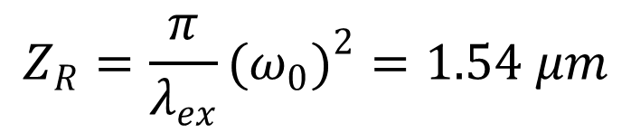

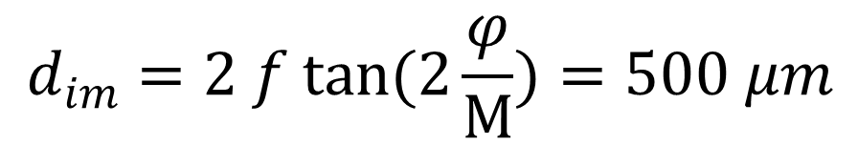
Field of view
Spot diameter and the Rayleigh range
$$ω_{0}=0.5k λ_{ex} f/\#=0.49 μm$$
$$Z_{R}=\frac{π}{λ_{ex}}(ω_{0})^{2}=1.54 μm$$
It wants to expand the beam system to 7mm for aperture diameter.
As M = 7, Field of view is
$$d_{im}=2 f tan(2\frac{φ}{M})=500 μm$$
  Here, φ represents the scanning angle of 5 °

Slide 9
Optical design
The strehl ratio
It represents the smallness of aberration
0.8 is the diffraction limit
Point Spread Function (PSF)
(Image) = (light spot) + (PSF)
the maximum angle of 10◦
the spot size is around 1.2μm.
This can identify until 6μm.
Real sample
PSF
Notes:
ストレール比 無収差との比

Slide 10
Wave aberration from OPD(optical path Difference)
in tangential and sagittal direction
Coma aberration occurs between the scan lens and MEMS mirror
Field curvature
Field curvature in tangential and sagittal direction
coma aberration > spherical aberration.
And another characteristic of the system important to look at is the field curvature
In total these aberrations restrict the maximum scanning angle to ±10◦. ⇒ this design is expected to application
of cell imaging.
Notes:
コマ収差
光軸に対して平行でなく、角度がついた状態でレンズに光が入ると、下図のように、その光がレンズに入って作る焦点が一点に集まらず、しかも、その焦点面(ピント面)が結像面と一致せずに傾くため
接線方向 サジタル方向
非点湾曲

Slide 11
Setup and results
Objective : 20 × 0.75
‘thick’ biological samples of fluorescent stained convalaria are imaged
In TC, group 7 has 228 line pairs/mm, corresponding to a line width of 2.2μm.
Notes:
スズランの細胞

Slide 12
summary
Confocal fluorescence laser scanning microscopes are well established and widely used in biological and medical research.
First measurements have shown a lateral and axial resolution of 2.2μm and 3μm, respectively with a field of view of 500μm × 500μm.

Slide 13
② ”Design and implementation of fiber-based multiphoton endoscopy with microelectromechanical systems scanning”
Introduction
Delivering femtosecond pulses through fibers and designing miniature scanning probes are two challenges in MPM endoscopy.
These problems were solved by
DCPCF(Double-cladding photonic crystal fibers) and MEMS mirror.
① Comparing SMF, hollow-core PBF, and DCPCF
② Three configurations of probe design are discussed,
and their advantages and disadvantages are compared.

Slide 14
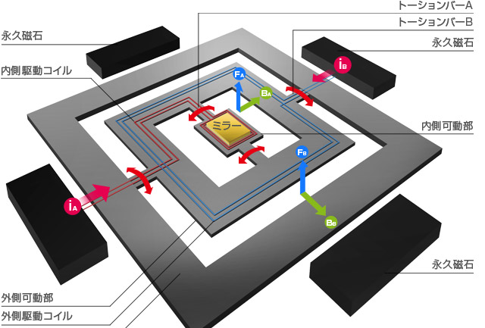
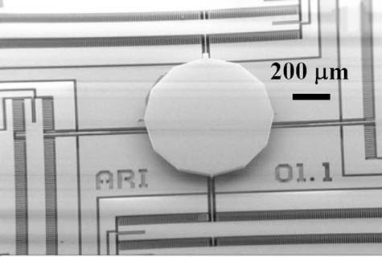
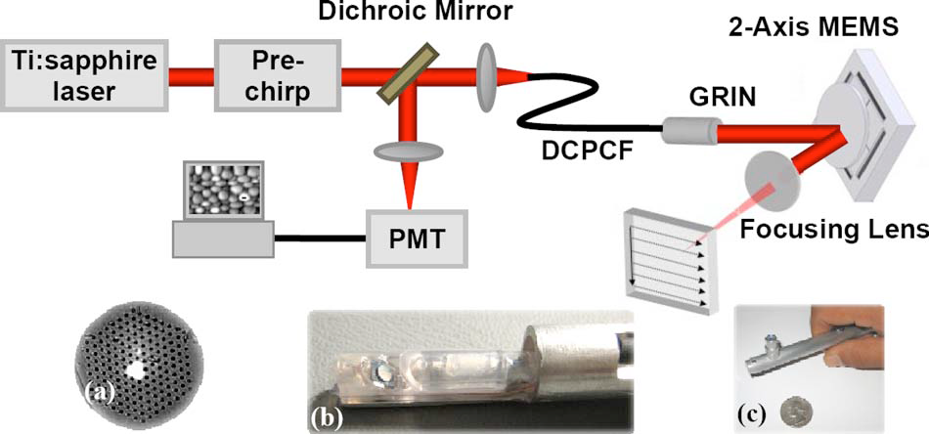
※Gimbal-two-axis MEMS
Setup:
A gimbal-less two-axis MEMS
MEMS mirror
Gimbal-less
Mirror diameter 2mm
Al coat (reflectance 80%)
The light source,
Ti: S laser (790nm, bandwidth 10nm,
pulse width 170fs)
Objective (5×, NA = 0.1)
Coupling efficiency of 30%

Slide 15
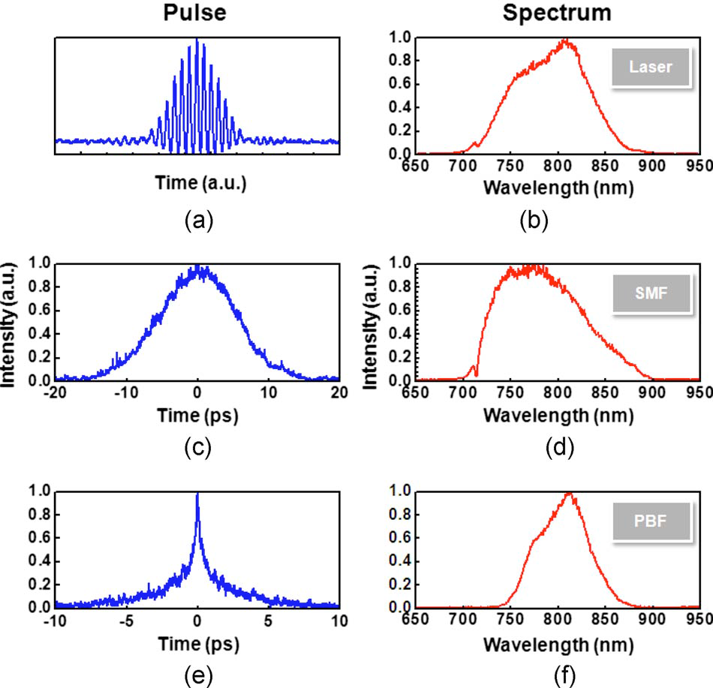
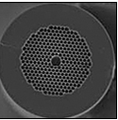
Fiber delivery
(c)(d)SMF
Signal attenuation is negligible
Laser bandwidth increase
(e)(f)Hollow-core PBF
~20 times lower dispersion than SMF
Inside low-loss window, attenuation is low
but outside the window, attenuation increases rapidly.
(window: 90 nm around a center wavelength of 800 nm
⇒DCPCF
Signal attenuation is negligible
A good collection efficiency with
core and the inner clad
Notes:
すべて800 nmの波長．12-fsのパルス幅と100 nmの帯域幅（Femtolasers）の光源
自己相関分光計により測定したファイバーを通って伝播した後のパルス幅とスペクトル
SM：12ps
PBF:0.7ps
しかし，スペクトル帯域幅は，低損失伝播の狭い窓により60nmに縮小される．
DCPCF:行きコア(SM)と内側 MPM内側と外側
大きいコアサイズ 不要な非線形効果を抑えることができる

Slide 16
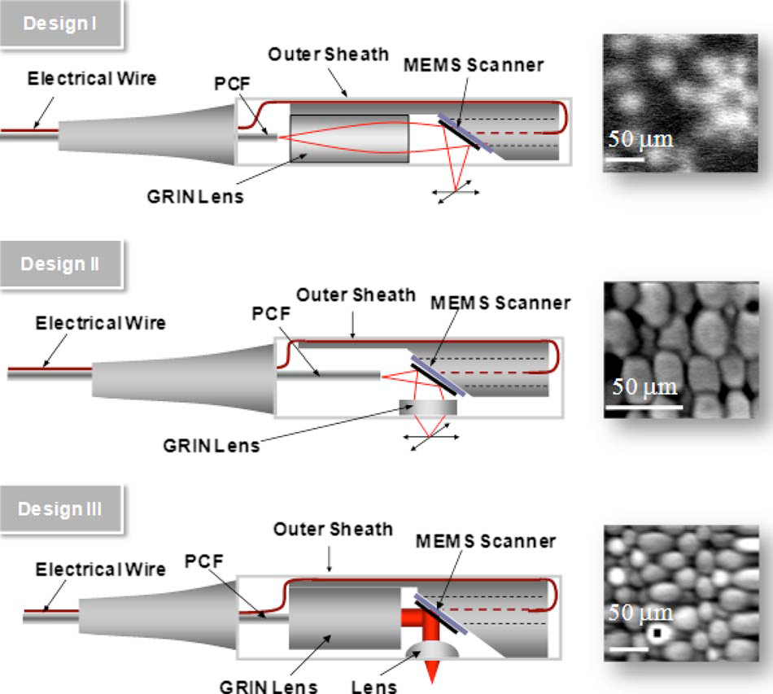
Design:
Design 1 the simplest case
〇 easy alignment and packaging
as well as size efficiency
×long WD : poor resolution
at the focal point.
Design 2
〇 short WD
×beam are restricted ⇒ lack of flexibility
Design 3
〇provide a collimated beam
⇒ good flexibility

Slide 17
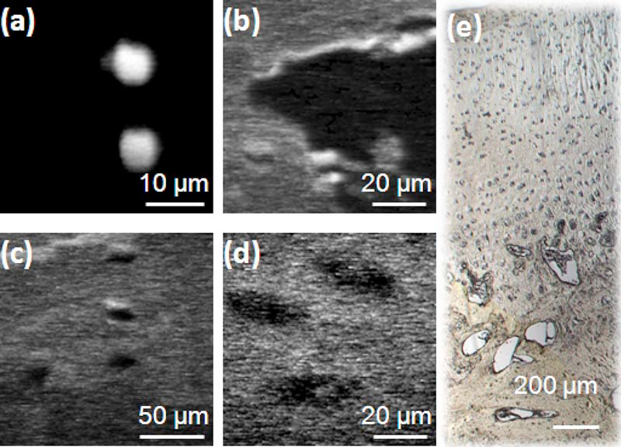
Result
The Fluorescence image
128 * 128 pixels
Frequency, 64Hz and 0.25Hz (multiphoton fluorescence is low signal)
Sample :
6μm beads;
bone structure
and (d) chondrocytes;
(e) white light microscope photo showing the bovine knee joint cartilage sample.
Notes:
(a)6μmのビーズ;
(b)骨構造
(d）軟骨細胞
(e)ウシ膝関節軟骨サンプル白色光顕微鏡写真

Slide 18
summary
Compares the three types of performance of the fiber, it was demonstrated pulses propagating and high collection efficiency ability of DCPCF.
・ Compares the three probe design, it was found configuration that provides flexibility for optimum imaging performance and packaging with collimating and focusing lens.

Slide 19
③“Fibroblast contractility and actin organization are stimulated by microtubule inhibitorsl”
Introduction
The locomotion of fibroblasts and other tissue cells results from their exertion of contractile 'traction‘ forces on objects and materials
⇒ These cells traction are known to be produced by a cytoplasmic actin(SF : stress fiber) and myosin network
Several lines of evidence have implicated microtubules as playing some controlling role in the motility of tissue cells ;
microtubule-depolymerizing drugs : cause regression of growth
⇒In cancer cells, to act as an anti-cancer agent
In this study…
performed to clarify whether the microtubules to determine what role by exerting traction.
Notes:
牽引力および再編成コラーゲンの配向は，形態形成の重要な機能を果たす．
これらの細胞牽引力(収縮力)は細胞質アクチンとミオシンのネットワークによって生成されることが知られている
微小管(チューブリン)：細胞骨格のひとつ 分裂時に形成される(押す力)
微小管脱重合薬(収縮力を生成)

Slide 20
method:
・C3H/10T1/2 mouse embryo fibroblasts
Eagle's MEM with Hanks' salts, supplemented with 10 % fetal calf serum, penicillin, streptomycin, and 7-5mM-Hepes.
Cells were removed from tissue culture flasks by a brief treatment with
trypsin-EDTA solution, and plated onto either glass coverslips or silicone rubber substrata.
Cells were used for experimentation 1-5 days after plating.
Experimental equipment
Immunofluorescence
・Zeiss 63 X, 1-4 n.a. Planapo objective on a Zeiss IM-35 inverted microscope equipped for epi-fluorescence.
・Single-labeling of f-actin and
Double-labelling of actin and tubulin:
Time-lapse filming
Kodak Plus-X Reversal film, using a Sage time-lapse apparatus attached (Olympus)
Notes:
C3H10T1/ 2マウス胚線維芽細胞を，10％ウシ胎仔血清，100unitsm$l^{−1}$ ペニシリン，100 ${μgml}^{−1}$ストレプトマイシン，および7-5mM-Hepesを補充したハンクス塩イーグルMEMで培養した．細胞をトリプシン-EDTA溶液で短時間処理により組織培養フラスコから除去し，カバーガラスやシリコンゴム基質のいずれかの上にプレーティングした．細胞は，プレーティング後1~5日の実験に使用した．
ペニシリン，ストレプトマイシン：抗生物質
血清には、ホルモンの供給源としての働き、培地の緩衝作用の増強、フェノールレッドや各種プロテアーゼからの保護効果などが知られているが、未知の物質が多く、いまだに血清を代替する物質も見つかっていないため、しかたなく添加している。

Slide 21
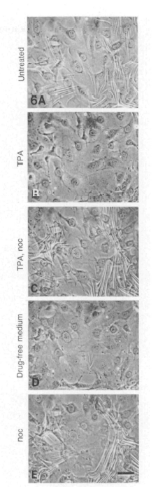
Result and Discussion
Tractive force is evaluated by the number and size of wrinkles in the rubber.
TPA : Tumor marker (But it is normal cell, too)
Noc : Stabilizers
Colcemid : anticancer drug
VB (vinblastine)
Notes:
TPA(組織ポリペプチド抗原)癌細胞など反応するたんぱく質
アクチンストレスファイバー減少
ノコダゾール：微小管脱重合薬 収縮力 大

Slide 22
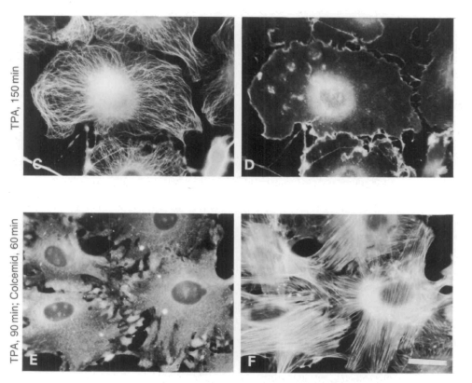
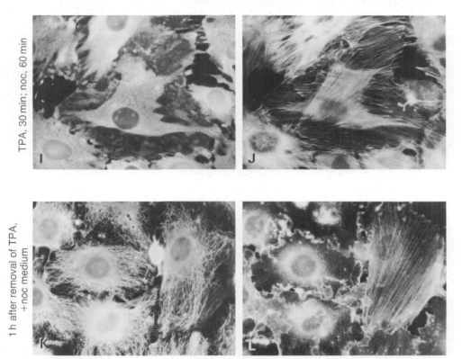
Result and Discussion
 | control | TPA | TPA Colcemid | TPA VB | TPA noc | remove
Tublin | 7A | C | E | G | I | K
Acatin | B | D Stress fiber ↓ | F Stress fiber ↑ | H | J Stress fiber ↑ | L Stress fiber ↓
Notes:
TPA(組織ポリペプチド抗原)癌細胞など反応するたんぱく質
アクチンストレスファイバー減少
コルセミド：毒

Slide 23
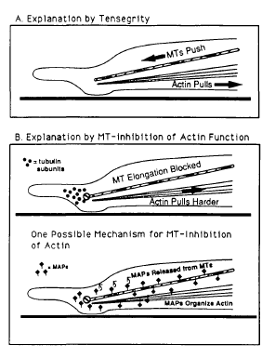
summary
Rather than a gradual change of fibroblasts, abrupt and change
Recovery of stress fibers was unexpected.
Cytoplasmic Microtubules, it is to exert a large pressing force, partially offset the pull of actin stress fibers.
Microtubule-associated protein is secreted, it interacts with actin SF.
Notes:
微小管阻害薬によって引き起こされる形態学的変化の前の観察は，いくつかの段階的な線維芽細胞の収縮の方向性の低下ではなく，実際に収縮強度の急激な発生と増加を期待するものを主導している可能性があります．これらは，TPAおよびその他の要因によって破壊された後でも，これらの微小管阻害剤はまた，アクチン含有ストレス繊維の急速な回復を引き起こすことが判明するのは非常に予想外でした．
収縮性の観察された増加のための第2の可能性の説明は，これらのフィラメントは，その微小管の微小管阻害剤によって破壊されている線維芽細胞に崩壊することが示されているので，それは，中間フィラメントの正常な細胞質配列の崩壊に起因するかもしれないということです．5時間が５分
Fig.8（a）に模式的に示す第3の可能な説明は，細胞質微小管は，通常，大きな押圧力を発揮することであり，このプッシュは，部分的にアクチンストレスファイバーのプルを相殺すること．微小管は，抗微小管薬により破壊された場合このように，ストレスファイバーの収縮力の大部分は，それによって増加した歪みを生成し，基層に加わることになります．このタイプのモデルでは，細胞のアクチンとミオシンによって生成された収縮力の任意の実際の増加があるわけではありません．むしろ，主な効果は，細胞の力の再配分です．

Slide 24
my opinion
・MEMS mirror can be expected wide field of view.
・There is a need for strict design for further miniaturization.
・Old study of fibroblast cells was determined by appearance
⇒ Quantitative evaluation is necessary

Slide 25
That’s all.

