Slide 1
2nd Journal review
Clinical application of
SHG microscope
2015/10/13 M2 Atsuta

Slide 2
① M. Weinigel et al.,“Compact clinical high-NA multiphoton endoscopy”, Proc. of SPIE.8217, 821706-1(2012).
② H. G. Breunig et al. , “Combining multiphoton and CARS microscopy for skin imaging”, Proc. of SPIE.8588, 85880N-1(2013).
③ M. Weinigel et al., “A novel clinical multimodal multiphoton tomograph for AF, SHG,CARS imaging, and FLIM”, Proc. of SPIE.8948, 89481R-1(2014).

Slide 3
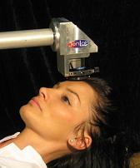
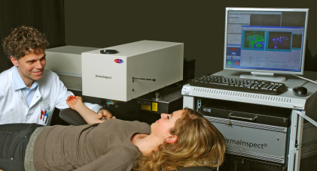
Introduction
SHG microscope : observation of non-centrosymmetric molecules (e. g. collagen)
⇒ Selective and non-invasive
To Clinical application…
・ Compact & Portable system
・ Combination with other microscope
DermaImspect
(Jen Lab.)
Ref.) http://www.jenlab.de/DermaInspect.29.0.html

Slide 4
① Compact clinical high-NA multiphoton endoscopy
Clinical high-resolution multi-tomography apparatus
Large probe ⇒ Restrict external access possibilities
hard-to-reach areas (like wounds)
It can be improved by the clinical multiphoton endoscopy.
Using gradient index (GRIN) lenses
& combining multiphoton endoscopy
(Fluorescent & SHG)
based on with CE-marked clinical tomography
Ref.) http://www.jenlab.de/DermaInspect.29.0.html

Slide 5
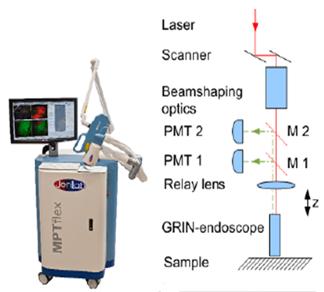
Setup

Slide 6
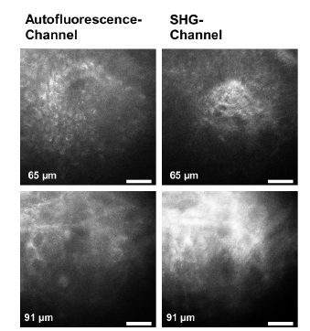
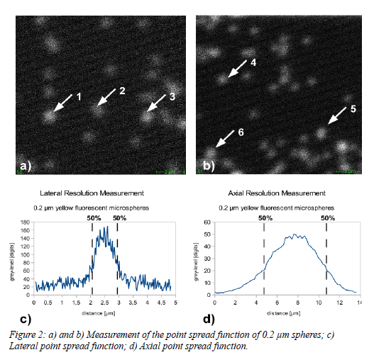
Results
The lateral resolution : 0.87 μm
The axial resolution : 5.5 μm

Slide 7
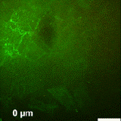
in vivo imaging @ Depth-resolved
12 optical sections
@ steps of 13 μm.
Sample:
Human skin (forearm)
It demonstrates that
high contrast features can be imaged up to a depth of about 117 μm.
Fluorescence (green)
SHG (yellow)

Slide 8
Summary
・Development of a set-up aimed at a combination of microscopic endoscope and medical certification tomography
・High resolution image has been acquired is in vivo multiphoton image human skin from the above depth 100μm

Slide 9
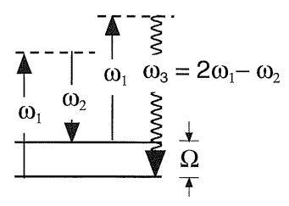
② Combining multiphoton and CARS microscopy for skin imaging
Multiphoton microscope + CARS microscopy
What’s CARS microscopy ?
$$ω_{3}= {2ω}_{1}−ω_{2} :CARS$$
The stretching vibration energy of CH2
Ω=2845$cm^{−1}$
Biological measurement…
known for lipids

Slide 10
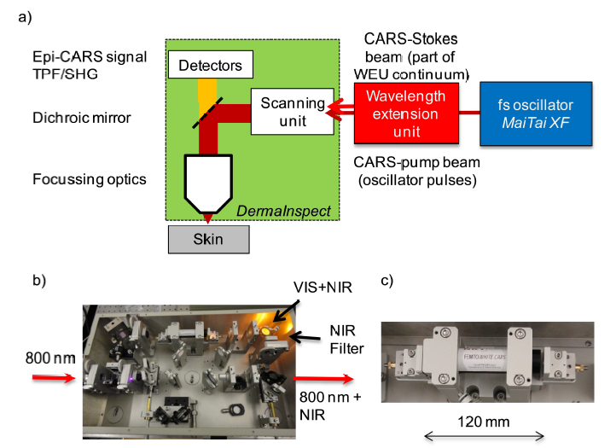
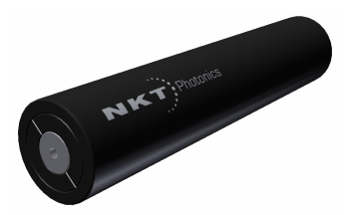
Setup
Notes:
CARSアプリケーションのスーパーコンティニュームデバイス
- 800nmの範囲のFSポンプ用に最適化
- CARSのために適したデュアル出力ピーク
- エンドファセットビーム拡大

Slide 11
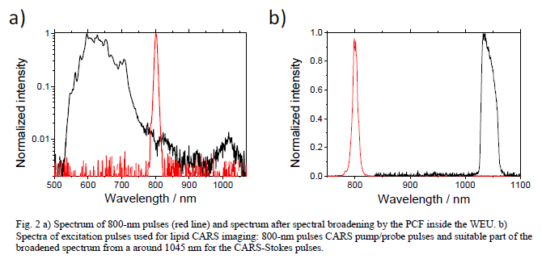
Results
Pump : 800nm
Stokes : 1035nm
CARS : 652nm
7.4 s/frame for images
with 512 x 512 pixels
(FOV :200 x 200 μm)
Stratum spinosum

Slide 12
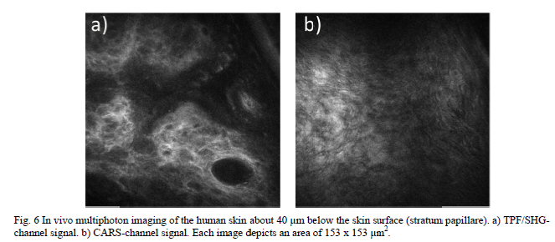
SHG & CARS イメージ

Slide 13
Summary
・Clinical CARS / TPF / SHG multi-photon human skin in vivo imaging of the imaging system has been shown.
・Different fluorophores and CH2 molecular distribution was observed inside the deeper layers of the skin cell structure and elastin or collagen are present.

Slide 14
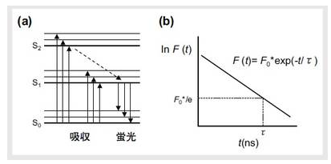
③ A novel clinical multimodal multiphoton tomograph
for AF, SHG,CARS imaging, and FLIM
medical certification tomography
combination AF / SHG / CARS microscope
Conventional system
elastin, melanin, and NAD(P)H
⇒ fluorescence lifetime
imaging (FLIM)
Ref.) http://www.horiba.com/jp/

Slide 15
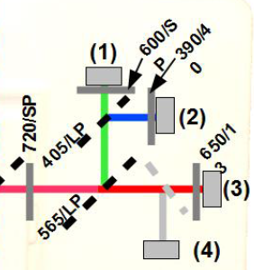
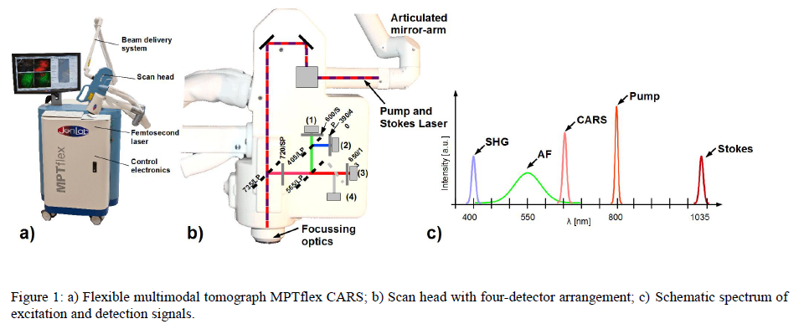
Setup

Slide 16
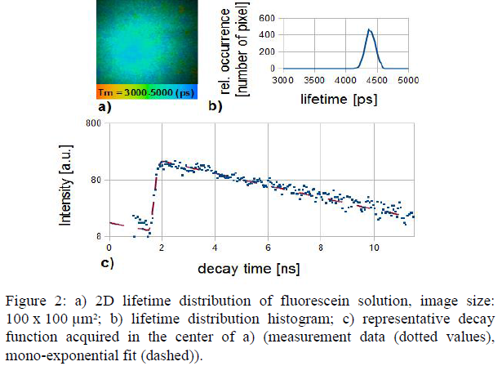
Results

Slide 17
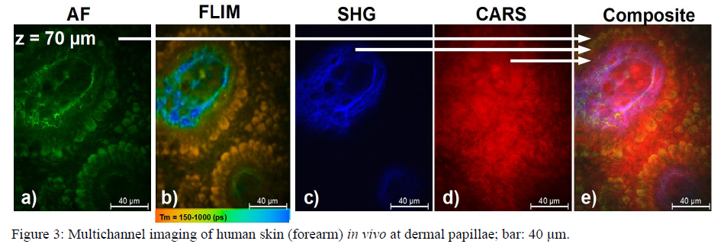
Results
healthy human skin @ a depth of 70 μm (dermal papillae)
FLIM : Melanin has a strong short lifetime component (orange color coded)
and elastin longer lifetimes (blue-green color coded)

Slide 18
Summary
・Multiphoton tomography, based on autofluorescence and SHG, to allow tissue imaging of high resolution.
・Additional information about the non-fluorescent and non-SHG-active tissue component can be obtained by CARS.
・New and it is compact, multi-channel simultaneous detection, AF · FLIM, separation of the SHG and CARS signal has become possible.

Slide 19
Summary
Multiphoton microscope is compact, and built into clinical high-resolution multi-tomograph, and the observation field is spread by combining with other systems.
These are expected to be a very powerful tool for the skin test in the future of the medical field and cosmetic field.

Slide 20
That’s all.

