Slide 1
2nd Journal review
HOMEWORK
2015/11/28 M2 Atsuta

Slide 2
- Outline -
① Configuration of the scanning optical system
(paper #1)
② About CE mark (paper #2)
③ How to lifetime imaging (paper #3)

Slide 3
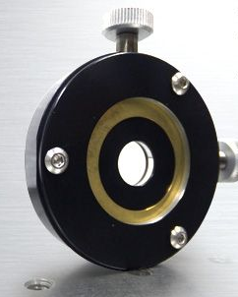
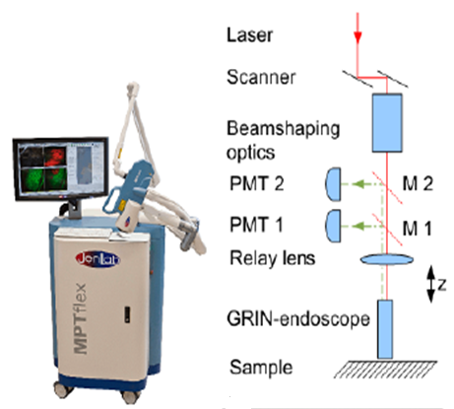
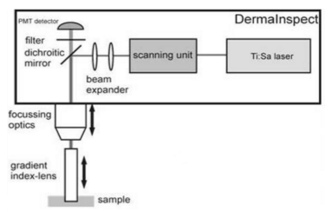
① Configuration of the scanning optical system
・Beam shapper
It can also be used as a lens as a beam-shaping optics
Ref. ) Karsten Konig, et al., J. Biophoton.1 , 13 (2008).

Slide 4
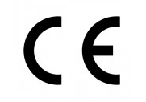
② What is CE mark ?
CE marking : what is required when you export the products to Europe (EU).
⇒ Allows the free circulation in EU．
Without EC mark… penalties such as the Fines or imprisonment, discontinuation of product sales.
In medical…
93/42 / EEC : Medical equipment
90/385 / EEC : Active implantable medical devices
98/79 / EC : in vitro diagnostic medical devices

Slide 5
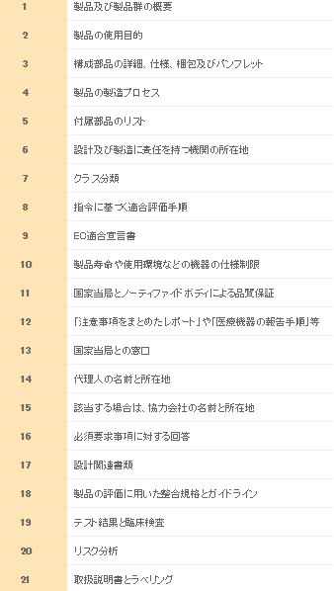
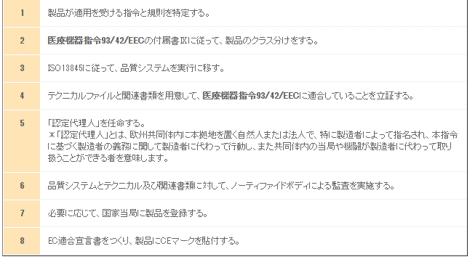
② How to CE mark
(Paper #2)
“The whole CARS DermaInspect has by itself received a CE certification after evaluation by a certified body as a clinical system.” @ PP-3, line 2
ISO 13485 ： the international standard for quality assurance of medical equipment
Ref.) http://tenderlove-pcb.biz/ce-marking/

Slide 6
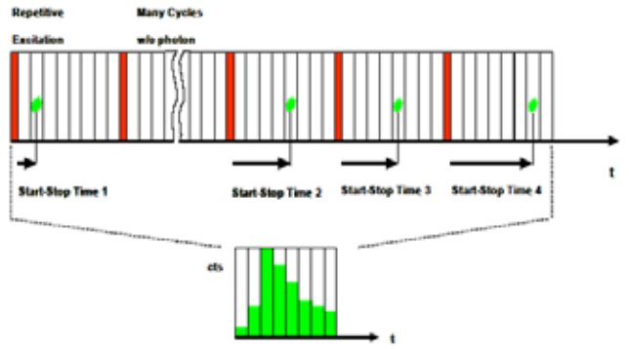
③ How to lifetime imaging
①Using the TCSPC method, single fluorescence photons have been counted with a fast PMT (transient time spread 150 ps)
②The PMT signal was synchronized with the x,y,z beam position calculated from signals of the galvoscanner and the piezodriven objective.
Ref.) http://www.tecan.co.jp/pdf/technote_flt_intro.pdf
③This information was used to provide spatially resolved autofluorescence decay curves per pixel and to calculate mean fluorescence lifetimes per pixel or per region of interest.
④The calculated mean fluorescence lifetimes were depicted as colorcoded t-images.
Ref.)Karsten Konig, et al., Journal of Biomedical Optics.8, 432 (2003).

Slide 7
That’s all.

