Slide 1
Real-Time Absolute Frequency Measurement of CW-THz Radiation Based on a Free-Running THz Comb
27B1-5
○Takashi Ogura¹⁾, Kenta Hayashi¹⁾, Yoshiaki Nakajima^{2,3)},
Hajime Inaba^{2,4)}, Kaoru Minoshima^{2,3)},
and Takeshi Yasui^{1,2)}
1) Tokushima Univ. Japan 2) JST-ERATO, Japan
3) UEC, Japan 4) AIST, Japan
CLEO-PR 2015 in Busan
Notes:
Thank you, Mr. Chairman. My name is Takashi Ogura from Tokushima university, Japan. Today, I will present Real-Time Absolute Frequency Measurement of CW-THz Wave Based on a Free-Running THz Comb

Slide 2
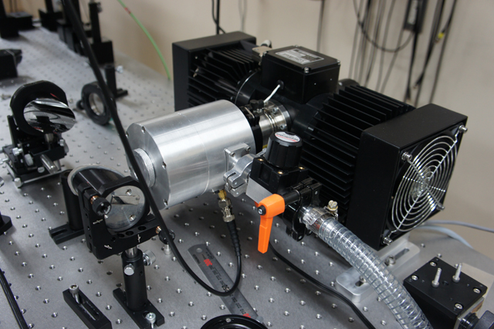
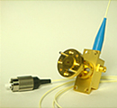
Background
Recent progress in
CW-THz sources
THz-QCL
UTC-PD
The requirements of Frequency measurement have increased
Conventional methods of the frequency measurement
・Electrical heterodyne method
・Optical interferometric method
Cryogenic cooling of mixers or detectors is required
Frequency measurement of CW-THz radiation without the need for cryogenic cooling is strongly required !
Notes:
Along with recent progress in CW-THz sources such as THz-QCL and UTC-PD, the requirements of frequency measurement of CW-THz wave(radiation) have increased in various applications. Conventionally, electrical heterodyne method and optical interferometric method have been often used for frequency measurement of CW-THz wave(radiation). However, these methods require cryogenic cooling of mixers or detectors to suppress thermal noise. Therefore, frequency measurement of CW-THz wave(radiation) without the need for cryogenic cooling is strongly required.

Slide 3
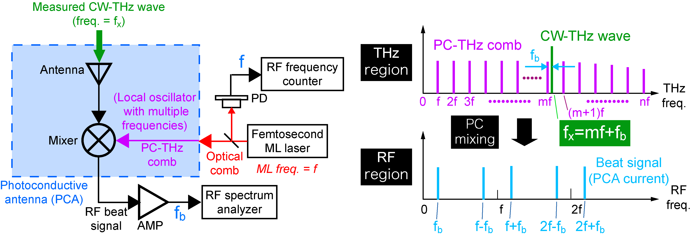
THz-comb-referenced frequency measurement based on photoconductive mixing
Freq. domain
f_{THz}
f_{rep}
f_{THz}=mf+f_{b}
f_{rep}
f_{beat}
f_{THz}=mf_{rep} ± f_{beat}
m: order of comb mode
f_{rep}: ML frequency
f_{beat}: beat frequency
Ref)
Opt. Express 16, 13052 (2008); Stabilized Ti:S laser, precision=10⁻¹¹, not real-time
Opt. Express 17, 17034 (2009); Stabilized Er:fiber laser, precision=10⁻¹¹, not real-time
Opt. Express 23, 11367 (2015); Stabilized dual Er:fiber laser, precision=10⁻¹¹, real-time
Notes:
So, we developed THz-comb-referenced frequency measurement.
Here is the principle of this method. This method is based on heterodyne technique. Compared with the electrical heterodyne technique,
We used PCA as a heterodyne receiver This results in high and broadband spectral sensitivity in the THz region without the need for cryogenic cooling. Another difference is the use of a PC-THz comb as a local oscillator.
The right part shows spectral behavior of this method. When an optical comb with mode-locked frequency of f is incident on the antenna gap, the PC-THz comb is induced in the PCA. Then a measured CW-THz wave is induced on the PCA. As a result, PC mixing generates a group of beat signals in the RF region. Please focus on a beat signal at the lowest frequency. This beat signal is generated by mixing this CW-THz wave and this mf. Therefore, the f_{THz} is given by this equation. The f_{rep} and f_{beat} can be easily measured with RF spectrum analyzer or frequency counter. To obtain the f_{THz}, we have to determine the m and sign of the f_{beat}.
Compared with the electrical heterodyne technique, a key difference is that the PCA is used as a heterodyne receiver. This results in high, broadband spectral sensitivity in the THz region without the need for cryogenic cooling. Another difference is the use of a PC-THz comb as a local oscillator.

Slide 4
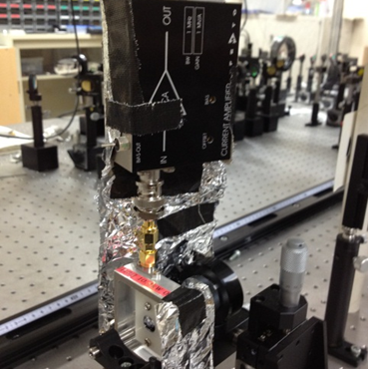
Problems of previous studies for practical use
Probing head using free-space optics and external current preamplifier
✔Bulky and complicated!
(2) Precisely stabilized
femtosecond ML laser
✔Expensive and delicate!
Current preamplifier
Free-space optics
PCA
Probing head
Present talk
(1) Compact and robust probing head using fiber optics and AMP-IC-integrated PCA
(2) Real-time, absolute frequency measurement using a free-running laser
Notes:
However, there were two problems of previous studies for practical use. First, the probing head using free-space optics and external current preamplifier is bulky and complicated. Second, precisely stabilized femtosecond laser has to be used to generate precise PC-THz comb. This results in expensive and delicate apparatus for practical use.
At the present talk. First, we developed compact and robust probing head using fiber optics and AMP-IC-integrated PCA. Furthermore, we demonstrate real-time absolute frequency measurement using a free-running laser.

Slide 5
(1) Compact and robust probing head using fiber optics and AMP-IC-integrated PCA module
Notes:
Compact and robust probing head using fiber optics and AMP-IC-integrated PCA module

Slide 6
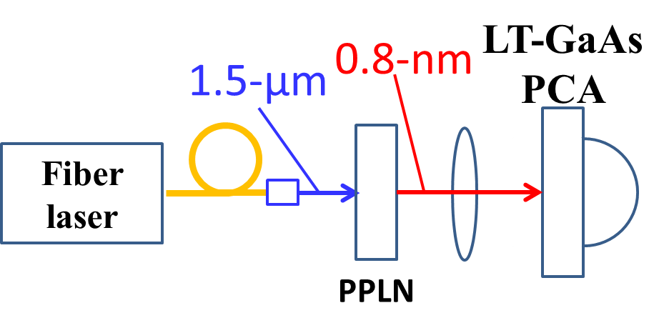
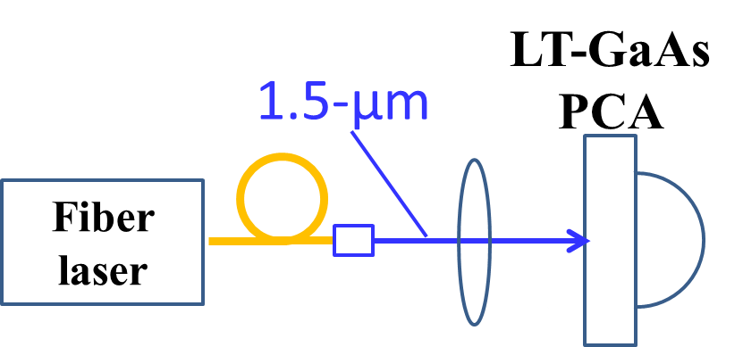
Direct excitation of LT-GaAs PCA by 1.5-µm light
LT-GaAs-PCA@0.8µm
Dependence of PCA resistance
LT-GaAs-PCA@1.5µm
Ref) M.Tani et al, Appl. Phys. Lett. 77, 1396 (2000).
Sufficient sensitivity
Considering SHG conversion efficiency(〜10%), sensitivity at 1.5μm excitation is comparable to that at 0.8μm.
Notes:
In the previous researches, LT-GaAs(gallium arsenide)-PCA has been used in combination with in the probing head, making it difficult to construct the compact probing head. If LT-GaAs-PCA can be directly excited by 1.5-µm light, the more compact probing head will be constructed without the need for the free-space optics. To evaluate the potential of 1.5-µm excitation, we compared the detection sensitivity of PCA, namely PCA resistance, between 0.8-µm excitation and 1.5-µm excitation with respect to incident power like here. To achieve the same sensitivity as the 0.8-µm light excitation, 10-times larger power is required for 1.5-µm light. However, considering SHG conversion efficiency of 〜10%, sensitivity at 1.5μm excitation is comparable to that at 0.8μm.

Slide 7
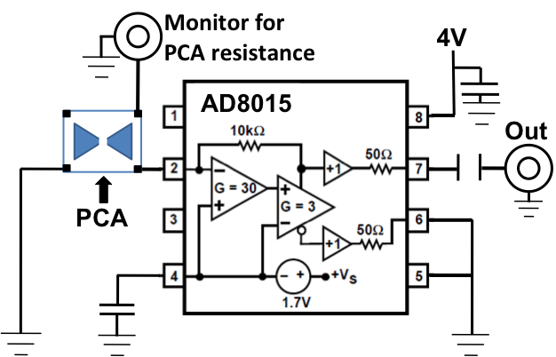
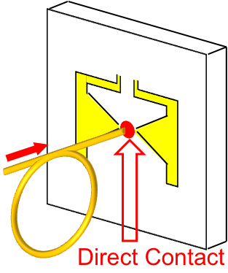
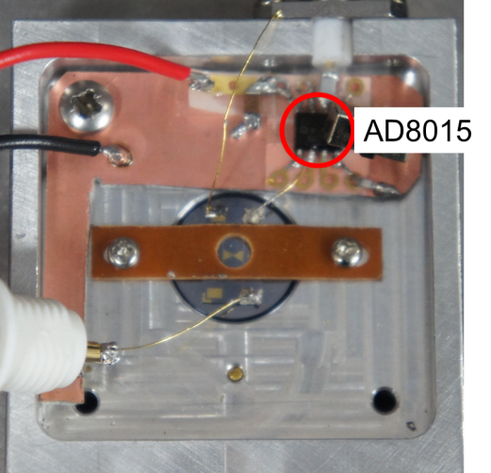
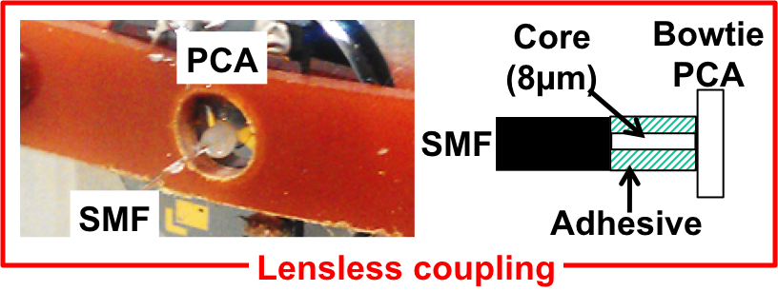
Compact and robust probing head
Lens-less coupling of
1.5-µm fiber laser
output on PCA
Integration of current preamp. IC with PCA
PCA
1.5-µm
Fiber
laser
AD8015
Gain=10kV/A
BW=240MHz
Notes:
Such direct excitation of PCA by 1.5 µm light enables lens-less coupling of 1.5-µm fiber laser output on PCA because the gap interval in PCA is comparable to diameter of the probe light. We achieved the lens-less coupling of the fiber end by adhesive without the need for any optics.
Furthermore, we integrated the current preamplifier IC, whose specification is here, into the probing head.
In this way, the compact and robust probing head was achieved.

Slide 8
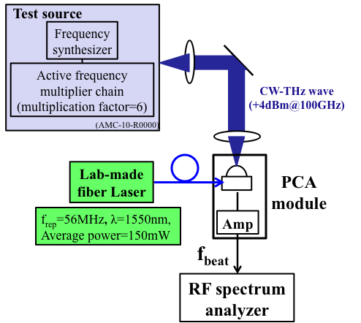
Result
Experimental setup
Beat signal between CW-THz wave and PC-THz comb mode
RF spectrum
analyzer
RBW:10kHz
SNR
45dB
Beat signal SNR＞10dB (required for frequency measurement)
Notes:
最初に何をするかの説明 開発した装置でTHzスペアナの実験を行った。
Left shows experimental setup. Photocarrier THz comb with frequency spacing of 56 MHz was induced in the PCA for THz detection by focusing the laser light on to PCA. Then, a measured CW-THz radiation around 0,1 THz was incident onto the PCA. Photoconductive mixing of PC-THz comb with CW-THz radiation generates a beat signal between them in RF region. The resulting SNR of beat signal was achieved to 45 dB, which is sufficient to determined the absolute frequency correctly.

Slide 9
(2) Real-time, absolute frequency measurement using a free-running laser
Notes:
Next, Real-time, absolute frequency measurement using a free-running laser

Slide 10
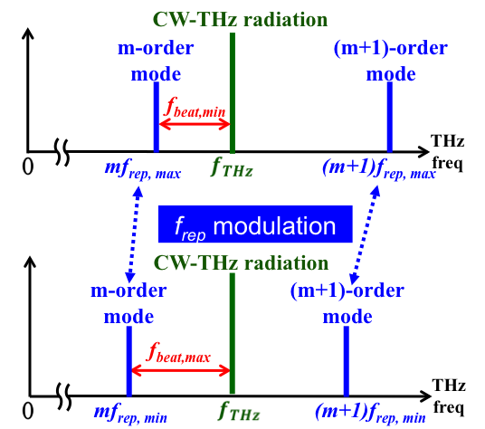
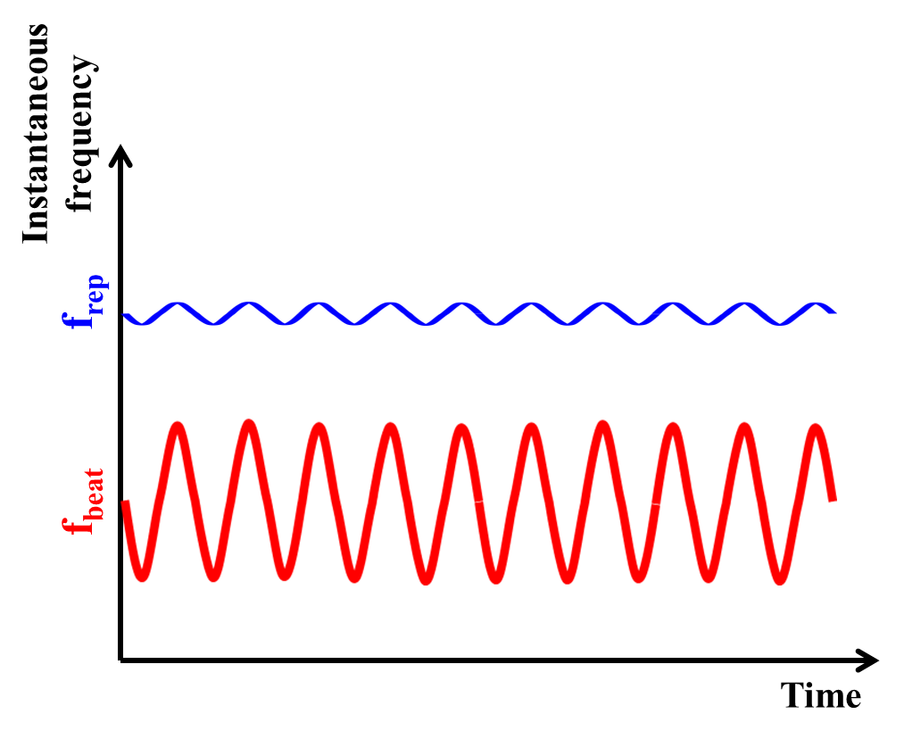
Real-time determination of CW-THz frequency
using a f_{rep}-modulated PC-THz comb
f_{rep,max}
f_{rep,min}
f_{beat,max}
f_{beat,min}
f_{THz}= mf_{rep} − f_{beat}
f_{THz}= mf_{rep} − f_{beat}
〈in-pahse between f_{rep} and f_{beat}〉
〈out-of-pahse between f_{rep} and f_{beat}〉
Notes:
THz-comb-referenced spectrum analyzer is based on a heterodyne technique based on photoconductive mixing [1, 2]. Figure 1(a) shows the spectral behavior of PC-THz comb mode (freq. interval = frep) and CW-THz radiation (freq. = fTHz) in this method. When frep is modulated sinusoidally (maximum frep value = frep_max, minimum frep value = frep_min), fbeat is also modulated in synchronization with the modulated frep (maximum fbeat value = fbeat_max,minimum fbeat value = fbeat_min) as shown Fig. 1(b). If fluctuation of fTHz is much slower than modulation frequency of frep, the mode order m of PC-THz comb nearest in frequency to fTHz can be determined using the following equation.m=(fbeat_max − fbeat_min)/(frep_max − frep_min).(1) Finally, fTHz is calculated as follow

Slide 11
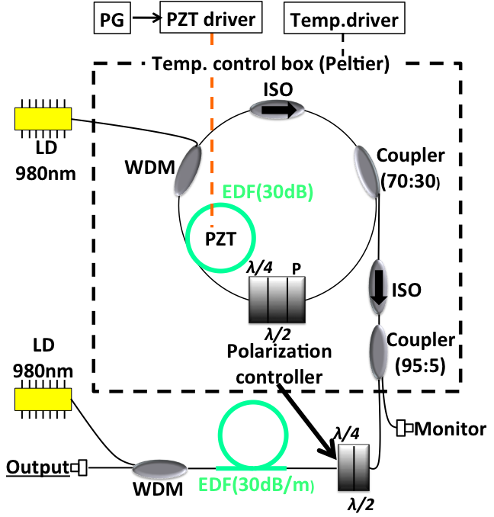
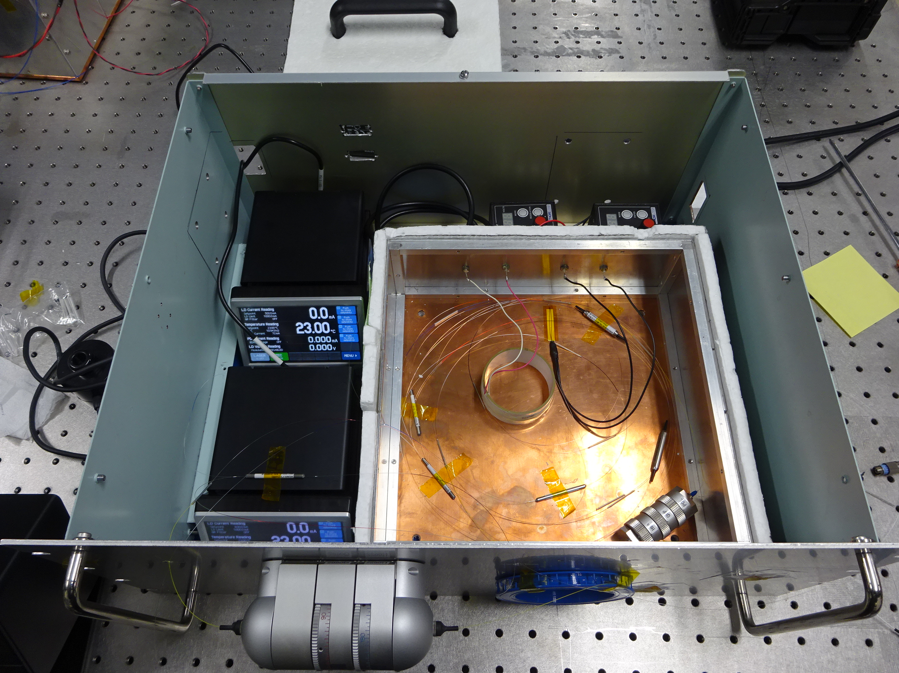
Portable f_{rep}-modulated Er:fiber laser
~compact, no stabilization, fiber output~
Cavity configuration
Photograph
19 inch
PZT driver
Temp. driver
LD driver
LD driver
Temp. control box
Center wavelength 1550nm
Average output power 110mW
Polarization controller
(optimize laser output)
Notes:
To modulate the frequency interval of PC-THz comb, we construct a portable frep-modulated Er:fiber laser.
Left shows cavity configuration of this laser. The mode-locking operation was achieved by nonlinear polarization rotation in a ring cavity. To modulate the frep of the fiber laser, an optical cavity length of the fiber cavity was modulated at 100 Hz by PZT. The output of the fiber oscillator is amplified up to 110 mW at 1.5µm by EDFA.
Right shows a photograph of the constructed laser
This laser is contained in a 19-inch lack for portable application.

Slide 12
Experimental setup
Test source
Frequency
synthesizer
clock
Rb frequency
standard
clock
Active frequency
multiplier chain
(multiplication factor=6)
Stability < 2*10⁻¹¹
Accuracy : 5*10⁻¹¹
Laser
f_{rep}=100,000,000Hz@Freerun
λ=1550nm, Δt=56fs
(AMC-10-R0000)
SHG crystal
Laser
PG
CW-THz wave
(75-110GHz, +4dBm@100GHz)
Amp
Modulation frquency:100Hz
f_{beat}
f_{rep}
Hilbert
transform
Instantaneous
frequency of
f_{rep} and f_{beat}
Digitizer
Ref) H. Füser et al,
Appl. Phys. Lett.99, 121111 (2011).
Notes:
Next shows experimental setup. In the following experiments, A femtosecond fiber laser was operated in free-running condition. The center frequency of the modulated frep was modulated around 56 MHz, and frequency deviation and modulation frequency were ±@@Hz and @@ Hz, respectively. After wavelength conversion by SHG crystal, the laser lights were focused onto the PCA, generating PC-THz comb in PCA. Then, CW-THz wave is incident onto PCA. The PC mixing between PC-THz comb and CW-THz wave generates the modulated beat signals in synchronization of the modulated frep. After amplification with current preamplifier, the temporal waveforms of the beat signal was acquired by a fast digitizer. Then, we obtain the instantaneous value of fTHz in real time by Hi;berlt transform.

Slide 13
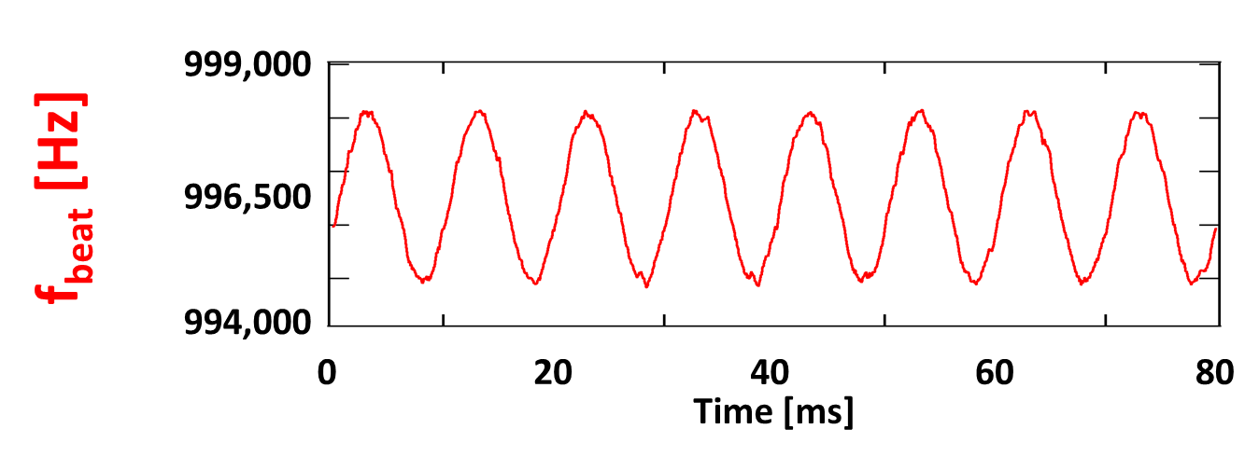
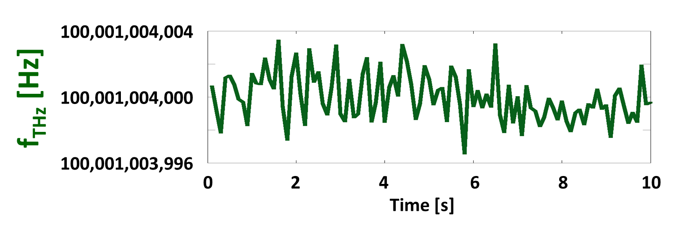
Real-time determination of f_{THz}
Sampling rate 10 MHz
Fitting of f_{rep} and f_{beat}
δf_{rep} = 3.1446 Hz
δf_{beat} = 3144.6 Hz
m = 1000
Data length 1 M
Sampling rate
10 Hz
Accuracy
6.2×10⁻¹²
Notes:
Next shows the temporal change of the instantaneous value in frep and fbeat, which is calculated from the temporal waveform of freo and fbeat acquired at 10 MHz . One can confirm that fbeat is modulated in synchronization with frep. Since frequency deviation of the modulated frep and fbeat were these value and the phase relation between frep and fbeat is out-of-phase, the comb mode order m was determined to be 1,000 in real time. After integration of 1,000,000 data, we determined the fTHz at a measurement rate of 10Hz, In this rate, the frequency accuracy was 6.2*10-12.
こちらが実際に測定された信号です．サンプリングレートは10MHzで，それぞれの瞬時周波数を高速に取得できています．またこの波形をフィッテングして変調幅を算出するとこのようになり，この結果から次数mを決定すること出来ました．また絶対周波数もサンプリングレート10Hzで決定することが出来ました．また算出された周波数確度はこのようになりました。
mode order m
The result of real-time determination of f_{THz} is shown here. The f_{THz} can be obtained at a sampling rate of 10 MHz. Since the frep1 and frep2 are fixed, we can determine fTHz by measuring fbeat1 and fbeat2. The resulting f_{THz} is here. Although these values were roughly consistent with the setting frequency in the CW-THz source, it includes a frequency error within 10 Hz due to no averaging.
Figure 3(a) and 3(b) respectively show the temporal change of frep and fbeat when we used an active frequency multiplier chain (frequency range = 75~120 GHz, linewidth < 0.6 Hz, fTHz = 100.001,004 GHz) as a test source. From fbeat_max = 998 kHz, fbeat_min = 995 kHz, frep_max = 100.000,009 MHz, and frep_min = 100.000,006 MHz in Fig. 3(a), m was determined to be 1000. Finally, we confirmed that fTHz was fluctuated around 100.001,004 GHz as shown in Fig. 3(c). The determined fTHz coincided with the configured fTHz with accuracy of 10-11.

Slide 14
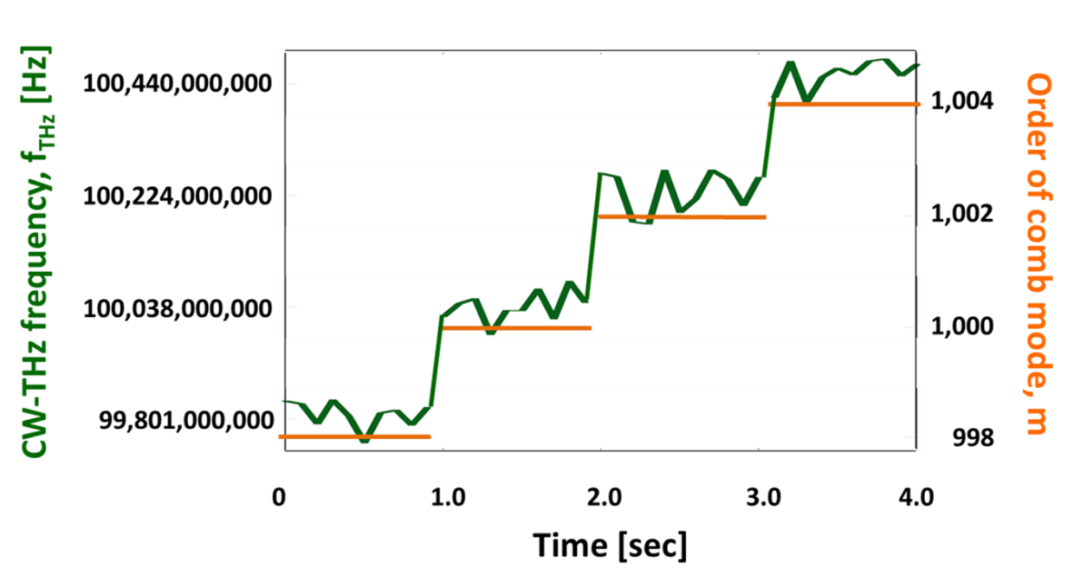
Real-time monitoring of CW-THz wave (Frequency fluctuation = 0.1THz + 200MHz)
A high potential for real time monitoring of large fluctuation such as mode hopping in CW-THz sources!
$$f_{THz}$$
$$f_{THz}$$
$$f_{THz}$$
$$f_{THz}$$
Order of comb mode
998
1000
1002
1004
Notes:
We next monitor the four-step large fluctuation in fTHz. Even though the CW-THz wave move 200 MHz across comb mode, the m and fTHz were correctly determined. This result indicates a high potential for real-time monitoring of large fluctuation such as mode hopping in CW-THz sources.

Slide 15
Summary
Compact and robust probing head based on lens-less coupling of fiber output and AMP IC-integrated PCA
Portable, f_{rep}-modulated fiber laser
Real-time, absolute frequency determination of CW-THz radiation at precision of 6.2×10⁻¹²
Applicable for large frequency change such as mode hopping
Notes:
In summary, we developed compact and robust probing head using fiber optics and AMP-IC-integrated PCA. Furthermore, we demonstrate real-time absolute frequency measurement using a free-running laser. This experimental result is shown here. Thank you for your attention.

Slide 16
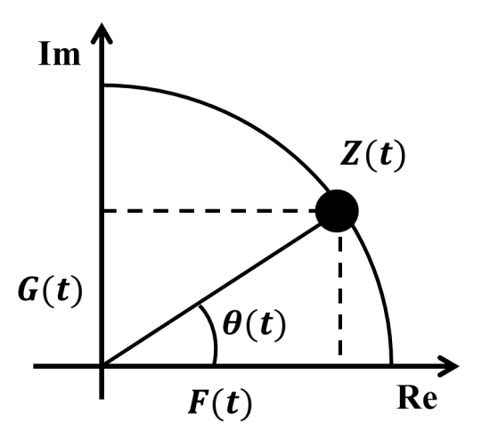
Instantaneous frequency measurement using Hilbert transformation
Ref) H. Füser et al, Appl. Phys. Lett. 99, 121111 (2011).
$$Z\left(t\right)=F\left(t\right)+iG\left(t\right)$$
measurement signal
$G\left(t\right)$:
signal after
Hilbert transform
Z(t): analytic signal
$F\left(t\right)$:
Notes:
Also, we employed Hilbert transformation to extract instantaneous values of fbeat from the temporal waveform measured by a fast digitizer. Hilbert transformation converts the signal F(t) measured in the real domain into the signal G(t) in the imaginary domain. The complex function of F(t) +iG(t) gives the analytic signal Z(t).
The instantaneous frequency f can be calculated by these two equations. Therefore, the instantaneous frequency can be obtained from the temporal waveform.

Slide 17
Real-time absolute frequency measurement using a single PC-THz comb
modulating f_{rep}
→Δf_{rep} and Δf_{beat} can be measured
2. using free-running laser
→Δf_{rep} and Δf_{beat} can be measured
The m and f_{THz} can be determine by measuring Δf_{rep} and Δf_{beat} at the same time !!

Slide 18
The advantage of Hilbert transformation
Compared with frequency counter
The beat signal of lower SNR (~10) can be measured
Fast phenomenon can be measured
→frequency counter is limited by gate time

