Slide 1
Optical fiber strain sensor homework
Journal seminar
2015/8/10
M2 Takashi Ogura

Slide 2
Sien-Ting Lau, et al. “Characterization of a 40-MHz Focused Transducer with a Fiber Grating Laser Hydrophone” IEEE Trans Ultrason Ferroelectr Freq Control. 55，2714–2718 (2008)
Liang Zhang, et al. “Optical fiber strain sensor using fiber resonator based on frequency comb Vernier spectroscopy” Opt. Lett. 37, 13 (2012)
3. Naoya Kuse, et al. “Static FBG strain sensor with high
resolution and large dynamic range by
dual-comb spectroscopy” Opt. Express. 21, 9(2013)

Slide 3
Sien-Ting Lau, Li-Yang Shao, Helen Lai-Wa Chen,
Hwa-Yaw Tam, Chang-Hong Hu, Hyung-Ham Kim,
Ruibin Liu, Qifa Zhou, and K. kirk Shung.
“Characterization of a 40-MHz Focused Transducer with a Fiber Grating Laser Hydrophone”
IEEE Trans Ultrason Ferroelectr Freq Control. 55，2714–2718 (2008)
Notes:
非侵襲血糖値測定法…生体に照射した断続光(近赤外光)がグルコースに吸収されることで生じる熱波や弾性波を皮膚表面で検出し、血糖値をすいていする． 断続光の変調周波数を調整することでPA信号が発生する深さ(測定可能深さ)
糖尿病の予防・治療 日々の生活における血糖値の測定・管理 しかし現在は痛みの軽減 連続的な血糖値測定
光の高コントラスト特性と音波の生体長距離伝搬特性
生体から明確な光音響信号を得るためには，Wオーダの光照射出力を利用する必要がある．
米国FDAの安全基準・・・十数mWオーダー 体内で発生する背景雑音とのSN比 -50dB 光音響分光法によるHbA1c濃度モニタリング

Slide 4
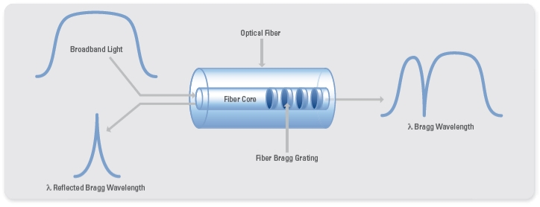
FBG(Fiber Bragg grating)
Bragg wavelength
n: Effective refractive index
Λ:Grating period
Notes:
ゲルマニウム（Ge）をドープした光ファイバのコアに、波長250nm前後の紫外（UV）光を照射すると、光誘起屈折率変化（Photosensitivity）によりその屈折率が変化し、照射を止めた後も持続する。
この式では、λoが当初の波長で、Δλが波長の変化量を表しています。式（2）の第1項は波長変動に対する歪みの影響を表しており、p_{e}は歪み－光係数、εはグレーティングが受ける歪みを示しています。第2項は波長変動に対する温度の影響を表しており、α_{Λ}は熱膨張係数、α_{n}は熱－光係数を示しています。つまりα_{n}は温度による屈折率の変化、α_{Λ}は温度によるグレーティング間隔の拡大にそれぞれ相当します。

Slide 5
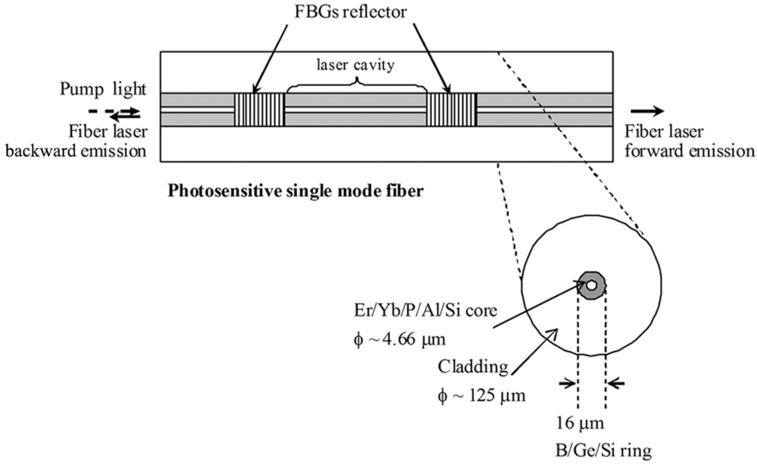
FBGs reflector
1550nm
980nm
ν: lasing frequency
B: induced birefringence
Notes:
Polymer waveguides 2×2µm2 in cross section
Optical fibers were butt coupled to the input and output
bus waveguide using UV curable epoxy Loctite 3526,
Henkel Loctite Corp., Rocky Hill, CT
異方性の変化 複屈折率

Slide 6
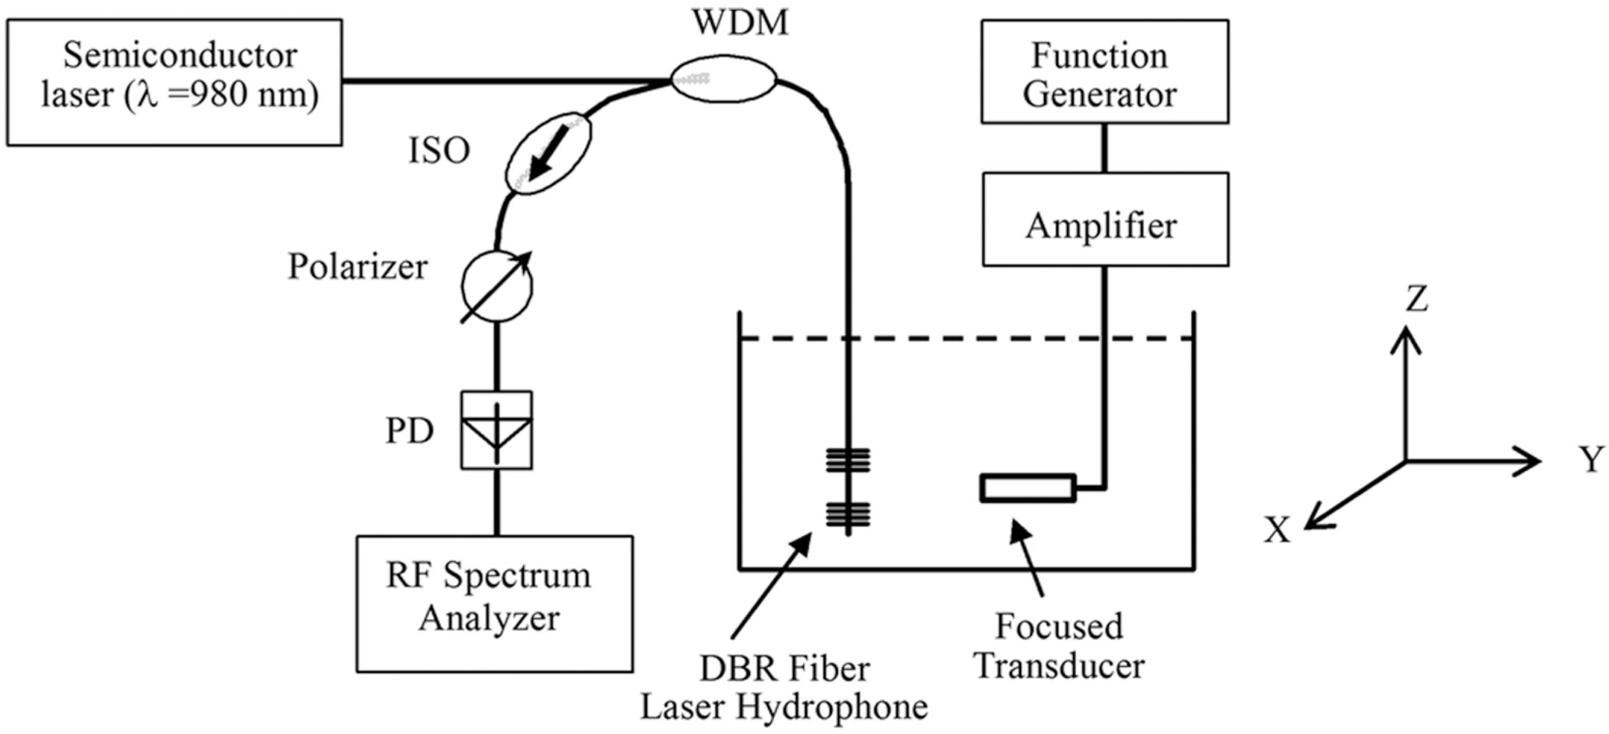
Setup
LiNbO₃(incorporating a lens for focusing and 2 matching layers)
ISO, isolator; PD, photodetector; WDM,wavelength division multiplexer
Notes:
Polymer waveguides 2×2µm2 in cross section
Optical fibers were butt coupled to the input and output
bus waveguide using UV curable epoxy Loctite 3526,
Henkel Loctite Corp., Rocky Hill, CT

Slide 7
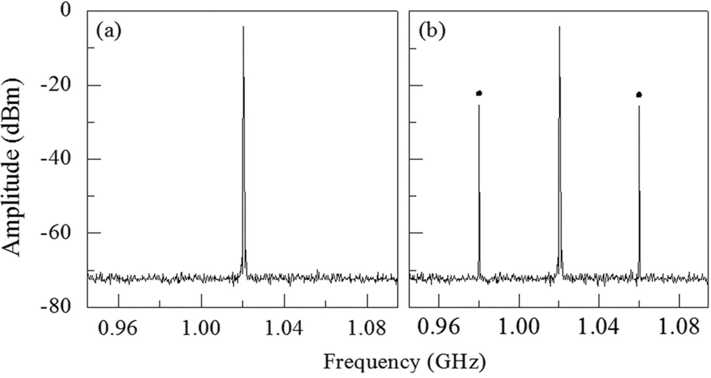
Experimental results
Beat signal spectra of the DBR laser fiber sensor
0V
0.28V at 40MHz
Notes:
Polymer waveguides 2×2µm2 in cross section
Optical fibers were butt coupled to the input and output
bus waveguide using UV curable epoxy Loctite 3526,
Henkel Loctite Corp., Rocky Hill, CT

Slide 8
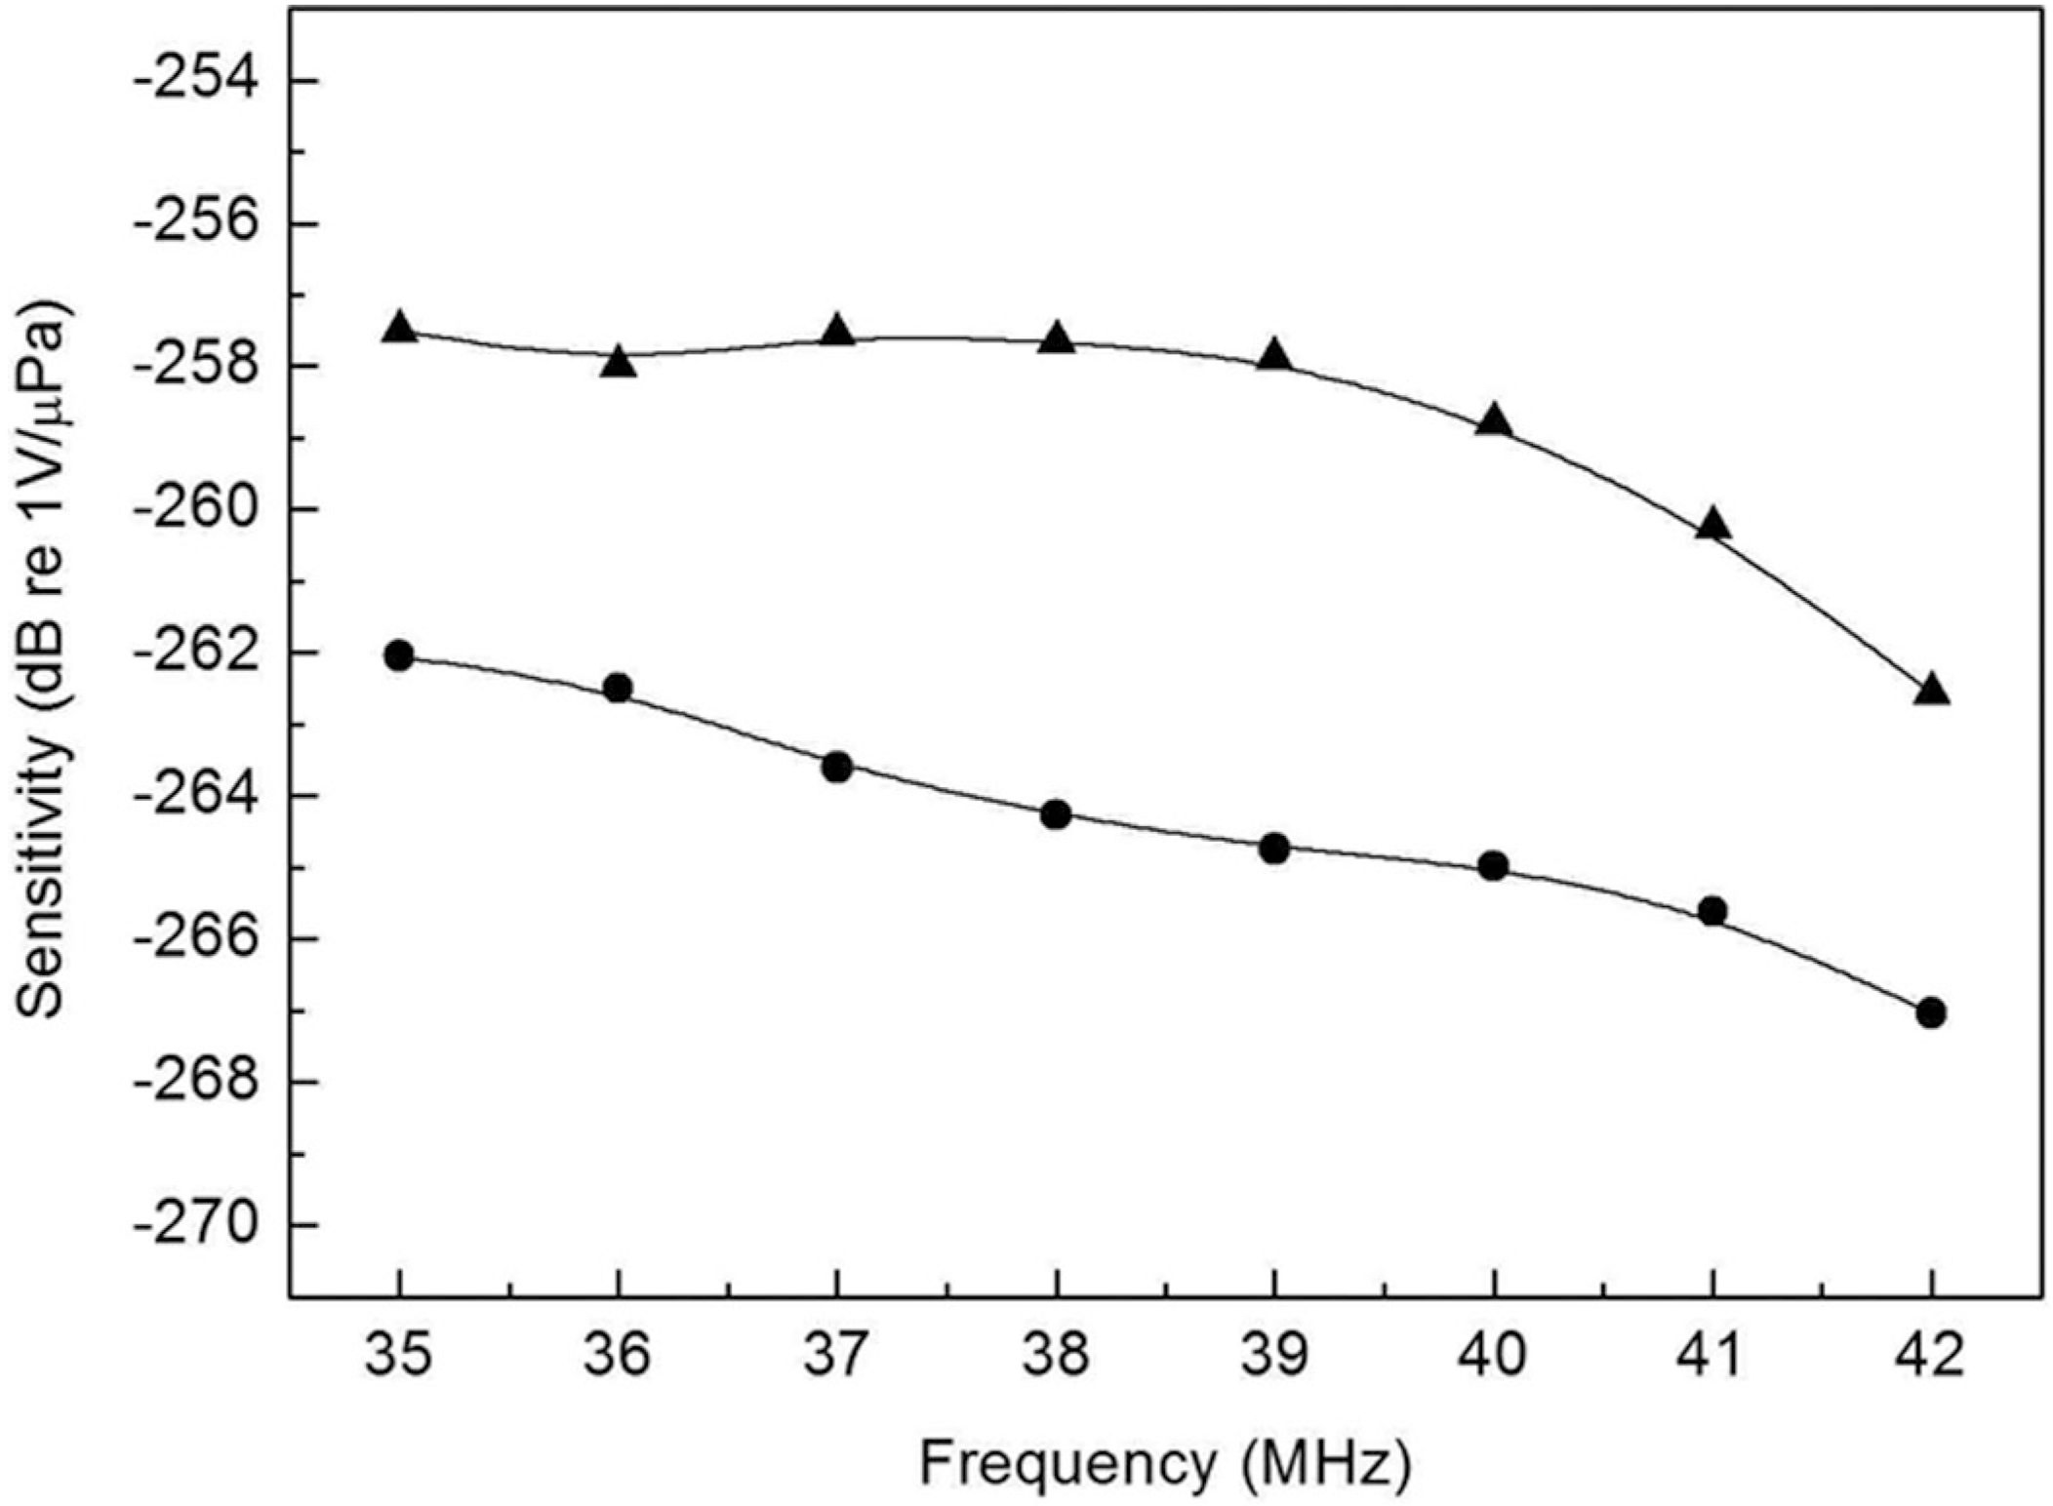
Experimental results
M =V_{f}/p
V_{f}: Voltage
p: Acoustic pressure
Frequency plot of the sensitivity of the fiber hydrophone (▲) and needle-type PVDF
hydrophone (●).
Notes:
Polymer waveguides 2×2µm2 in cross section
Optical fibers were butt coupled to the input and output
bus waveguide using UV curable epoxy Loctite 3526,
Henkel Loctite Corp., Rocky Hill, CT

Slide 9
Liang Zhang, Ping Lu,Li Chen, Chaoran Huang, Deming Liu, and Shibin Jiang
“Optical fiber strain sensor using fiber resonator based on frequency comb Vernier spectroscopy”
Opt. Lett. 37, 13 (2012)

Slide 10
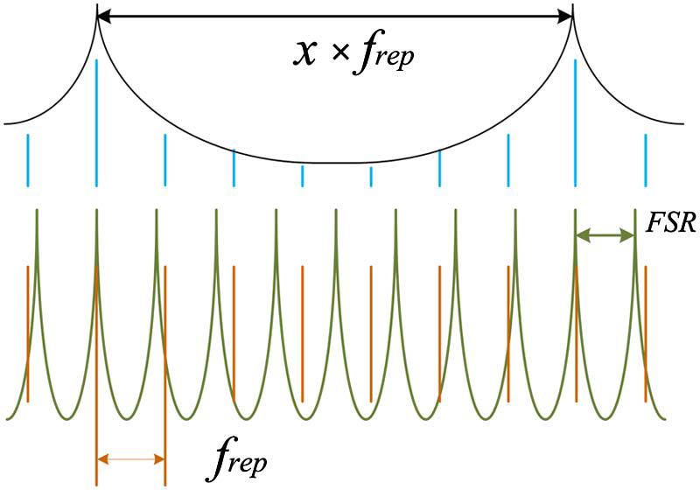
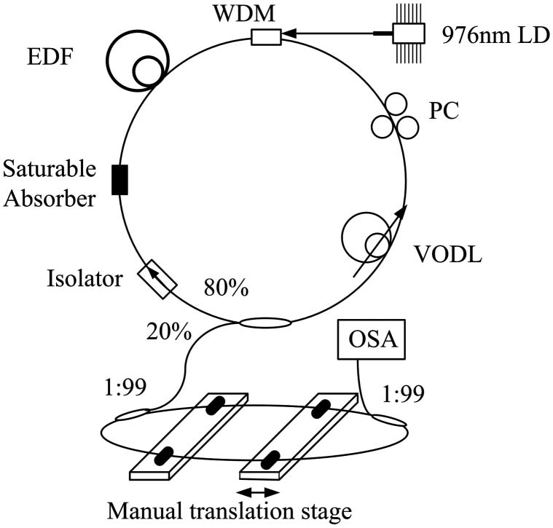
Principle&Setup
・The length of the laser cavity was about 11 m, corresponding to the f rep of 18.8 MHz
・The length of the resonator was about 11 m, corresponding to FSR of 19 MHz
・Two sections of optical fibers of
about 5 m as sensing heads
Notes:
Polymer waveguides 2×2µm2 in cross section
Optical fibers were butt coupled to the input and output
bus waveguide using UV curable epoxy Loctite 3526,
Henkel Loctite Corp., Rocky Hill, CT

Slide 11
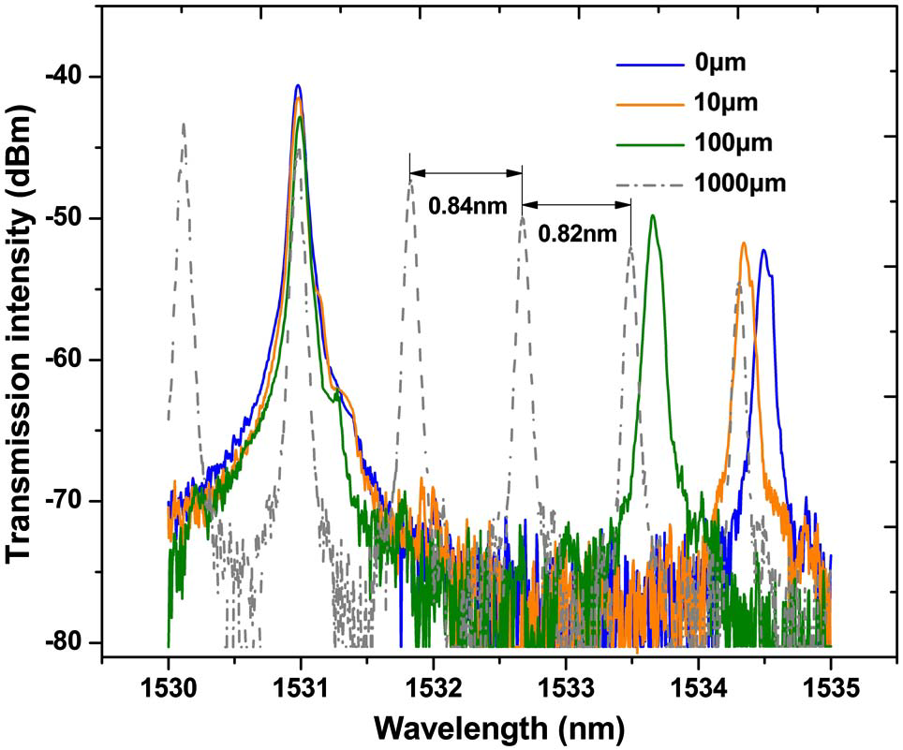
Experimental results
Notes:
To reduce its influence on the measurement accuracy the wavelength spacing was measured when a peak wave length shifted to a fixed wavelenght
レゾネータのファイバーの分散値のむらが、ファイバースペーシングのむらを引き起こす。

Slide 12
Naoya, Kuse, Akira Ozawa, and Yohei Kobayash
i
“Static FBG strain sensor with high
resolution and large dynamic range by
dual-comb spectroscopy”
Opt. Express. 21, 9(2013)

Slide 13
Principle
Notes:
Scanning electron micrograph
Gap 150nm

Slide 14
Experimental setup
Center frequency 290.4THz
Transmission bandwidth is 500MHz
Stop band width is 400GHz
Notes:
Scanning electron micrograph
Gap 150nm

Slide 15
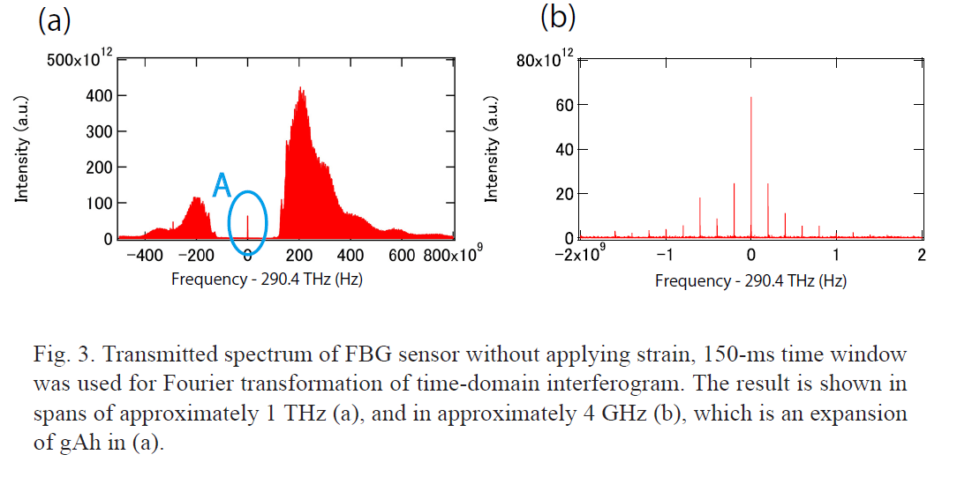
Experimental results
Notes:
Scanning electron micrograph
Gap 150nm

Slide 16
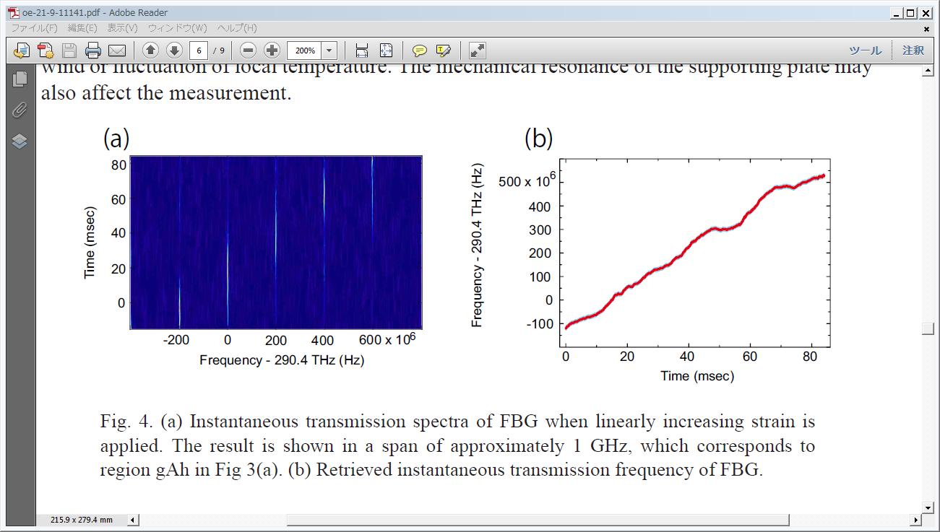
Experimental results
Notes:
Scanning electron micrograph
Gap 150nm

Slide 17
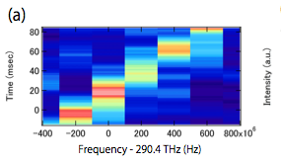
Experimental results
Notes:
Scanning electron micrograph
Gap 150nm

Slide 18
Summary
They have demonstrated a quasi-static FBG strain sensor with 34 nε -resolution and 1-THz bandwidthby dual-comb spectroscopy. This high-resolution, broad-bandwidth FBG sensor has apotential as a tool for geophysics applications.

Slide 19
Intoroduction
Ultrasound is frequently used in bioimaging
・clinical imaging
・cardiology
・obstetrics, and gynecology
PVDF hydrophones have been widely used in medical ultrasound
□Problem
when the ultrasound frequency is increased,
the size of the hydrophone needs to be decreased. With the sensing element smaller than afraction of 1 mm, the sensitivity diminishes significantly.
In this letter
・novel fiber-optic hydrophone with a dual polarization distributed Bragg reflector (DBR) fiber laser as the sensing element
Notes:
非常に制限
小さな要素のノイズレベルが増える 電気的接続の複雑さ 製作上の困難

