Slide 1
Optical fiber strain sensor
Journal seminar
2015/7/7
M2 Takashi Ogura

Slide 2
Fiber sensing using optical comb cavity
Disturbance/ RFfrequency conversion
c: light speed
n: group refractive index
L: fiber length
Utilize the dynamic range of optical comb
Disturbance
Sensing cavity
Expansion of the
dynamic range of sensing
Notes:
リング型共振器を光コムの光源として使います。
そして、共振器の一部をセンシングのプローブとして使います
外乱が合ったときに光コムの周波数に変換て計測します
繰り返し周波数は共振器な長さできまるので、
外乱があった時に周波数に変換可能

Slide 3
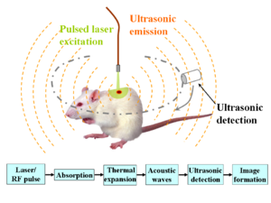
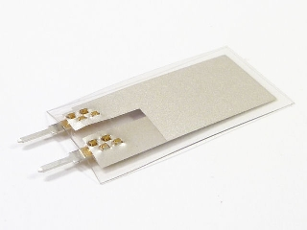
Photoacousitc
Traditional detector
for ultrasound
PVDF:Polyvinylidene fluoride
Microring resonator

Slide 4
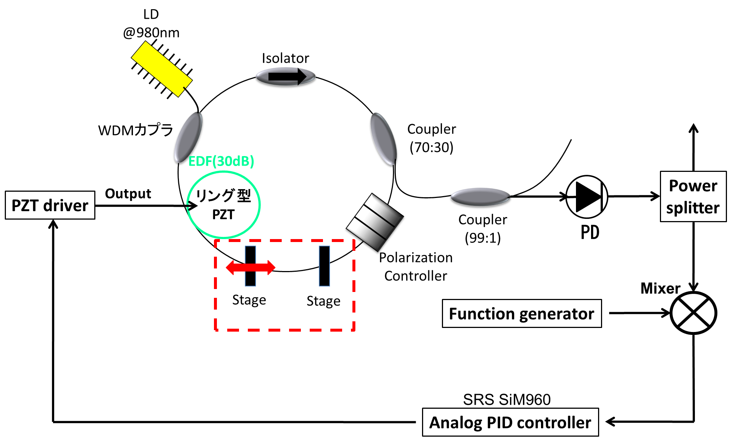
Strain-sensing fiber comb
(f_{rep} stabilized mode-locked Er:fiber laser)
Function generator
PZT driver
Reference
PZT for dynamic or small strain
Dynamic
strain
measurement
Lock-in amp
Monitor
Oscilloscope
Static strain
measurement
Translation stage for static or large strain
Notes:
実際の高速光通信用のフォトダイオードアンプにおいて，ダイオードとアンプは同一パッケージ内にあり，ボンディングワイヤーによってミリメートル以下の配線で結ばれている T-ZAMpのノイズと帯域幅
AD8067
RFスペアナのノイズ以上にするために

Slide 5
Experimental results
①Minimum displacement detection=0.036µm
②Maximum displacement detection=36µm
③Cutoff frequeny：f_{c}=200 Hz
Future plan
①High speed control optical comb
（cutoff frequency>200kHz
②Using for photoacoustic imaging

Slide 6
Consideration
①Comparison with FBG sensor
②Another sensing application and method
In this seminar
①FBG laser Hydrophone
(frequency response=40MHz)
②Strain sensor using optical comb

Slide 7
Sien-Ting Lau, et al. “Characterization of a 40-MHz Focused Transducer with a Fiber Grating Laser Hydrophone” IEEE Trans Ultrason Ferroelectr Freq Control. 55，2714–2718 (2008)
Liang Zhang, et al. “Optical fiber strain sensor using fiber resonator based on frequency comb Vernier spectroscopy” Opt. Lett. 37, 13 (2012)
3. Naoya Kuse, et al. “Static FBG strain sensor with high
resolution and large dynamic range by
dual-comb spectroscopy” Opt. Express. 21, 9(2013)

Slide 8
Sien-Ting Lau, Li-Yang Shao, Helen Lai-Wa Chen,
Hwa-Yaw Tam, Chang-Hong Hu, Hyung-Ham Kim,
Ruibin Liu, Qifa Zhou, and K. kirk Shung.
“Characterization of a 40-MHz Focused Transducer with a Fiber Grating Laser Hydrophone”
IEEE Trans Ultrason Ferroelectr Freq Control. 55，2714–2718 (2008)
Notes:
非侵襲血糖値測定法…生体に照射した断続光(近赤外光)がグルコースに吸収されることで生じる熱波や弾性波を皮膚表面で検出し、血糖値をすいていする． 断続光の変調周波数を調整することでPA信号が発生する深さ(測定可能深さ)
糖尿病の予防・治療 日々の生活における血糖値の測定・管理 しかし現在は痛みの軽減 連続的な血糖値測定
光の高コントラスト特性と音波の生体長距離伝搬特性
生体から明確な光音響信号を得るためには，Wオーダの光照射出力を利用する必要がある．
米国FDAの安全基準・・・十数mWオーダー 体内で発生する背景雑音とのSN比 -50dB 光音響分光法によるHbA1c濃度モニタリング

Slide 9
Intoroduction
Ultrasound is frequently used in bioimaging
・clinical imaging
・cardiology
・obstetrics, and gynecology
PVDF hydrophones have been widely used in medical ultrasound
□Problem
when the ultrasound frequency is increased,
the size of the hydrophone needs to be decreased. With the sensing element smaller than afraction of 1 mm, the sensitivity diminishes significantly.
In this letter
・novel fiber-optic hydrophone with a dual polarization distributed Bragg reflector (DBR) fiber laser as the sensing element
Notes:
非常に制限
小さな要素のノイズレベルが増える 電気的接続の複雑さ 製作上の困難

Slide 10
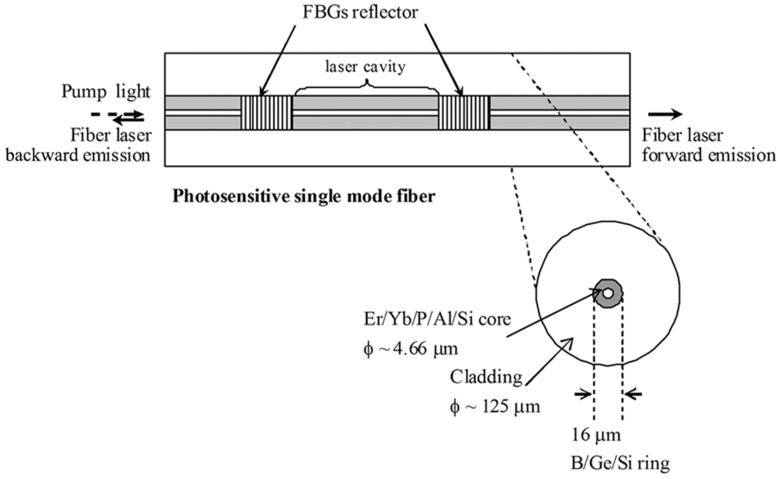
FBGs reflector
ν: lasing frequency
B: induced birefringenc
Notes:
Polymer waveguides 2×2µm2 in cross section
Optical fibers were butt coupled to the input and output
bus waveguide using UV curable epoxy Loctite 3526,
Henkel Loctite Corp., Rocky Hill, CT

Slide 11
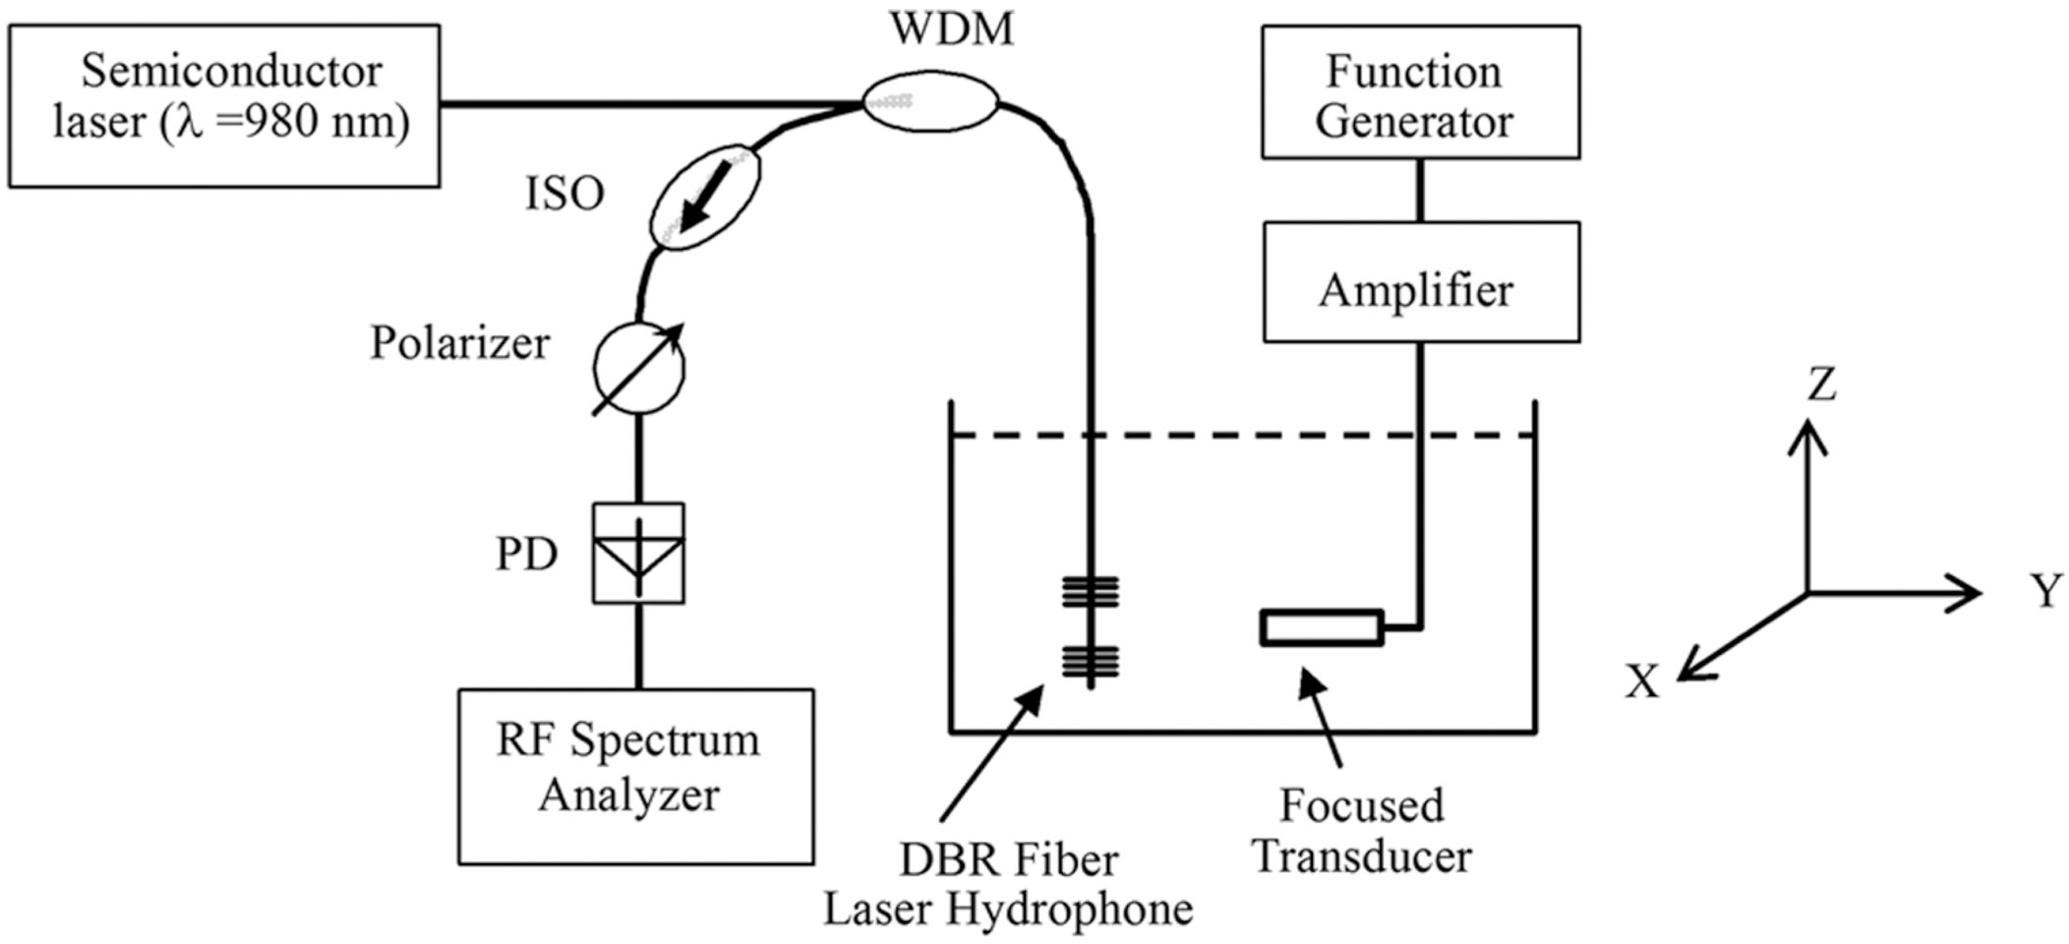
Setup
ISO, isolator; PD, photodetector; WDM,wavelength division multiplexer
Notes:
Polymer waveguides 2×2µm2 in cross section
Optical fibers were butt coupled to the input and output
bus waveguide using UV curable epoxy Loctite 3526,
Henkel Loctite Corp., Rocky Hill, CT

Slide 12
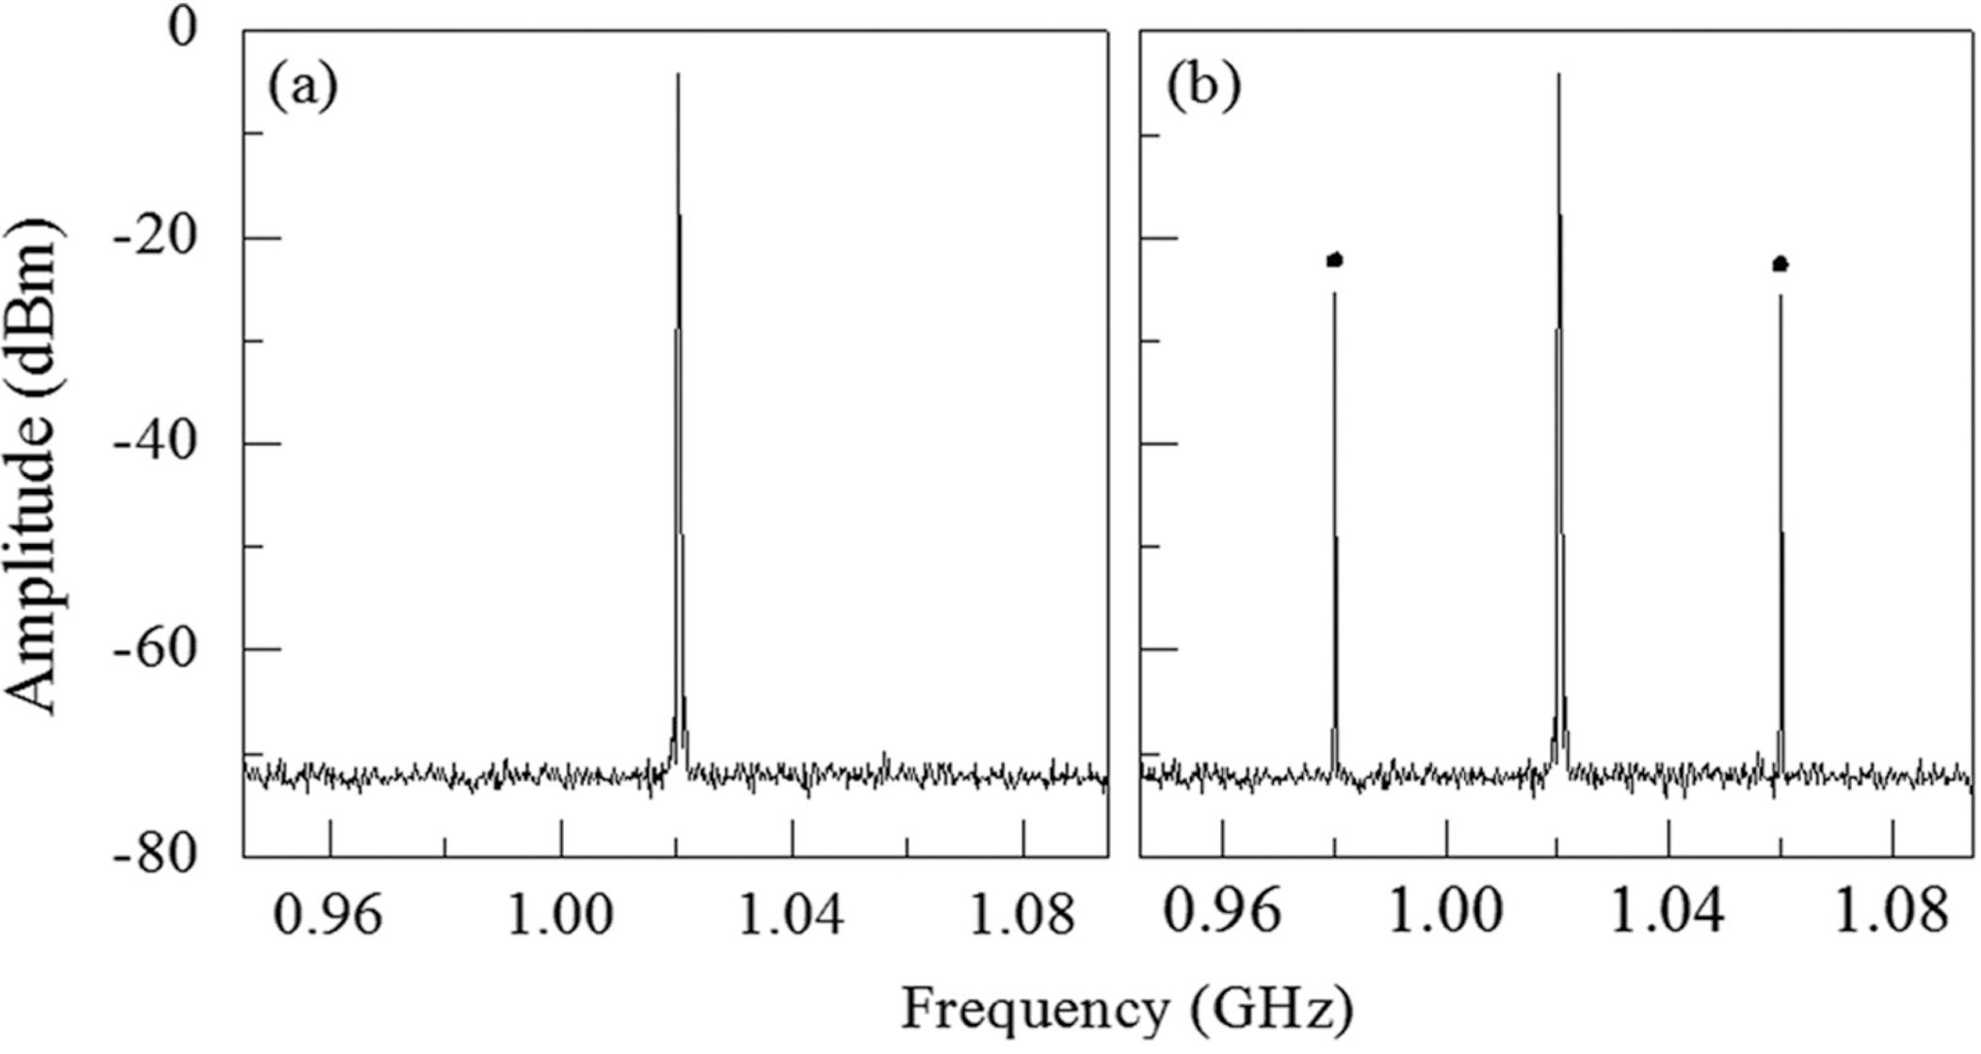
Experimental results
Beat signal spectra of the DBR laser fiber sensor
0V
0.28V at 40MHz
Notes:
Polymer waveguides 2×2µm2 in cross section
Optical fibers were butt coupled to the input and output
bus waveguide using UV curable epoxy Loctite 3526,
Henkel Loctite Corp., Rocky Hill, CT

Slide 13
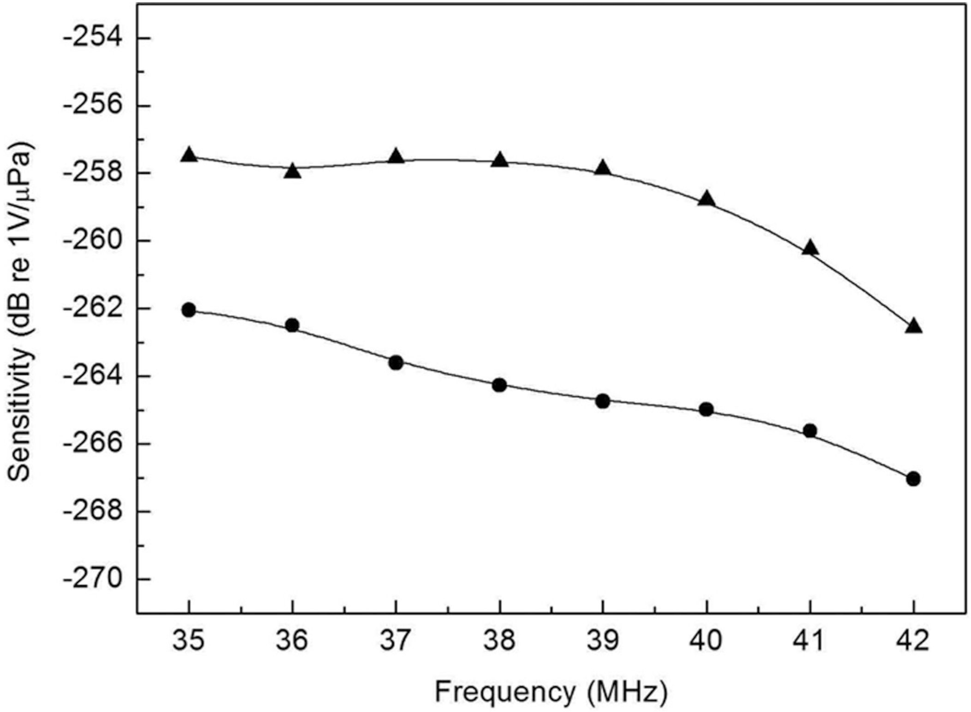
Experimental results
Frequency plot of the sensitivity of the fiber hydrophone (▲) and needle-type PVDF
hydrophone (●).
Notes:
Polymer waveguides 2×2µm2 in cross section
Optical fibers were butt coupled to the input and output
bus waveguide using UV curable epoxy Loctite 3526,
Henkel Loctite Corp., Rocky Hill, CT

Slide 14
Summary
A thinned fiber-optic acoustic pressure sensor that employed a dual polarization short-cavity fiber laser has been demonstrated.
Based on the modulation of the birefringence of the in-fiber laser by acoustic pressure, the sensor is capable of detecting ultrasound up to a frequency of 42 M Hz with good sensitivity (approximate −259 dB re 1V/μPa).

Slide 15
Liang Zhang, Ping Lu,Li Chen, Chaoran Huang, Deming Liu, and Shibin Jiang
“Optical fiber strain sensor using fiber resonator based on frequency comb Vernier spectroscopy”
Opt. Lett. 37, 13 (2012)

Slide 16
Intoroduction
Fiber Bragg gratings have been used as sensitive strain sensors
□Advantages
・cost effective
・small
・immune to electromagnetic interference
Frequency comb Vernier spectroscopy
□Problem
However, the aforementioned
techniques are implemented in mirror-based cavities,
whose difficult alignment limits their application
in strain sensing.
In this letter
・ alternative scheme for strain sensing using a fiber ring resonator based on frequency comb Vernier spectroscopy,
Notes:
非常に制限
小さな要素のノイズレベルが増える 電気的接続の複雑さ 製作上の困難

Slide 17
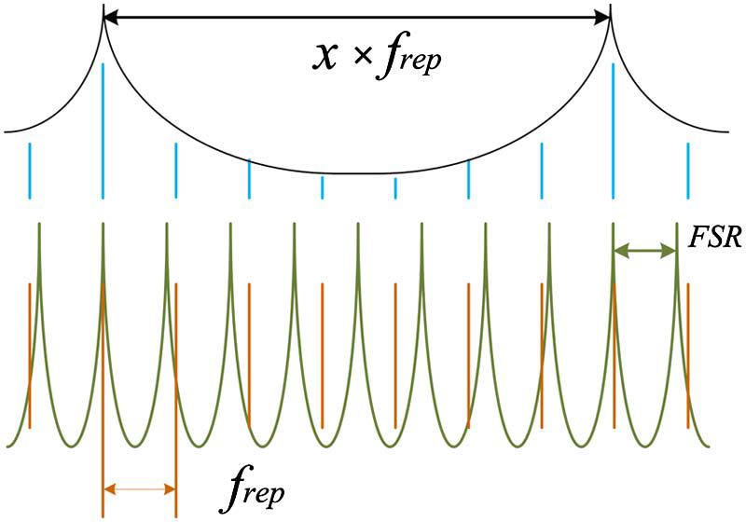
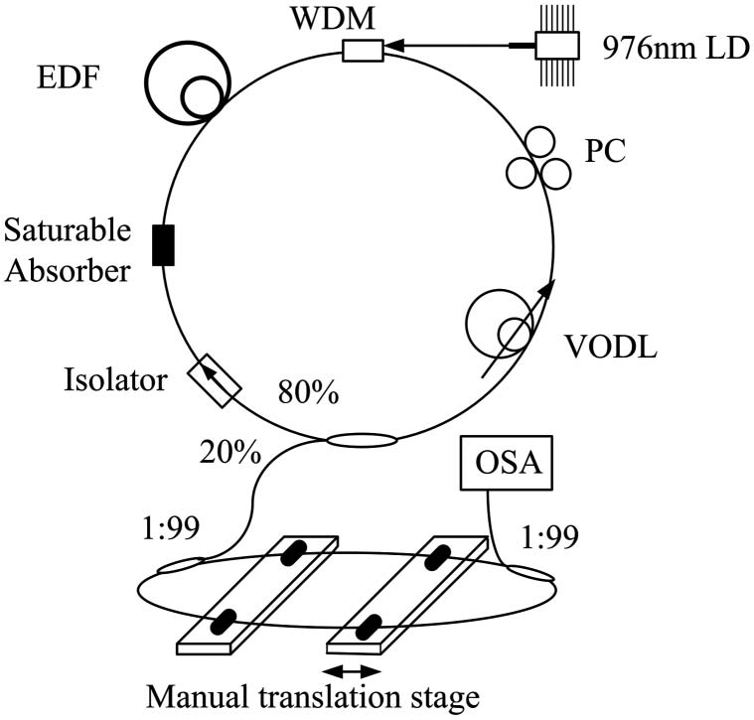
Principle&Setup
・The length of the laser cavity was about 11 m, corresponding to the f rep of 18.8 MHz
・The length of the resonator was about 11 m, corresponding to FSR of 19 MHz
・Two sections of optical fibers of
about 5 m as sensing heads
Notes:
Polymer waveguides 2×2µm2 in cross section
Optical fibers were butt coupled to the input and output
bus waveguide using UV curable epoxy Loctite 3526,
Henkel Loctite Corp., Rocky Hill, CT

Slide 18
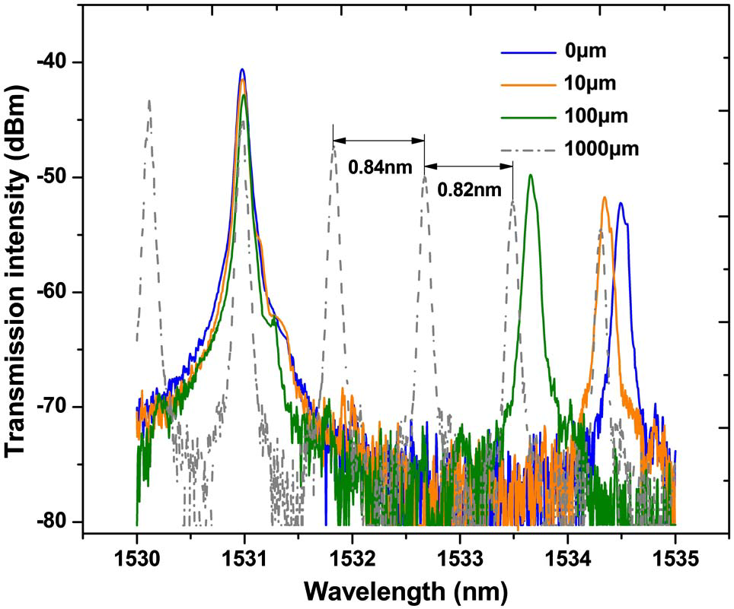
Experimental results
Notes:
Polymer waveguides 2×2µm2 in cross section
Optical fibers were butt coupled to the input and output
bus waveguide using UV curable epoxy Loctite 3526,
Henkel Loctite Corp., Rocky Hill, CT

Slide 19
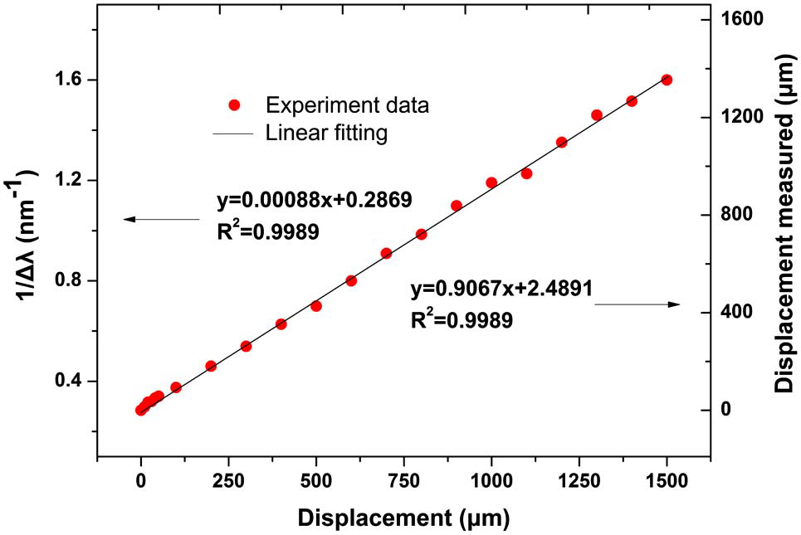
Experimental results(strain)
Notes:
Polymer waveguides 2×2µm2 in cross section
Optical fibers were butt coupled to the input and output
bus waveguide using UV curable epoxy Loctite 3526,
Henkel Loctite Corp., Rocky Hill, CT

Slide 20
Summary
They have proposed and experimentally demonstrateda novel (to our best knowledge) optical fiberstrain sensor using a fiber ring resonator based on frequency comb Vernier spectroscopy.
The transmission spectrum
demonstrates high sensitivities better than 40 pm∕με
within the range of 0 to 10 με.

Slide 21
Naoya, Kuse, Akira Ozawa, and Yohei Kobayash
i
“Static FBG strain sensor with high
resolution and large dynamic range by
dual-comb spectroscopy”
Opt. Express. 21, 9(2013)

Slide 22
Intoroduction
Fiber Bragg gratings have been used as sensitive strain sensors
□Advantages
・cost effective
・small
・immune to electromagnetic interference
Single-longitudinal-mode continuous-wave (CW) lasers are often used to detect the spectral shift of FBGs with high resolution
□Problems
the resolution is limited by the frequency
noise of the laser source.
In this letter
・ we propose and demonstrate a precise and broadband characterization of FBG sensors by employing dual-comb spectroscopy,
Notes:
非常に制限
小さな要素のノイズレベルが増える 電気的接続の複雑さ 製作上の困難

Slide 23
Principle
Notes:
Scanning electron micrograph
Gap 150nm

Slide 24
Experimental setup
Notes:
Scanning electron micrograph
Gap 150nm

Slide 25
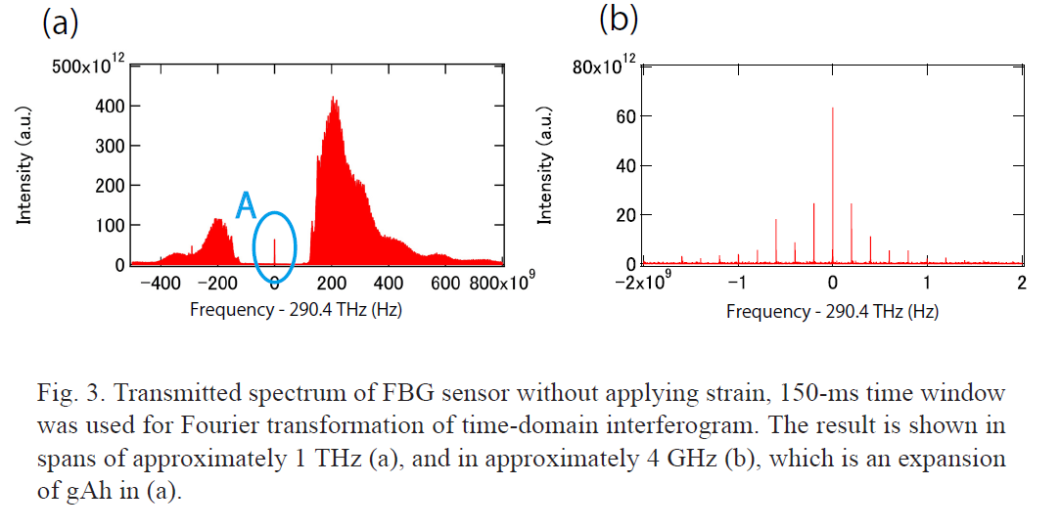
Experimental results
Notes:
Scanning electron micrograph
Gap 150nm

Slide 26
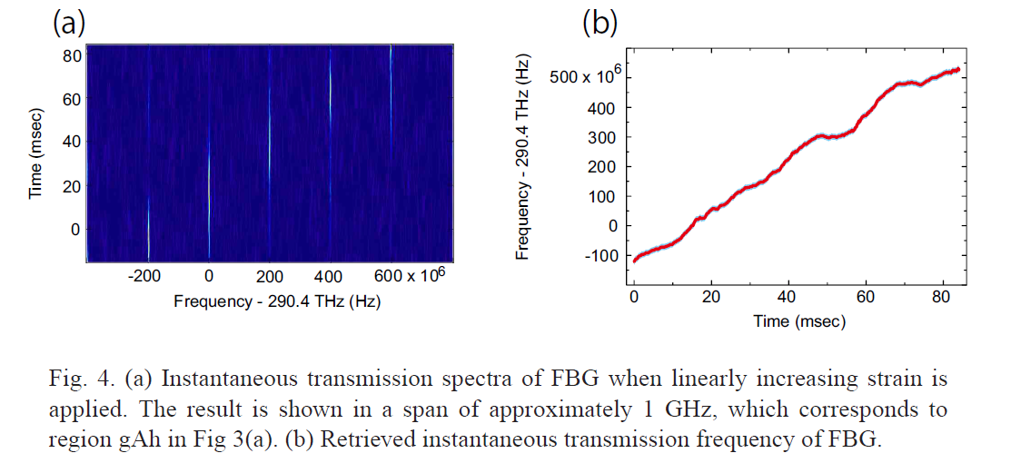
Experimental results
Notes:
Scanning electron micrograph
Gap 150nm

Slide 27
Summary
They have demonstrated a quasi-static FBG strain sensor with 34 nε -resolution and 1-THz bandwidthby dual-comb spectroscopy. This high-resolution, broad-bandwidth FBG sensor has apotential as a tool for geophysics applications.

Slide 28
Carbon NanoTube
Notes:
Polymer waveguides 2×2µm2 in cross section
Optical fibers were butt coupled to the input and output
bus waveguide using UV curable epoxy Loctite 3526,
Henkel Loctite Corp., Rocky Hill, CT

