Slide 1
Titles
1- High-precision microscopic phase imaging without phase unwrapping for cancer cell identification, OL (2013)
2- Label-free imaging of intracellular motility by low-coherent quantitative phase microscopy, OE (2011)
3- Wide-field optical detection of nanoparticles using on-chip microscopy and self-assembled nanolenses, Nature (2013)
By
D.G.Abdelsalam

Slide 2
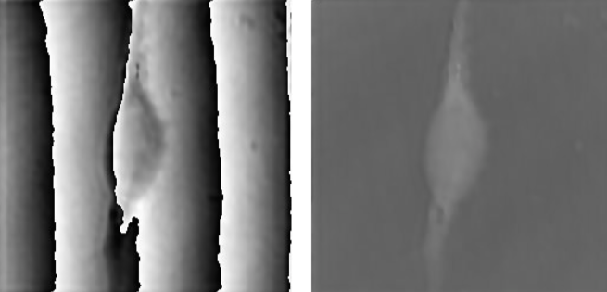
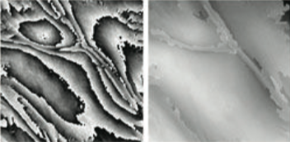
1- High-precision microscopic phase imaging without phase unwrapping for cancer cell identification, OL (2013), Japan
Objective
Cancer cell identification using high-precision optical path length with no phase unwrapping
Brief Introduction
embryo fibroblast cell
Onion cells

Slide 3
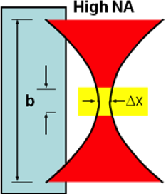
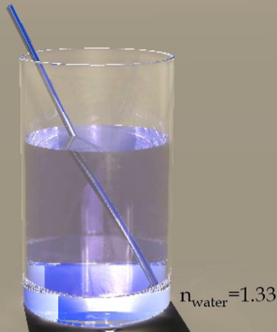
Brief Introduction
The potential of this approach for cancer cell Identification by distinguishing normal cells from cancerous cells through comparison of their optical path length differences.
Index of refraction of cancer cells is relatively higher than
normal cells.
Cytoplasmic region
nucleus
Plasma membrane
n1<n2<n3
d
A
n2
D1
nuclei
n3
D2
B
D3
C
n1

Slide 4
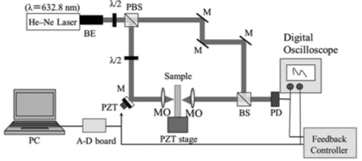
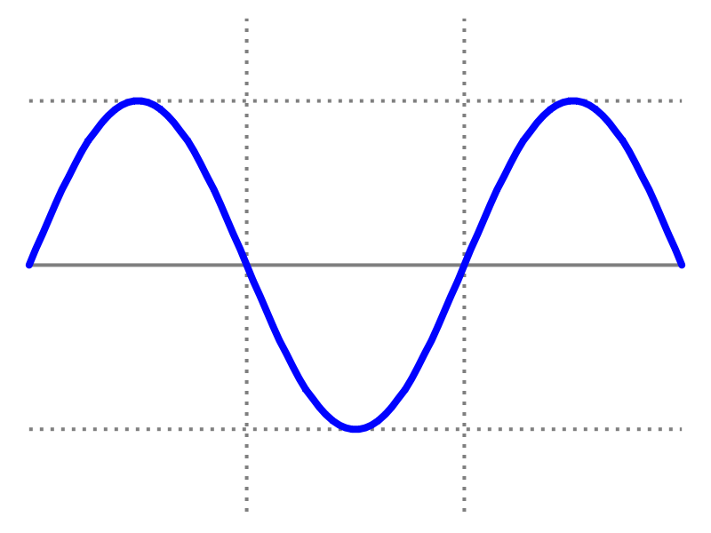
Setup
Optical path length distr.
If the voltage applied to PZT compensates , ,we have the condition of phase locking as
Controls the path length

Slide 5
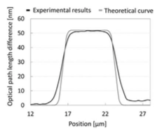
Phase sensitivity check
Example 1
Planar light wave circuit (PLC) with known refractive index
Measured optical path length 52.0 nm
Theoretical (geometrical optics)
Average of 10 times scan
1D optical path length (Exp.)
The sensitivity of optical path length is calculated by stv to be less than 2nm, n = 10, i.e. the error in measurement is 2nm
Spherical aberration

Slide 6
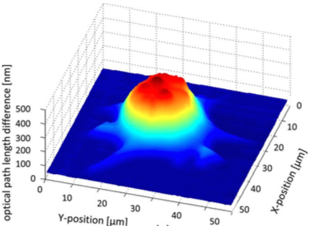
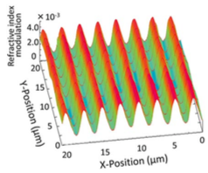
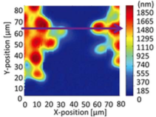
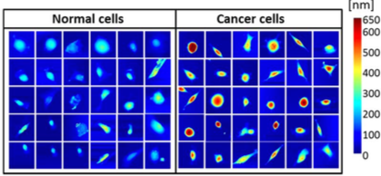
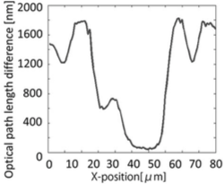
Example 2 (grating), 3 (thick cells), and 4 cancer
Scanned in 2D over 20 x 20 micron
3D optical path length difference distribution of a breast cancer cell
Nominal and measured pitch of 2.2 microns
nuclei form
Thick cells (about 3 lambda optical path length differences)

Slide 7
Summary and Conclusion
Cancer cells associated with higher optical path length difference than that of the normal cells
The system can measure transparent objects without using phase unwrapping process even if the thickness of the object is more than wavelength
Comment from the presenter
The calibration of voltage with displacement is not exactly linear, how did the authors calibrate the PZD for a high dynamic range?

Slide 8
2- Label-free imaging of intracellular motility by low-coherent quantitative phase microscopy, OE (2011), Japan
Objective
Low-coherent interferometric technique and phase-referenced phase shifting technique were integrated to reveal the depth of intracellular motility without contrast agents.
Notes
This paper shows the 3D of quantitatively phase fluctuation caused by the motion of multiple-surfaces in cultured cells.
The authors used high NA with low-coherence light source
Axial and transversal resolutions were 0.93 and 0.56 microns
results revealed the depth fluctuations of the intracellular surfaces such as plasma membrane, reflecting surfaces in cytoplasmic region and the surface of substrate independently.

Slide 9
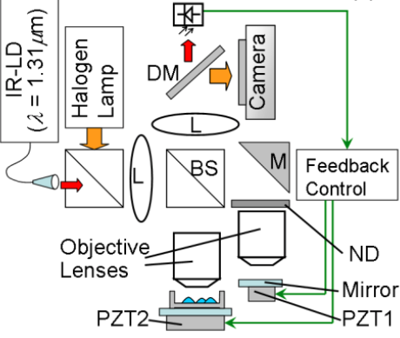
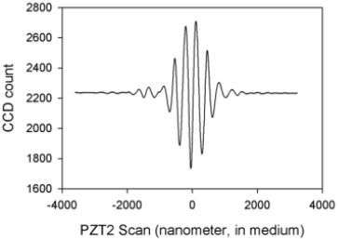
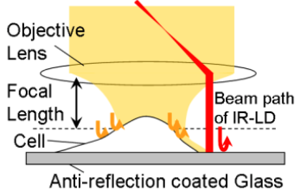
Experimental setup based on Linnik configuration
Wavelength = 695nm
The feedback circuit controls the PZT1 arm to adjust the OPD by nanometer resolution

Slide 10
Method, similar to OL , phase shifting 7 frame algorithm
FWHM =930 nm
OL work
327 nm
OE work
Seven raw images
2π
Optical path difference
Optical Coherence Function

Slide 11
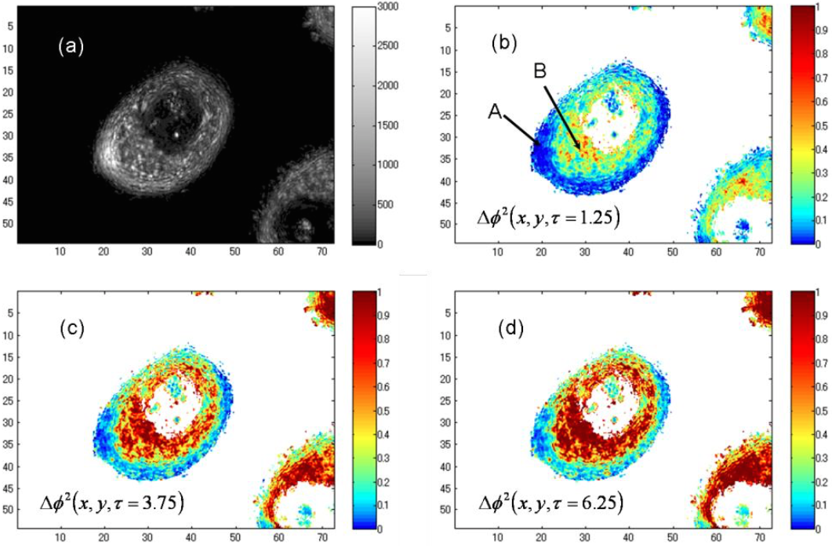
Results: human breast cancer cells (living)
To quantify the phase fluctuation, the authors used mean squared displacement (MSD)
Amplitude
Cytoplasmic region
f1
Plasma membrane
f2
f3

Slide 12
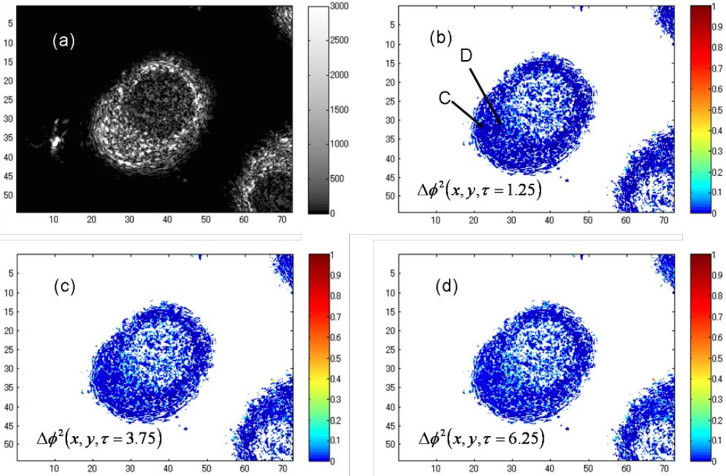
Results: human breast cancer cells (dead)
The samples were fixed with 2% paraformaldehyde, after treatment, the cells died.
Amplitude
Cytoplasmic region
f1
Plasma membrane
f2
f3

Slide 13
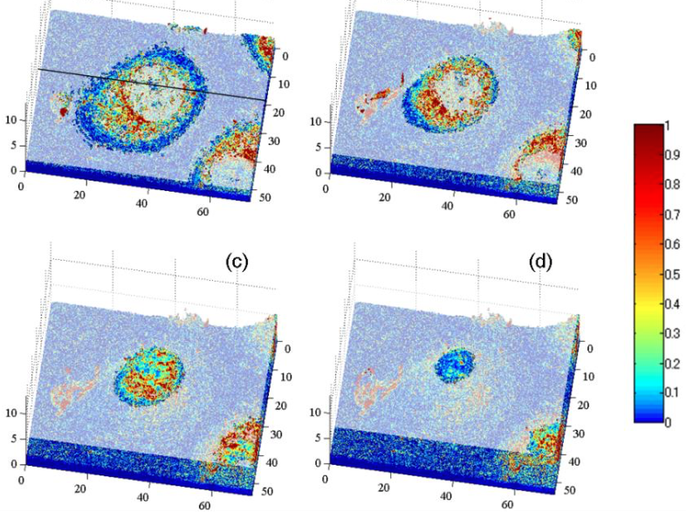
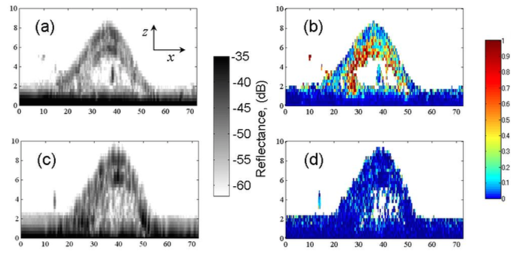
To see the nuclear membrane
To analyze the intracellular structure in detail. The authors captured the phase-fluctuation image at different heights
Amplit
Living cells
Phase
dead cells
Phase
Amplit
The authors claim that there is a spherical membrane inside the cell, which they believe is the nuclear membrane

Slide 14
Summary and Conclusion
The authors used low coherent QPM to visualize the distribution of the fluctuations of the intracellelular surfaces and cell membrane.
This was done in the paper by using low-coherent interferometric technique and phase-referenced phase shifting technique without contrast agents.

Slide 15
3- Wide-field optical detection of nanoparticles using on-chip microscopy and self-assembled nanolenses, Nature (2013)
University of California
Objective
Compact, cost-effective and high-throughput optical microscopy technique that can detect individual sub-100 nm particles and moderately sized viruses across and ultralarge FOV of 20.2 mm² is presented.
Method
Digital holography – Angular spectrum method
Objects
Polystyrene nanoparticles, adenoviruses and influenza A (H1N1) viral particles

Slide 16
Introduction
Nano scale objects are difficult to visualize using optical techniques (wavelength is greater than nano size)
Without mechanical scanning
Adv. The technique does not
circumvent the optical diffraction limit
To boost spatial resolution
20mm²
AFM
Elect M
Super res.
Near field
0.2mm²
Digital holography
Limited FOV
Excellent resolution

Slide 17
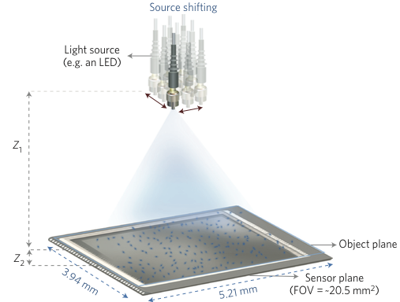
Setup
Lensfress pixel super-resolution holography schematic
A single pixel super-resolved holographic image is then synthesized from these sub-pixel shifted holograms, and is finally reconstructed to yield phase and amplitude images of the Individual nanoparticles with their surrounding self-assembled liquid lenses.
Lambda = 480 nm
Create sub-pixel less than 1.12 micron image shifts on the detector plane, which are used to generate a pixel super-resolved holographic image
Spectral bandwidth
= 3nm, multimode fiber core size 0.1mm
0.1 mm
LED light
Several holograms from the same nanoparticle are captured with source shift of 0.1mm.
Nanoparticle
Z1 = 8-12 cm
Pixel size
Z2 = 300 micron
CMOS (1.12 micron)
Sub-pixel

Slide 18
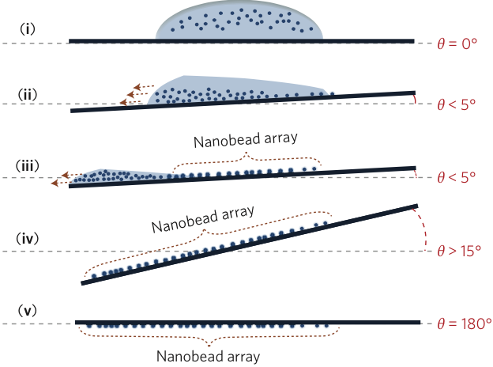
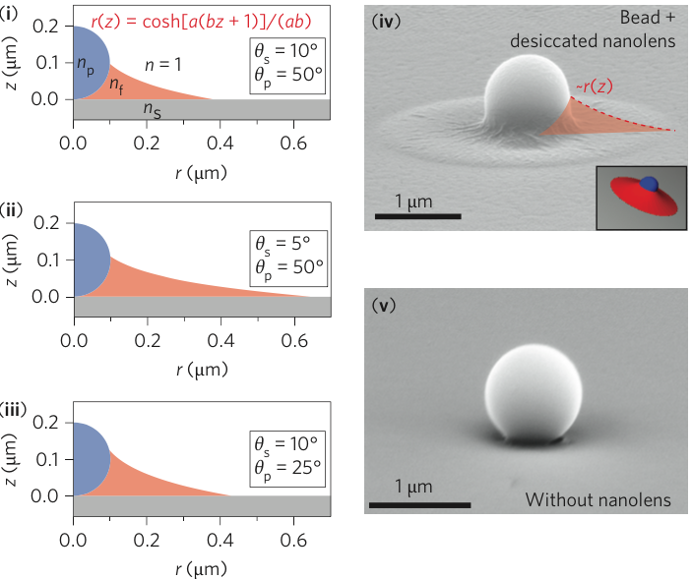
Sample preparation (nanoparticles)
Liquid nanolenses are assembled around each nanoparticle seated on hydrophilic surface
droplet
These liquid lenses acting as a spatial phase mask that enhance the diffraction signature of the embedded nanoparticles/nanolense
SEM
SEM

Slide 19
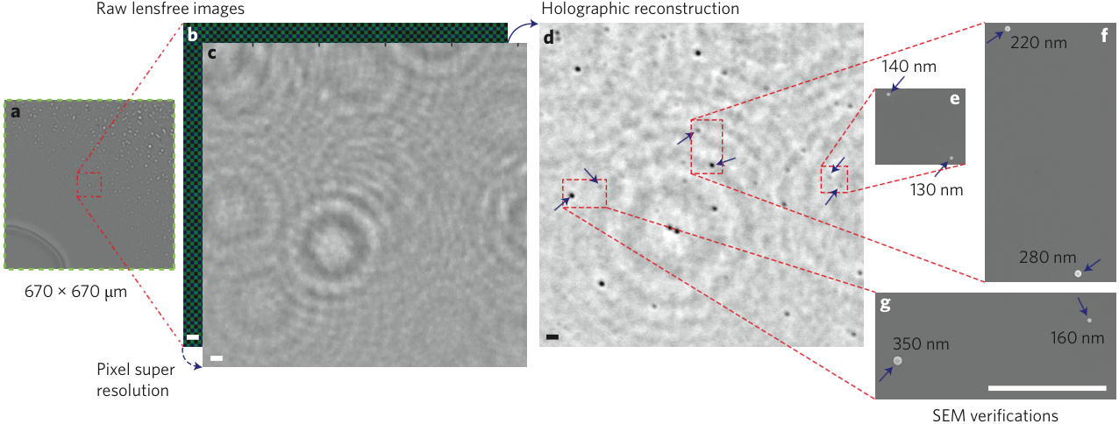
Results
Lensfree holograms without nanolens
Lensfree holograms with nanolens

Slide 20
Effect of no.of holograms in super-resolution on contrast of 95 nm particles
Increasing the number of holographic frames used in pixel super-resolution algorithm significantly enhance the contrast and the SNR of individual nanoparticles.
The combination of self-assembled liquid nanolenses and holographic computational on-chip microscopy enables the detection of individual sub-100 nm particles that are
Not visible with holographic imaging alone and have low contrast with conventional oil immersion objective lenses NA of (1.25).

Slide 21
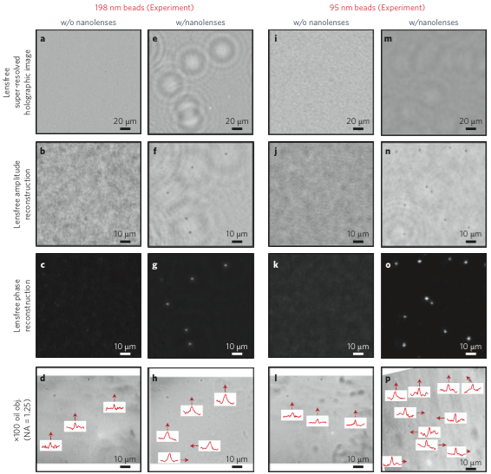
Particles of 95 nm and 198 nm with nanolenses

Slide 22
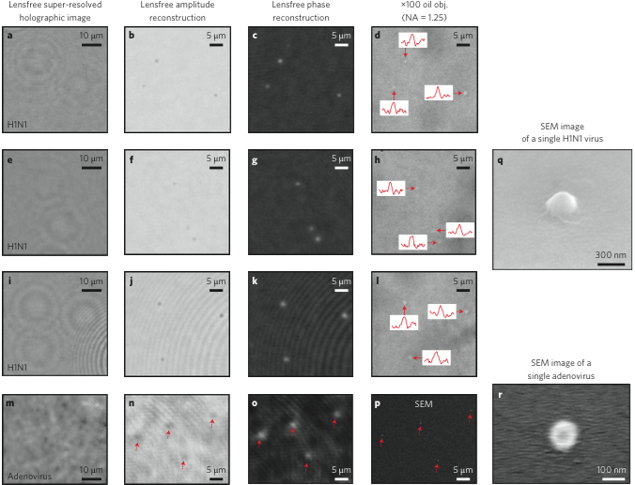
Individual influenza A (H1N1) viruses and adenoviruses

Slide 23
Summary and Conclusion
The authors introduced a compact, cost-effective and high throughput computational on-chip microscopy technique that can detect individual sub-100 nm particles and viruses across an ultralarge FOV of 20.5 mm².
Through a wetting film-based method that induces self-assembled liquid nanolenses around individual particles, the authors reconstructed both amplitude and phase images of single nanoparticles that are otherwise undetectable with conventional microscopy.

Slide 24
Thank you for listening. Any questions or suggestions?

