Slide 1
High-speed elipsometer
2015/06/11
PD Yi-Da Hsieh

Slide 2
Introduction
Ellipsometer
45°
Linearly polarized light
Elliptically polarized light
Ψ
d
Δ
Sample

Slide 3
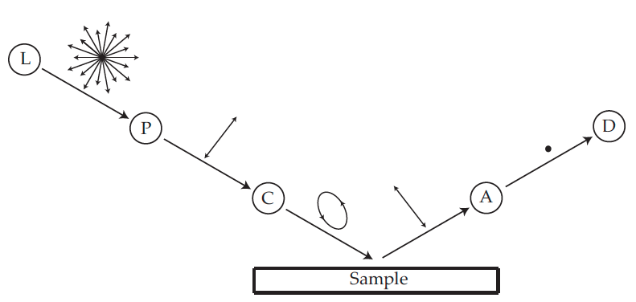
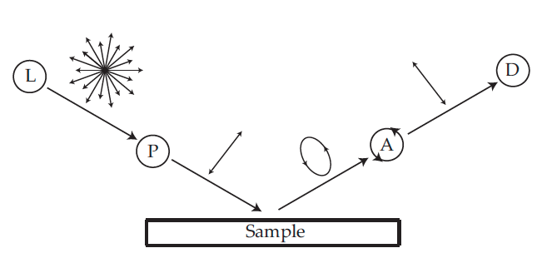
Introduction
Null ellipsometer
Photometric ellipsometer

Slide 4
Determination of retardation parameters of multiple-order wave plate using a phase-sensitive heterodyne ellipsometer
High speed interferometric ellipsometer
Dual-frequency paired polarization phase shifting ellipsometer
Ref) C. –H. Hsieh, et. al., Appl. Opt. 46: 5944 (2007)
Ref) C. –C. Tsai, et., al., Opt. Express. 16: 7778 (2008)
Ref) C. –J. Yu., et., al., Opt. commun. 282:1516 (2009)

Slide 5
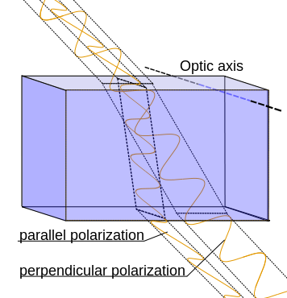
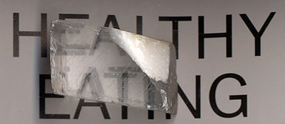
Birefringent material

Slide 6
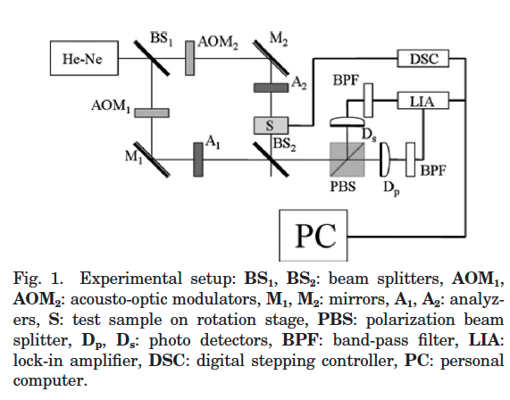
Experimental setup
Mach-Zehnder interferometer

Slide 7
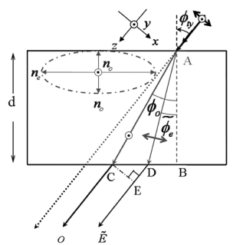
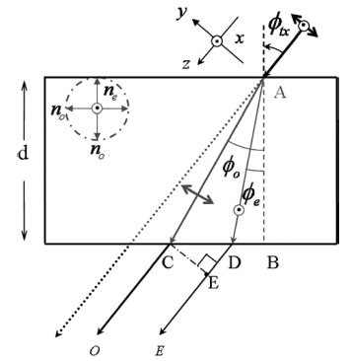
Method
Multiple-order wave plate
A linear birefringent material

Slide 8
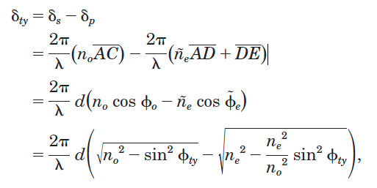
Method

Slide 9
Method
For a linearly birefringent medium ：

Slide 10
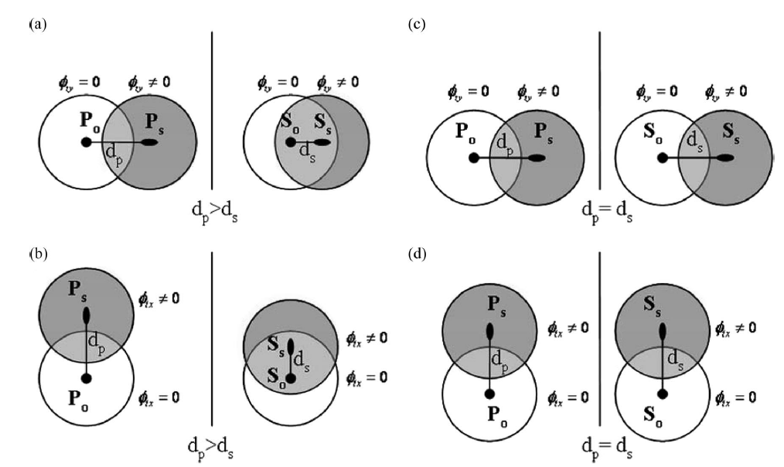
Method

Slide 11
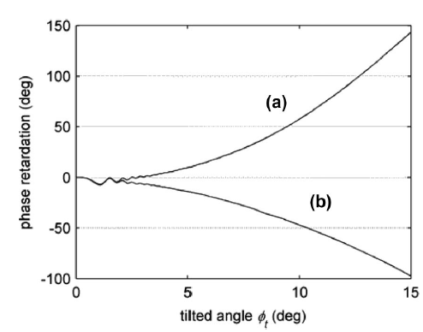
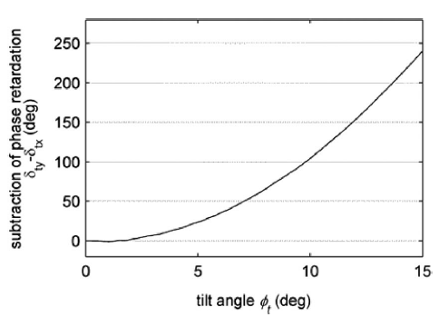
Results

Slide 12
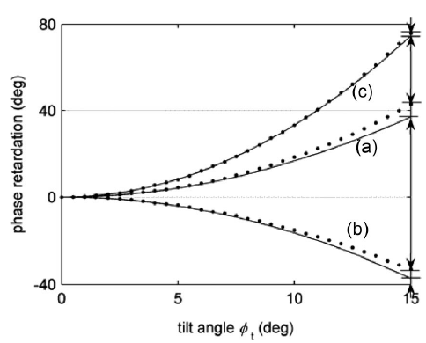
Results
m=7
n₀=1.5427
n_{e}=1.5518
Error: 0.05%

Slide 13
Summary
highly sensitive and accurate measurement of retardation parameters (RPs), which includes the refractive indices of the extraordinary ray n_{e} and ordinary ray n_{o}, is obtained by this method.

Slide 14
Determination of retardation parameters of multiple-order wave plate using a phase-sensitive heterodyne ellipsometer
High speed interferometric ellipsometer
Dual-frequency paired polarization phase shifting ellipsometer
Ref) C. –H. Hsieh, et. al., Appl. Opt. 46: 5944 (2007)
Ref) C. –C. Tsai, et., al., Opt. Express. 16: 7778 (2008)
Ref) C. –J. Yu., et., al., Opt. commun. 282:1516 (2009)

Slide 15
Method
The polarized heterodyne signals at photo-detectors D_{P} and D_{S} can be expressed by
set

Slide 16
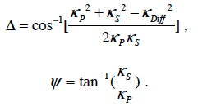
Method
The output signal, from DA

Slide 17
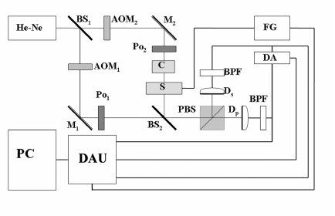
Experiment setup

Slide 18
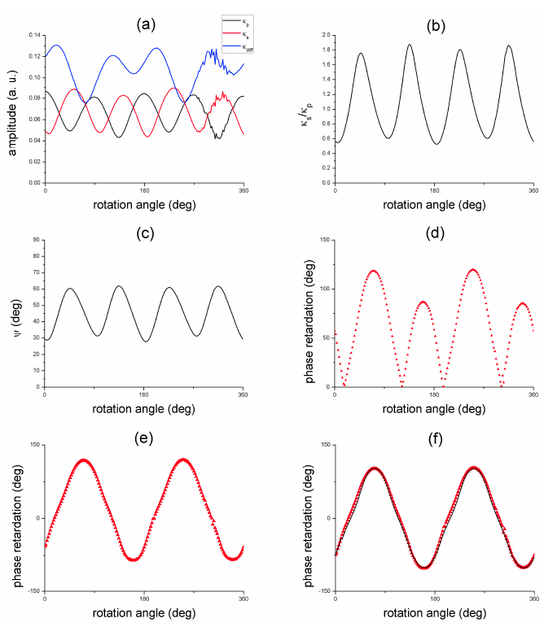
Results
Sample1: QWP

Slide 19
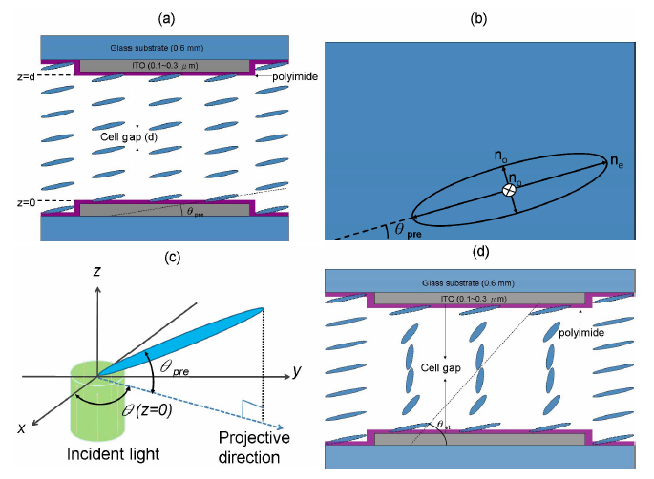
Results
Sample2: Parallel aligned liquid crystal device (PALCD)

Slide 20
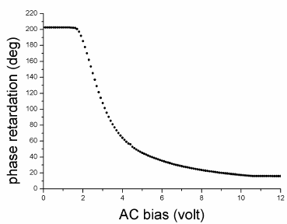
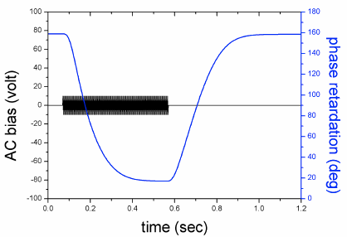
Results
1kHz square wave

Slide 21
Summary
high-speed interferometric ellipsometer not only able to measure ellipsometric parameters in real time but also to relax the requirement of equal amplitude of two polarized heterodyne signals.

Slide 22
Determination of retardation parameters of multiple-order wave plate using a phase-sensitive heterodyne ellipsometer
High speed interferometric ellipsometer
Dual-frequency paired polarization phase shifting ellipsometer
Ref) C. –H. Hsieh, et. al., Appl. Opt. 46: 5944 (2007)
Ref) C. –C. Tsai, et., al., Opt. Express. 16: 7778 (2008)
Ref) C. –J. Yu., et., al., Opt. commun. 282:1516 (2009)

Slide 23
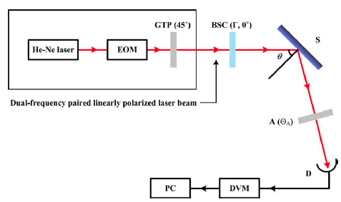
Experiment setup

Slide 24
Dual frequency laser
Linearly polarized light
Applied a sawtooth wave for EOM
０

Slide 25
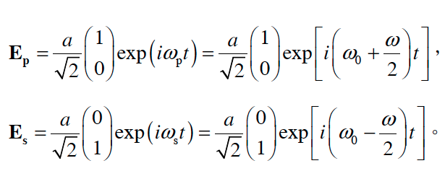
Dual frequency laser
With sawtooth wave

Slide 26
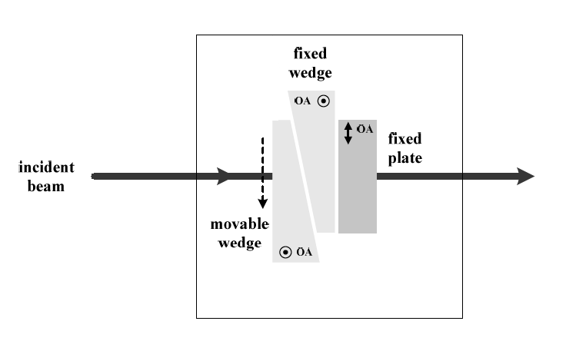
Babinet Soleil compensator (BSC)

Slide 27
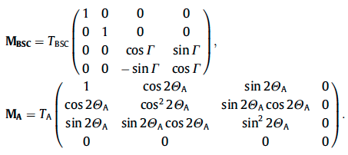
Method
The Mueller matrices of BSC and analyzer are expressed as
A dual-frequency paired linearly polarized laser beam, which can be expressed by Stokes vector as:

Slide 28
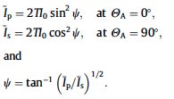
Method
If Γ of BSC is adjusted at 0° and Θ_{A} is set either at 0° or 90° then:

Slide 29
Method
Similarly, when the analyzer is set at 45°
Thus, Δ can be obtained by shifting the phase retardation Γ of BSC at 0, 90, 180, and 270 sequentially.

Slide 30
Results
The calibrated step wafer in which the silicon dioxide thin film (Mikropack ID0153).

Slide 31
Summary
The phase shifting technique integrated into DPPSE fully expands the dynamic range of EP. This overcomes the limitation of conventional ellipsometer based on intensity modulation in measurement

