Slide 1
State of progress in
THz and broadband spectrum manipulation group
Takeshi Yasui
(Tokushima University)
Minoshima ERATO 2nd group meeting in 2014
（Dec. 22, 2014@AIST）
Notes:
それでは、国家標準にトレーサブルなコヒーレント周波数リンクの創生とそれに基づいたTHz周波数標準技術の系統的構築について、徳島大学の安井が説明いたします。なお、本研究は、産総研・計測標準研究部門との共同研究となっています。

Slide 2
Research topics
(1) Intelligent THz instrumentation and application
•Adaptive sampling dual THz comb spectroscopy (M2)
•Broadband THz synthesizer (M2)
•THz-comb-referenced spectrum analyzer (M2)
•THz digital holography (B4, just start)
•THz ghost imaging (M1, not start)
(2) Novel optical comb measurement and application
•Full-field confocal optical-comb microscopy (M2)
•Discrete Fourier transform infrared spectroscopy (Hsieh)
(in collaboration with AIST)
•CARS gas analysis (Harsono, not start)
•Sensing comb for photoacoustic imaging (M1, just start)
Notes:
それでは、国家標準にトレーサブルなコヒーレント周波数リンクの創生とそれに基づいたTHz周波数標準技術の系統的構築について、徳島大学の安井が説明いたします。なお、本研究は、産総研・計測標準研究部門との共同研究となっています。

Slide 3
(1) Adaptive sampling dual THz comb spectroscopy
Notes:
それでは、国家標準にトレーサブルなコヒーレント周波数リンクの創生とそれに基づいたTHz周波数標準技術の系統的構築について、徳島大学の安井が説明いたします。なお、本研究は、産総研・計測標準研究部門との共同研究となっています。

Slide 4
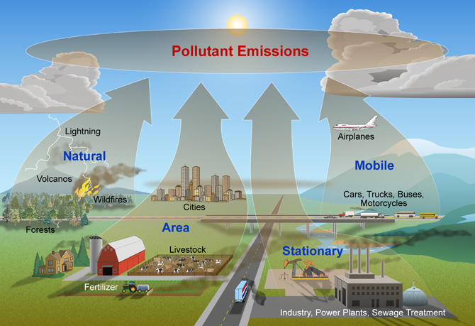
ΤHz gas spectroscopy
Rotational transitions of polar molecules
Rich spectral fingerprints
High selectivity and high sensitivity
High discrimination at low pressure
due to narrow Doppler linewidth (~1MHz)
☞Multiple gas analysis
(2) Less scattering
λ_{ΤHz} >> particle diameter
☞Possible to analyze gas
mixed with aerosols
(fog, cloud, smoke, soot, etc)
Atmospheric pollution
Ref)http://www.nature.nps.gov/air/aqbasics/sources.cfm
Notes:
4
Recent growing awareness of atmospheric pollution has increased the importance of gas analysis. In many case, we need to measure mixed gas which contains multiple gas molecules and unnecessary aerosols, such as smoke, soot, fog, cloud, and so on. THz gas spectroscopy has some advantages over infrared spectroscopy. There are rich spectral fingerprints caused by rotational transitions of many polar molecules in THz region. Absorption lines caused by rotational transitions enable high selectivity and sensitivity. Furthermore, THz gas spectroscopy has high discrimination at low pressure because Doppler linewidth is much narrower than that in visible and infrared regions. THz gas spectroscopy is less affected by scattering because THz wavelength is much longer than a particle diameter. In this way, THz gas spectroscopy well suits gas analysis.

Slide 5


ΤHz spectral fingerprints
Target gas
Atmospheric gas molecule
To discriminate the target gas correctly, high resolution, high accuracy, and broadband spectrum are required!!
Volatile organic compound (VOC) gas
Notes:
5
The absorption spectrum of Atmospheric gas molecules and VOC gases is shown here. VOC is the general term of organic compounds that become gaseous in the air. VOCs are emitted from factories, and produce other primary air pollutants such as high ground-level ozone and small particulate matter after photochemical reaction. Therefore, the instrumental analysis of VOC gases is important for the pollution control. In our experiment, we measured acetonitrile gas. However, as shown, there are not only VOC gases but also a lot of other gas molecules in the atmosphere. To discriminate the target gas correctly, high resolution, high accuracy, and broadband spectrum are required.

Slide 6
Optical comb and THz comb
Precise frequency marker
for broadband THz spectrum
Simple, broadband selectivity, high spectral purity,
and absolute frequency calibration
Notes:
This slide shows behavior of optical comb and THz comb in time and frequency domains. Mode-locked optical pulse train from fs laser shows a series of regular frequency spikes separated by a laser mode-locked frequency of f in frequency domain, namely optical comb. When such mode-locked optical pulse train is incident onto a PCA, mode-locked THz pulse train at repetition rate of f is radiated in free space in synchronization with the optical pulse train. A description of such mode-locked THz radiation in frequency domain gives a frequency comb in THz region, namely THz frequency comb. Since THz comb possesses the characteristics of narrow-linewidth CW-THz waves as well as a broadband THz spectrum, it is attractive for high-resolution broadband spectroscopy. Furthermore, the absolute frequencies of all comb modes can be phase-locked to a microwave frequency standard by precise laser control. Therefore, THz comb can be used as precise frequency marker for broadband THz spectrum.
Next shows behaviors of optical comb and THz comb in time and frequency domains. A femtosecond laser generates a sequence of optical pulses that are essentially copies of the same pulse at the mode-locked frequency of f. The highly stable fs-ML pulse train is synthesized by a series of frequency spikes regularly separated by the mode-locked frequency f in the optical frequency domain. This structure is called to a optical comb. On the other hand, when the mode-locked optical pulse is incident to the PCA for THz generation, a sequence of THz pulse is radiated in synchronization with the optical pulse. Such ML THz pulse train at f constructs frequency comb structure of THz radiation, namely THz comb. Since THz comb are considered to be a set of many CW–THz waves with frequency spacing f, they provides attractive features for THz spectroscopy, namely simple, broadband selectivity, high spectral purity, and absolute frequency calibration. Therefore, if frequency interval of is well stabilized by precise laser control, THz comb can be used as precise frequency marker for broad THZ spectrum.

Slide 7
How to measure mode-resolved THz comb spectrum
Traditional THz-TDS equipped with mechanical time-delay scanning
Time-window-extended THz-TDS
Notes:
7
Next, let us consider how to measure THz comb-mode-resolved spectrum. Traditional THz-TDS with mechanical time-delay scanning usually extract a portion of temporal waveform for pulsed THz electric field. FFT calculation of this temporal waveform gives the continuous spectrum of the broadband THz radiation without any comb structures. On the other hand, if the time window is largely extended over one repetition period, the temporal waveform of the THz pulse train can be measured. In this case, FFT calculation gives spectrum of THz comb because FT of the periodical multiple pulse train imposed the spectral modulaion on the broad THz spectrum. Unfortunately, traditional THz-TDS system can not measure such the temporal waveform of the THz pulse train because it needs quite long mechanical time-delay scanning.

Slide 8
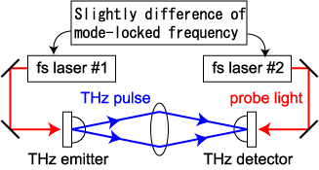
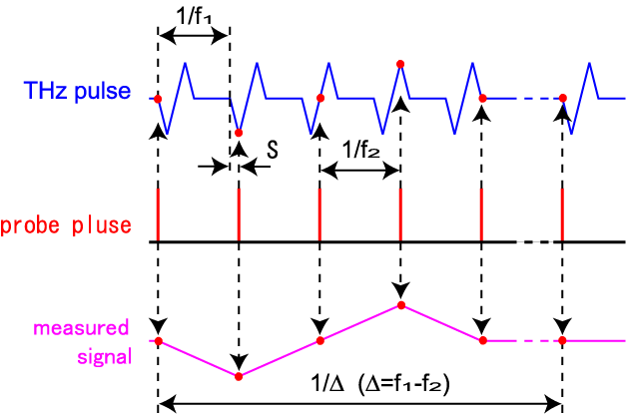
Asynchronous-optical-sampling THz-TDS
(ASOPS-THz-TDS)
Overlap timing between THz and probe pulses is automatically shifted every pulse
∆=f₁ -f₂
f₁
f₂
THz
detector
Oscilloscope
ref) T. Yasui, Appl. Phys. Lett. 87, 061101 (2005).
•No need for mechanical time-delay scanning
•No limitation for size of time window
Time scale of ps THz pulse is linearly expanded to µs order
Temporal magnification factor
(TMF) = f₁/∆f
Notes:
Therefore, we focus on the ASOPS THz-TDS. In this method, two fs lasers with slightly mismatched ML freq. f1 and f2 are used for generation and detection of the THz pulse, respectively. Rights shows a timing chart of THz pulse and probe pulse in the THz detector. Since time period of the THz pulse is slightly detuned from that of the probe pulse, overlap timing between THz and probe pulse is automatically shifted every pulse, namely asynchronous-optical-sampling. As a result, time scale of the ps THz pulse is linearly expanded to microsecond order. The resulting slow signal can be captured on a standard oscilloscope without the need for mechanical time-delay scanning. Therefore, this method has are no limitation for size of time window.

Slide 9
Use of free-running, dual fs lasers
in dual ΤHz comb spectroscopy
Expand the application fields of dual ΤHz comb spectroscopy
However, timing jitter between free-running dual fs lasers distorts the linearity of time and frequency scales due to fluctuation of TMF!
Notes:
If we can use free-running dual femtosecond lasers in ASOPS, the application will be significantly expanded. However, the problem is that timing jitter between free-running dual lasers distorts the linearity of time and frequency scale due to fluctuation of temporal magnification factor.

Slide 10


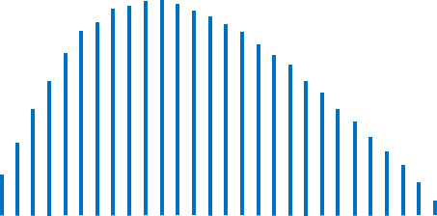
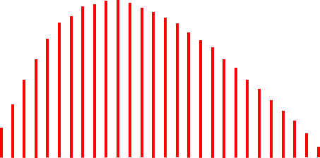
Influence of timing jitter in ASOPS
ΤHz region
RF region (ASOPS signal)
Frequency
downscaling
Electric field
Time
Electric field
Time
Nonlinearity of time scale.
Time
Fluctuated!
F.T.
Frequency
Amplitude
Amplitude
Frequency
[ΤHz]
Frequency
[MHz]
Frequency
calibration
Nonlinearity of frequency scale limits spectral resolution and accuracy!!
Nonlinearity of frequency scale.
Notes:
This is the flow-chart to get the THz comb spectrum in ASOPS. First, time scale of picosecond THz pulses is expanded to microsecond order based on temporal magnification factor. Second, we acquire the RF comb spectrum by Fourier Transform. Finally, we can obtain THz comb spectrum by frequency calibration. However, the linearity of time scale of the microsecond THz pulses is greatly distorted because the temporal magnification factor reflects the fluctuation of the lasers. And the same can be said about linearity of RF comb spectrum obtained by Fourier Transform. As a result, the accuracy and resolution of the THz comb spectrum obtained by rescaling reduce.

Slide 11
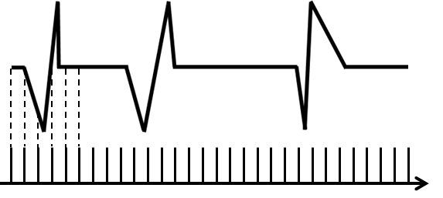
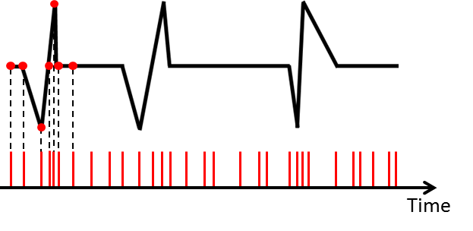


Adaptive sampling method
Ref) T. Ideguchi, Nat. Comm., 5, 3375 (2014).
Conventional method
(constant sampling)
Proposed method
(Adaptive sampling)
Sampled signal by ASOPS
Data acquisition
timing
Constant clock
Adaptive clock
reflecting timing jitter
Temporal waveform is still distorted!!
linearity of time scale
is recovered!!
Acquired
signal
Adaptive clock can be generated by beat signal between dual ΤHz comb modes!!
Notes:
So we developed adaptive sampling as a new method to solve this problem. Here is the THz pulse train obtained by ASOPS. The linearity of time scale is clearly distorted due to the influence of timing jitter. In conventional method, data acquisition timing of THz pulse trains is decided by the constant clock of the data acquisition board. However the acquired signal is still distorted. In a proposed method, we use the adaptive clock which reflects the fluctuation of timing jitter for data acquisition timing. As a result, linearity of time scale is recovered, and we can get the THz signal without influence of timing jitter shown as here. The adaptive clock can be generated by beat signals between dual THz combs.

Slide 12
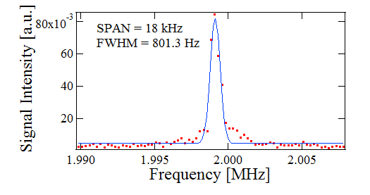
Generation of THz adaptive clock using dual THz-comb-referenced spectrum analyzer
Beat signal between dual THz comb modes at 4 THz
一般公開（予定）

Slide 13
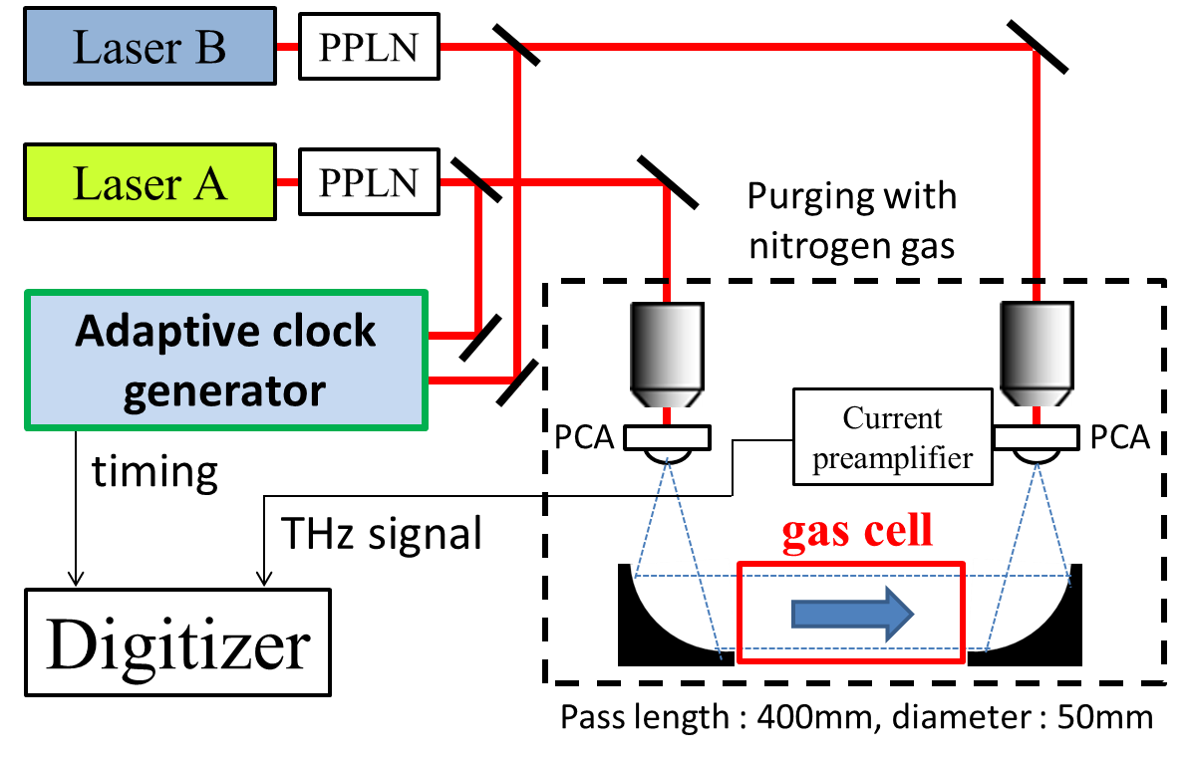
Setup for dual ΤHz comb spectroscopy
Notes:
This is the experimental setup for THz gas spectroscopy. THz pulse propagates the 400mm long and 50mm wide gas cell. In order to suppress the influence of water vapor in the atmosphere, the optical pass of the THz pulse has a nitrogen purge.

Slide 14
Integrated temporal waveform of ΤHz pulses
Integration number=10000
Signal disappeared!!
Constant clock
with free-running lasers
Peak fluctuated!!
Constant clock
with stabilized lasers
Peak constant!!
Adaptive clock
with free-running lasers
Notes:
At first, we acquired the temporal waveform of 10 THz pulses. Green graph shows the result using a constant clock and free-running frep1 and frep2. THz signals disappear due to the influence of timing jitter. Blue graph shows the result of conventional method using a constant clock and stabilized frep1 and frep2. Red graph shows the result of the proposed method using adaptive clock and free-running frep1 and frep2. Though both of the red and green graphs use same free-running, THz signals obtained by proposed method can get the good THz signal without the influence of timing jitter. Furthermore, peak value is constant in proposed method, while the peak is fluctuated in the conventional method.

Slide 15
Mode-resolved ΤHz comb spectrum
Constant clock
with stabilized lasers
Adaptive clock
with free-running lasers
noise floor
Frequency [ΤHz]
Blurred comb mode!
Distinct comb mode!
f_{rep}
f_{rep}
Notes:
This is the spectrum obtained by Fourier Transform of 10 THz pulses. In both approaches, we obtained almost the same spectrum. However, at the expanded graph at 0.5 THz, the comb mode of the proposed method is clearly separated while that of the conventional method is blurred. This result shows that the influence of timing jitter remains in the conventional method.

Slide 16
Water vapor at low pressure
Rotational transition I₁₀←I₀₁ @ 0.556936THz
Pressure broadening linewidth = 200MHz
Constant clock
with stabilized lasers
Adaptive clock
with free-running lasers
ν=0.55700THz
∆ν=212MHz
ν=0.55694THz
∆ν=211MHz
Notes:
Finally, we measure the acetonitrile gas which is a kind of VOCs. This is the absorption spectrum obtained by conventional and proposed method. These absorption lines caused by rotational transitions appear with interval of 18.4GHz, and in good agreement with the value calculated from rotational constant in both approach.

Slide 17
Acetonitrile gas at low pressure(1kPa)
NASA database
Acetonitrile (CH₃CN)
・One of VOCs
・Very abundant species in
interstellar medium
18.4 GHz
Constant clock
With stabilized lasers
Adaptive clock
with free-running lasers
18.4 GHz
18.4 GHz
Frequency [ΤHz]
Notes:
Finally, we measure the acetonitrile gas which is a kind of VOCs. This is the absorption spectrum obtained by conventional and proposed method. These absorption lines caused by rotational transitions appear with interval of 18.4GHz, and in good agreement with the value calculated from rotational constant in both approach.

Slide 18
(2) Full-field confocal optical-comb microscopy
Notes:
それでは、国家標準にトレーサブルなコヒーレント周波数リンクの創生とそれに基づいたTHz周波数標準技術の系統的構築について、徳島大学の安井が説明いたします。なお、本研究は、産総研・計測標準研究部門との共同研究となっています。

Slide 19
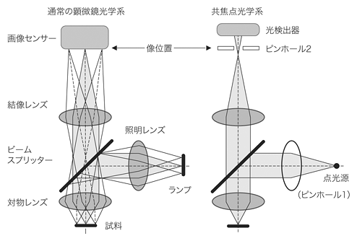
Optical microscopy
Normal microscopy
Confocal microscopy
Point detector
Imaging sensor
Imaging
plane
Pinhole 2
Imaging lens
Beam
splitter
Beam
splitter
Point
source
Light
source
(Laser with Pinhole 1)
Objective
lens
Sample
http://bioimaging.jp/learn/023/

Slide 20
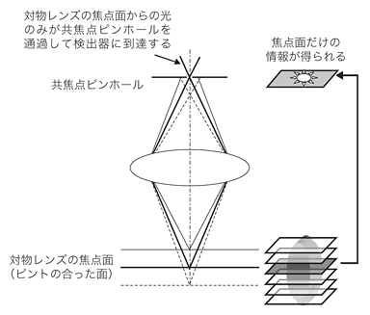
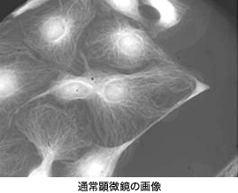
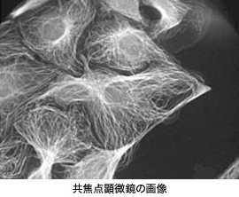
Confocal optical microscopy
Light coming from the focal plane can pass through the pinhole
Obtain information at the focal plane
Confocal
Pinhole
Normal microscopy
Focal plane
Detect signal at focal plane
・No stray light
・Depth resolution
・Applicable for thick sample
http://bioimaging.jp/learn/023/
Confocal microscopy

Slide 21
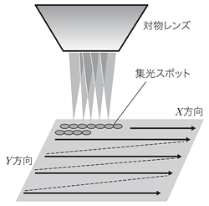
Confocal laser microscopy
Objective
Focal spot
X direction
Y direction
Raster scanning of a focused laser spot
Optical configuration
http://bioimaging.jp/learn/023/
http://bioimaging.jp/learn/023/index_2.html
Faster image acquisition ! Higher spatial resolution!
Notes:
（左図）
多くの特徴を有する共焦点顕微鏡であるが、その根幹である共焦点光学系とは基本的に1点照明かつ1点検出であり、そのままでは画像が形成できない。そこで、照明を固定したまま試料（ステージ）をXY面内で2次元走査するか、試料を固定したまま照明（ここではレーザービーム）を走査することで、各点の情報を集めて画像化することになる。例として、TVモニターの走査線による画面形成方法を想像すると理解しやすい。
図5に走査による像形成の概念図を示すが、実際の2次元走査方法として試料（ステージ）を走査することは、走査速度や機械的安定性の理由から困難なため、ガルバノミラーなど、高速で光を偏向可能な素子を用いて、照明するレーザービームを走査する方法が一般的である。なお、Z方向にはステッピングモーターやピエゾ素子を用い、2次元走査を終えるごとに、対物レンズもしくはステージを逐次移動させていく。
ここで重要なのは、共焦点顕微鏡の画像は各点の集合体であり、デジタルそのものであるということである。昨今、顕微鏡のデジタル化が叫ばれているが、共焦点顕微鏡はまさしくデジタル顕微鏡の先駆けという位置付けにある。さまざまな画像処理により、精度の高い定量解析やフーリエ解析による分析、さらには複数の画像から3次元構造の再現を容易に実現できる。
(右図）
光記録
多層記録 multilayer recording
多層記録は面密度の向上に加えて深さ方向の次元を利用した大容量化の技術である．まだ基礎的なレベルではあるが，大阪大学によりフォトクロミック材料を用いた五十層記録の実験が行われている．パワー密度が高い集光点のみで吸収が起こる二光子吸収を用いて記録を行うことにより，記録すべき層の手前の層における吸収による光量損失を抑制している．また，反射光の再集光点にピンホールを設ける共焦点光学系を用いて再生を行うことにより，再生すべき層の前後の層からの信号が再生信号に漏れ込む層間クロストークを抑制している．(片山龍一)
1) Y. Kawata, et al.: Appl. Opt., 34 (1995) 4105.

Slide 22
Fast confocal microscopy
Conventional
Proposal
Optical comb
Serial imaging based on
mechanical scanning
One-shot imaging based on parallel data acquisition

Slide 23
Dimension-converting comb
Optical comb
Temporal
Spatial
Polarization
etc
Conversion to wavelength
Information is superimposed on each comb mode
Dual comb spectroscopy
Number of comb mode
☞Tremendous channel number
Linewidth of comb mode
☞Infinitesimal sampling interval
Mode-resolved
comb spectrum

Slide 24
Single-shot imaging based on bidirectional conversion between wavelength and 2D space

Slide 25
Optical-comb confocal microscopy
Confidential
No mechanical scanning, single-shot imaging, super resolution
Notes:
（左図）
多くの特徴を有する共焦点顕微鏡であるが、その根幹である共焦点光学系とは基本的に1点照明かつ1点検出であり、そのままでは画像が形成できない。そこで、照明を固定したまま試料（ステージ）をXY面内で2次元走査するか、試料を固定したまま照明（ここではレーザービーム）を走査することで、各点の情報を集めて画像化することになる。例として、TVモニターの走査線による画面形成方法を想像すると理解しやすい。
図5に走査による像形成の概念図を示すが、実際の2次元走査方法として試料（ステージ）を走査することは、走査速度や機械的安定性の理由から困難なため、ガルバノミラーなど、高速で光を偏向可能な素子を用いて、照明するレーザービームを走査する方法が一般的である。なお、Z方向にはステッピングモーターやピエゾ素子を用い、2次元走査を終えるごとに、対物レンズもしくはステージを逐次移動させていく。
ここで重要なのは、共焦点顕微鏡の画像は各点の集合体であり、デジタルそのものであるということである。昨今、顕微鏡のデジタル化が叫ばれているが、共焦点顕微鏡はまさしくデジタル顕微鏡の先駆けという位置付けにある。さまざまな画像処理により、精度の高い定量解析やフーリエ解析による分析、さらには複数の画像から3次元構造の再現を容易に実現できる。
(右図）
光記録
多層記録 multilayer recording
多層記録は面密度の向上に加えて深さ方向の次元を利用した大容量化の技術である．まだ基礎的なレベルではあるが，大阪大学によりフォトクロミック材料を用いた五十層記録の実験が行われている．パワー密度が高い集光点のみで吸収が起こる二光子吸収を用いて記録を行うことにより，記録すべき層の手前の層における吸収による光量損失を抑制している．また，反射光の再集光点にピンホールを設ける共焦点光学系を用いて再生を行うことにより，再生すべき層の前後の層からの信号が再生信号に漏れ込む層間クロストークを抑制している．(片山龍一)
1) Y. Kawata, et al.: Appl. Opt., 34 (1995) 4105.

Slide 26
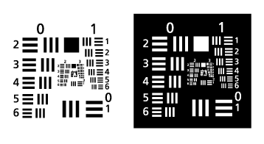
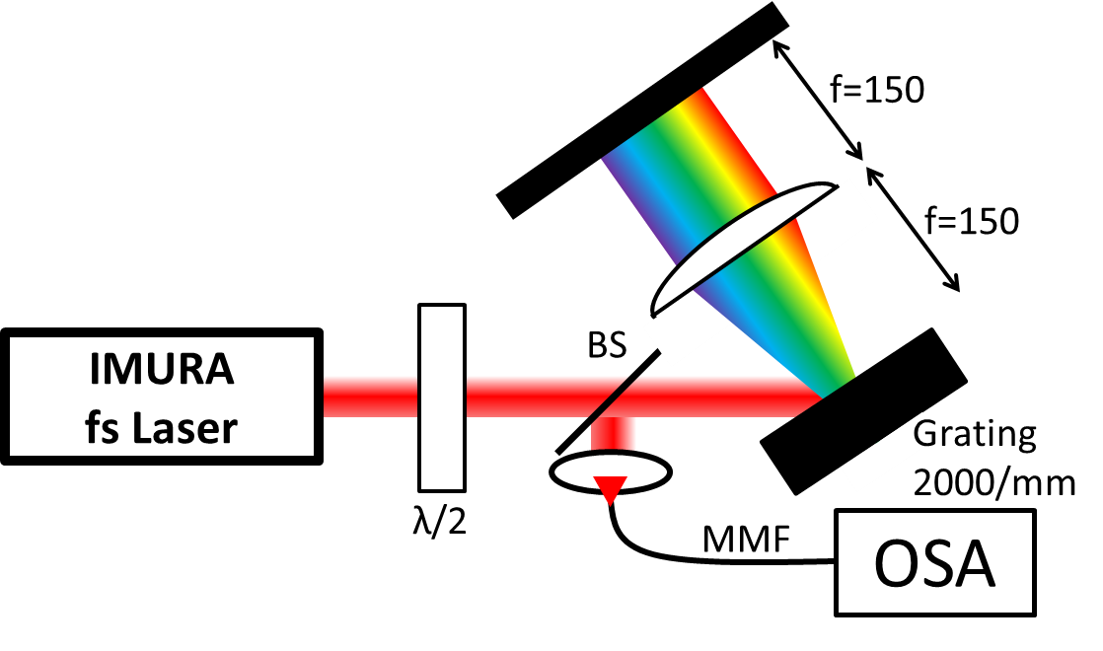
Optical setup for line imaging with OSA
Fourier plane
Sample : Test Target
(1951USAF negative)

Slide 27
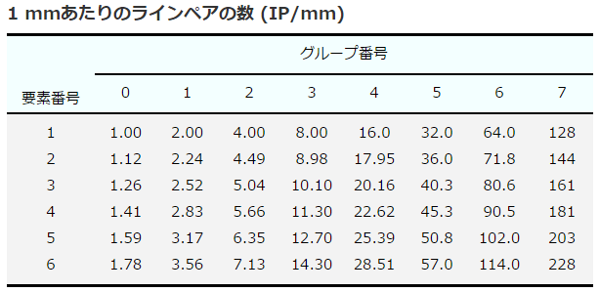
Results (1)
Reflection from glass
①Spec. res=0.1 nm, span=11 nm
③
②
①
②Spec. res=0.05 nm, span=9 nm
①
③
②
Can not resolved
③Spec. res=0.05 nm, span=5 nm

Slide 28
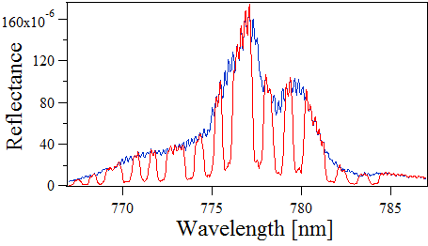
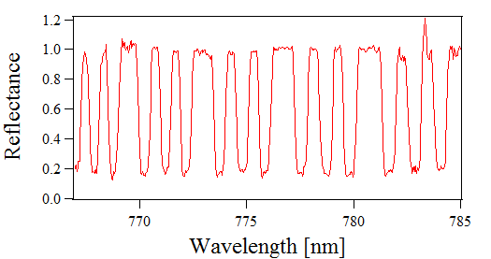
Results (2)

Slide 29
(3) Discrete Fourier transform infrared spectroscopy
(in collaboration with AIST)
Notes:
それでは、国家標準にトレーサブルなコヒーレント周波数リンクの創生とそれに基づいたTHz周波数標準技術の系統的構築について、徳島大学の安井が説明いたします。なお、本研究は、産総研・計測標準研究部門との共同研究となっています。

Slide 30
Fourier transform of transient signal h(t)
Formula
of FT
Transient signal h(t)
×
Frequency signal cos2πft
Time integration
Actual spectral resolution is determined by observed time window.
Pulse train of
THz electric field
Upper limit of time window
= repetition period of THz pulse
Notes:
THz-TDS is one of Fourier transform spectroscopy in THz region. FT of transient signal h(t) is given by this equation. From this equation, we first multiply transient signal h(t) by frequency signal at frequency f cos2πft, and then we integrate this product within infinite time window. However, the actual spectral resolution is determined by observed time window.
In case of THz-TDS, since the the pulse train of THz electric field is used, upper limit of time window is the repetition period of THz pulse. In other word, theoretical limit of the spectral resolution should be equal to repetition frequency of THz pulse.
次にフーリエ変換について説明します。時間波形信号ｈ(ｔ)を取得し、そのスペクトル波形Ｈ(ｆ)をフーリエ変換によって取得する場合を考えます。測定信号ｈ(ｔ)のある周波数成分ｆを得るためには、この式より、測定信号ｈ(ｔ)と観測したい周波数信号ｃｏｓ２πｆｔの掛け算を行い、時間領域で積分することによって算出されます。
そして、これを各周波数成分に対して同様な処理を行うことにより、スペクトル波形を取得します。ここで、時間積分領域の大きさ（観測時間窓に相当）が、スペクトル分解能を決定することになります。

Slide 31
FT of transient signals induced by THz pulse train
Relaxation time
of transient signal
>
Repetition period of
THz pulse train
e.g. FID signal
Transient signal h(t)
Periodic
excitation
Repetition
period
Notes:
We next consider FT of transient signals induced by THz pulse train. We assume here that the relaxation time of transient signal is longer than the repetition period of THz pulse train like here.
Let us focus transient signal induced by individual THz pulse.
Since this situation is corresponding to the case in frequency domain that the this transient signal has narrower linewidth than the repetition frequency, it is impossible to correctly resolved this spectrum by conventional THz-TDS.

Slide 32
FT of transient signals induced by THz pulse train
Relaxation time
of transient signal
>
Repetition period of
THz pulse train
Signal before
three periods
Signal before
two periods
Signal before
one period
Latest
signal
Transient
signal
h(t)
Periodic
excitation
Pulse before
three periods
Pulse before
two periods
Pulse before
one period
Repetition
period
Notes:
At first, latest THz pulse induces transient signals like here.
Previously, THz pulse before one pulse period induces another transient signal at different timing.
In the same way, THz pulses before two and three pulse periods induces induces similar transient signals at different timings respectively.
These transient signals are overlapped in time domain.
このようにあるパルスによって励起された信号の一周期分を観測時間窓に設定した場合、ひとつ前のパルスによって励起された信号、二つ前のパルスによって励起された信号、３つ前のパルスによって励起された信号、さらにその前のパルスによって励起された信号が時間的に重なります。

Slide 33
FT of transient signals induced by THz pulse train
Relaxation time
of transient signal
>
Repetition period of
THz pulse train
Signal before
three periods
Signal before
two periods
Signal before
one period
Latest
signal
Repetition
period
Focus on pieces of different transient signals included in the same one period
Pulse before
three periods
Pulse before
two periods
Pulse before
one period
Notes:
Here, we focus on pieces of different transient signals included in the same one period.
Each piece can be separated like here.
よって繰り返し周期よりも長い緩和信号の一周期分をフーリエ変換することは、このような信号にそれぞれフーリエ変換していることと同等になります。

Slide 34
Observed time window
= One repetition period
FT of transient signals induced by THz pulse train
Each piece can be temporally connected!
Latest
signal
Latest
signal
×
＋
Signal
before
1 period
Signal
before
1 period
h(t)
×
＝
×
One period
＋
Signal
before
2 periods
cos2πft
Signal
before
2 periods
×
Time integration
＋
Signal
before
3 periods
Signal
before
3 periods
Equivalent to integration of h(t)•cos2πft within infinite time window!
×
Notes:
FT of these signals can be obtained by summation of FT of each pieces of different transient signals.
However, if the observed time window is exactly equal to the the repetition period, each pieces of different transient signals can be temporally connected.
The resulting waveform is equivalent to the whole temporal waveform of the transient signal.
In the same manner, the frequency signal can be reconstructed too.
Therefore, this calculation under this condition is equivalent to integration of this product within infinite time window!
よってこのような繰り返し周期よりも長い緩和信号の一周期分をフーリエ変換することは、このような信号にそれぞれフーリエ変換していることと同等になります。

Slide 35
Discrete Fourier transform spectrum
Frequency of
each plot
n: number of data plot
T: repetition period
1/T
f₄
•••••••••••••••••••••••••••••••
Freq.
f₁
f₂
f₃
f_{n}
Each plot has infinite spectral resolution due to infinite time window.
However, discrete distribution limits spectral resolution to plot interval.
Notes:
In this case, we can obtain discrete FT spectrum like here.
Frequency of each plot is given by this equation, where n is number of data plot and T is the repetition period.
Here, it is important to note that each plot has infinite spectral resolution due to infinite time window.
However, if such spectrum is used for broadband THz spectroscopy, discrete distribution of data plot limits spectral resolution to plot interval.
To make full use of this infinite spectral resolution, we should interpolate gap between each plots because there are no spectral information at the gap region.
Since the plot interval is determined by the THz repetition period, it can be swept by changing the laser repetition period.
実際に得られるスペクトルはこのような離散フーリエ変換スペクトルとなる。
次に実際にASOPS-THz-TDSで1周期の測定時間窓で得られるスペクトルを示します。
繰り返し周期をTとすると、スペクトルの各プロットは、無限小のスペクトル分解能を有しているものの、１／Ｔの間隔で離散的に分布しています。そのため、このまま利用すると、実用上のスペクトル分解能はプロット間隔になってしまいます。

Slide 36
Sweeping of discrete FT spectrum
Spectrally interleaving spectrum
Changing repetition period
Freq.
Spectral overlapping
Changing repetition period
Freq.
Freq.
Gaps between data plots can be filled in
Freq.
Notes:
Therefore, if incremental sweeping of data plots is repeated by changing the repetition period and the resulting spectra are overlaid in the frequency domain, the gaps between data plots can be interpolated. The resulting densely distributed spectrum enables us to large enhancement of the spectral resolution.
そこで我々は、周波数走査型ASOPS-THz-TDSという手法を提案しました。各プロットが有する無限小スペクトル分解能を利用するためには、各プロット間に存在する隙間を補間する必要があります。そのために、モード同期周波数を変化させることによりパルス周期Tを変化させ、このようなスペクトルをそれぞれ取得し、最終的に重ねることにより、補間された微細化スペクトルを得ることができます。

Slide 37
Experimental setup
λ_{c}=1550nm, ∆τ=50fs, P_{avg} =500mW,
f_{rep1}=250MHz, f_{rep2}= 250MHz+50Hz
∆f_{rep}= f_{rep2}-f_{rep1}= 50Hz,
RMS timing jitter<150fs [0.5~500kHz]
(L = 500 mm, Dia. = f40 mm)
Resolution = 20 bit
Sampling rate = 2 MS/s
Sampling number = 10⁸
Sampling interval = 100 fs
Notes:
Next slide shows experimental setup.
We used dual fiber lasers at 1550nm for generation and detection of pulsed THz radiation. Output light from the pump laser was converted into SHG light and focused a dipole-shaped low-temperature-grown GaAs (LTG-GaAs) PCA for THz generation and detection, respectively.
The resulting THz pulse propagates in free space, pass through a low-pressure gas cell, and then incident onto the PCA detector.
Portion of the output light from the two lasers were fed into a sum-frequency-generation (SFG) cross-correlator to generate a time origin signal in the ASOPS-THz-TDS.
Finally, a temporal waveform of the current signal form PCA detector is amplified and then acquired by a fast digitizer triggered by the SFG signal.

Slide 38
Relation between time window and repetition period
（Relaxation time > repetition period）
Rotational transition of H₂O at 0.557 THz (H₂O＠6 Pa＆N₂＠140 Pa)
Expected pressure broadening linewidth = 10.6 MHz
Relaxation time of absorption = 94ns （25 periods）
Time window = 1 period
Time window = 0.9995 period
Before sweeping
f₁=250,000,000 Hz
f₂=250,000,050 Hz
∆=50Hz
Correctly measured!
Spectral shape
is distorted!
∆f₁, ∆f₂
+11,210 Hz
∆:
constant
Incremental sweeping is repeated 10 times
at interval of 25 MHz
Notes:
To confirm the validity of our concept, we first investigate a relation between time window and repetition period.
To this end, we measured the absorption spectrum of the rotational transition in low-pressure water vapor at 0.557 THz.
Since the pressure broadening linewidth was set to 10.6 MHz, this absorption phenomenon was continued for an inverse of this linewidth, namely 94.3 ns.
This relaxation time is 25-time longer than a repetition periods of 4 ns.
In this experiment, before sweeping, f1, f2, and Δ are set at these value. Then f 1 and f2 are increased by this frequency while keeping ∆ at constant.
Such incremental sweeping is repeated ten times.
As a result, we obtained the data plot at interval of 25 MHz.
Left shows the absorption spectrum when the time window is exactly equal to one pulse period.
The sharp absorption line was correctly measured.
However, when the time window is a little shorter than one repetition period, the spectral shape was largely distorted..

Slide 39
Relation between time window and repetition period
（Relaxation time > repetition period）
Latest
signal
Temporal discontinuity
×
h(t)
＋
Signal
before
1 period
=
×
×
One period
＋
Signal
before
2 periods
cos2πft
×
Each piece of different transient signals can not be connected!
＋
Signal
before
3 periods
×
Notes:
This is because each piece of different transient signals can not be connected due to miss matching of the observed time window to one repetition period like here.
In this way, we confirmed the correctness of our idea.
よってこのような繰り返し周期よりも長い緩和信号の一周期分をフーリエ変換することは、このような信号にそれぞれフーリエ変換していることと同等になります。

Slide 40
Relation between time window and repetition period
Time window = 1 period
Time window = 0.9995 period
Time window = 1 period
Data for 0.9995period
+
Null for 0.005period
Notes:
To confirm the validity of our concept, we first investigate a relation between time window and repetition period.
To this end, we measured the absorption spectrum of the rotational transition in low-pressure water vapor at 0.557 THz.
Since the pressure broadening linewidth was set to 10.6 MHz, this absorption phenomenon was continued for an inverse of this linewidth, namely 94.3 ns.
This relaxation time is 25-time longer than a repetition periods of 4 ns.
In this experiment, before sweeping, f1, f2, and Δ are set at these value. Then f 1 and f2 are increased by this frequency while keeping ∆ at constant.
Such incremental sweeping is repeated ten times.
As a result, we obtained the data plot at interval of 25 MHz.
Left shows the absorption spectrum when the time window is exactly equal to one pulse period.
The sharp absorption line was correctly measured.
However, when the time window is a little shorter than one repetition period, the spectral shape was largely distorted..

Slide 41
Relation between time window and repetition period
（Relaxation time < repetition period）
Rotational transition of H₂O at 0.557 THz (H₂O＠1kPa＆N₂＠3.5kPa)
Expected pressure broadening linewidth = 500 MHz
Relaxation time of absorption = 2 ns （0.5periods）
Time window = 1 period
Time window = 0.9995 period
Notes:
To confirm the validity of our concept, we first investigate a relation between time window and repetition period.
To this end, we measured the absorption spectrum of the rotational transition in low-pressure water vapor at 0.557 THz.
Since the pressure broadening linewidth was set to 10.6 MHz, this absorption phenomenon was continued for an inverse of this linewidth, namely 94.3 ns.
This relaxation time is 25-time longer than a repetition periods of 4 ns.
In this experiment, before sweeping, f1, f2, and Δ are set at these value. Then f 1 and f2 are increased by this frequency while keeping ∆ at constant.
Such incremental sweeping is repeated ten times.
As a result, we obtained the data plot at interval of 25 MHz.
Left shows the absorption spectrum when the time window is exactly equal to one pulse period.
The sharp absorption line was correctly measured.
However, when the time window is a little shorter than one repetition period, the spectral shape was largely distorted..

Slide 42
Pressure broadening characteristics of H₂O
Spectral interleaving interval limits spectral resolution independent of time window size
Notes:
Next, to investigate the actual spectral resolution, we measured pressure broadening characteristics of the same absorption line in the water vapor like here. Red plot shows the result of the proposed method whereas blue line shows the theoretical curve of the pressure broadening characteristic. For comparison, the result of the one-pulse-period ASOPS-THz-TDS was indicated in the green color as a conventional method. Although the spectral resolution of the conventional method was remained around the repetition frequency of 250 MHz, the proposed method enhance the spectral resolution down to 3 MHz at minimum.
Frequency deviation of experimental data from the theoretical curve is due to timing jitter between dual fiber lasers and/or fluctuation of the gas pressure.
こちらは従来のASOPS-THz-TDSで得られた線幅、ゼロフィリングによってスペクトル間隔を補間して得られた線幅、周波数走査型ASOPS-THz-TDSで得られた線幅、圧力拡がりから予測される線幅との比較のグラフです。従来法では繰り返し周波数の250MHzに制限されているのに対して、本手法では理論線幅とほぼ同等に変化し、3MHzの線幅を達成していることがわかります。

Slide 43
Spectroscopy of multiple absorption lines
Sample gas：CH₃CN＠30Pa
Symmetric top molecule with rotational constant B of 9.2GHz
1.3 GHz
0.1 THz
J=32
J=35
J=36
J=34-35
J=37
18.4 GHz
J=34
J=33
Notes:
Finally, we demonstrated spectroscopy of multiple absorption lines
Sample gas is acetonitrile (CH3CN) at 30 Pa. acetonitrile is a symmetric top molecule with a rotational constant B of 9.2 GHz, indicating characteristic spectral fingerprint in THz region.
The spectrum observed with the frequency range of 0.1 THz indicated 6 manifolds of rotational transitions regularly spaced by 2B.
We next expanded the spectral region around a single manifold of J34.
In this case, 10 rotation transitions K0 to K10 was clearly observed.
We further expanded the spectral region around K0 and K1.
続いて本手法の広帯域・高分解能・高確度特性を評価するため、アセトニトリルガスを測定しました。アセトニトリルは対称コマ型分子あり、回転遷移による吸収線が等間隔に存在し、またそれらは細かく見ると微細な構造を示すことが知られています。従来は、等間隔の広い構造を見る際にはTHz-TDSを、微細な構造を見る際はCW-THz分光を用いていました。周波数走査型ASOPSを用いればこれらの計測が一台でできると考えられます。そこでこのような実験条件でアセトニトリルの計測を行いました。
こちらは0.6～0.7ＴＨｚの範囲におけるス吸収スペクトルを示している。またこちらは0.65THz付近の拡大図を示している。18.4GHzごとの等間隔の吸収線と、0.65THz付近の吸収線微細構造を確認することができる。しかしながら、今回は周波数ステップを12.5MHzで計測を行っているため、これらの12MHzの間隔しかない、吸収線は区別ができていないことがわかる。

Slide 44
Spectroscopy of multiple absorption lines
70 MHz
J=34-35
12MHz
K | Literature value (THz) | Experimental value (THz) | Discrepancy (MHz)
1 | 0.643 257 622 0 | 0.643 257 498 7 | 0.12
0 | 0.643 269 866 7 | 0.643 268 764 0 | 1.10
Notes:
In this case, two adjacent absorption lines with frequency separation of 12 MHz was clearly resolved.
This table shows comparison of center frequency between experimental data and spectral database.
Frequency discrepancy of the experimental data from the spectral database was around 1 MHz.
In this way, enhanced spectral resolution resulted in improvement of the spectral accuracy.
次に近接する吸収線を見分けるために、周波数ステップを1.25MHzで計測を行いました。
図を見ると二つの吸収線をはっきりと見分けることができていることがわかる。
これらより、本手法は、THz-TDSの広帯域特性とCW-THz分光法の高いスペクトル分解能を併せもち、究極のTHz分光装置であるといえる。

Slide 45
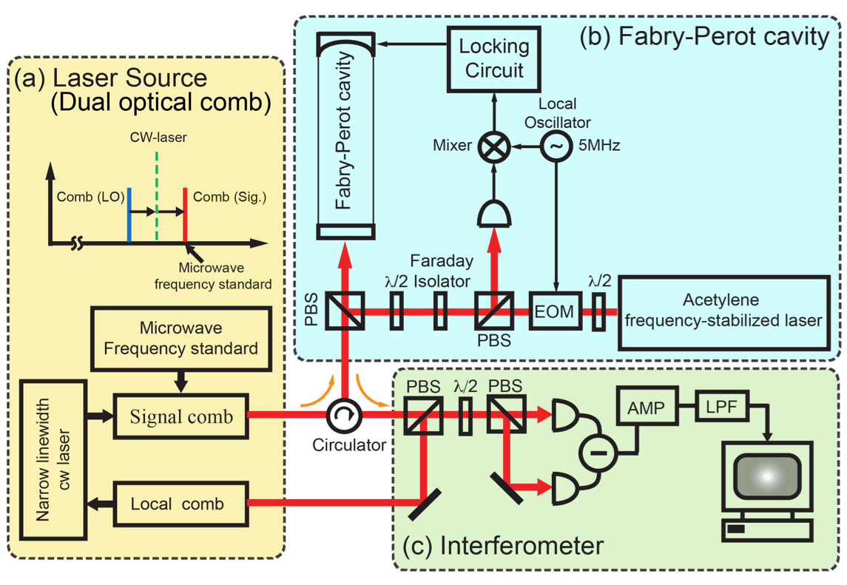
Experimental setup
Confidential
f_{rep_LO}=48,350,631Hz
f_{rep_S}= 48,350,676Hz
∆f_{rep}= f_{rep_S} - f_{rep_LO}= 45Hz
Notes:
Next slide shows experimental setup.
We used dual fiber lasers at 1550nm for generation and detection of pulsed THz radiation. Output light from the pump laser was converted into SHG light and focused a dipole-shaped low-temperature-grown GaAs (LTG-GaAs) PCA for THz generation and detection, respectively.
The resulting THz pulse propagates in free space, pass through a low-pressure gas cell, and then incident onto the PCA detector.
Portion of the output light from the two lasers were fed into a sum-frequency-generation (SFG) cross-correlator to generate a time origin signal in the ASOPS-THz-TDS.
Finally, a temporal waveform of the current signal form PCA detector is amplified and then acquired by a fast digitizer triggered by the SFG signal.

Slide 46
Result
Confidential
f_{rep, S}=48.350676MHz➔48.350685MHz, 100 times sweep
∆f=44.99513Hz
FSR=566MHz
∆ν_{n}=2.2MHz
The resonance mode in
Fabry-Perot cavity

Slide 47
Summary
(1) Intelligent THz instrumentation and application
•Adaptive sampling dual THz comb spectroscopy
(CLEO, to be submitted in this year)
•THz-comb-referenced spectrum analyzer (CLEO)
(2) Novel optical comb measurement and application
•Full-field confocal optical-comb microscopy
(Patent preparation)
•Discrete Fourier transform infrared spectroscopy
(CLEO)
Notes:
それでは、国家標準にトレーサブルなコヒーレント周波数リンクの創生とそれに基づいたTHz周波数標準技術の系統的構築について、徳島大学の安井が説明いたします。なお、本研究は、産総研・計測標準研究部門との共同研究となっています。

Slide 49
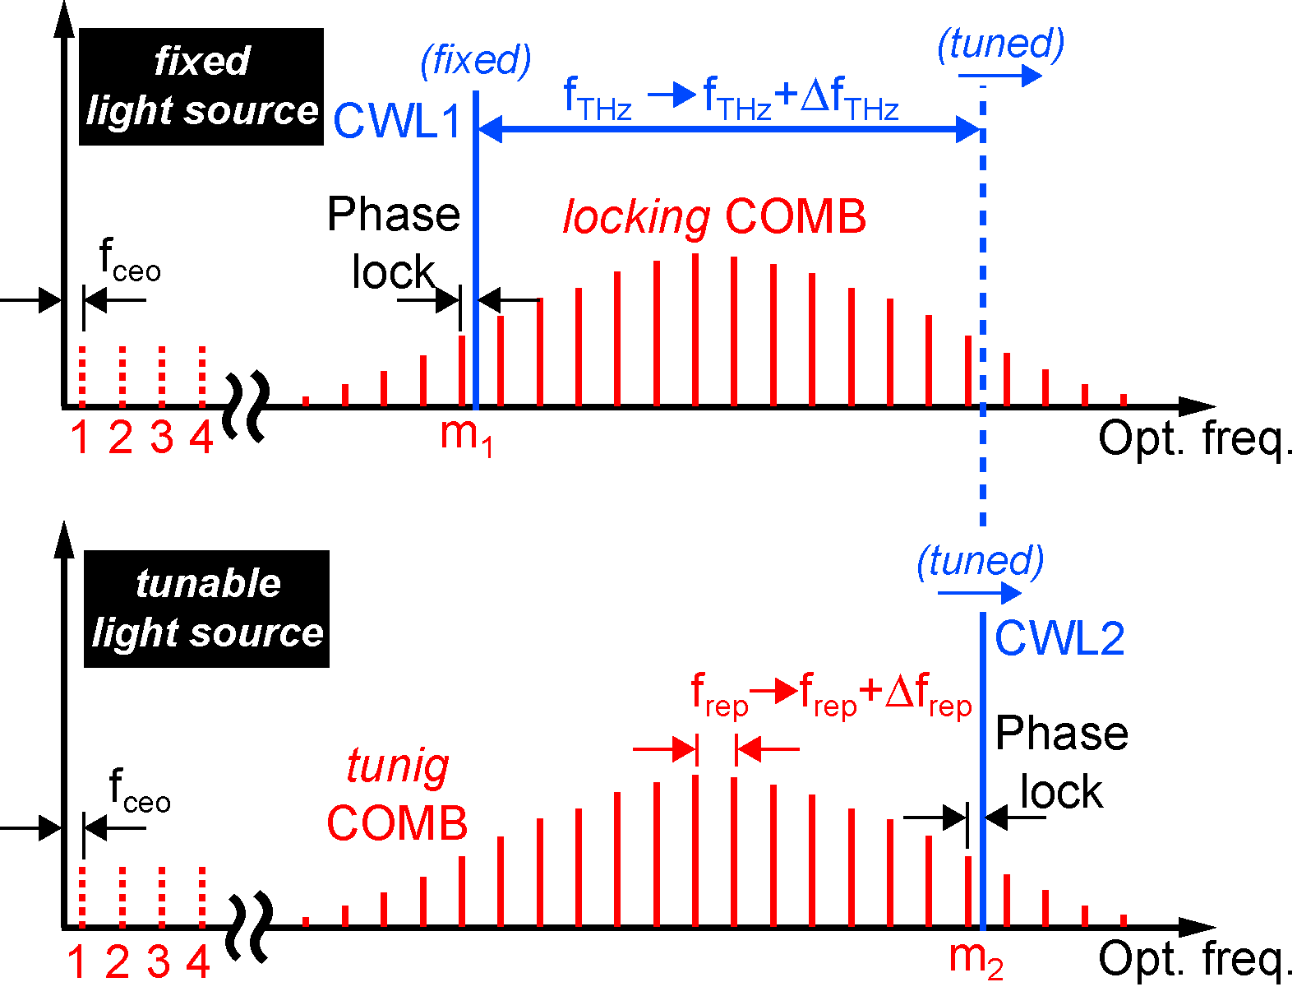
THz分光ツール①：THzシンセ
光シンセのフォトミキシング
ref) Opt. Express 19, 4428 (2011)
Fixed OFS
(OFS1)
f_{THz} = f_{ofs2} - f_{ofs1}
∆f_{THz}=m₂ × ∆f_{rep2} = ∆f_{ofs2}
Photomixing
m₂>>∆m
Tunable OFS
(OFS2)
Previous method based on one optical comb
∆f_{THz}=∆m × ∆f_{rep}
Continuous tuning range is largely increased!

Slide 50
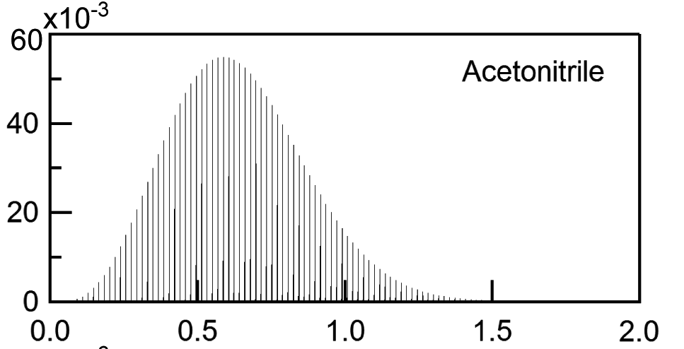
Gas-phase spectroscopy of CH₃CN at 20 Pa
Wide tuning from 0.6 to 0.72 THz at step of 5 MHz
0.12 THz
スペクトル
データベース
2B=
18.4
GHz
J=32
J=33
J=34
J=35
J=36
J=37
J=38
7 manifolds of rotation transitions appeared at every 2B

Slide 51
Gas-phase spectroscopy of CH₃CN at 20 Pa
Fine tuning from 0.62475 to 0.62495 THz at step of 30 kHz
スペクトル
データベース
200 MHz
スペクトル分解能
<500kHz
スペクトル確度
<10⁷

Slide 52
THz分光ツール②：非同期光サンプリング式THz-TDS
デュアルTHzコム分光法
ref) T. Yasui et al., Appl. Phys. Lett. 87, 061101 (2005).
特許4565198&米国特許7605371
THzパルスとプローブパルスの重なるタイミングが各パルス毎に自動的にシフト
∆=f₁ -f₂
f₁
f₂
・機械式時間遅延走査が不要
・高速測定(スキャンレート∆)
・任意の測定時間窓を設定可能
・スペクトル確度はモード同期周波数の安定性に依存
ピコ秒オーダー（周期1/f₁）のTHzパルスをマイクロ秒オーダー（周期1/∆）までスケール拡大
（時間スケール拡大率=f₁/∆）

Slide 53
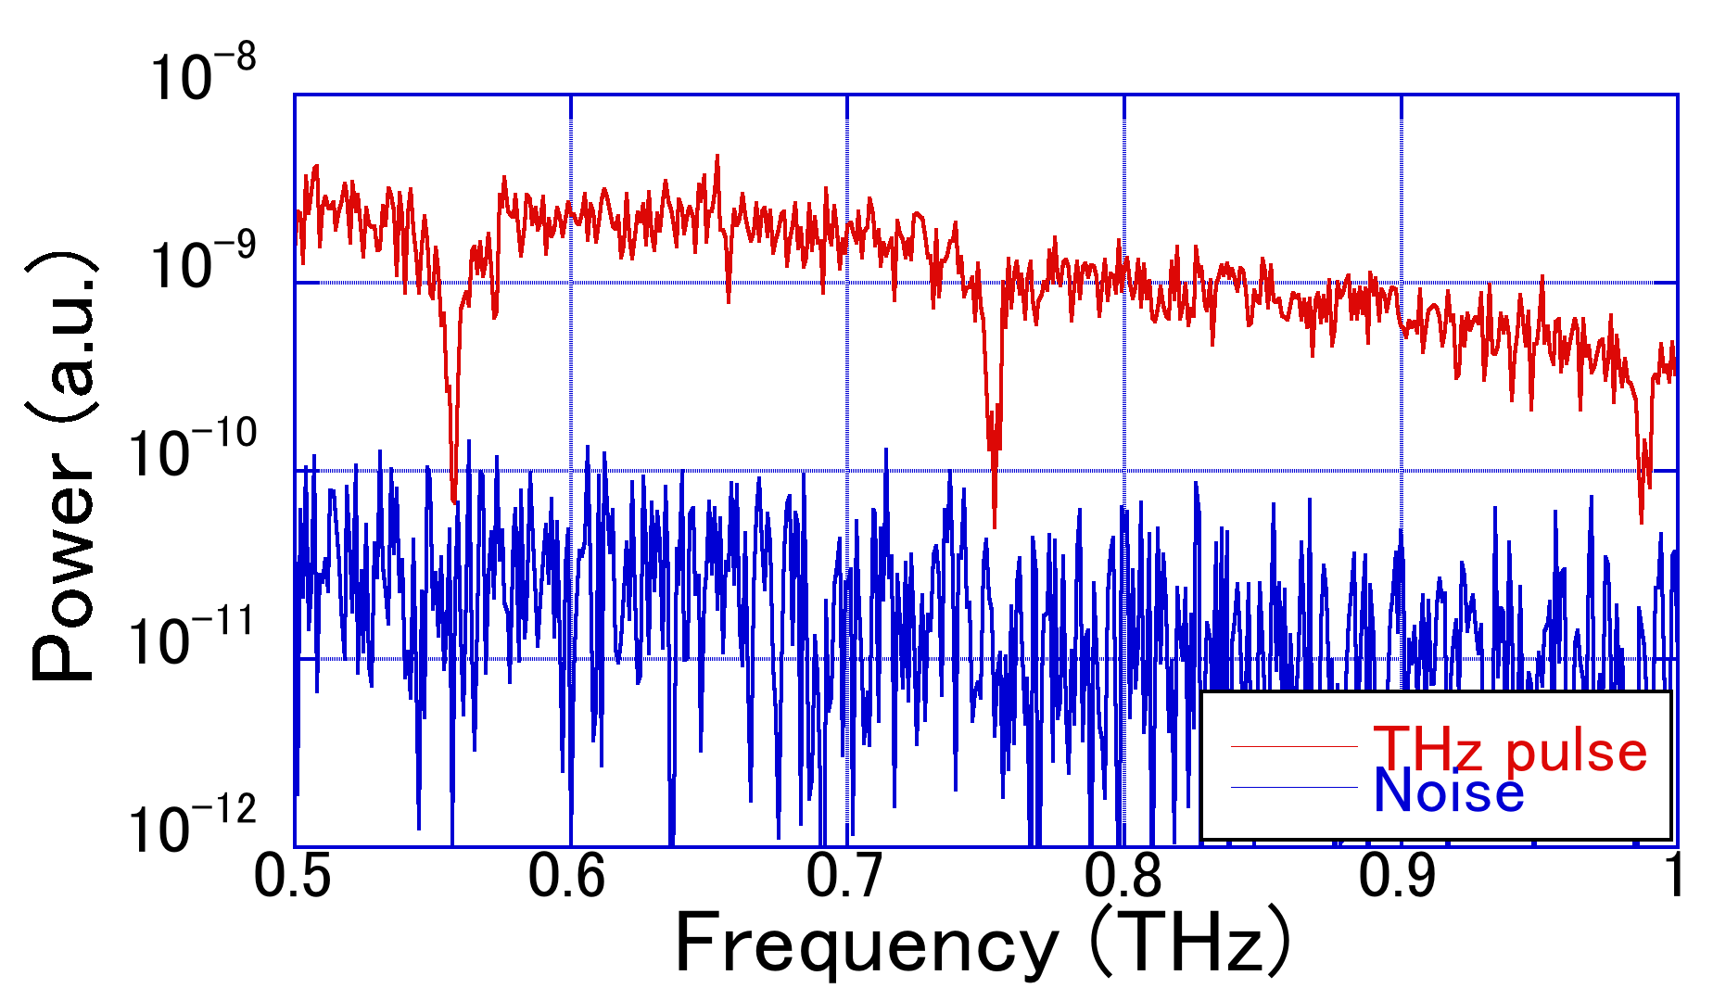
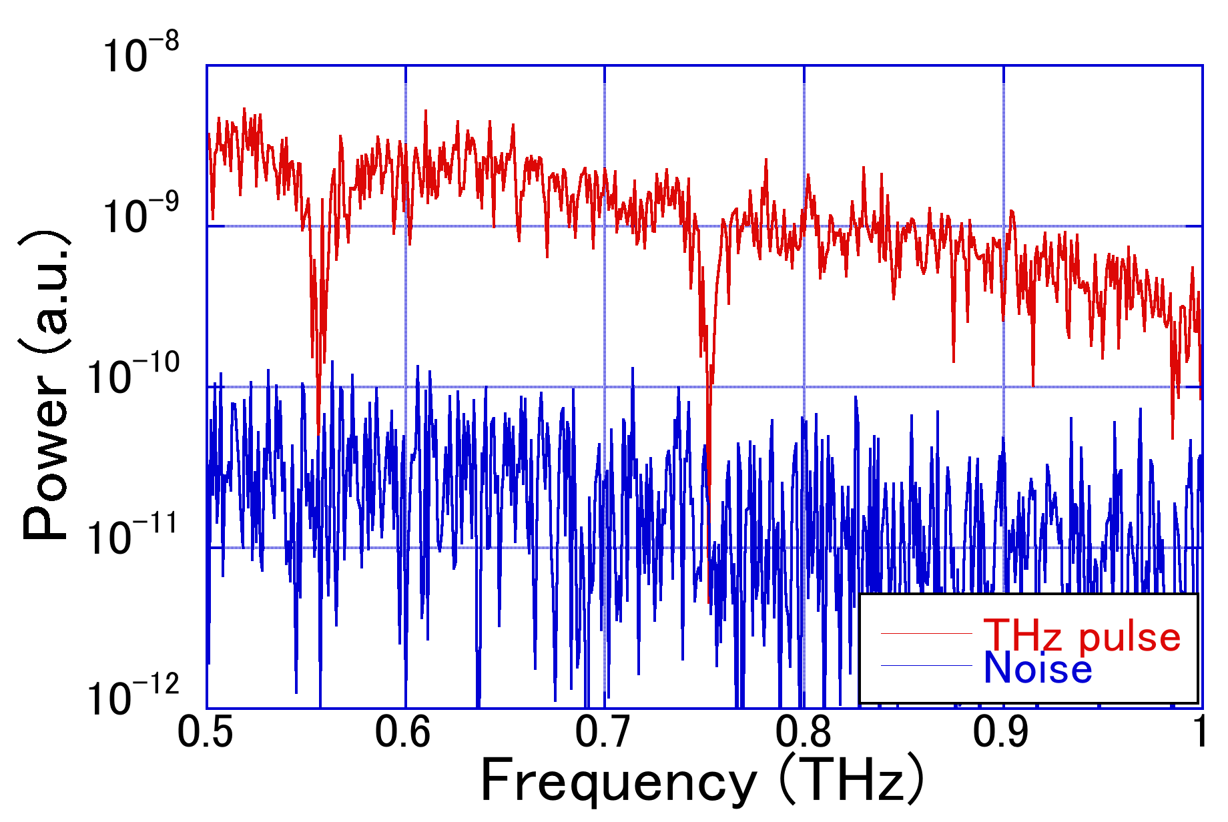
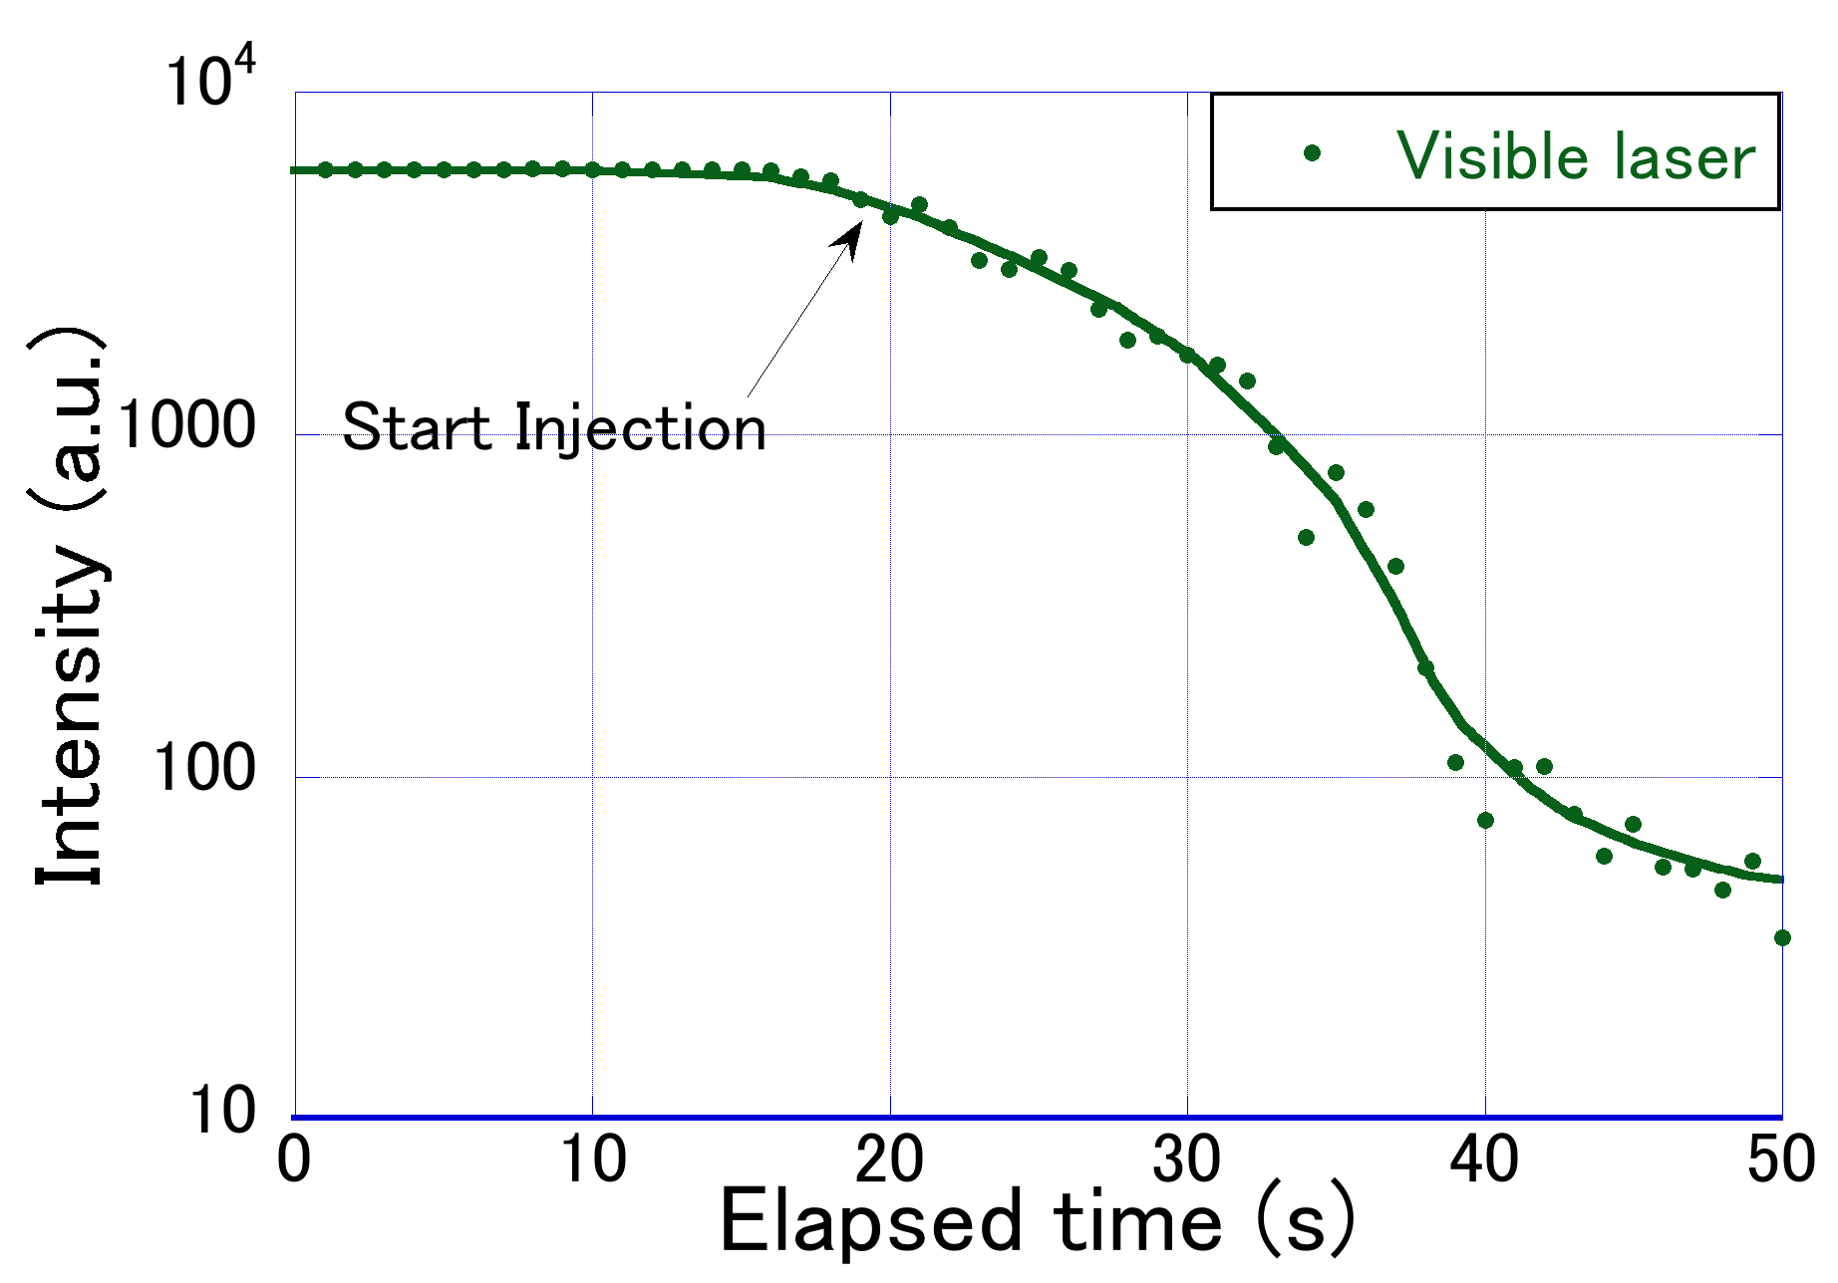
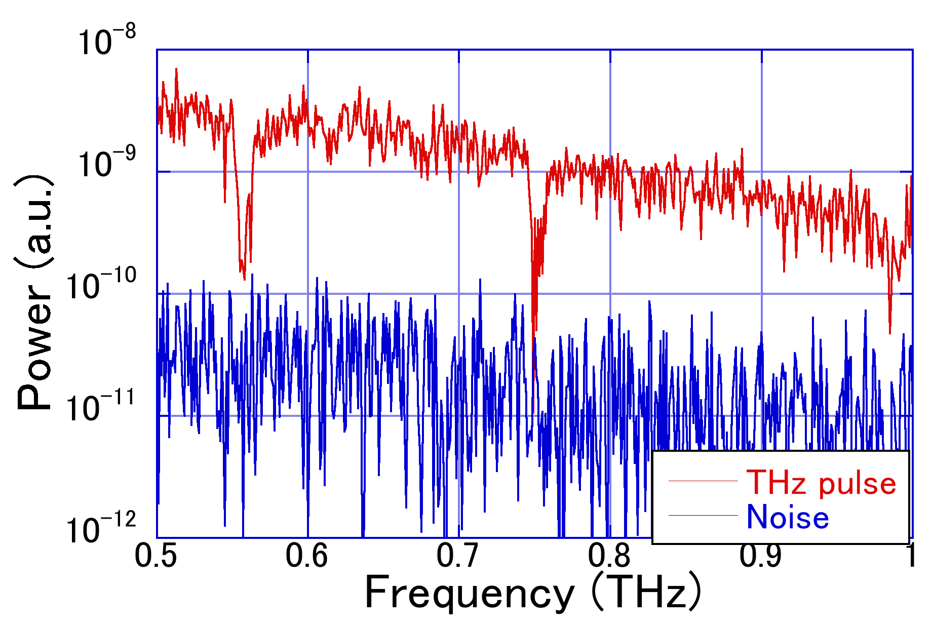
エアロゾル（線香煙）注入による信号変化（THz, 可視光）
計測時間1s、光路長200mm
スペクトル分解能1GHz
Notes:
まず、ガスセル内に煙を注入していき、その時間的変化をモニタリングしました。このときの計測時間は1sです。横軸に経過時間、縦軸に強度を取ったプロット図です。緑のプロットは可視レーザー光強度の値、水色のプロットはノイズを示しています。線香の煙は経過時間が20s立ってから注入を開始しました。線香の煙は時間経過とともにセル内に充満していくことで、注入開始後、エアロゾルの影響により急速に低下し、50s後には注入前の約1/100倍まで信号強度が落ちています。一方、THzパルスは注入前、注入後も変化がなく一定であり、ダイナミックレンジを損なうことなくエアロゾル環境での計測が可能であることがわかった。

Slide 54
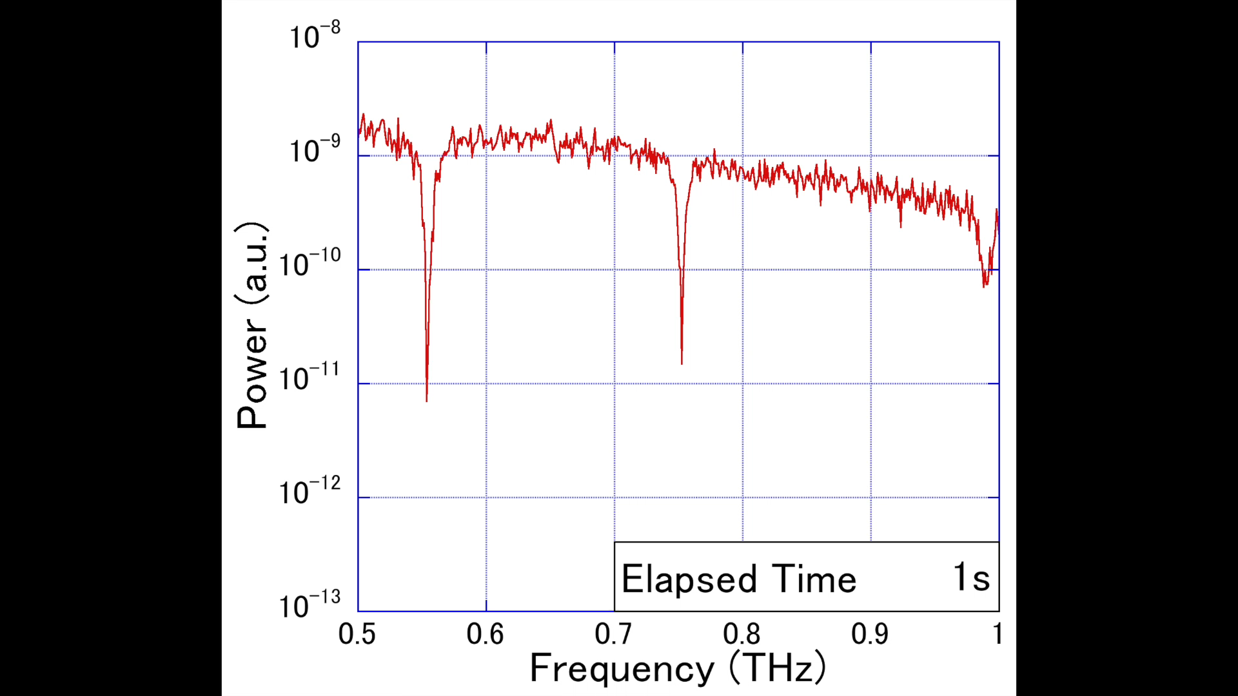
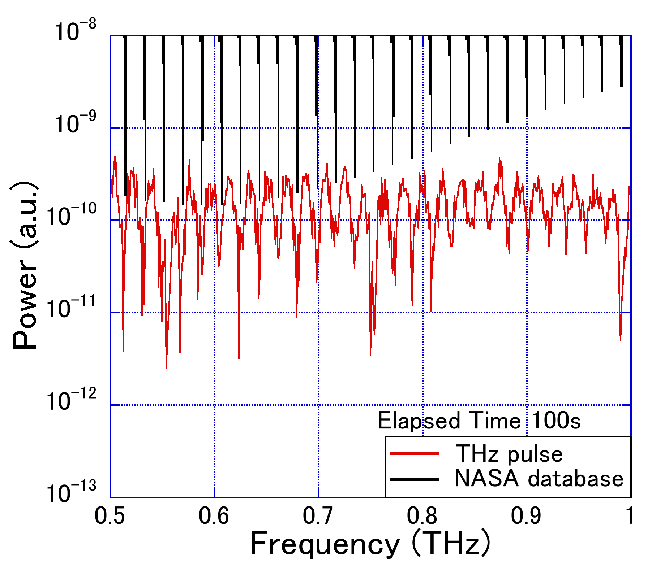
エアロゾル（線香煙）混在状況における
アセトニトリルの動的分光
計測時間1s、光路長200mm
スペクトル分解能1GHz
アセトニトリルの吸収線とNASAのデータベースとの一致を確認
煙による散乱の影響を受けずにアセトニトリルのみの時間的変化の観察に成功
Notes:
セル内に線香煙が充満した状態で、アセトニトリルを滴下しその時間的変化を観察しました。こちらが得られたデータの動画になります。時間経過が進むごとにセル内でアセトニトリルが気化し吸収強度徐々に大きくなっていることが分かります。100s後に得られたスペクトルデータでは経過時間1sで見られなかった18GHzごとのスペクトルディップを見ることができます。この得られたデータをNASAデータベースと比較することで、吸収線の一致を確認しました。この結果から、線香煙による散乱の影響を受けずにアセトニトリルのみの時間的変化の観察することができます。

Slide 55
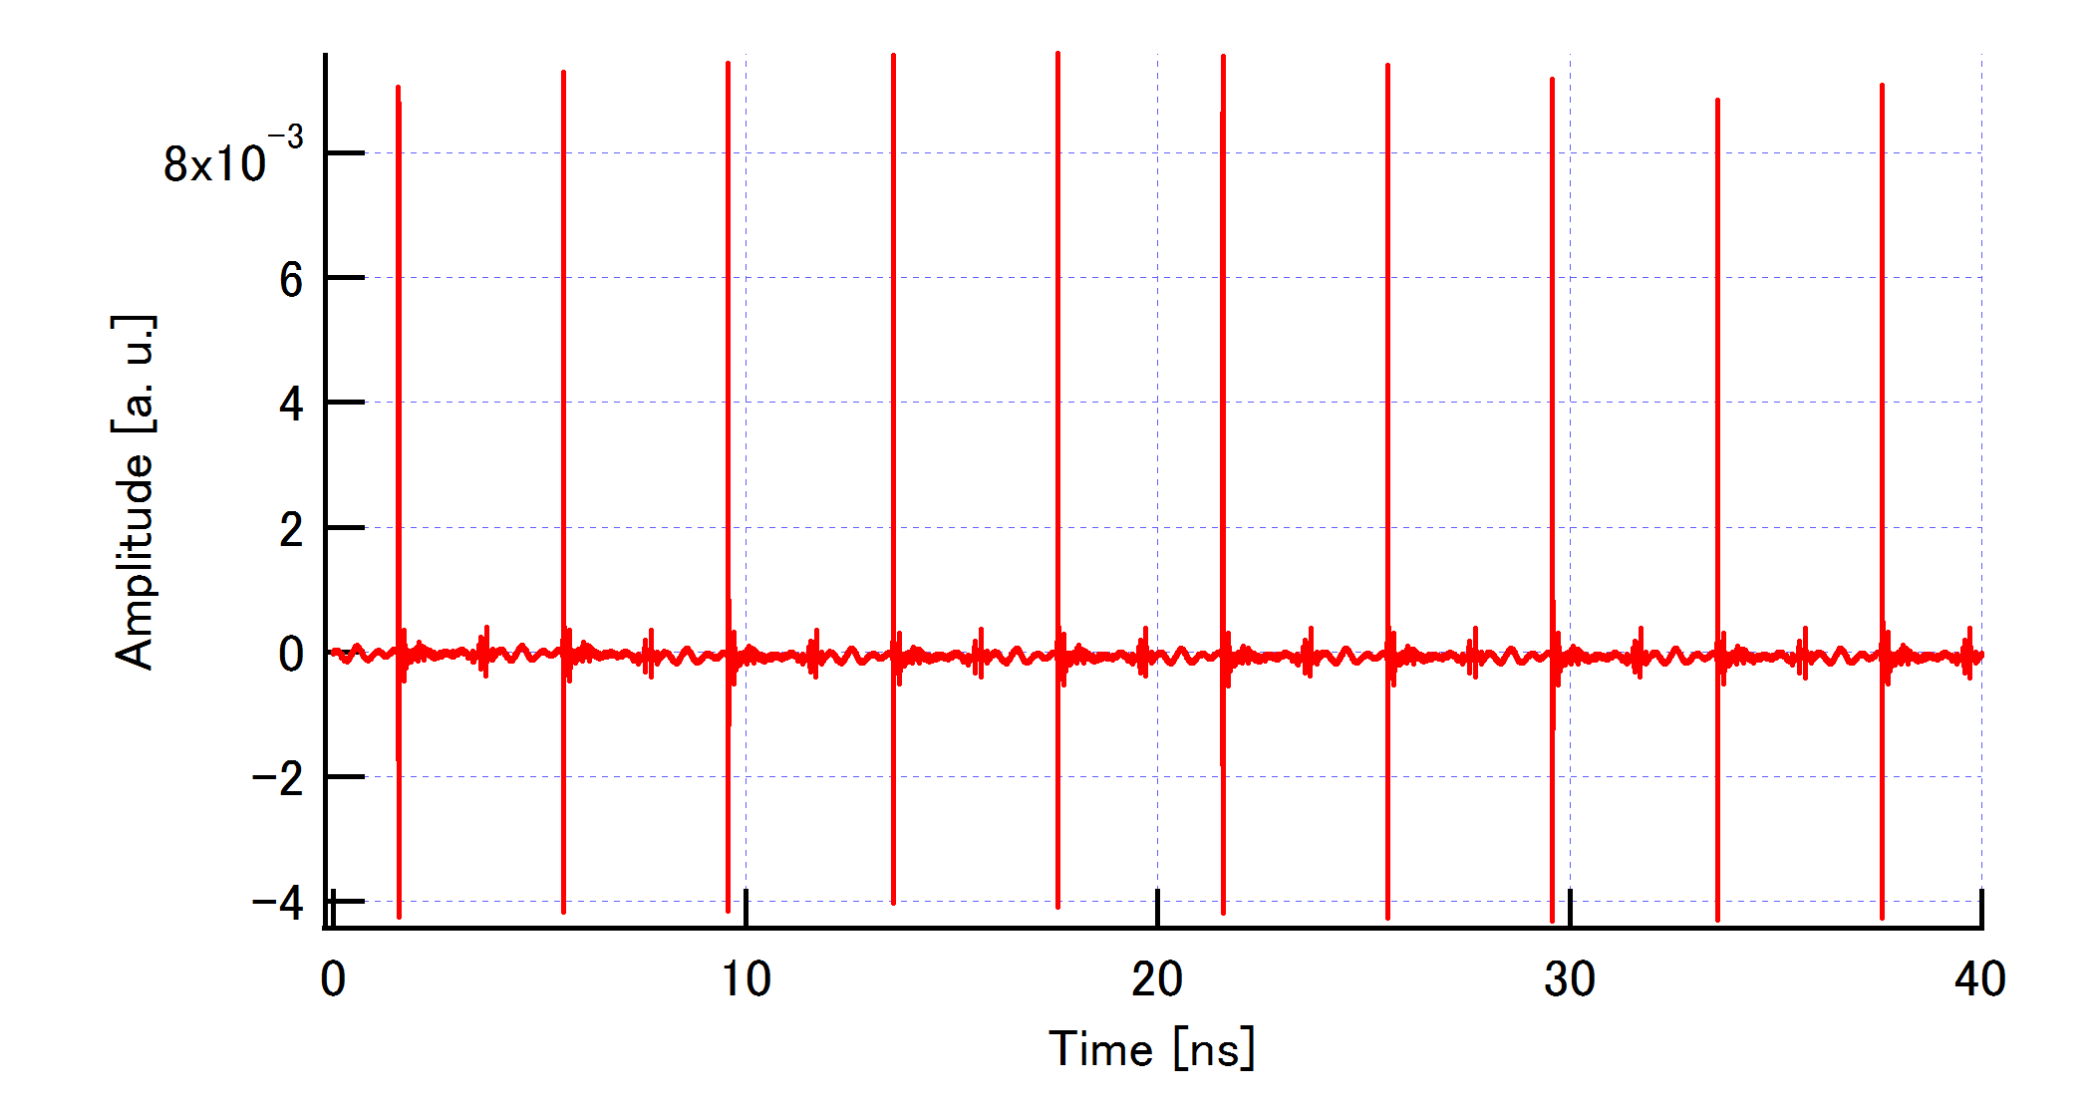
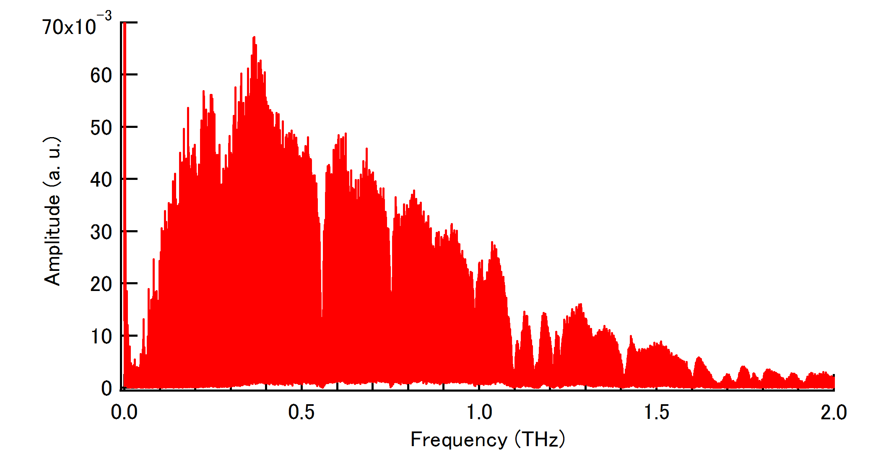
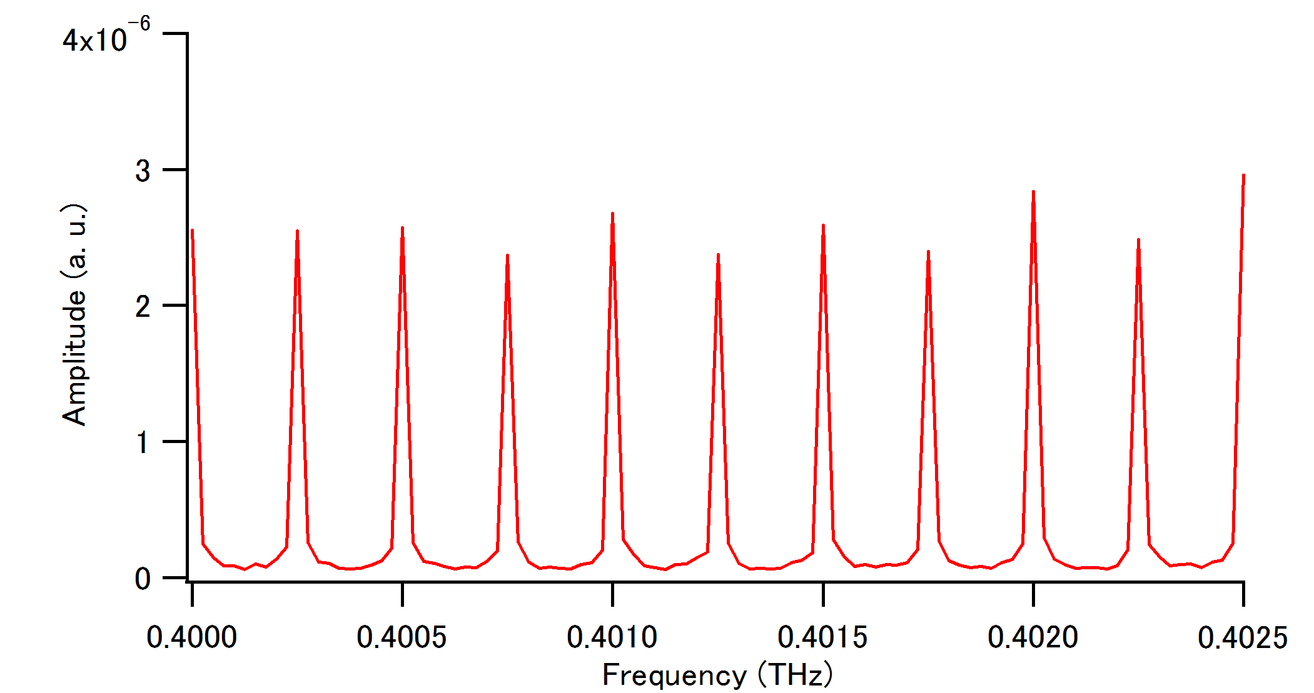
THz分光ツール③：デュアルTHzコム分光法
250MHz
25MHz
0.4 THz
Notes:
55
To confirm the detail structure of the THz comb, we expanded the spectral region around 0.4 THz. One can confirm that THz comb mode has frequency spacing of 250MHz and linewidth of 25 MHz. This freq. spacing was equal to the ML frequency of the fiber laser while the linewidth was determined by the inverse of the temporal window of 40ns. If the time window is further increased, the linewidth can be further decreased. Here, if the mode-locked frequency is phase-locked to a microwave atomic clock, frequency uncertainty of these comb modes will be secured by a national standard of frequency. As a result, traceability of frequency scale in the THz spectrum can be achieved.
When such the THz comb mode is used for precise frequency marker for broadband THz spectrum, spectral resolution should be equal to the frequency spacing between come modes due to stationary and discrete distribution of comb mode. However, linewidth of come mode is much narrower than frequency spacing of comb mode. If this linewidth can be used for THz spectroscopy, spectral resolution will be largely enhanced.

Slide 56
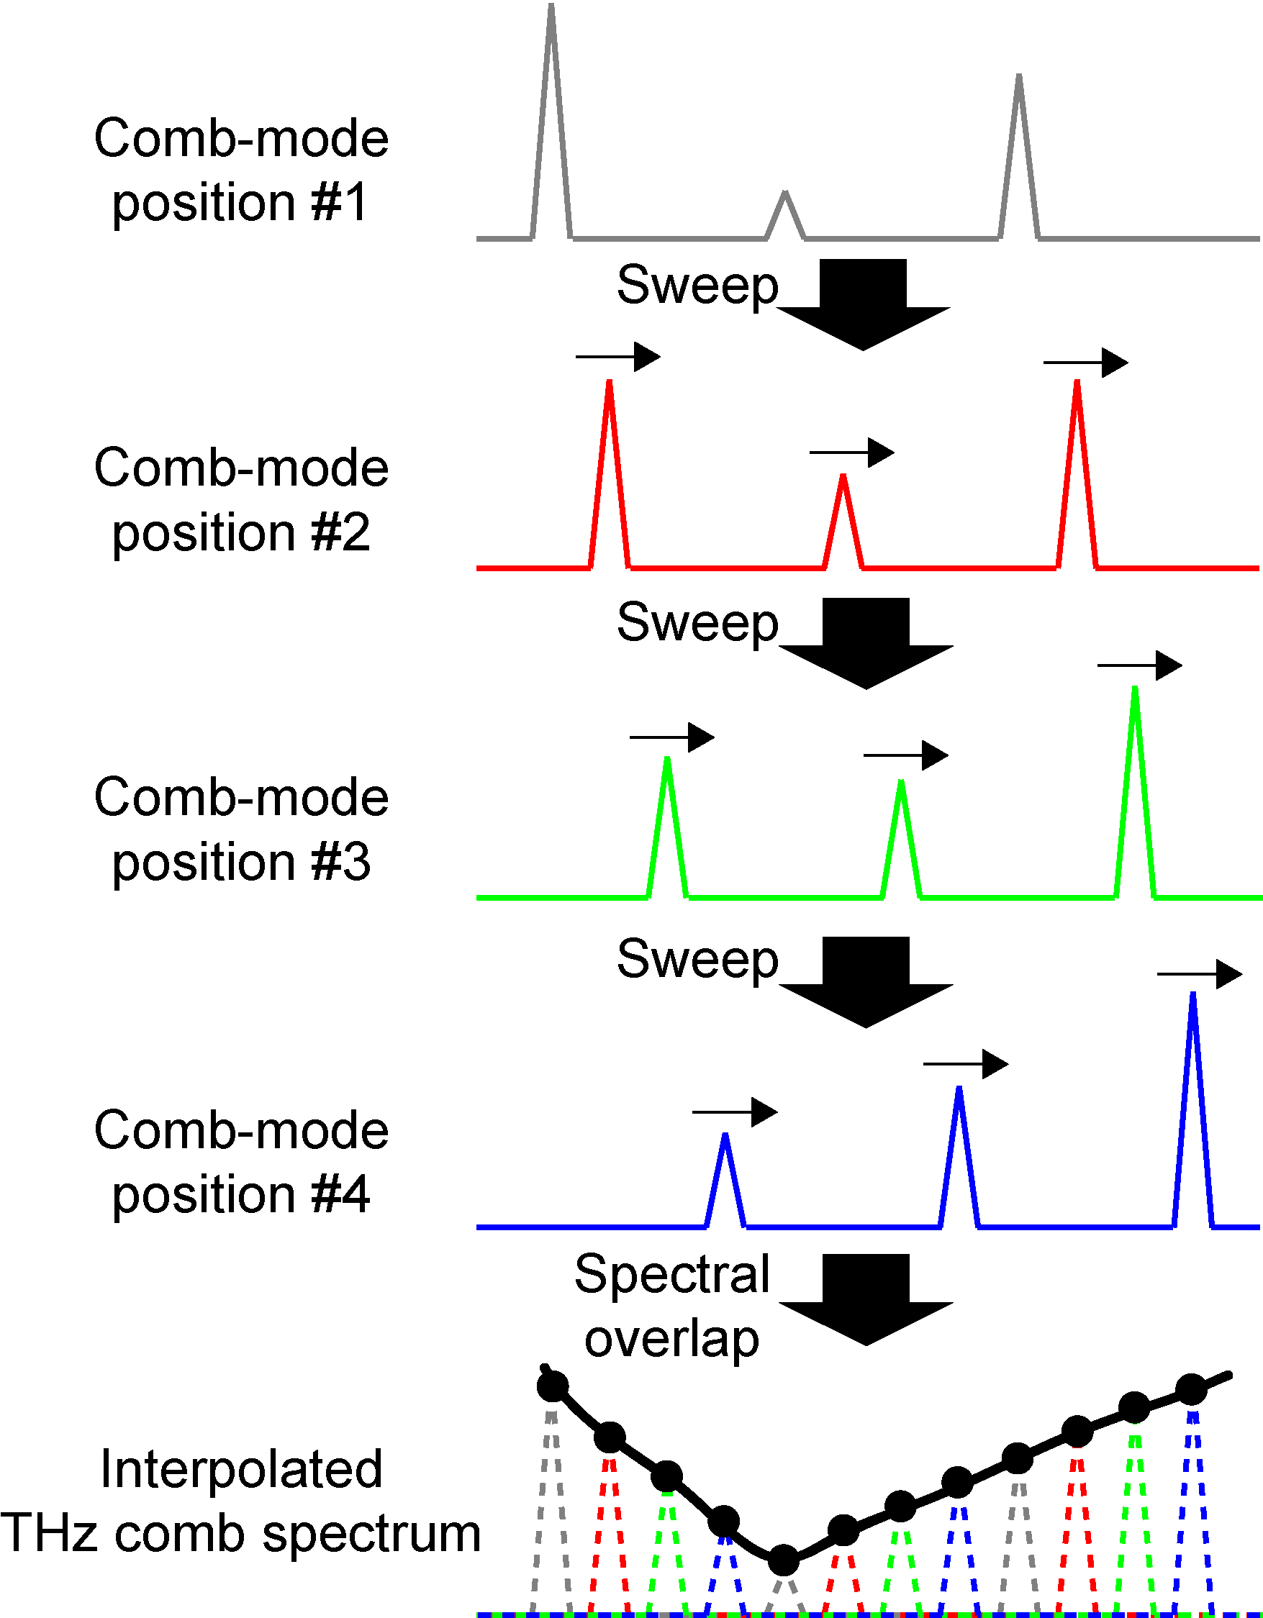
ギャップレスTHzコム（THzコムの走査）
  THzコム分光法では、コムが離散的に分布してるので、スペクトルサンプリング間隔はコム間隔になる。
コム線幅<<コム間隔
  コム・モードを高精度に少しずつ横ずらししながらコム・モード間のギャップを補完する
スペクトルサンプリング間隔をコムモードの線幅まで、向上できる！

Slide 57
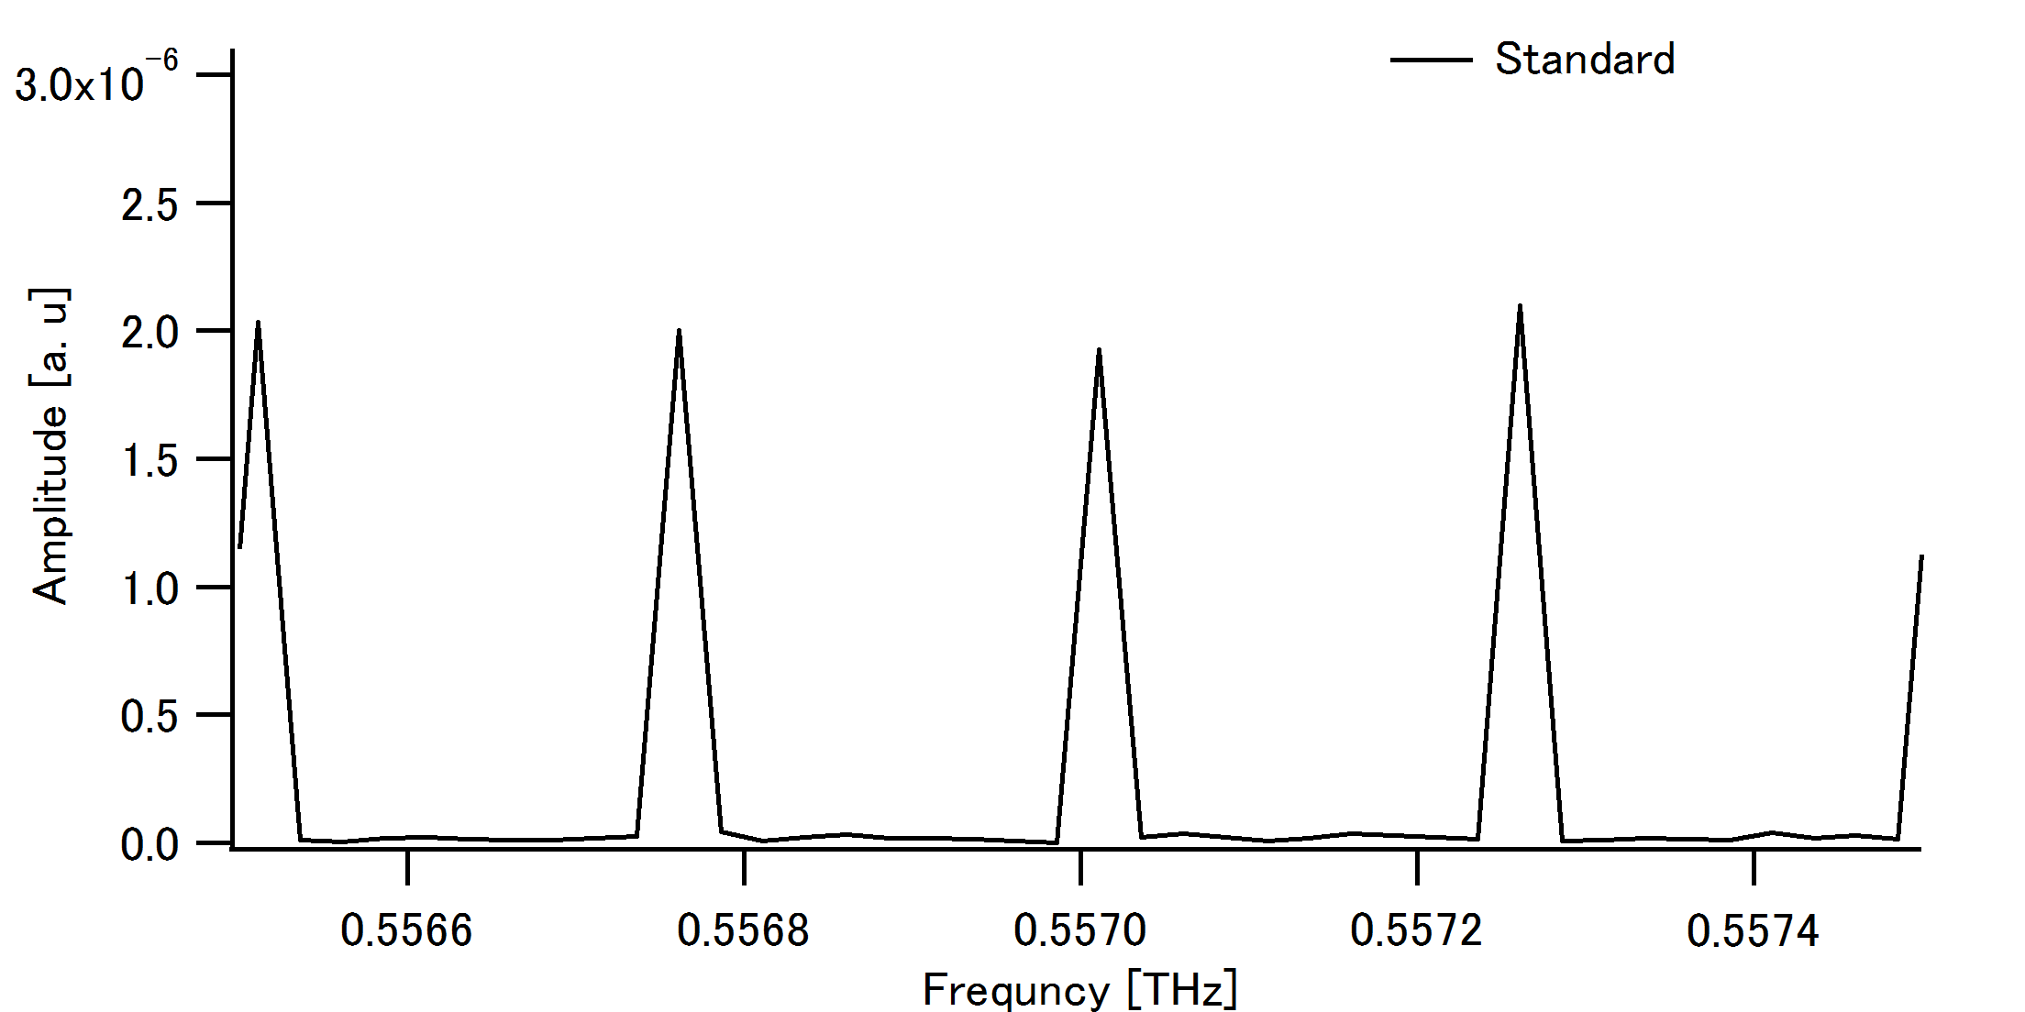
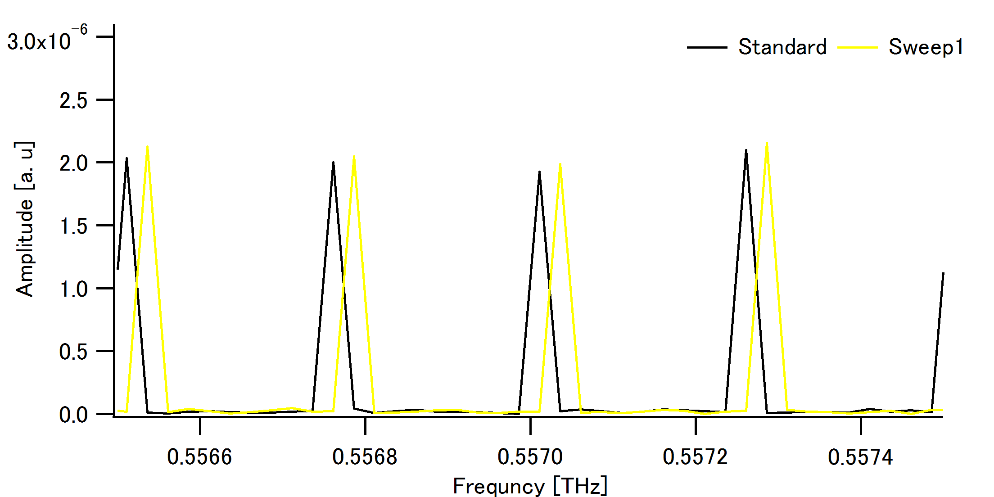
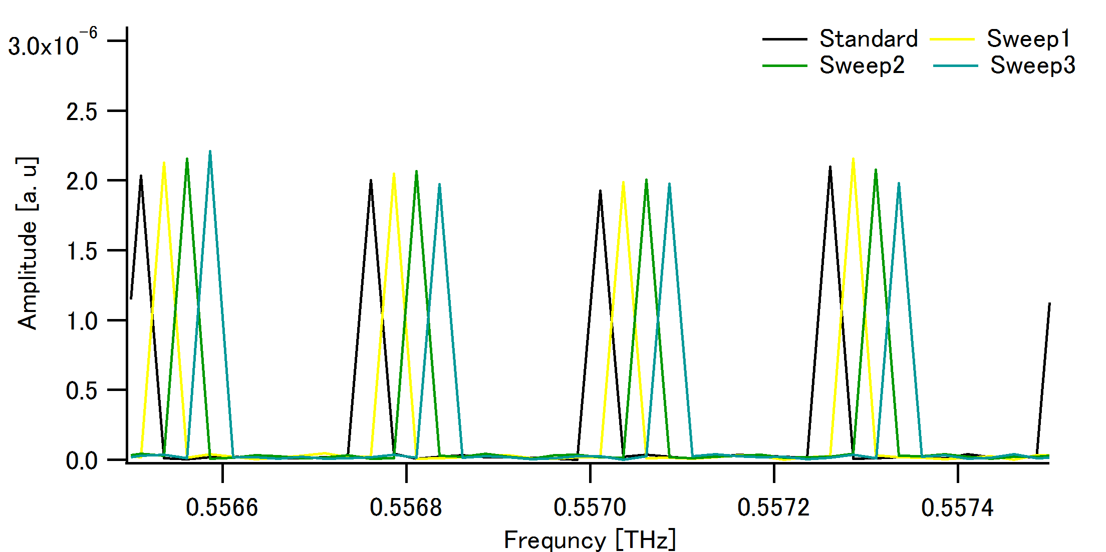
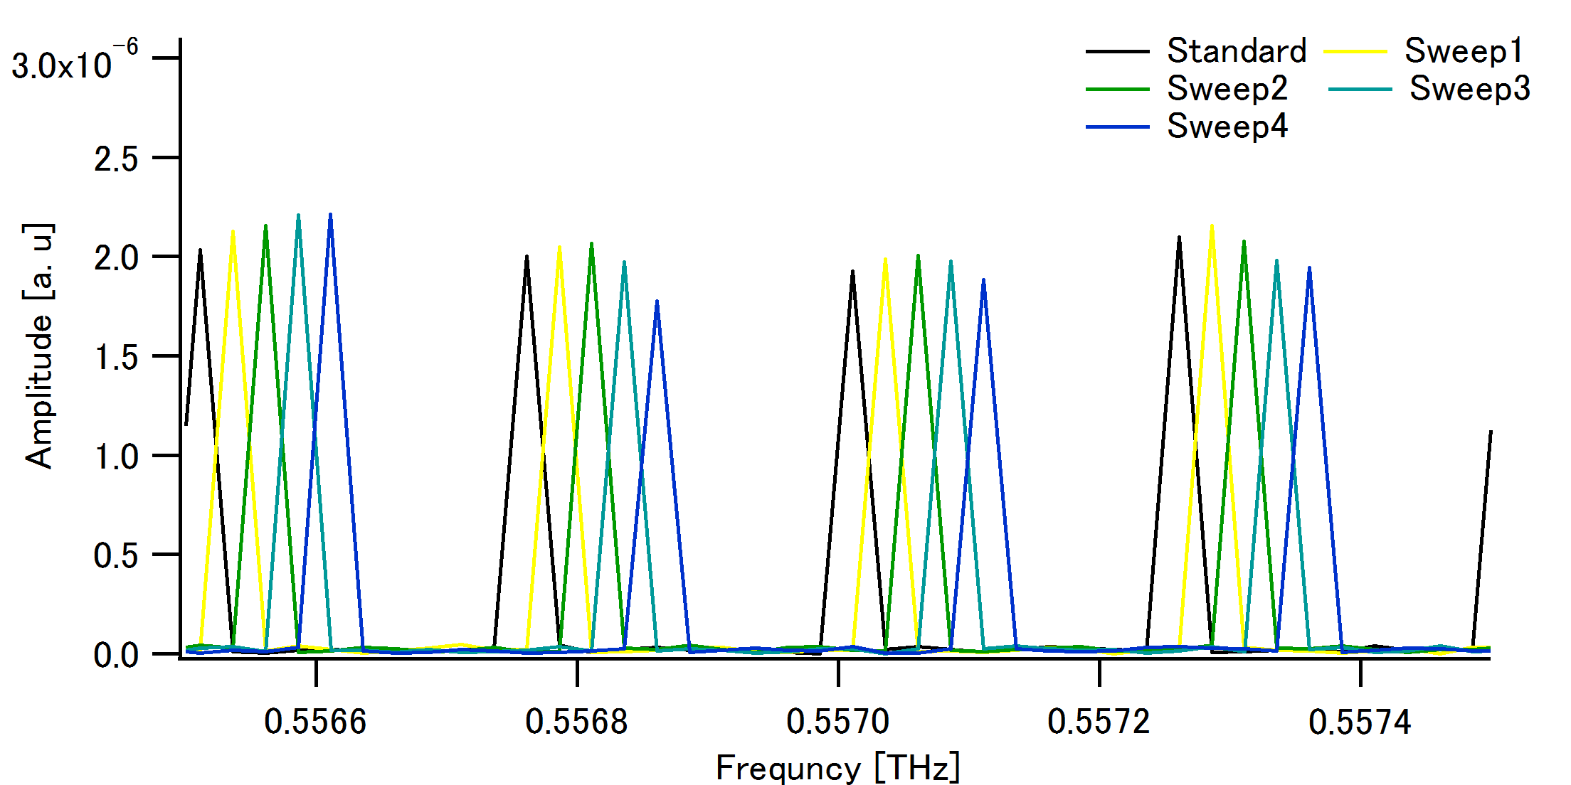
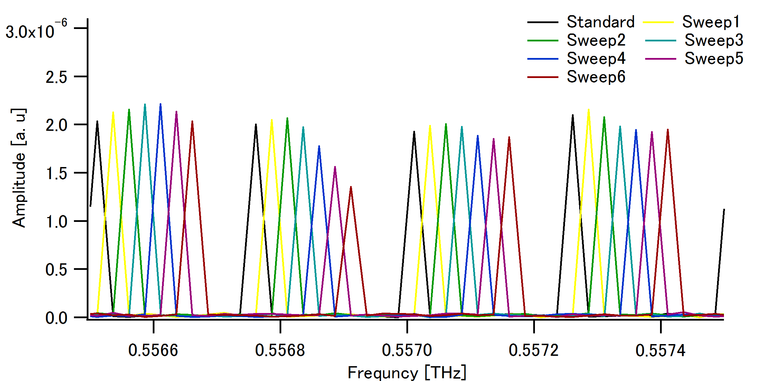
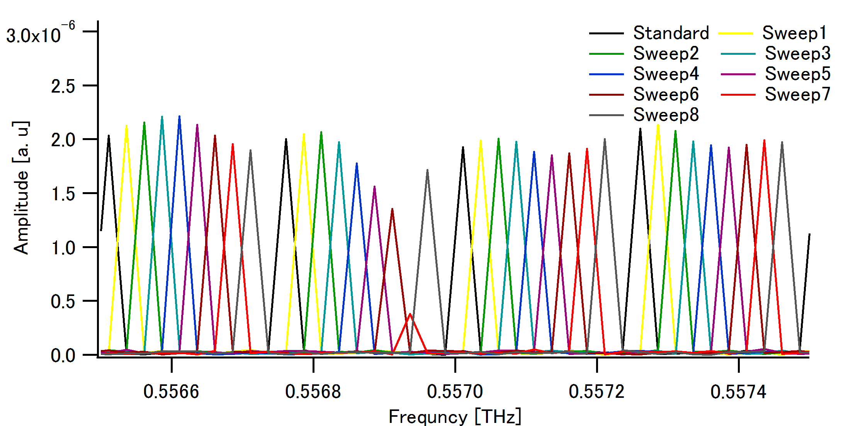
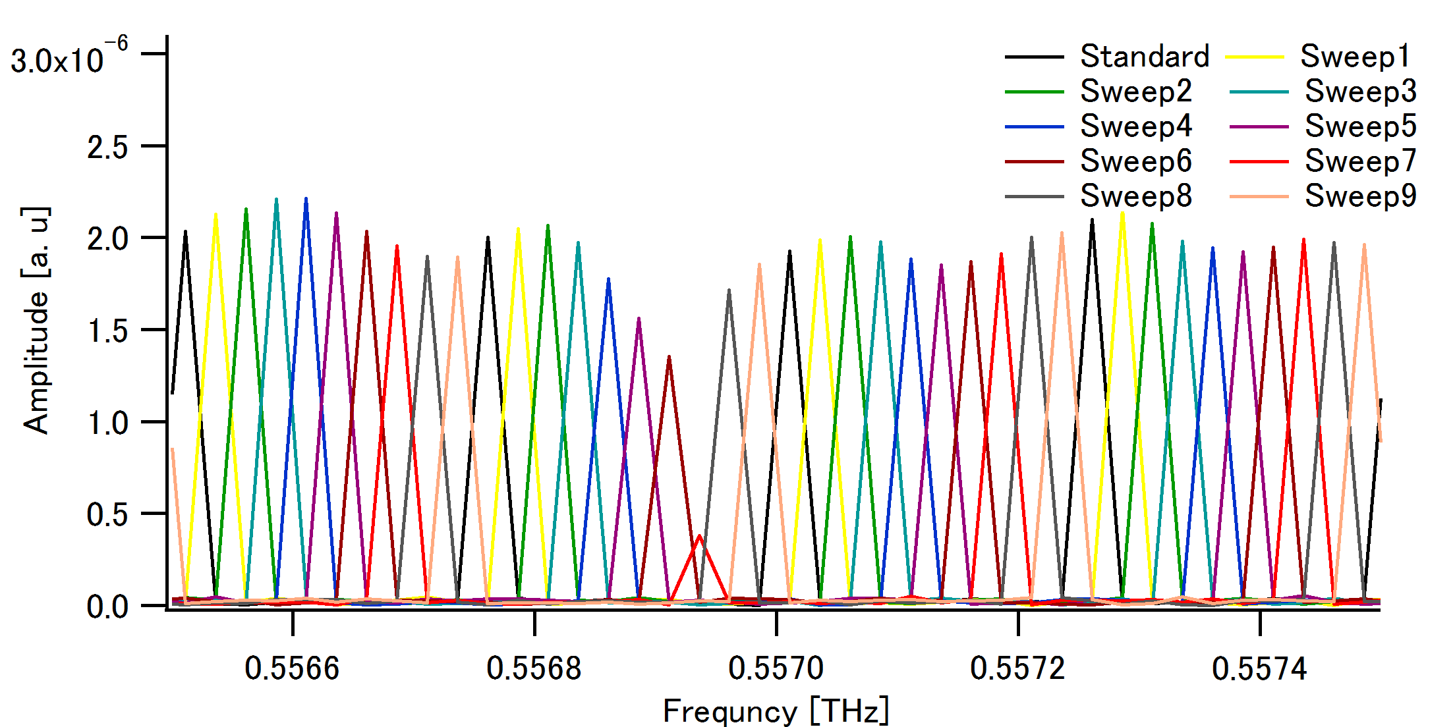
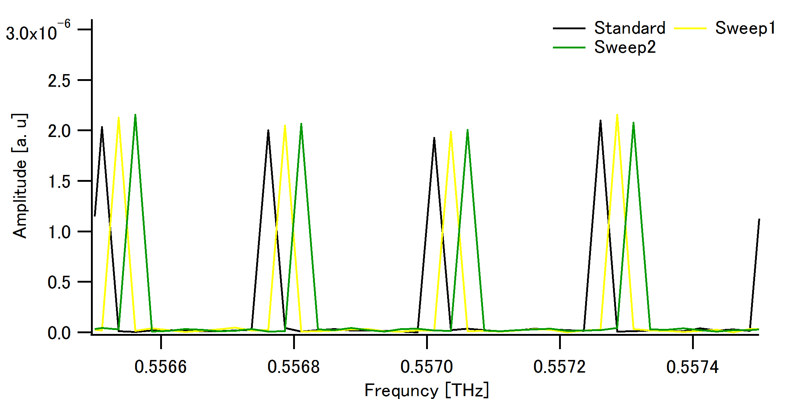
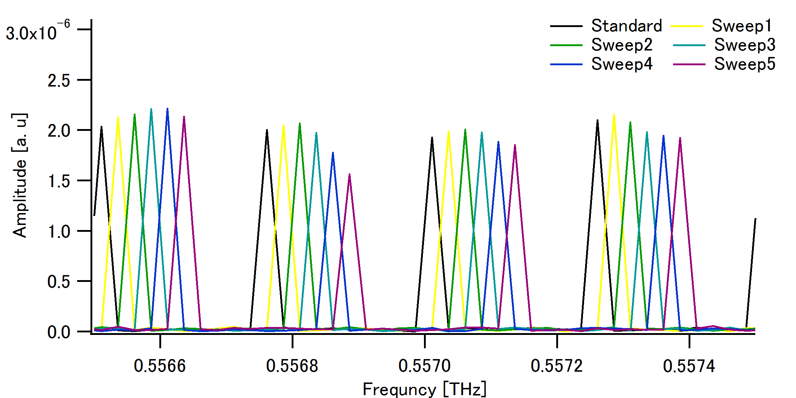
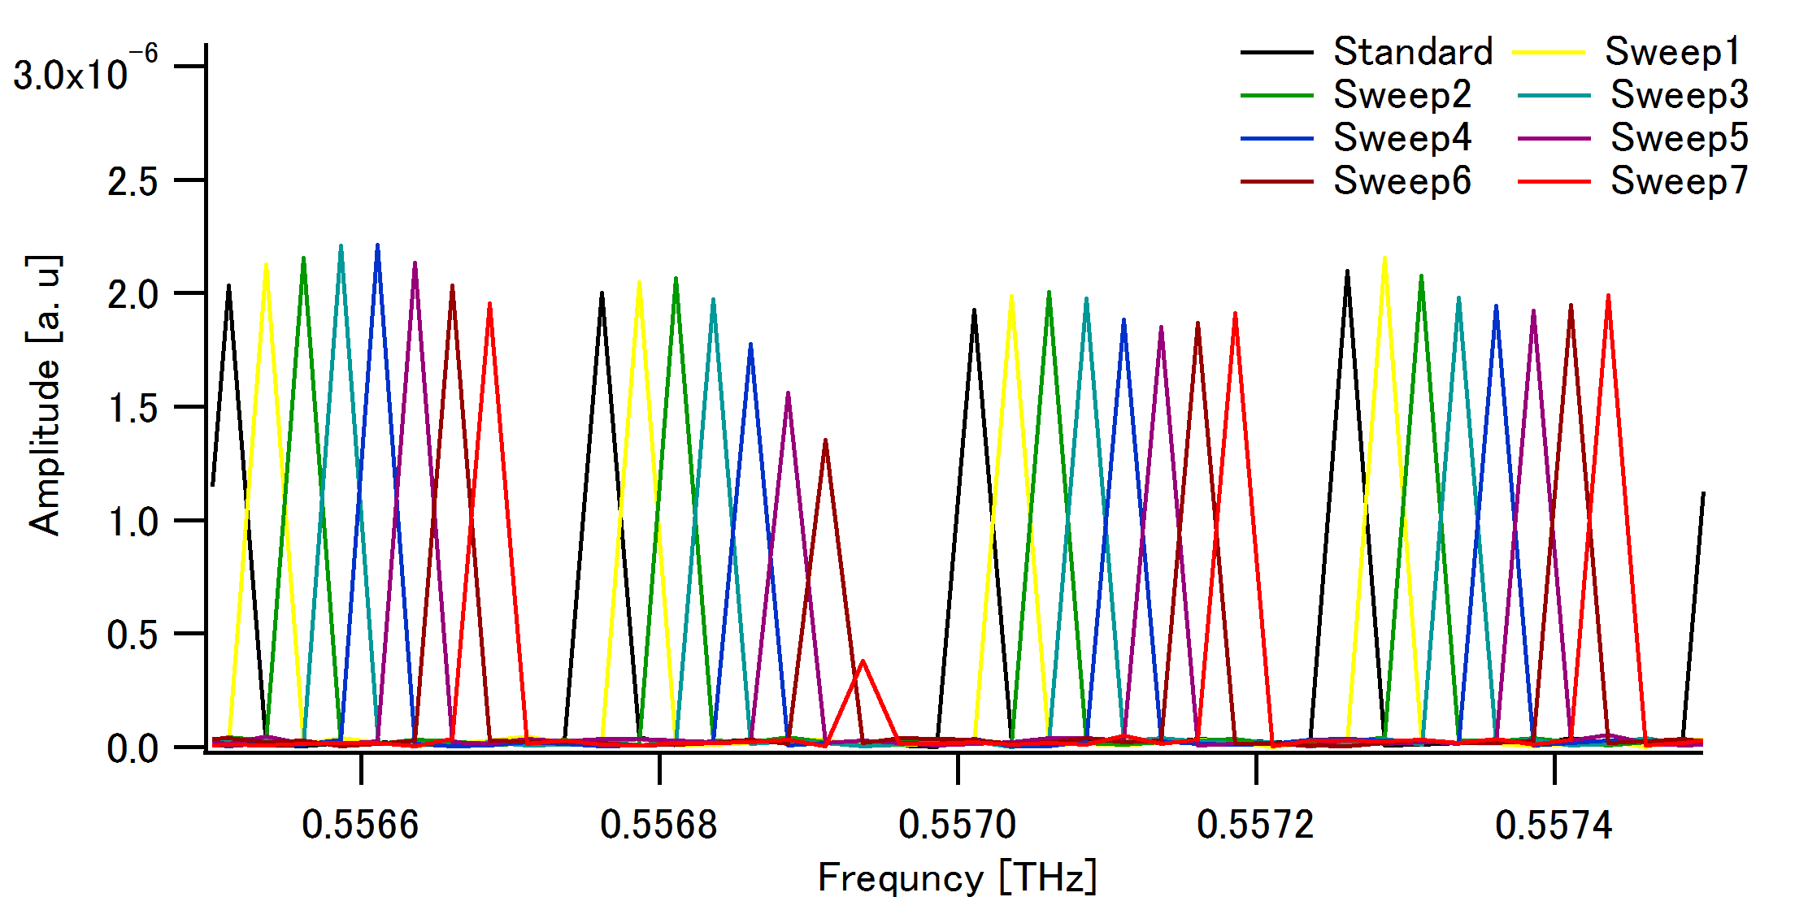
低圧水蒸気の分光計測
回転遷移 1₁₀ → 1₀₁ : 0.5569360THz@NASA database
(圧力拡がり線幅= 23 MHz @H₂O:10Pa&N₂:320Pa)
振幅スペクトル（10周期ギャップレスTHzコム）
走査前
f₁=250,000,049 Hz
f₂=250,000,099 Hz
∆=50Hz
∆f₁, ∆f₂
+15,625 Hz
ステップ走査を１０回
繰り返し
THzコムをギャップレス化
Notes:
To evaluate the performance of gap-less THz comb spectroscopy, we demonstrate spectroscopy of low-pressure water vapor. In this experiment, the water vapor is diluted with nitrogen gas at this pressure condition.
Here, the selected absorption line was the water rotational transition of 110-101 around 0.557 THz. Under this pressure condition, the pressure broadening linewidth was expected to 23 MHz. The amplitude spectrum without incremental sweeping of THz comb did not indicate any spectral shape of the absorption line due to too coarse distribution of comb mode. However, when the incremental sweeping was repeated 10 times, the sharp spectral dip was significantly appeared at the position of the water absorption line.

Slide 58
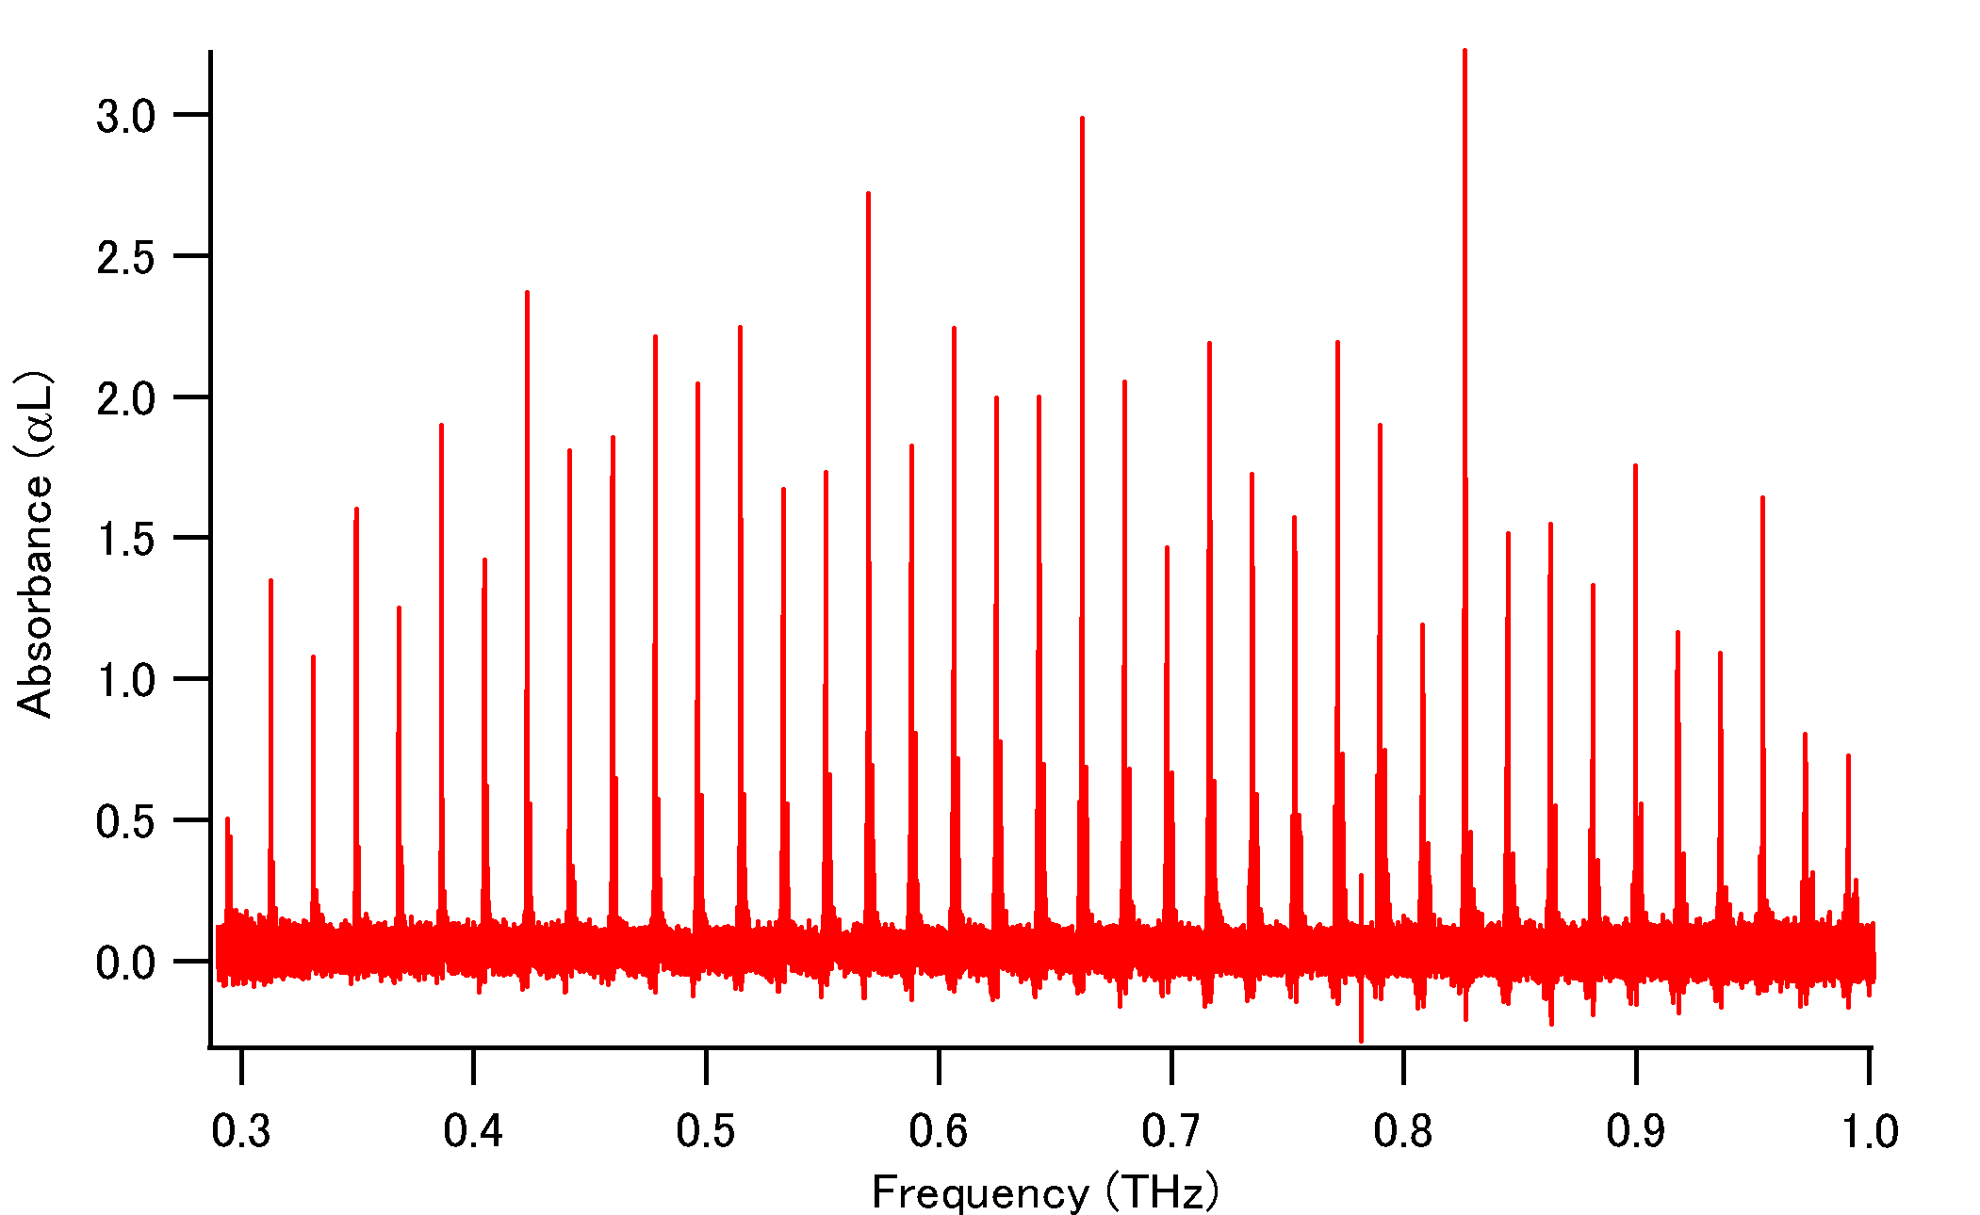
低圧アセトニトリル（CH₃CN）の分光計測
吸収スペクトル（100周期ギャップレスTHzコム）
K=1
K=0
偏差
0.62MHz
偏差
0.26MHz
NASAﾃﾞｰﾀﾍﾞｰｽとの偏差
1MHz以下(ｽﾍﾟｸﾄﾙ確度<10⁻⁷)
↓
ﾃﾞｰﾀﾍﾞｰｽの高精度化
12MHz
極めて周波数ダイナミックレンジ（不確かさ1MHz＠周波数1THz）の広い分光計測を実現

Slide 59
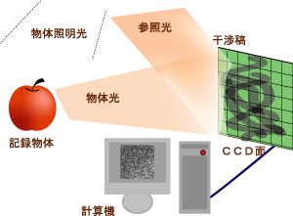
THzデジタル・ホログラフィー
可視デジタル・ホログラフィー
THzデジタル・ホログラフィー
THz波の良好な物質透過性を利用することにより、内部構造を３次元で可視化できる
２次元自由空間電気光学サンプリングの利用により、電場振幅/位相イメージの直接取得が可能☞干渉計測が不要
THz指紋スペクトルを利用すると、成分分析型内部透視イメージングが可能。
例）３次元表面形状測定
ソフトマテリアルの非破壊検査

Slide 60
THzコム位相同期THz-QCL
アクティブ制御
パッシブ制御
インジェクションロック＠THzコム＞高出力THzシンセ?
or高出力THzコム？
インジェクションロック＠THzシンセ＞高出力THzシンセ？

Slide 61
②新奇光コム計測の開拓と応用計測展開
・偏光コム
・画像コム
・センシングコム
・次元変換コム

Slide 62
偏光コム
偏光コム
（ﾁｬﾈﾙﾄﾞ･ｽﾍﾟｸﾄﾙ）
読み出し光コム
ストークス・パラメーター
（S₁, S₂, S₃）
エリプソ・パラメーター
（Δ、Ψ）
偏光&分光計測＠デュアル光コム
分光器フリー
回転偏光素子フリー
偏光RFコム（電気コム）
偏光解析の
大幅な高精度化

Slide 63
ハイパー・チャネルドスペクトル
ファブリ・ペロー共振器
エンハンスド共振器
波長板の次数：大
→ 周波数：小
サンプル
デュアル光コム分光
（偏光計測@方位-45°
&分光計測）
Intensity
偏光子
（方位：45°）
高次波長板
（方位：０°）
検光子
（方位：-45°）
λ
波長板の次数をあげることで
チャネルドスペクトルを高密度化
n
S1, S2, S3
Intensity
λ
λ
・・・
・・・
高精度屈折率分散計測
高精度偏光計測
λ
・複屈折標準試料の作製

Slide 64
分光コム・エリプソメトリー
回転検光子
デュアル光コム分光
（偏光計測@方位-45°
&分光計測）
偏光子
（方位：45°）
サンプル
振幅と位相の同時計測
☞複素屈折率の直接算出
☞偏光子の回転不要
☞実時間測定
高分解能測定
☞モデルフィッティング精度の向上

Slide 65

画像コム
画像コム
（超ﾏﾙﾁｶﾗｰ画像群）
読み出しコム
デュアル光コム分光イメージング
ロックイン・イメージング
（振幅＆位相＆画像＆周波数の多重化）
画像RFコム（電気コム）
ﾊﾞｲｵｲﾒｰｼﾞﾝｸﾞ
光情報記録
3次元内部透視
ﾃﾞｨｽﾌﾟﾚｲ
光情報量の大幅な増大
（画像、振幅、位相、周波数）
任意波長のイメージ抽出

Slide 66
画像コムと非線形ラマン分光の融合
ω₂
ω₁
分子指紋を究極の分光性能（高分解能、高確度、広帯域、実時間、高感度）で識別して画像化
Notes:
そこで、本研究では、ラマン分光で究極の分光性能を実現するために、マルチプレックスCARSとギャップレスデュアル光コム分光法を融合します。
まず、マルチプレックスCARSでは、広帯域光コムの高周波の狭帯域成分と低周波の広帯域成分をそれぞれw1光とw2光とすることにより、マルチプレックスCARSコムを生成します。
次に、マルチプレックスCARSコムとコム間隔がわずかに異なる局部発振器光コムを準備し、マルチヘテロダイン干渉を用いて、マルチプレックスCARSコムを光領域からRF領域に周波数ダウンスケーリングします。そしてその周波数スペクトルを高精度計測することにより、分子指紋を究極の分光性能で識別し、呼気診断に新展開を則すことを目指します。

Slide 67
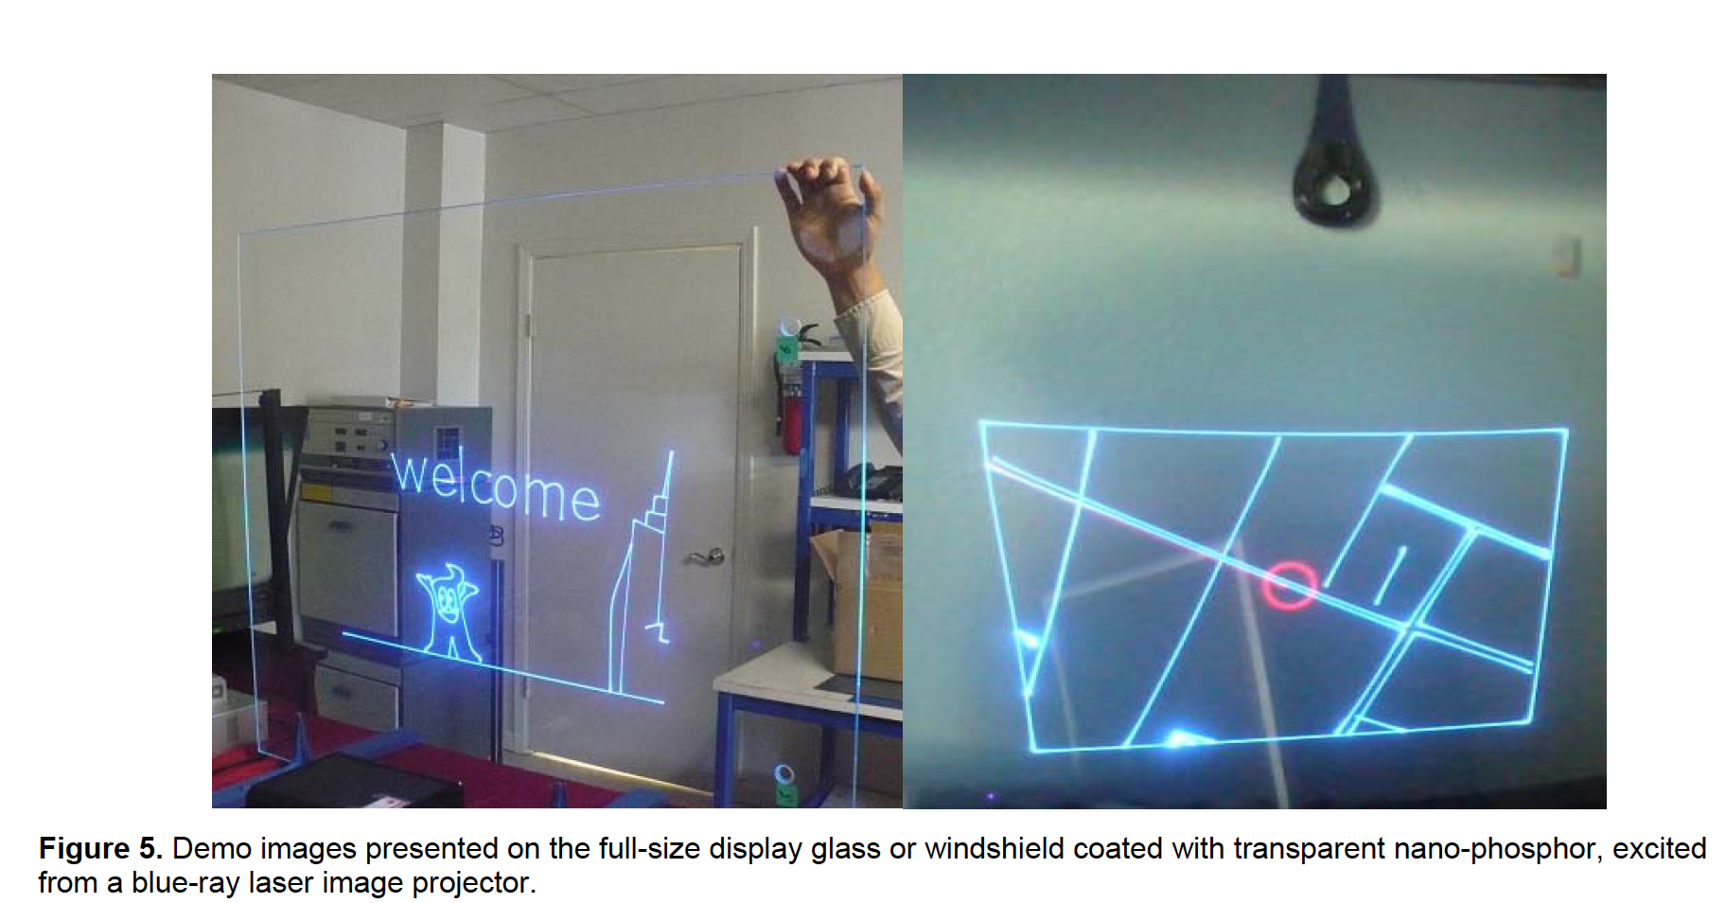
エッジリットコムディスプレイ
エッジ照明ディスプレイ
ガラス基板の側面から照明光を入射，ガラス面上に映像を
表示する技術．従来はガラスの片面の形状を加工して
特定の位置までは全反射で伝搬するようにして実現されていた．
透過像が歪む欠点があるだけでなく，大画面化と像の明るさと精度に課題．
参考: edge lit 技術自体は，LCDのLEDバックライトに普及．
要素技術
米国 Sun Innovations社が透明な蛍光スクリーンを開発[1]．
蛍光励起
  赤(390-410nm）
  緑(490-510nm）
  青(420-440nm）
従来：プロジェクター必要
映画「Minority Report」に出てくるような透明ガラス表示
光コムを使って，世界最大のフラットパネルディスプレイを．
周波数分解されたビームの交差位置で２光子吸収可能であれば，周波数を空間位置に対応付け可能
  コムの周波数密度の高さと位相が揃っていることが重要なファクター．
静止画の表示であれば，ガラス面を共振器のようにして使って映像表示可能か？入射側と反対側のエッジで反射した光パルスと入射光パルスが重なった位置で発光．
小型画面であれば
ホログラフィック多焦点レンズを使って周波数ごとに位置の異なる集光点を形成．
[1] Ted Sun et al., SID 2013 DIGEST, pp. 755-758 (2013).
Notes:
まだmissing pieceがあるために，実現イメージがわかりにくいのであると思います．説明を加えましたが，本当に可能か，コムの専門家の意見を伺いたいところです．波長ごとの変調とかパルス間隔の制御ができると自由に絵をだせますが，難しいかもしれません．

Slide 68
センシングコム
Pump LD
(1480nm)
Isolator
Output
測定物理量を
周波数に置換
Er-doped
fiber
光コムの圧倒的な周波数
ダイナミックレンジの利用
Polarization
controller
測定ダイナミックレンジの
大幅な拡大
測定物理量
（歪みなど）
センシング
キャビティ

Slide 69
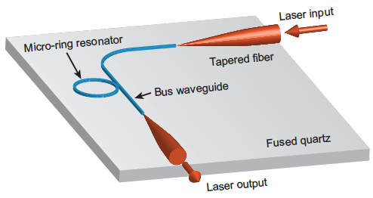
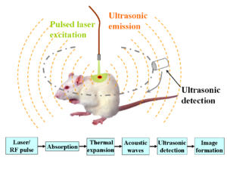
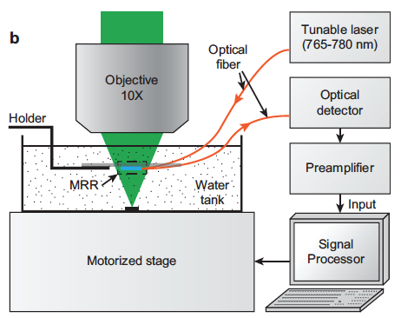
光音響イメージングへの応用
光センシング
超音波トランスデューサー＠従来
Scientific Reports 4, 4496 (2014).

Slide 70
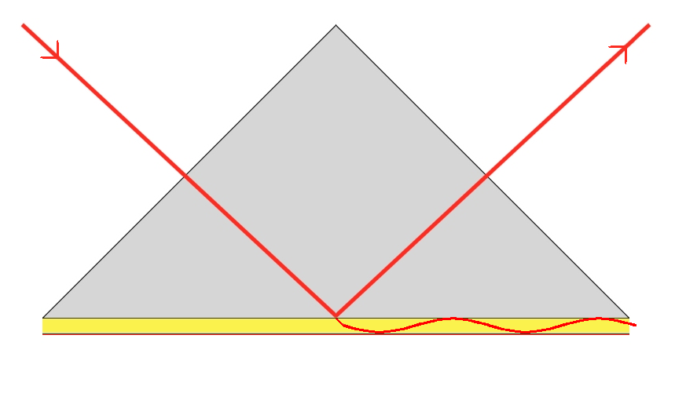
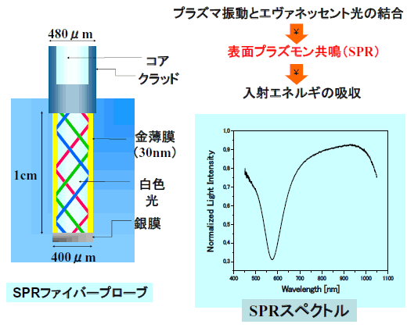

SPRセンシング
クレッチマン配置
モードシフト
f_{rep}変化＠共鳴波長？
コムモードシフト＠共鳴波長？
高分解能スペクトル＠デュアル光コム
複素SPRスペクトル（K-K変換なし）
レーザー波長の問題？
スペクトルモード
Notes:
表面プラズモン（時間展開）
時間・空間・周波数の
金属物性

Slide 71

チャープ光の利用
時間-波長変換
線形チャープ
３次元形状計測＠美濃島さん
時間波形をｽﾍﾟｸﾄﾙ波形にｴﾝｺｰﾄﾞ
デュアル光コムで超高分解分光
シャッター時間：コムモード線幅
（パルス幅とは独立）
データ点数：コムモード総数
（数万チャネル）
深さ分解能の大幅な向上
画像コムと融合
究極の時間分解能（<1fs）が可能
（但し、かなり離散サンプリング）

Slide 72

STEAM camera＠東大・合田先生
デュアル光コム
空間-波長変換
ref) Nature 458, 1145 (2009).

Slide 73

スキャンフリーなフルフィールド共焦点顕微鏡
デュアルコム分光
2次元
回折格子
機械走査なしにライン同時検出ができる
共焦点顕微鏡
回折限界を超える空間分解能
レーザービーム走査による画像形成概念図
http://bioimaging.jp/learn/023/
共焦点顕微鏡の光学系概略
http://bioimaging.jp/learn/023/index_2.html
Notes:
（左図）
多くの特徴を有する共焦点顕微鏡であるが、その根幹である共焦点光学系とは基本的に1点照明かつ1点検出であり、そのままでは画像が形成できない。そこで、照明を固定したまま試料（ステージ）をXY面内で2次元走査するか、試料を固定したまま照明（ここではレーザービーム）を走査することで、各点の情報を集めて画像化することになる。例として、TVモニターの走査線による画面形成方法を想像すると理解しやすい。
図5に走査による像形成の概念図を示すが、実際の2次元走査方法として試料（ステージ）を走査することは、走査速度や機械的安定性の理由から困難なため、ガルバノミラーなど、高速で光を偏向可能な素子を用いて、照明するレーザービームを走査する方法が一般的である。なお、Z方向にはステッピングモーターやピエゾ素子を用い、2次元走査を終えるごとに、対物レンズもしくはステージを逐次移動させていく。
ここで重要なのは、共焦点顕微鏡の画像は各点の集合体であり、デジタルそのものであるということである。昨今、顕微鏡のデジタル化が叫ばれているが、共焦点顕微鏡はまさしくデジタル顕微鏡の先駆けという位置付けにある。さまざまな画像処理により、精度の高い定量解析やフーリエ解析による分析、さらには複数の画像から3次元構造の再現を容易に実現できる。
(右図）
光記録
多層記録 multilayer recording
多層記録は面密度の向上に加えて深さ方向の次元を利用した大容量化の技術である．まだ基礎的なレベルではあるが，大阪大学によりフォトクロミック材料を用いた五十層記録の実験が行われている．パワー密度が高い集光点のみで吸収が起こる二光子吸収を用いて記録を行うことにより，記録すべき層の手前の層における吸収による光量損失を抑制している．また，反射光の再集光点にピンホールを設ける共焦点光学系を用いて再生を行うことにより，再生すべき層の前後の層からの信号が再生信号に漏れ込む層間クロストークを抑制している．(片山龍一)
1) Y. Kawata, et al.: Appl. Opt., 34 (1995) 4105.

Slide 74


定量位相差顕微鏡＠浜ホト
デュアル光コムの導入
・マルチチャンネルの分光ホログラフィーを取得＠画像コム．
・スキャンレス・フルフィールド共焦点顕微鏡との併用
☞ホログラフィーと共焦点機能の融合による
高分解能3次元化

Slide 75
まとめ
①THzコム計測の高度化と応用計測展開
★計測手法はそれなりに成熟
★機械工学のBGを活かした実用展開
②新奇光コム計測の開拓と応用計測展開
色々と新しいことが出来そう
しかしスピード勝負になりそう？
現状は低ジッターなデュアル光コム分光装置を構築中
☞産総研の協力をお願いします
Notes:
それでは、国家標準にトレーサブルなコヒーレント周波数リンクの創生とそれに基づいたTHz周波数標準技術の系統的構築について、徳島大学の安井が説明いたします。なお、本研究は、産総研・計測標準研究部門との共同研究となっています。

Slide 77
Asynchronous-optical-sampling THz-TDS
(ASOPS-THz-TDS)
Overlap timing between THz and probe pulse is automatically shifted every pulse
ref) T. Yasui, Appl. Phys. Lett. 87, 061101 (2005).
Δ=f₁ -f₂
f₁
f₂
THz
detector
Oscilloscope
No need for mechanical time-delay scanning
Time scale of ps THz pulse is linearly expanded to µs order
Possible to adjust and coincide the observed time window to one repetition period exactly!
Notes:
To achieve this concept in THz region, we used ASOPS-THz-TDS. In ASOPS-THz-TDS, two fs lasers with slightly mismatched ML freq. f1 and f2 are used for generation and detection of the THz pulse, respectively. Rights shows a timing chart of THz pulse and probe pulse in the THz detector. Since repetition period of the THz pulse is slightly detuned from that of the probe pulse, overlap timing between THz and probe pulse is automatically shifted every pulse. In this way, time scale of the ps THz pulse is linearly expanded to microsecond order. The resulting slow signal in RF region can be directly captured using a standard oscilloscope without the need for mechanical time-delay scanning. Therefore, ASOPS-THz-TDS enables us to adjust and coincide the observed time window to one repetition period exactly!

Slide 78
Experimental setup
λ_{c}=1550nm, Δτ=50fs, P_{avg} =500mW,
f₁=250MHz, f₂= 250MHz+50Hz
Δ= f₂-f₁= 50Hz,
RMS timing jitter<150fs [0.5~500kHz]
(L = 500 mm, Dia. = φ40 mm)
Resolution = 20 bit
Sampling rate = 2 MS/s
Sampling number = 10⁸
Sampling interval = 100 fs
Notes:
Next slide shows experimental setup.
We used dual fiber lasers at 1550nm for generation and detection of pulsed THz radiation. Output light from the pump laser was converted into SHG light and focused a dipole-shaped low-temperature-grown GaAs (LTG-GaAs) PCA for THz generation and detection, respectively.
The resulting THz pulse propagates in free space, pass through a low-pressure gas cell, and then incident onto the PCA detector.
Portion of the output light from the two lasers were fed into a sum-frequency-generation (SFG) cross-correlator to generate a time origin signal in the ASOPS-THz-TDS.
Finally, a temporal waveform of the current signal form PCA detector is amplified and then acquired by a fast digitizer triggered by the SFG signal.

